Slide 1

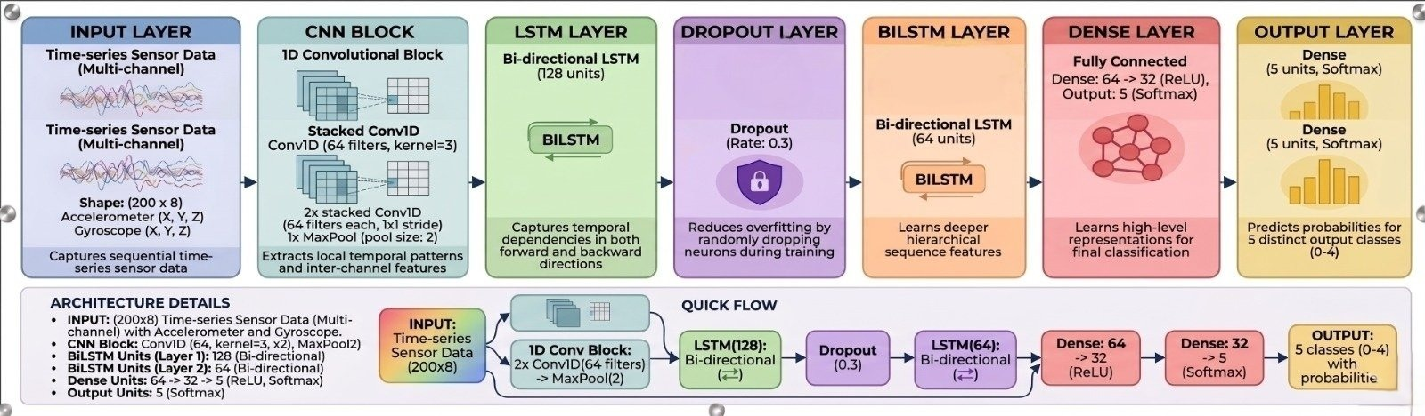
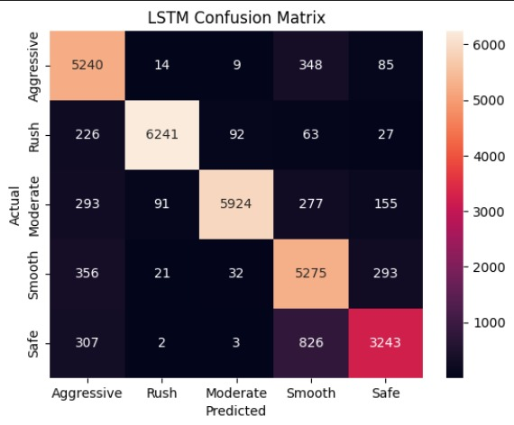
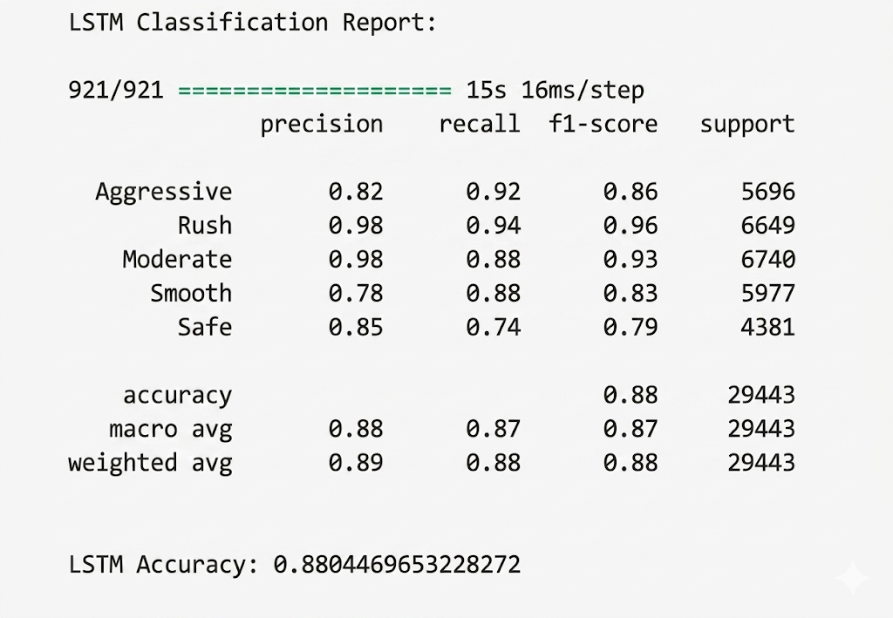
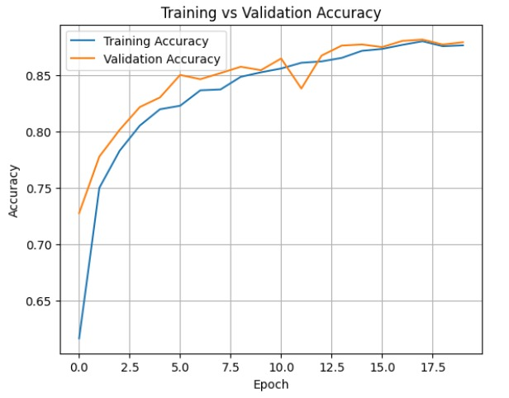
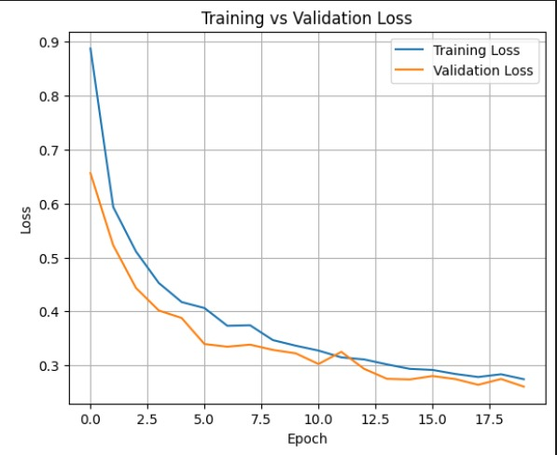
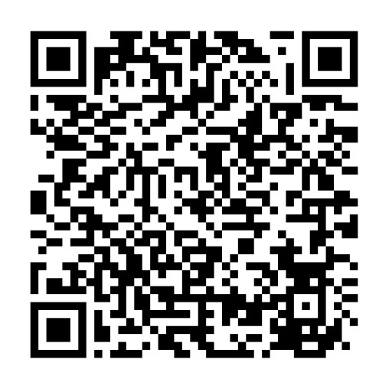
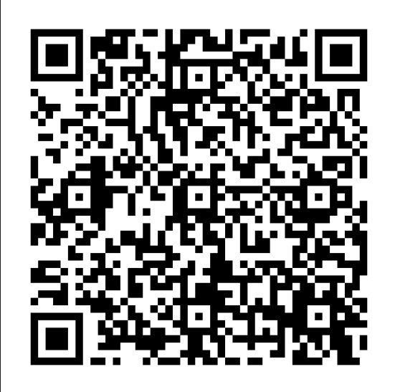
z
Driving Risk Prediction using CNN-BiLSTM on Sensor Data
Developed and Prepared by:
Daniyal Aftab
Third Year, B.E. (Artificial Intelligence & Data Science)
daniyalaftab4786@gmail.com/7413813740
CSE-MBMU
CSE-MBMU
Introduction
Dataset Description
Monitoring a driving behavior is Essential for Improving the Road safety in two-wheeler.
Modern Smartphones has motion sensors such as Accelerometers and Gyroscopes that can Captures real–time riding dynamics.
These Sensors can record variations in acceleration, braking and turning which shows the driving style of an Individual.
These type of data is known as temporal motion data and also Long Short-Term Memory (LSTM) Model are capable of Learning Long-term dependencies on time – series Signals.
In this Project, a CNN + Bi LSTM Model is developed to classify driving behavior into 5 different categories such as Aggressive, Rush, Moderate, Smooth and Safe.
A driving score is generated to quantify riders behavior and risk level.
The System Overall helps evaluate and monitoring driving performance in near real-time using smartphone senor data.
.
The dataset consists of time-series sensor data collected using an mobile applications that records motion sensor readings.
Each sample includes readings from
Accelerometer (X, Y, Z) – captures linear motion
Gyroscope (X, Y, Z) – captures rotational motion
Data was collected under different conditions including multiple riders , different vehicles and varying driving speeds.
A total of 8 features are used to represent vehicle dynamics
The continuous time-series data was segmented using a sliding window approach:
Window size: 120 timesteps
Step size: 20 timesteps
The dataset was split into 80% training and 20% testing and additional 15% for validation split from training data for model evaluation.
The final dataset represents real–world driving behavior for LSTM-based Classification.
Network Architecture Diagram
QUICK INSIGHTS:
Total No. of Parameters: ~386,437
Optimizer: Adam
Loss Function: Categorical Crossentropy
Library Used: TensorFlow/Keras
Inference Requirements:
- Memory: ~ 100-150 MB(runtime)
- Inference time on CPU: ~200 ms (Tested on intel i5,8 Cores, ~ 2.2Ghz )
Model Training
Model Validation and Discussion
Raw accelerometer and gyroscope sensor readings were collected and Standardized.
Feature Engineering was performed by computing acceleration magnitude and gyroscope magnitude , resulting in a total of 8 input features.
Split dataset into training and validation sets for performance evaluation.
The dataset is Normalized using StandardScaler.
A CNN + Bidirectional LSTM architecture was used , where CNN layers extract local motion patterns and LSTM layers learn temporal dependencies.
Trained for 20 epochs with a batch size of 64 and learning rate of 0.001.
The Model was trained using Adam Optimizer and categorical cross entropy loss function.
Applied Dropout layers between CNN, LSTM and dense layers to reduce overfitting.
Early stopping was also applied to monitor validation loss and restore the best model weights during trainning.
The model was evaluated using a held-out test dataset consisting of 20% of the samples.
Model Predictions were generated with the help of Softmax Output layer.
A confusion matrix was plotted to analyze class-wise prediction performance.
Precision , Recall and F-1 score were computed using the classification report to evaluate class imbalance overfitting.
Compared with other students models like LSTM or GRU , the CNN + Bi-LSTM architecture provided improved stability and better classification accuracy.
Performance Results :
Overall Accuracy of LSTM Model: 88%
Limitations and Future Scope
Project Repositories
Limitations :
The dataset size is relatively limited , which may affect the generalization of the model.
Sensor data can contain noise and inconsistencies due to different phone placements and different roads.
Overlapping characteristics between driving styles (e.g., moderate and Smooth) can lead to misclassification.
Also , Hardware differences across smartphones may lead to inconsistent readings.
The Model depends only on motion sensor data and doesn’t include additional features like road conditions and GPS speed.
The model may not perform well for unseen riders or extreme driving conditions.
Future Scope :
Expand the dataset by including more riders, vehicles and different road conditions.
Integrated additional features like GPS speed , location and road type prediction.
Develop a mobile applications for live driving behavior for monitoring the driver speed. Also, will include driver alert systems to warn users about risky driving behavior.
Scan for Dataset
Scan for Source Code
Note: Trained model weights are also available in the source code repository.
Reviewed and Edited By: Abhisek Gour, Assistant Professor
Department of Computer Science and Engineering, MBM University, Jodhpur

