Slide 1

Artificial Neural Network
PRESENTED BY:
Moiz Ahmed
Usama Khalid
Daniyal Zakir
Irfan khan

Slide 2
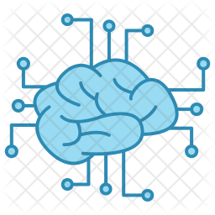
CONTENTS
INTRODUCTION
WORKING
APPLICATIONS
ADVANTAGES
LEARNING
CONCLUSION

Slide 3
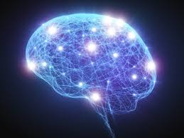
Artificial Neural Network
Introduction:
An Artificial Neural Network (ANN) is an information processing model that is inspired by the way biological nervous systems, such as the brain, process information.
A network that mimics human brain ,but don’t work like human brain.

Slide 4
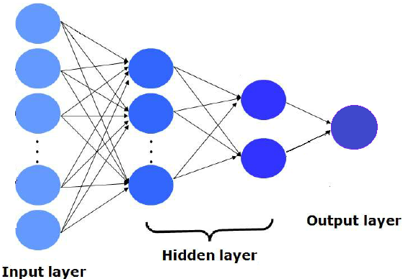

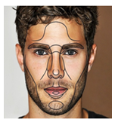
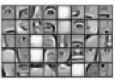


WORKING
Face Recognition:
Pictures comprise pixels (Color images and Channels/RGB).
A neural network corresponds to pixels.
Earlier layers will detect edges, then lobes and then objects.

Slide 5

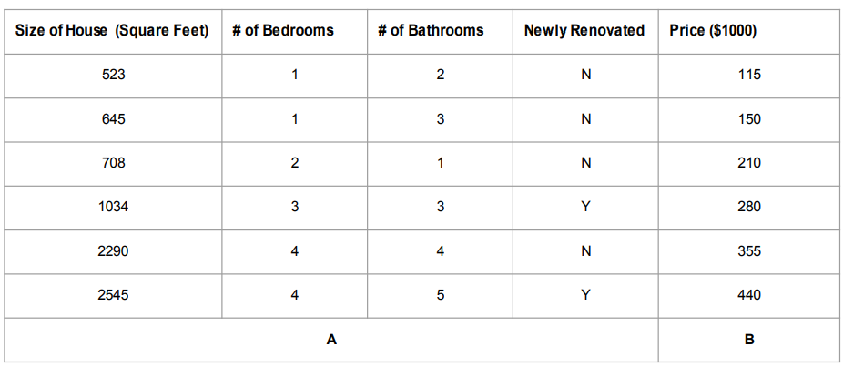
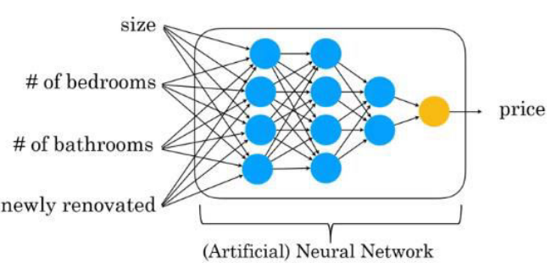
WORKING
Price (Prediction) on a Houses (Dataset):
(A to B Mapping) or (Input to Output Mapping).

Slide 6
Applications
Natural Language Processing (NLP)
Speech Processing
Defense Sector
Image Processing
Healthcare and Medicine
Industry
Auto Mobile

Slide 7
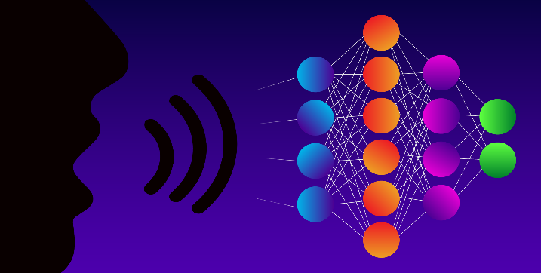
Application
Natural Language Processing (NLP):
It is a branch of Artificial Intelligence.
Using natural human language instead of computer language.
Deals with analyzing, understanding and generating the languages.
Interface with computer in both written and spoken contexts.

Slide 8
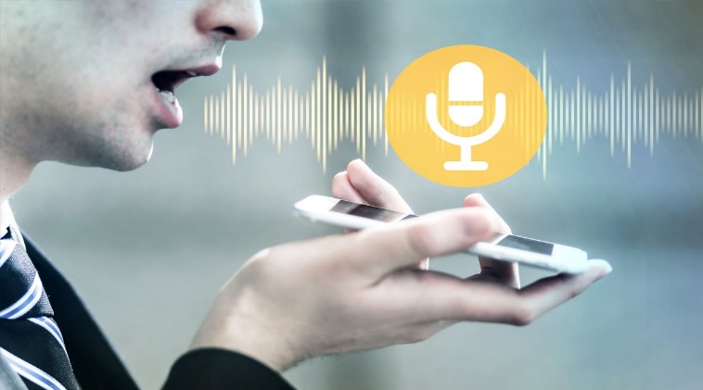
Application
Speech Processing:
Automatic Speech recognition.
Computer Speech recognition.
Understanding and performing any required task.

Slide 9
Advantages
It involves human like thinking.
They handle noisy or missing data.
They can work with large number of variables or parameter.
They provide general solutions with good predictive accuracy.
System has got property of continuous learning.
They deal with the non-linearity in the world in which we live.

Slide 10
Learning
Learning algorithm is the power of neural network.
ANN learning refers to the method of modifying the weight of the connection between the nodes of a specified network.
The learning ability of a neural network is determined by its architecture and the algorithmic method chosen for training.

Slide 11
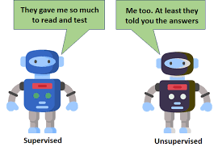
Types Of Learning
Supervised Learning:
Learning in the class room in the presence of teacher.
Input data is labelled.
Uses training dataset.
Divide into two types i.e. classification & Regression.
Unsupervised Learning:
Learning by itself.
Uses input dataset.
Uses property to classify to it.
Divide into two types i.e. clustering & association.

Slide 12
Conclusion
We want to make our machines efficient to do work like human brain in a body. Learning the things ,trained the data and perform. In short, we just want to place human brain in machine.
X
X
X

