Slide 1

ENG 400 – Capstone Project - Fall 2022
A Presentation on Capstone Project I
Surface Electromyography (sEMG) Signal Processing & Classification for a Myoelectric Prosthesis Design
Daniyar Zhakyp [ID 201774605]
Supervisor: Muhammad Tahir Akhtar
Co-Supervisor: Prashant Kumar Jamwal
Applications of Signal Processing Lab (ASP-Lab)
Department of Electrical and Computer Engineering
School of Engineering and Digital Sciences
Nazarbayev University, Nur-Sultan, Kazakhstan
Email: daniyar.zhakyp@nu.edu.kz
21.11.2022

Slide 2
Presentation Layout
Project Background
Problem Statement and Motivation
Project Aims and Objectives
Pattern Recognition (PR) Model
Dataset Information
Filtering
Feature Engineering
Classification Results
Capstone I: Tasks & Achieved Results
Capstone II: Tasks & Expected Results
Conclusion & Future steps
References

Slide 3
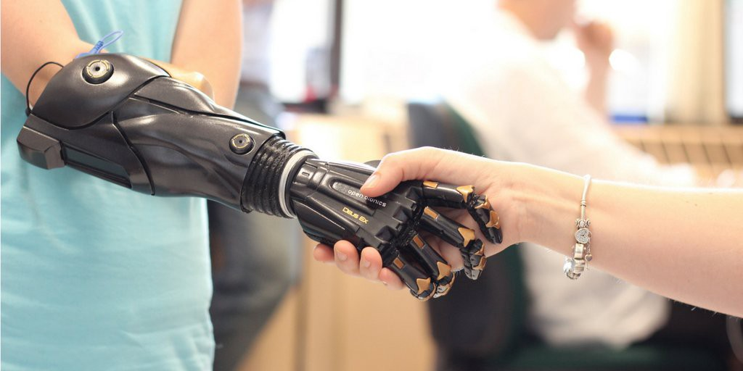
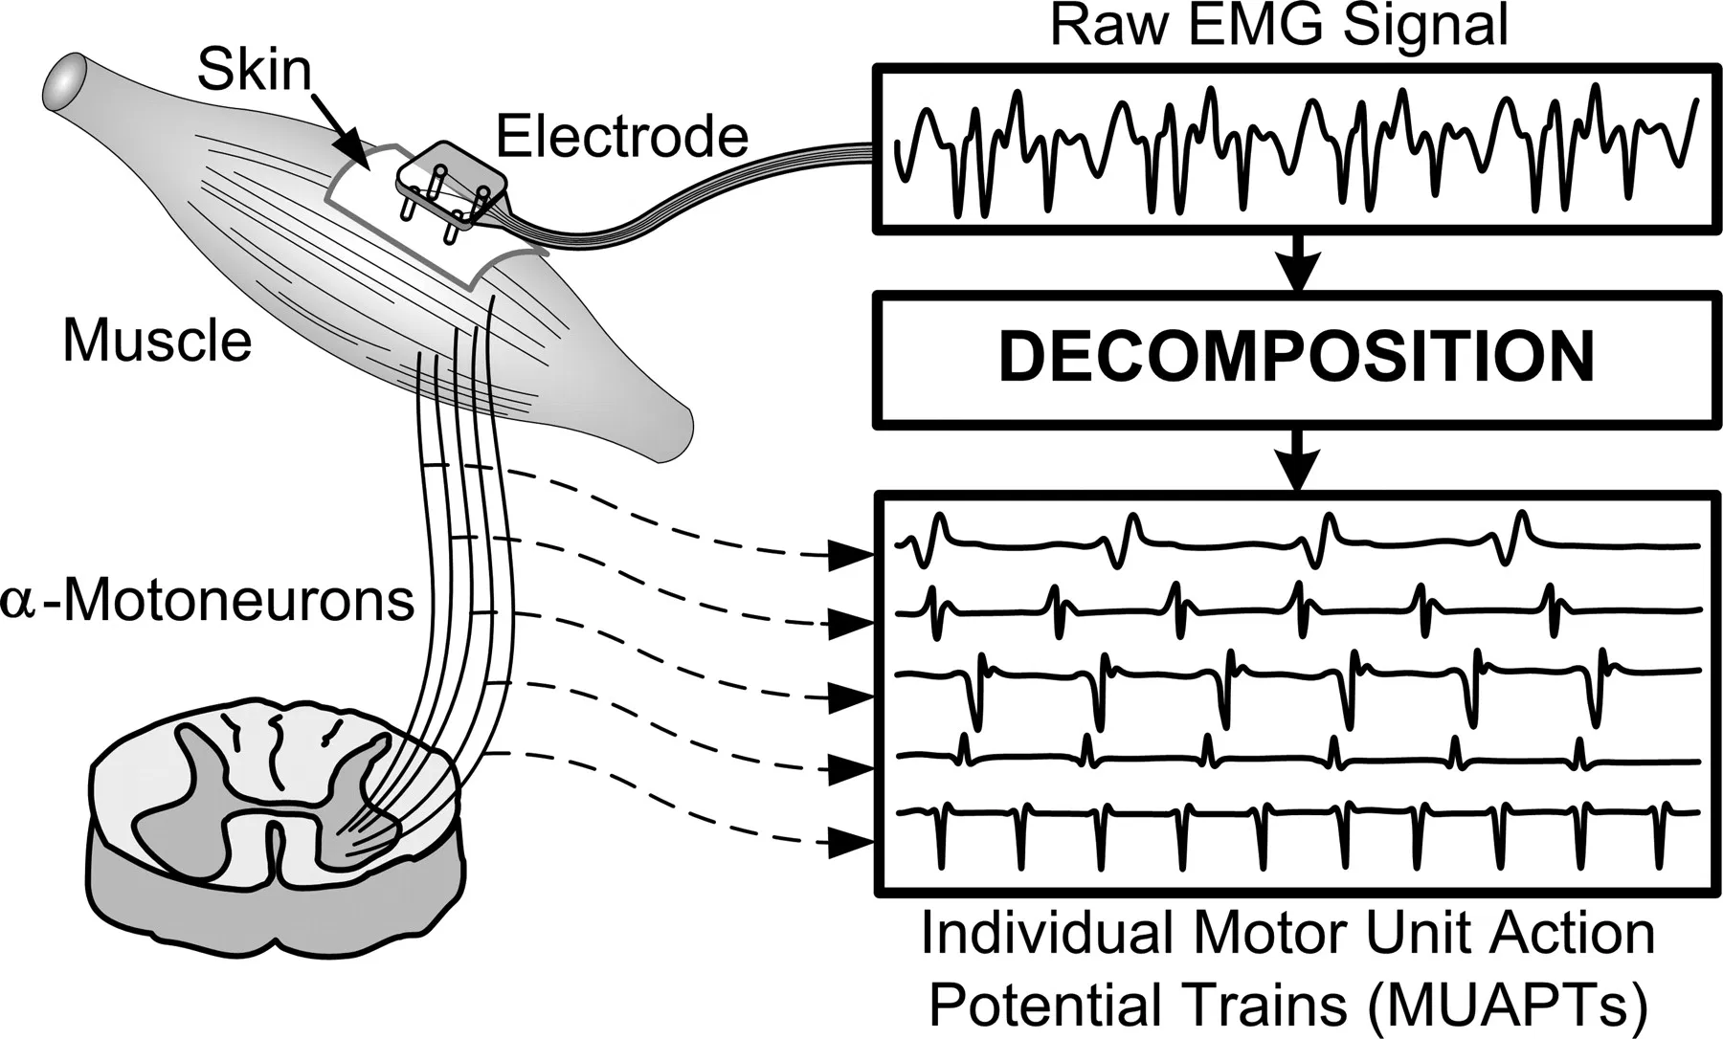
Project Background (1/2)
What is a myoelectric prosthesis?
An artificial limb actuated through surface electromyography signals (sEMG) and aimed to restore the necessary functions of an intact hand
What is an sEMG signal?
A sum of individual electrical pulses in a muscle recorded by electrodes during muscle contraction

Slide 4
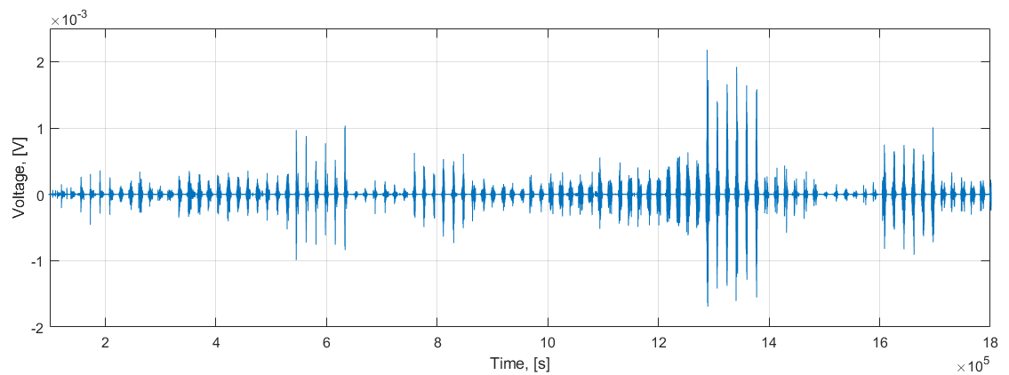
Project Background (2/2)
sEMG is a non-stationary bio-signal
sEMG amplitude: 0.5 - 2 mV
sEMG useful frequency band: 20 – 300 Hz
Total gain of the circuit: ~=1000
The raw EMG signal

Slide 5
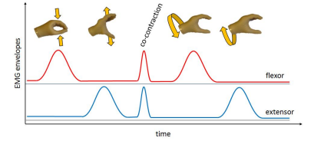
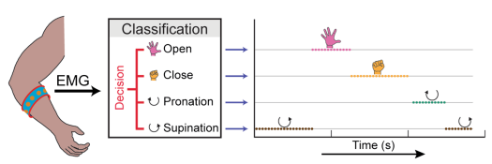
Project Statement and Motivation
The direct control
The pattern recognition-based (PR) control
Used in commercial prostheses
Advantages:
No training process
Reliability
Disadvantages:
Few hand motions span (no classification)
High dependance on electrodes (number and position)
Used in my Capstone project
Advantages:
Increase in dexterity and functionality
No strict arrangement of electrodes
Disadvantages:
Training process required
Less reliability

Slide 6
Project Aims and Objectives
Aims
Develop a real-time sEMG signal processing & classification model for a myoelectric prosthesis design
Produce an efficient and cost-effective myoelectric hand prototype
Objectives
Make a detailed study of the most relevant sEMG PR models
Apply Machine Learning (ML) algorithms resulting into highest classification metrics and real-time performance
Implement the model on a microcontroller

Slide 7
Pattern Recognition (PR) Model
DATA ACQUISTION
DATABASE CREATION & LABELING
PREPROCESSING
EMG sensor
Deploy & Integrate
FEATURE ENGINEERING
MODEL TRAINING
Extraction
Selection
Reduction
Hyperparameter Optimization
Extract Time-Domain (TD) features
Select features with high feature ranking
Reduce the dimensions of a feature vector
Performance Assessment

Slide 8
Dataset Information (1/2)
Two large NinaPro databases
 | NinaPro Database 2 (DB2) | NinaPro Database 3 (DB3)
No. of subjects | 40 healthy subjects | 11 amputees
No. of motions performed | 40 distinct hand motions + rest | 40 distinct hand motions + rest
No. of repetitions | 6 | 6
No. of sEMG channels | 12 | 12
Experiment details:
Subjects repeated motions appeared on the laptop’s screen
Each motion lasted 5 seconds followed by the 3 second rest
The data was sampled at a 2 kHz sampling rate

Slide 9
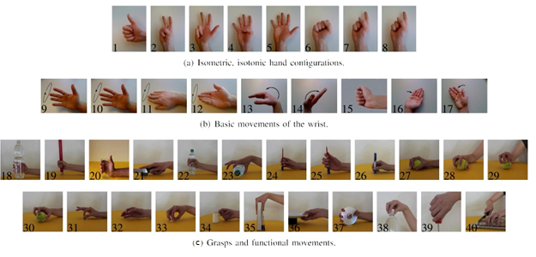
Dataset Information (2/2)
Forty distinct hand motions divided into three exercises
Isometric, isotonic hand configurations
Basic wrist movements
Grasps and functional movements
M. Atzori and H. Muller, "The Ninapro database: a Resource for sEMG Naturally Controlled Robotic Hand Prosthetics", in Proc. 37th Annual International Conference of the IEEE Engineering in Medicine and Biology Society (EMBC), Milan, 2016.

Slide 10
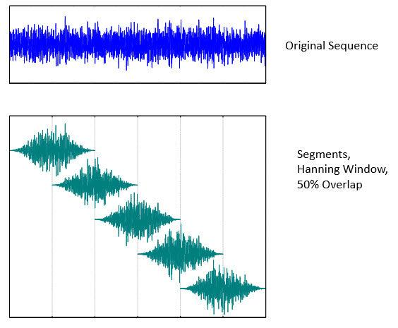
Filtering (1/2)
Power Spectral Density (PSD)
Provides the information about the power of each frequency component.
Welch’s method divides the signal into overlapping or nonoverlapping windows , computes the Fast Fourier Transform (FFT) in each small window, and finds the PSD as an average of FFTs over all windows.
Dividing into windows
Finding the FFT
Averaging
Welch’s PSD
enDAQ. 2022. Power Spectral Density. [online] Available at: <https://endaq.com/pages/power-spectral-density>

Slide 11
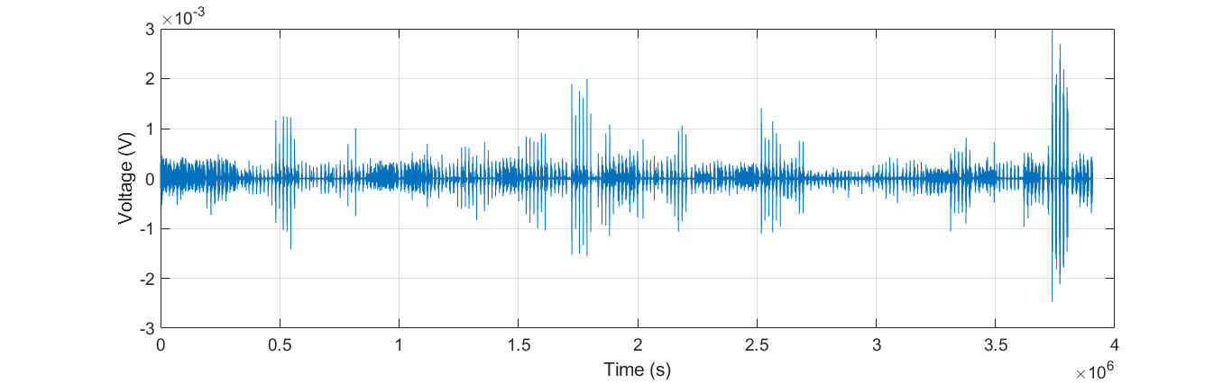
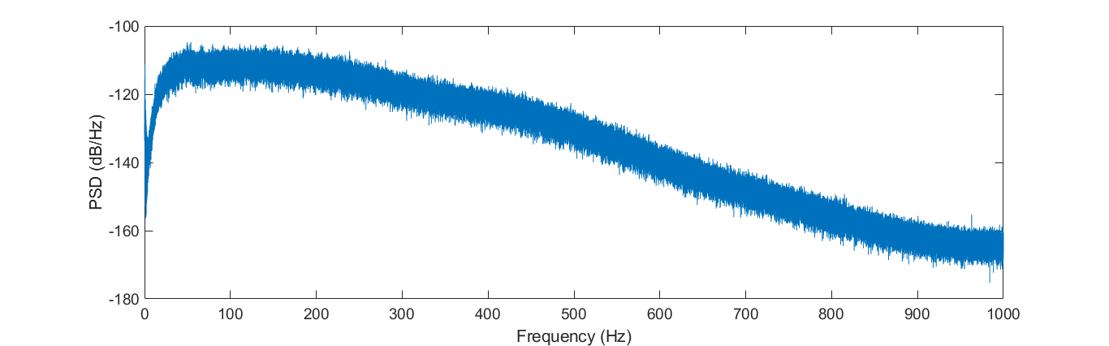
Filtering (2/2)
The raw sEMG signal from one channel
PSD estimation
pwelch() command parameters:
8 segments multiplied by a Hanning window
50 % overlap between segments
256 FFT points (N = 256)

Slide 12
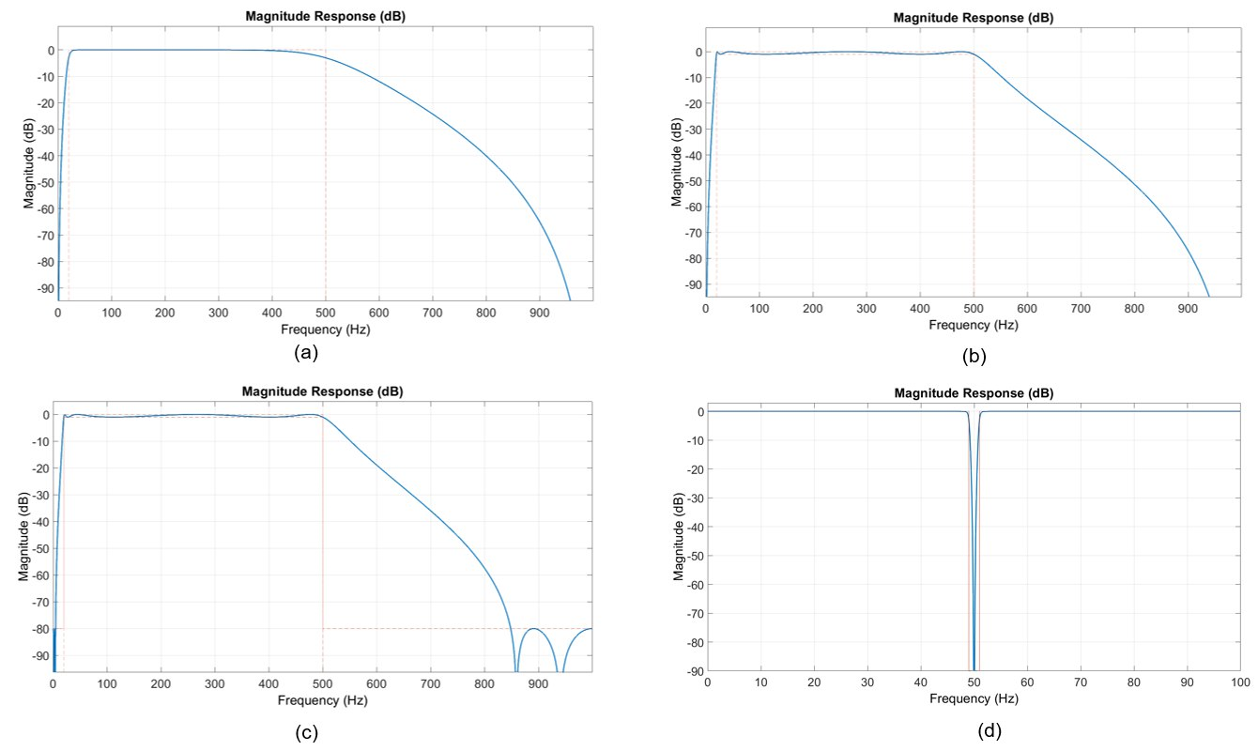
Frequency Response of Four Filters
8th order Butterworth filter (20-500 Hz)
8th order Chebyshev Type I filter (20-500 Hz)
8th order Elliptic filter (20-500 Hz)
2nd order Notch filter (50 Hz)

Slide 13
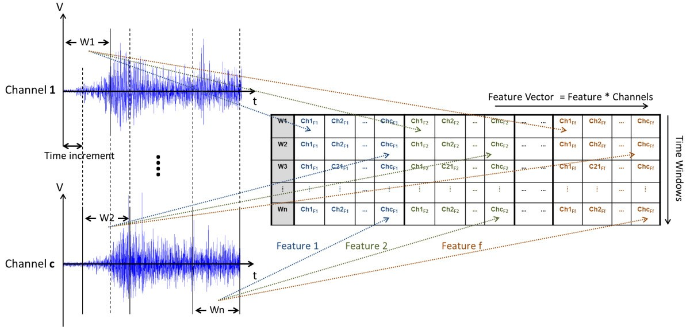
Feature Engineering (1/7)
Features are extracted in windows such that the window size and increment could be altered (e.g., 128, 256, 400 ms).
A feature extraction process
M. Ortiz-Catalan, R. Brånemark and B. Håkansson, "BioPatRec: A modular research platform for the control of artificial limbs based on pattern recognition algorithms", Source Code for Biology and Medicine, vol. 8, no. 1, 2013. Available: 10.1186/1751-0473-8-11.

Slide 14
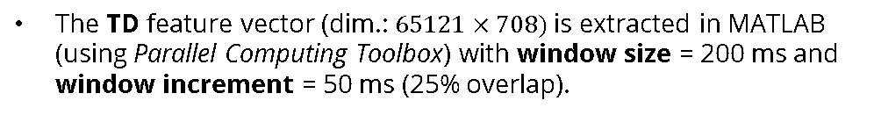
Feature Engineering (2/7)
Four types of features extracted from sEMG in MATLAB
Type of the feature | Number of features | Example of a feature
Time-Domain | 44 | Zero Crossing (ZC)
Frequency-Domain | 7 | Mean Frequency (MF)
Time-Frequency Domain | 11 | Variance of Discrete Wavelet Transform Coefficients (DWTVAR)
Entropy-based | 2 | Shannon Entropy (ShEN)
The TD feature vector (dim.: $65121×708)$is extracted in MATLAB (using Parallel Computing Toolbox) with window size = 200 ms and window increment = 50 ms (25% overlap).

Slide 15
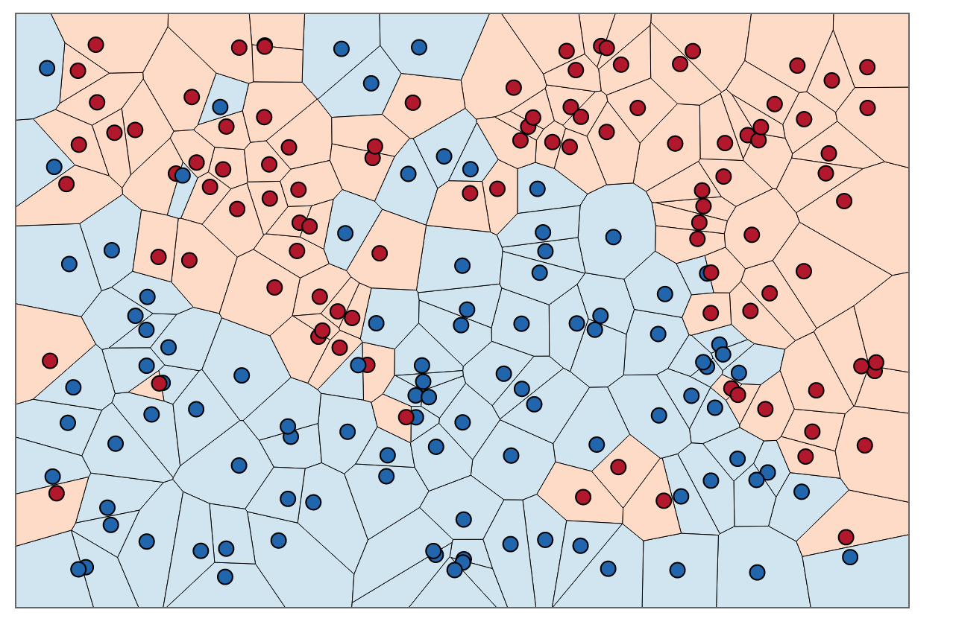
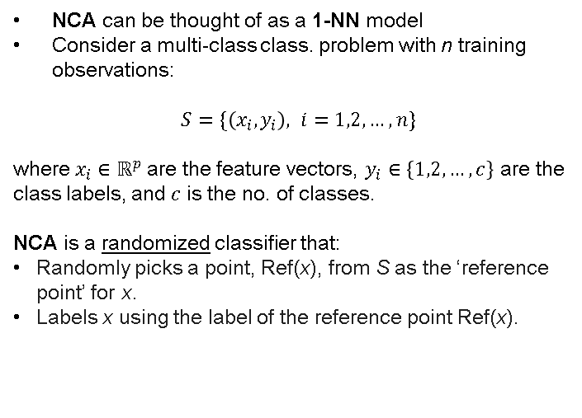
Feature Engineering (3/7)
Problems associated with using ALL the features:
Degradation of the performance: peaking phenomenon for a finite no. of features
Lack of interpretability: certain features may be redundant
Neighborhood Component Analysis (NCA) feature selection algorithm
A 1-NN algorithm for a binary classification problem
NCA can be thought of as a 1-NN model
Consider a multi-class class. problem with n training observations:
$$S=\{\left(x_{i},y_{i}\right), i=1,2,…,n\}$$
where $x_{i}∈ℝ^{p}$ are the feature vectors, $y_{i}∈\left\{1,2,…,c\right\}$ are the class labels, and $c$ is the no. of classes.
NCA is a randomized classifier that:
Randomly picks a point, Ref(x), from S as the ‘reference point’ for x.
Labels x using the label of the reference point Ref(x).
Image source: Neighbourhood Components Analysis | LaptrinhX

Slide 16
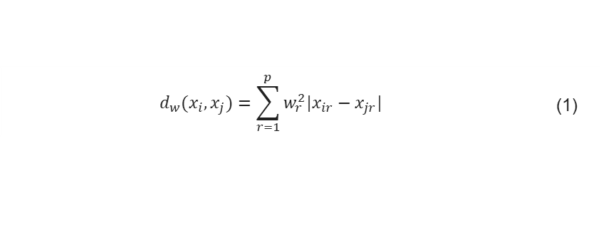
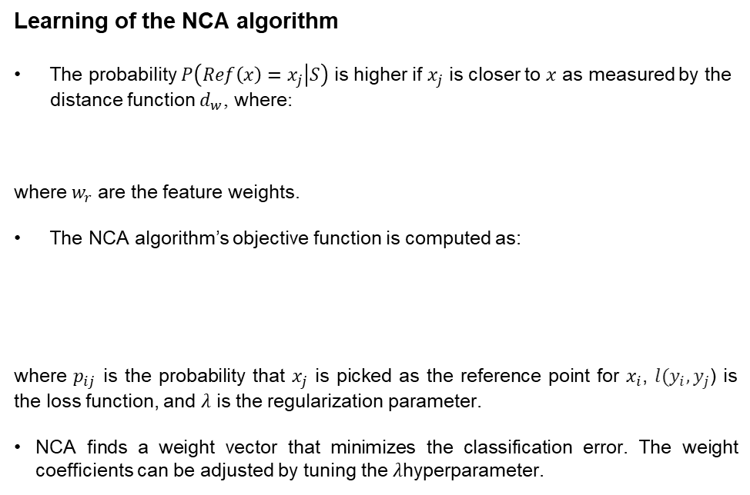
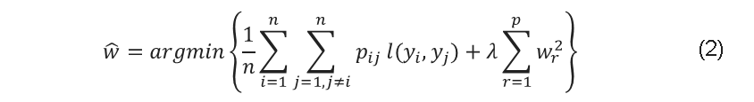
Feature Engineering (4/7)
Learning of the NCA algorithm
The probability $P\left(Ref\left(x\right)=x_{j} | S\right)$ is higher if $x_{j}$ is closer to $x$ as measured by the distance function $d_{w}$, where:
where $w_{r}$are the feature weights.
The NCA algorithm’s objective function is computed as:
where $p_{ij}$ is the probability that $x_{j}$ is picked as the reference point for $x_{i}$, $l(y_{i},y_{j}$) is the loss function, and $λ$ is the regularization parameter.
NCA finds a weight vector that minimizes the classification error. The weight coefficients can be adjusted by tuning the $λ$hyperparameter.
$$d_{w}(x_{i},x_{j})=\sum_{r=1}^{p}{w_{r}^{2}|x_{ir}−x_{jr}|}$$ | (1)
$$\hat{w}=argmin\left\{\frac{1}{n}\sum_{i=1}^{n}{\sum_{j=1, j≠i}^{n}{p_{ij}}l(y_{i},y_{j})}+λ\sum_{r=1}^{p}{w_{r}^{2}}\right\}$$ | (2)

Slide 17
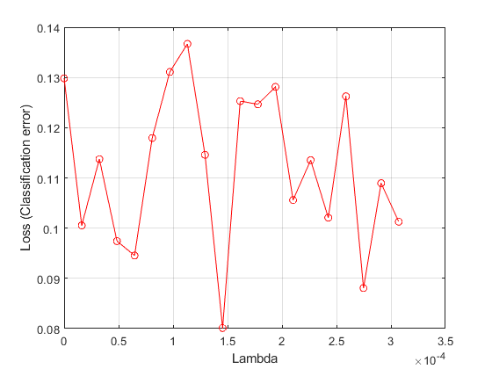
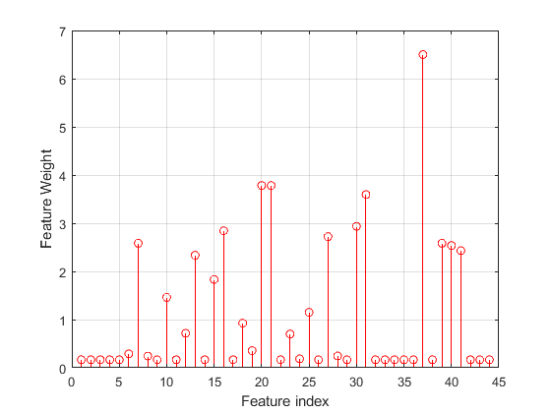
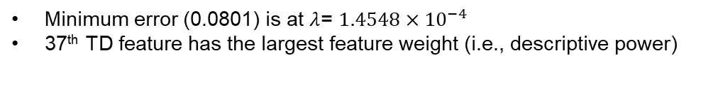

Feature engineering (5/7)
NCA feature selection in MATLAB:
Tunning of $the λ$ hyperparameter of the NCA model
The feature weights from the trained NCA model
Minimum error (0.0801) is at $λ$= $1.4548×{10}^{−4}$
37th TD feature has the largest feature weight (i.e., descriptive power)

Slide 18
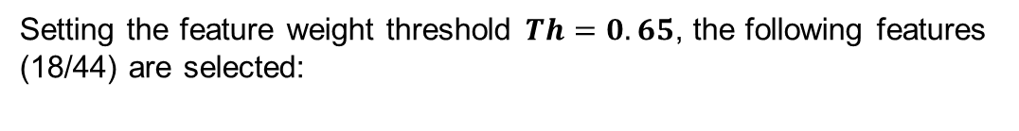
Feature engineering (6/7)
Setting the feature weight threshold $Th=0.65$, the following features (18/44) are selected:
Difference Absolute Standard Deviation value
Maximum Fractal Length
Mean Absolute Value Slope
Cardinality
Enhanced Mean Absolute Value
Enhanced Waveform Length
Myopulse Percentage
Skewness
Log of Difference Abs. SD value
Interquartile Range
Modified Mean Absolute Value 1
Zero Crossing
Kurtosis
Log Detector
Slop Sign Change
Willison Amplitude
Vorder
Histogram

Slide 19
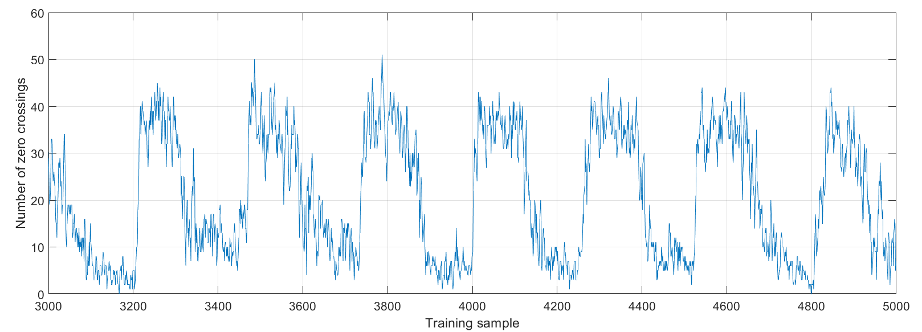
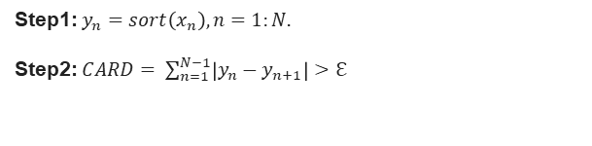
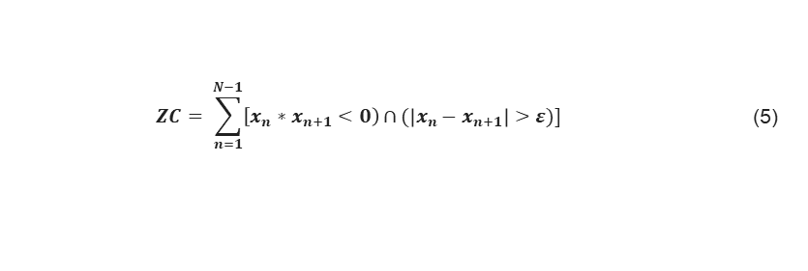

Feature engineering (7/7)
Cardinality (CARD) feature can be computed as:
 | (3)
Step1: $y_{n}=sort\left(x_{n}\right), n=1:N.$
Step2: $CARD= \sum_{n=1}^{N−1}{\left|y_{n}−y_{n+1}\right|>ℇ}$
Difference Absolute Standard Deviation Value (DASDV) feature can be computed as:
$$DASDV= \sqrt{\frac{1}{N−1}\sum_{n=1}^{N−1}{{{(x}_{n+1}−x_{n})}^{2}}}$$
 | (4)
Zero Crossing (ZC) can be computed as:
$$ZC= \sum_{n=1}^{N−1}{\left[x_{n}∗x_{n+1}<0\right)∩}(\left|x_{n}−x_{n+1}\right|>ε)]$$ | (5)
No. of zero crossings within the sEMG signal

Slide 20
Classification Results
 | Decision Tree (DT) | Linear Discriminant Analysis (LDA) | k-Nearest Neighbors (k-NN)
 | Max no. of splits = 100; Split criterion = Gini index | Covariance structure: Full | No. of neighbors = 5; Distance weight: Equal
5-fold val. accuracy | 0.676 | 0.808 | 0.944
Test accuracy | 0.614 | 0.551 | 0.743
Precision | 0.398 | 0.439 | 0.644
Recall | 0.221 | 0.287 | 0.593
F1 score | 0.284 | 0.347 | 0.618
Avg. AUC | 0.824 | 0.624 | 0.887
Min. AUC | Class 26: 0.64 | Class 10: 0.17 | Class 32: 0.72

Slide 21
Capstone I: Tasks & Achieved Results
Tasks
Achieved results
Dataset preprocessing
Analyzed the frequency content of the signal
Designed filters to preprocess the signal
Feature extraction
Wrote MATLAB codes for feature extraction in three domains + entropy-based features.
Extracted 44 TD features using Parallel Computing Toolbox.
Feature selection
Built and tuned the NCA model for feature a selection algorithm
Applied the NCA feature selection on the TD feature vector and chose the best subset
Model selection & evaluation
Apply more robust ML models
Tune hyperparameters to prevent overfitting
Reduce the number of classes to be classified

Slide 22
Capstone II: Tasks & Expected Results
Tasks
Expected results
Study of embedded systems
Study implementation of ML algorithms on a microcontroller
Source code development
Implement of the tested PR model on the embedded system
Create a buffer for real-time processing
Real-time experiments
Record the real-time performance of the system
Summarize and analyze the results
System optimization
Optimize the model to achieve better real-time classification metrics and faster run-time

Slide 23
Conclusion & Future Steps
The feature vector of 44 time-domain features has been extracted.
The NCA algorithm has selected the best feature subset of 18 out of 44 TD features.
The k-NN classifier (no. of neighbors = 5) has shown the best accuracy on the validation (94.4%) and test (74.3%) sets.
Future steps
Apply other more robust ML models like Support Vector Machine (SVM) or Ensemble Learning Models.
Transfer feature vectors to Python to make model selection & evaluation part more convenient.
Perform classification using frequency and time-frequency domain feature vectors.

Slide 24
References
M. Atzori and H. Muller, "The Ninapro database: a Resource for sEMG Naturally Controlled Robotic Hand Prosthetics", in 37th Annual International Conference of the IEEE Engineering in Medicine and Biology Society (EMBC), Milan, 2016.
enDAQ. 2022. Power Spectral Density. [online] Available at: <https://endaq.com/pages/power-spectral-density>
M. Ortiz-Catalan, R. Brånemark and B. Håkansson, "BioPatRec: A modular research platform for the control of artificial limbs based on pattern recognition algorithms", Source Code for Biology and Medicine, vol. 8, no. 1, 2013. Available: 10.1186/1751-0473-8-11.
A. Phinyomark, P. Phukpattaranont, and C. Limsakul, “Feature reduction and selection for EMG Signal Classification,” Expert Systems with Applications, vol. 39, no. 8, pp. 7420–7431, 2012.

Slide 25


Thank you!

