Slide 1
Слайд 1 с информацией о кадрах
Recommendations
On opening restaurant at the city Almaty, Kazakhstan
Made by

Slide 2
Слайд 2 с информацией о кадрах
План презентации
Business problem
Preparing data
Analyze taken data
Results and conversation
Conclusion

Slide 3
Слайд 5 с информацией о кадрах
Location
Busines problem
How the location impacts the success of the restaurant business
Location
Population density
Competitors
Population density
Competitors

Slide 4
Слайд 4 с информацией о кадрах
A large number of open sources
Official data
Data accuracy
Latest data
Data processing
Preparing data

Slide 5
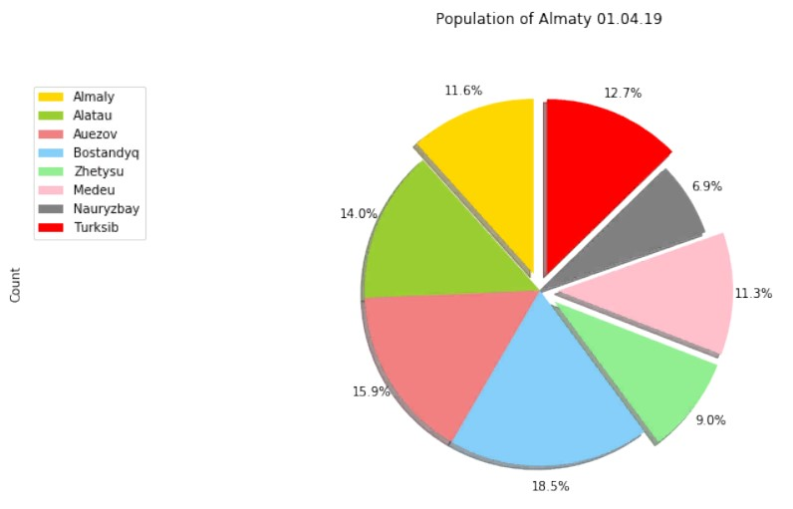
Слайд 6 с информацией о кадрах
Analysis and visualization
Ratio of population density in districts of Almaty
Pie chart

Slide 6
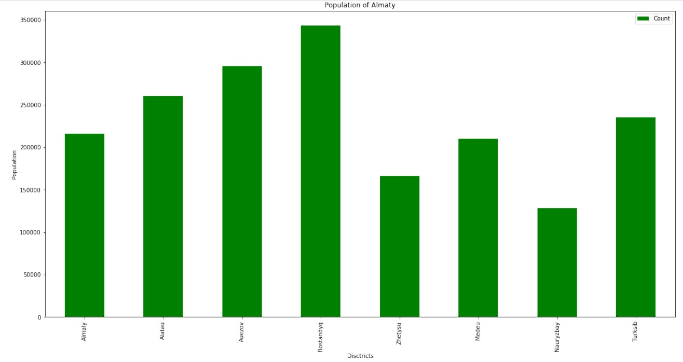
Слайд 6 с информацией о кадрах
Analysis and visualization
Ratio of population density in districts of Almaty
Bar chart

Slide 7
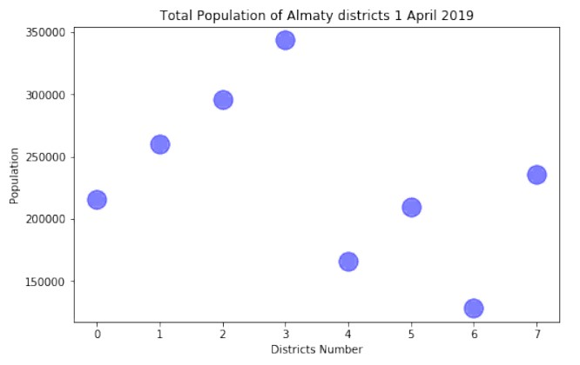
Слайд 6 с информацией о кадрах
Analysis and visualization
Ratio of population density in districts of Almaty
Scatter Plot

Slide 8

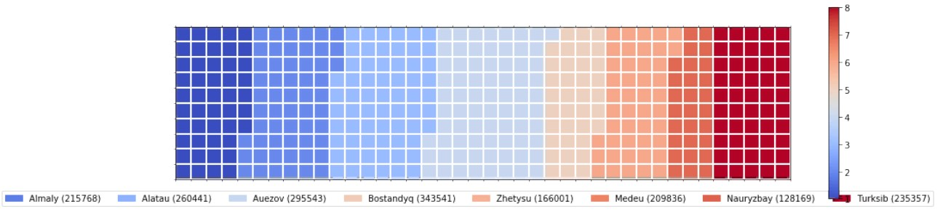

Слайд 7 с информацией о кадрах
Analysis and visualization
Waffle

Slide 9
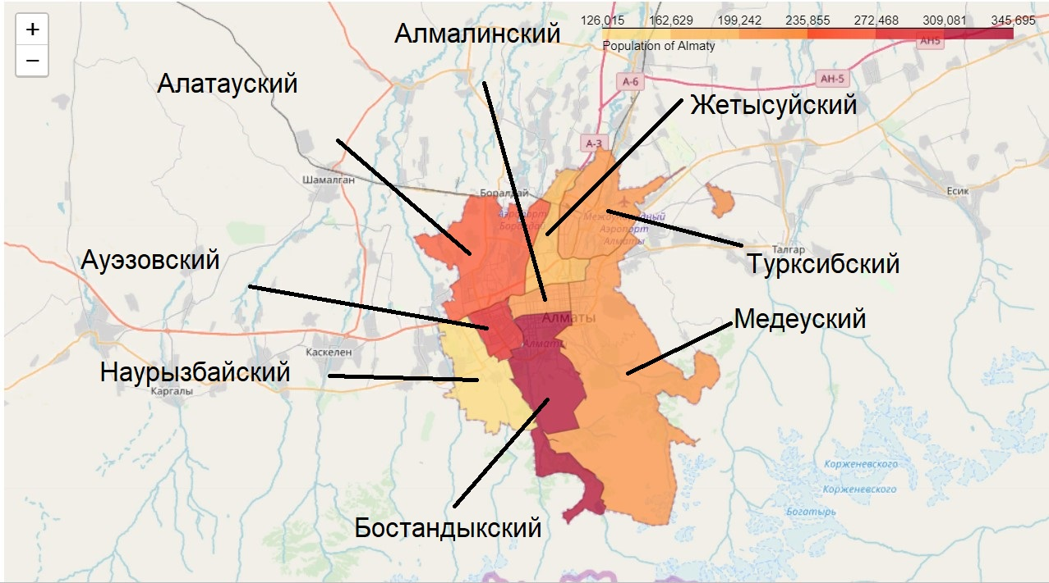
Слайд 6 с информацией о кадрах
Analysis and visualization
Ratio of population density in districts of Almaty

Slide 10
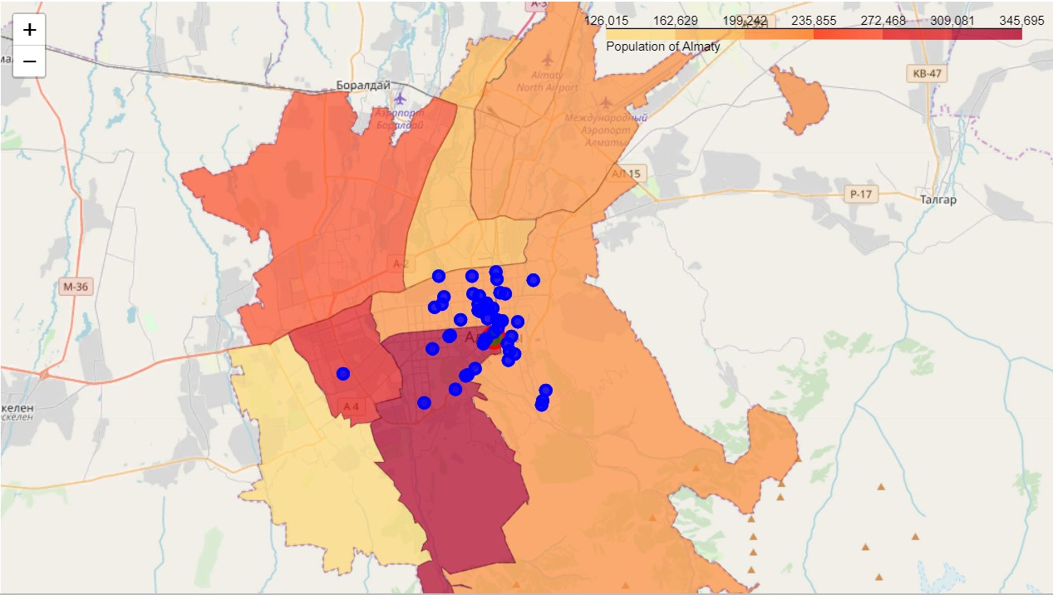
Слайд 8 с информацией о кадрах
Results and conversation
This map shows the ratio of population density in the districts of Almaty, as well as the location of various restaurants.

Slide 11
Слайд 10 с информацией о кадрах
Thanks for attention

