Slide 1
A.S.M.T. HACKATHON 2K26 · TEAM BHAND CODERS
ASMT Aegis
A campus emergency response system. Scan a QR code, hold one button, and the right responder is alerted in seconds — with the urgency already judged.
TEAM
BUILT BY
LIVE
Bhand Coders
Vibhor Mehta
Devanshu Gupta
Sunny Gujjar
asmt-aegis.vercel.app
Anangpuria School of
Management & Technology
ASMT Aegis · Bhand Coders

Slide 2
02
The problem
Nobody knows the number. In an emergency a student opens their contacts and hunts for a warden's number they never saved.
The message loses the details. A phone call leaves no record of which block, which floor, or what was said.
Everything is equally urgent. A sprained ankle and someone who has stopped breathing arrive on the same WhatsApp group, in the same font.
No one owns it. If the first person paged is teaching, in a meeting, or asleep, nothing escalates — the report just sits there.
The reporter is left blind. They have no idea whether help is coming, so they call again, and again.
ASMT operates across three blocks — Main, Academic and Hostel. A responder on the wrong side of campus is minutes away from someone who may have seconds.
Aegis targets the gap between something has happened and the right person knows, and has said they are coming.
ASMT Aegis · Bhand Coders

Slide 3
03
What we built
15s
3
2
100
to file a report
escalation tiers
languages, spoken
Lighthouse accessibility
An installable web app — no store, no download. Judges scan a QR and it opens on their own phone.
QR codes posted on every block pre-fill the location, so a panicking student never picks from a dropdown.
Urgency is judged automatically by a rule engine plus an AI second opinion, and the more severe verdict wins.
The right responder is paged on Telegram by block and role, escalating through tiers if nobody answers.
The reporter watches it happen live — classified, notified, acknowledged, with an ETA.
ASMT Aegis · Bhand Coders

Slide 4
04
The 60-second demo
RUN THIS ORDER
1
Scan the printed QR code
Report form opens with block and floor already filled in. No typing.
2
Tap Fire, describe it — or speak it
Six emergency types, two columns, thumb-reachable. Voice input for hands-free.
3
Hold SOS for two seconds
A ring fills around the button. Buzz on Android, beep and pulse on iOS.
4
Telegram fires
CRITICAL alert with block, floor, description and a link to the incident.
5
It appears on the dashboard by itself
No refresh. Card flashing red, alarm sounding, escalation counting down.
6
Responder taps Acknowledge
Alarm stops, and the reporter's phone updates instantly with an ETA.
The line to close on: every step degrades gracefully. Classification works with the AI provider down, alerts work with a responder offline, and the report survives having no network at all.
ASMT Aegis · Bhand Coders

Slide 5
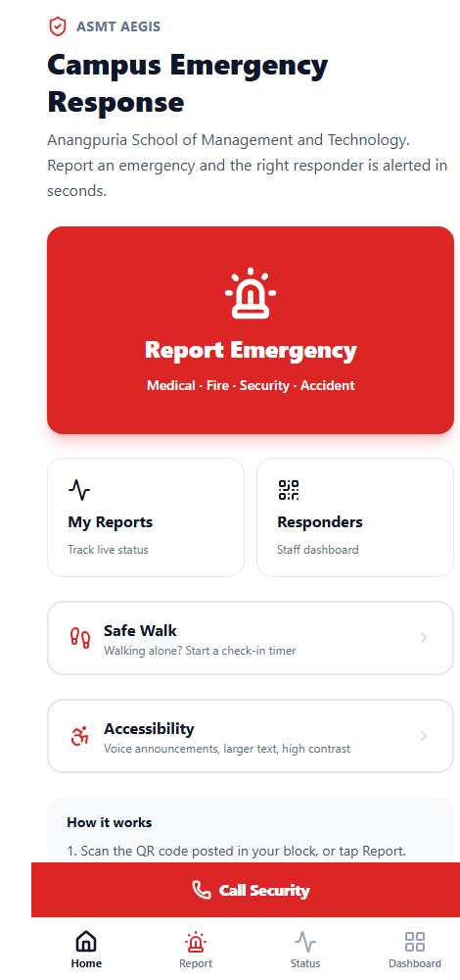
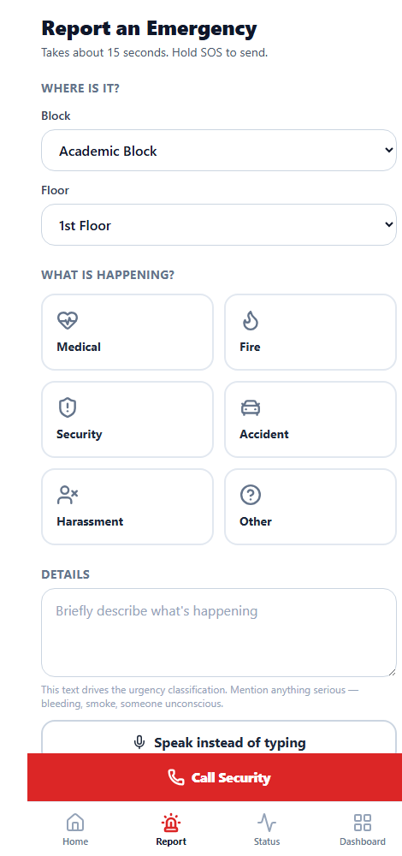
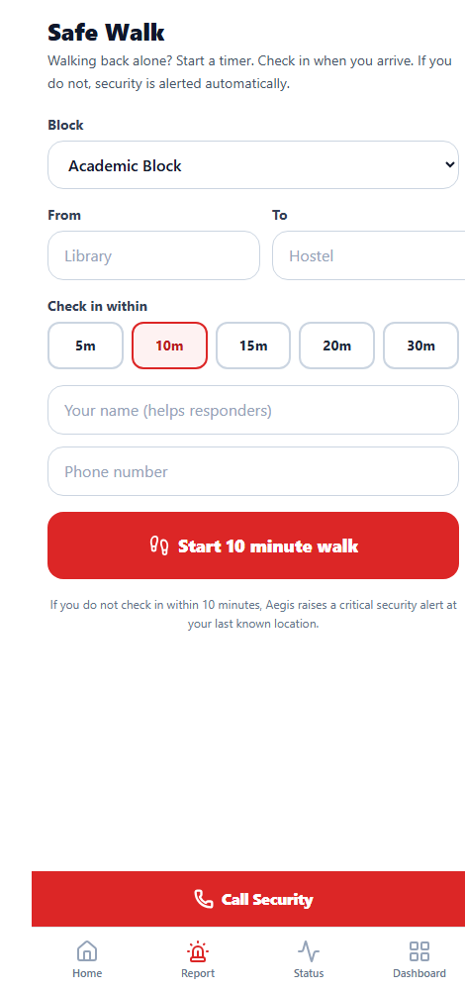
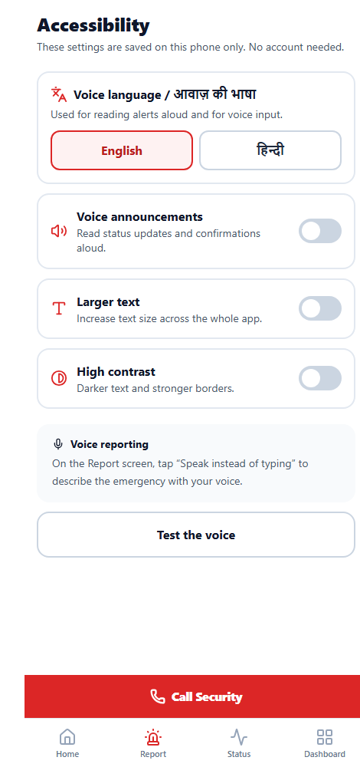
05
The app
CAPTURED LIVE
Home
Report
Safe Walk
Accessibility
One oversized action. Everything else is secondary.
Location pre-filled by QR. Six types, voice input, optional photo.
A check-in timer whose expiry is itself the alarm.
Hindi or English voice, larger text, high contrast.
ASMT Aegis · Bhand Coders

Slide 6
06
Two-stage classification
OUR DIFFERENTIATOR
An emergency system that stops working when an API key expires is not an emergency system. So the AI never sits on the critical path.
description "Student collapsed near the
stairs and is not breathing"
rule_priority critical
rule_matched ["not breathing","collapsed"]
ai_priority null (429 no credit)
final_priority critical <- rules carried it
telegram delivered
--- Hindi, same pipeline ---
"छात्र बेहोश है और खून बह रहा है"
rule_priority critical
final_priority critical
Stage 1 — rule engine. A deterministic keyword scan that always runs and cannot fail. English, Hindi and romanised Hinglish.
Stage 2 — AI second opinion. One prompt to Claude or GPT under a hard 4-second timeout, swappable with one environment variable.
The more severe verdict wins. AI can escalate a report; it can never talk the system down from a rule-matched emergency.
During the build our OpenAI key ran out of credit mid-demo. The alert still went out, correctly marked CRITICAL — by design, not by luck.
A latent bug we caught here: the text normaliser stripped every non-ASCII character, which silently blanked Devanagari and would have scored a real emergency as normal.
ASMT Aegis · Bhand Coders

Slide 7
07
Nobody answered. Now what?
Most systems stop at “notification sent”. Aegis treats silence as a failure state.
TIER | PAGED | TRIGGER | RECORDED
Tier 1 | Medical + Security | On classification | escalations row + timeline
Tier 2 | Security + Warden | 60s unacknowledged (critical) | Re-notified on Telegram
Tier 3 | Warden + Admin | A further threshold passes | Full audit trail
Thresholds scale with severity — 60s critical, 180s urgent, 600s normal.
Idempotent by construction. Each tier is paged exactly once, enforced by the escalations table, so five open dashboards cannot page a warden five times.
The countdown is visible on every card — “Escalates in 23s” — so responders see the clock they are racing.
Missing the deadline sounds an alarm on the dashboard, not just a silent database row.
ASMT Aegis · Bhand Coders

Slide 8
08
Built for everyone on campus
ACCESSIBILITY
Hindi, spoken and understood. Dictate in Hindi and hear updates read back in Hindi. The classifier reads Devanagari and Hinglish, so “बेहोश” and “behosh” both trigger critical.
For blind users. Voice announcements read every status change aloud, with aria-live regions and accessible names that match their visible labels so voice control can reach them.
Hands-free reporting. Speak instead of typing — for someone who cannot see the screen, and for anyone whose hands are dealing with the emergency.
Larger text and high contrast, saved per device with no account.
Lighthouse accessibility 100. We re-enabled pinch-zoom after measuring it was the only thing keeping the score below 100.
Our chart palette was validated programmatically: green and amber separate by only ΔE 7 under protanopia, so every bar carries its label and count as text. Colour is never the only signal.
ASMT Aegis · Bhand Coders

Slide 9
09
When things go wrong
FAILURE IS THE NORMAL CASE
NO NETWORK
NO DATA AT ALL
WEBSOCKET BLOCKED
Offline outbox
Voice and SMS fallback
Triple-redundant live sync
A failed report is written to IndexedDB and sends itself when signal returns. The user sees “Saved — will send when online”.
A permanent Call Security bar and a pre-filled emergency SMS, both working on cellular voice with zero data.
Realtime, plus a resync on every reconnect, plus polling. The screen cannot silently freeze.
AI PROVIDER DOWN
FIVE REPORTS, ONE FIRE
FALSE ALARM
Rule engine carries it
Duplicate grouping
10-second undo
Classification never depends on a third party being up.
Same type, same block, inside 10 minutes folds into the original — one alert, shown as “Confirmed by 3 people”.
The reporter can withdraw immediately, until a responder acts on it.
ASMT Aegis · Bhand Coders

Slide 10
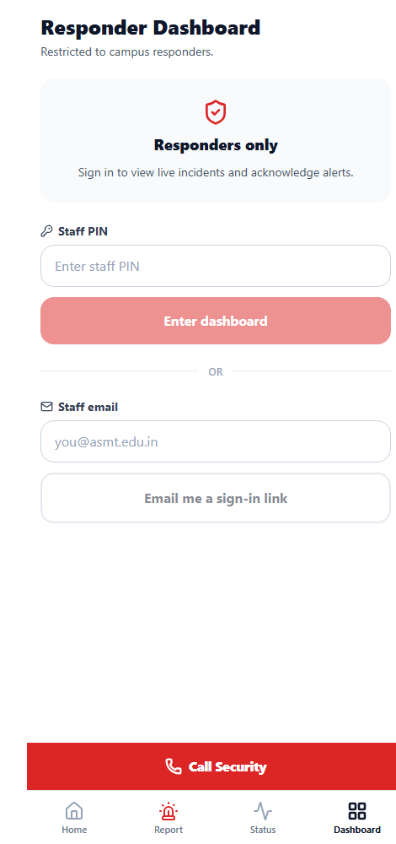
10
Safe Walk, and the responder side
A student walking back alone starts a timer — 5 to 30 minutes — before setting off. Arriving safely takes one tap.
Silence is the alarm. If the timer expires with no check-in, Aegis raises a critical security incident automatically, at their last known GPS position, and pages tier 1. It is raised pre-classified, so it never waits on an AI call.
Live incident board, sorted by priority then by who has waited longest. Critical cards flash and sound an alarm until acknowledged.
Station-wide alerts. A signed-in responder on any screen gets a takeover sheet, alarm and OS notification — one tap to the incident.
Acknowledge sends their position, so the reporter sees a real ETA.
Plus a live campus schematic, the QR generator, and analytics on response times.
Safe Walk — silence as the alarm
Responder dashboard
ASMT Aegis · Bhand Coders

Slide 11
11
What it is made of
TECH STACK
FRONTEND
STYLING
Next.js 14 · App Router · TypeScript
Tailwind CSS
React Server Components with the public screens statically rendered, so they paint instantly. Strict TypeScript throughout.
A white-ground design system with safe-area insets, 48px touch targets and no hover states — every control designed for a thumb.
BACKEND
INTELLIGENCE
Supabase — Postgres, Realtime, Auth, Storage
Rule engine + OpenAI / Anthropic
Row Level Security on every table, live subscriptions, magic-link auth and an image bucket for photo evidence.
Provider swappable with a single environment variable, behind a hard timeout and a deterministic fallback.
ALERTING
PLATFORM
Telegram Bot API
PWA on Vercel
Routed by campus and role, with priority emoji, location, description and a deep link. No Twilio, no Firebase.
Installable on iOS and Android, Workbox service worker, offline app shell and IndexedDB outbox.
BROWSER APIS
CODEGEN
Web Speech · WebAudio · Geolocation · Vibration
qrcode · custom PNG encoder
Speech synthesis and recognition, a generated siren, positions for ETA, haptics where allowed.
Server-rendered QR codes, and app icons generated by a pure-Node PNG encoder we wrote — no image library.
ASMT Aegis · Bhand Coders

Slide 12
12
Try it yourself
Scan the QR code on the table, or open asmt-aegis.vercel.app on your phone.
TEAM
Bhand Coders
It installs to your home screen. File a report and watch it classify, alert and escalate in real time.
BUILT BY
Vibhor Mehta
Devanshu Gupta
Sunny Gujjar
Aegis is not a form that emails somebody. It is a system that decides how urgent something is, pages the right person, and refuses to let silence be the outcome.
EVENT
A.S.M.T. Hackathon 2K26
Anangpuria School of Management and Technology · Bhawani Shanker Anangpuria Charitable Trust
ASMT Aegis · Bhand Coders

