Slide 1

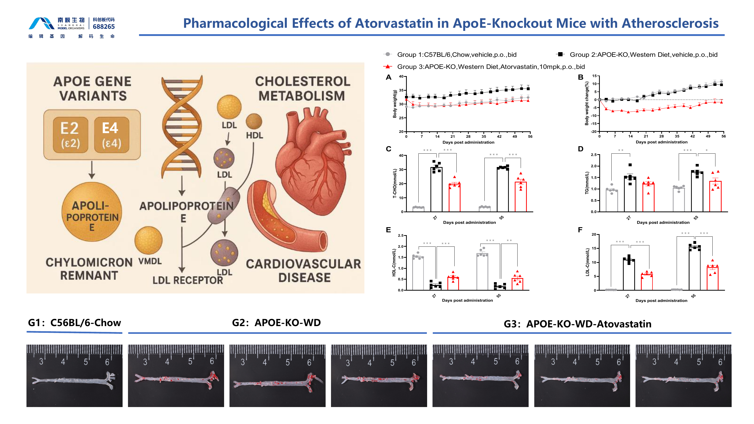

ApoE-KO Atherosclerosis Mouse Model
Western-diet ApoE-knockout mice provide an integrated cardiovascular efficacy model spanning serum lipids, longitudinal body weight, en face aortic plaque burden and aortic-root histology. Atorvastatin serves as the pharmacological validation control.
Systemic lipid response and plaque burden
Atorvastatin (10 mg/kg, p.o., bid) is benchmarked against western-diet vehicle and chow controls through day 55.
55-DAY ATORVASTATIN
Fig. 1. Western-diet ApoE-KO mice developed adverse lipid profiles and extensive aortic lipid staining; atorvastatin partially normalized circulating lipids and reduced visible plaque burden. Source slide 28.
Notes:
[Sources]
- /Users/lx/Downloads/2026南模生物代谢模型数据总结 -liuxia-2026-07-09.pptx, slide 28 (primary figure and treatment-group evidence).
- /Users/lx/.codex/skills/brochure-blueprint/assets/layout.json (brochure geometry).
- /Users/lx/.codex/skills/brochure-blueprint/assets/brand/ (logo and English footer artwork).
[/Sources]

Slide 2
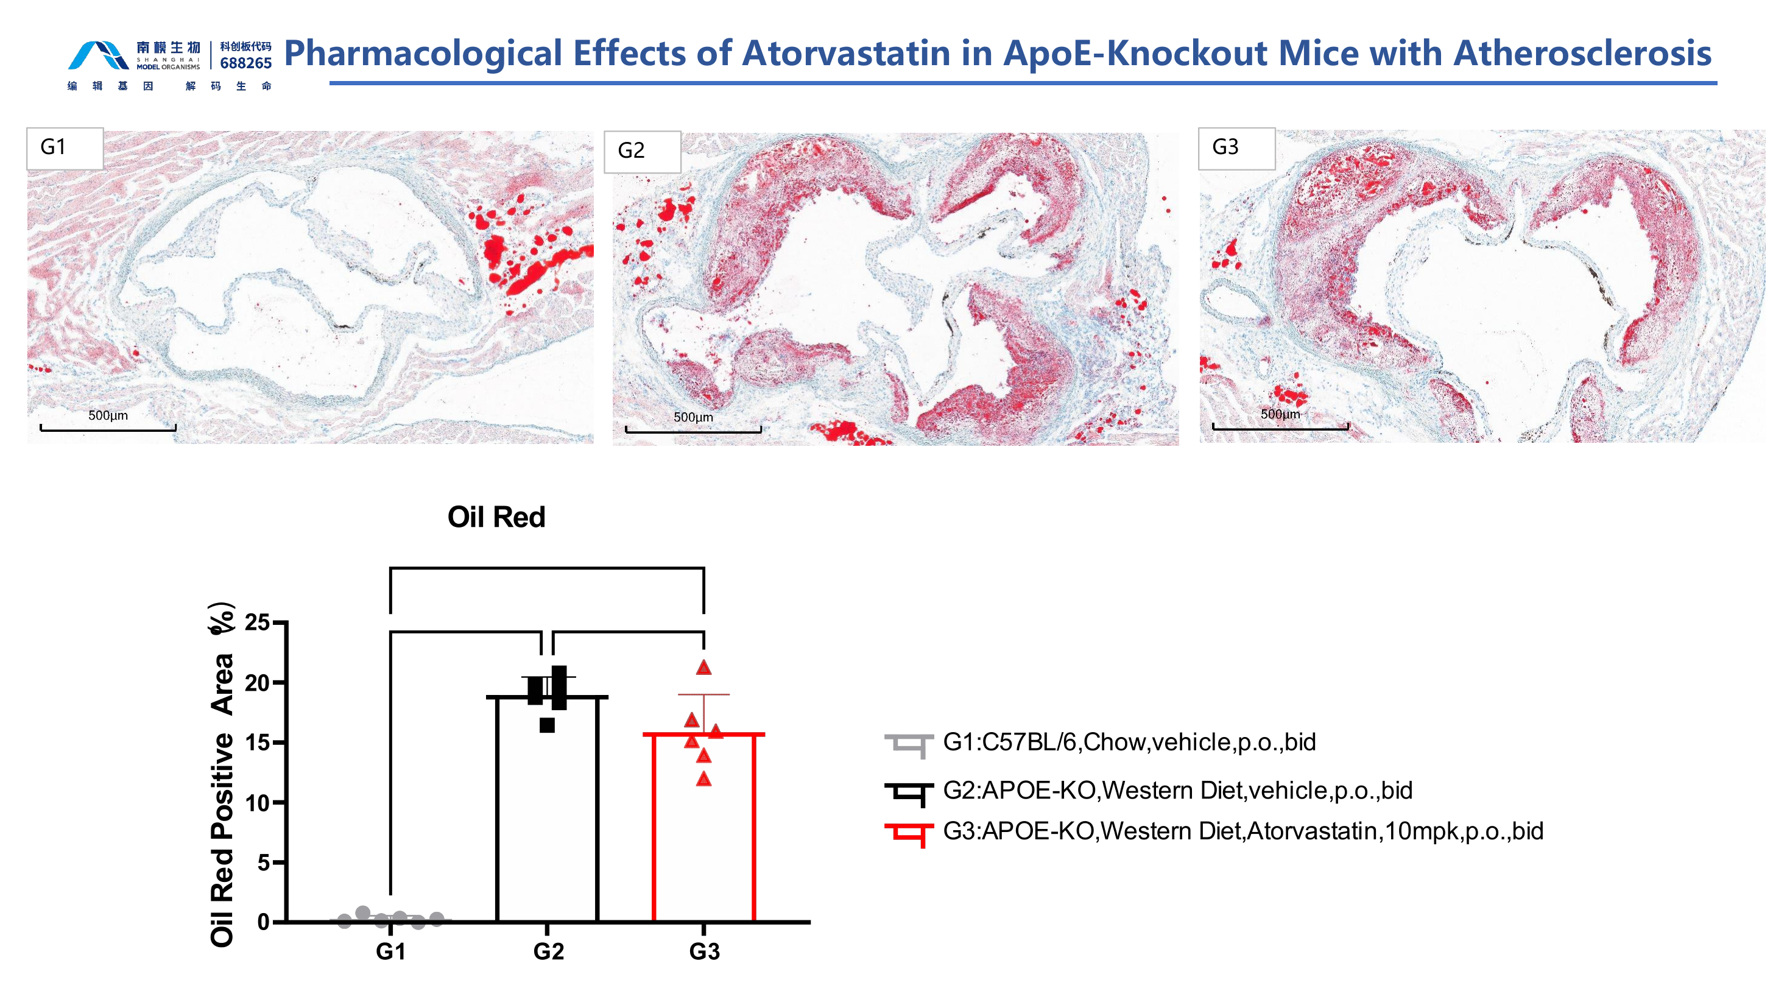
Atherosclerosis Model | Histopathology
Aortic-root histology confirms lesion burden
Oil Red O staining and quantitative lesion area provide tissue-level validation of disease severity and treatment response.
OIL RED O HISTOLOGY
Fig. 2. Aortic-root Oil Red O staining and lesion-area quantification distinguish chow controls from western-diet ApoE-KO mice and show a partial atorvastatin response. Source slide 29.
Notes:
[Sources]
- /Users/lx/Downloads/2026南模生物代谢模型数据总结 -liuxia-2026-07-09.pptx, slide 29 (primary figure and treatment-group evidence).
- /Users/lx/.codex/skills/brochure-blueprint/assets/layout.json (brochure geometry).
- /Users/lx/.codex/skills/brochure-blueprint/assets/brand/ (logo and English footer artwork).
[/Sources]

