Slide 1

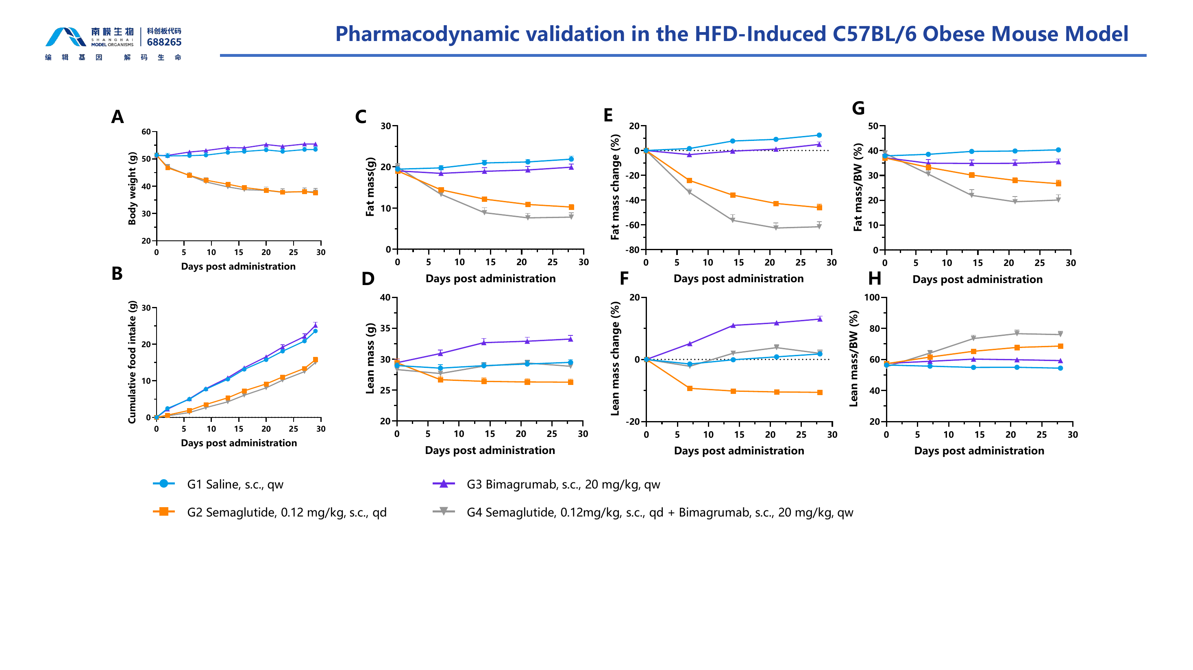

HFD-Induced C57BL/6 Obese Mouse Model
Validated diet-induced obesity platform for body-weight and body-composition pharmacology. The study compares saline, semaglutide, bimagrumab and combination treatment across longitudinal weight, food intake, fat mass, lean mass and terminal tissue endpoints.
Body-weight and composition response
A 28-day study quantifies body weight and cumulative intake alongside fat- and lean-mass trajectories.
28-DAY DIO STUDY
Fig. 1. Semaglutide reduced body weight and fat mass; adding bimagrumab produced the largest fat-mass decline while supporting lean mass relative to semaglutide alone. Source slide 11.
Notes:
[Sources]
- /Users/lx/Downloads/2026南模生物代谢模型数据总结 -liuxia-2026-07-09.pptx, slide 11 (primary figure and treatment-group evidence).
- /Users/lx/.codex/skills/brochure-blueprint/assets/layout.json (brochure geometry).
- /Users/lx/.codex/skills/brochure-blueprint/assets/brand/ (logo and English footer artwork).
[/Sources]

Slide 2
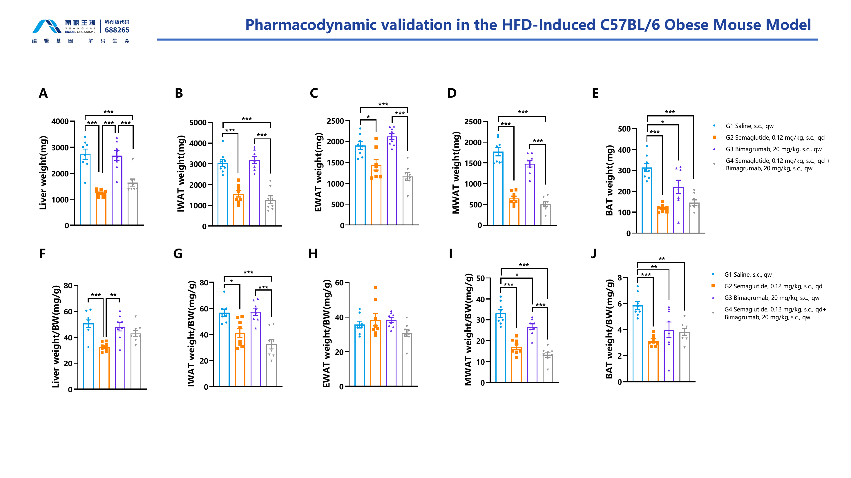
DIO Mouse Model | Terminal Endpoints
Organ and adipose-depot pharmacodynamics
Endpoint liver, adipose-depot and tissue weights support organ-level interpretation of the treatment response.
TERMINAL ENDPOINTS
Fig. 2. Semaglutide-containing arms reduced multiple adipose depots and organ weights; the combination arm paired broad fat-depot reductions with bimagrumab-supported lean-tissue outcomes. Source slide 12.
Notes:
[Sources]
- /Users/lx/Downloads/2026南模生物代谢模型数据总结 -liuxia-2026-07-09.pptx, slide 12 (primary figure and treatment-group evidence).
- /Users/lx/.codex/skills/brochure-blueprint/assets/layout.json (brochure geometry).
- /Users/lx/.codex/skills/brochure-blueprint/assets/brand/ (logo and English footer artwork).
[/Sources]

