Slide 1

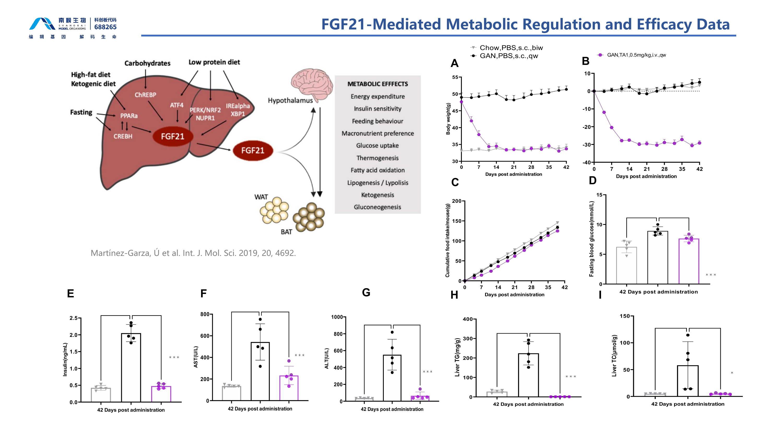

GAN Diet-Induced MASH Mouse Model
Translational MASH platform combining systemic metabolic measures, liver biochemistry and histopathology. The source studies profile FGF21-pathway efficacy across body weight, glucose, insulin, AST/ALT, liver triglycerides, steatosis, fibrosis and NAS components.
FGF21 pathway efficacy in GAN diet-induced MASH
A 42-day study compares chow/PBS, GAN/PBS and GAN/FGF21 groups across systemic and hepatic endpoints.
42-DAY FGF21 STUDY
Fig. 1. FGF21 treatment produced sustained weight loss and improved fasting glucose, insulin, liver enzymes and hepatic lipid measures versus GAN-diet vehicle. Source slide 31.
Notes:
[Sources]
- /Users/lx/Downloads/2026南模生物代谢模型数据总结 -liuxia-2026-07-09.pptx, slide 31 (primary figure and treatment-group evidence).
- /Users/lx/.codex/skills/brochure-blueprint/assets/layout.json (brochure geometry).
- /Users/lx/.codex/skills/brochure-blueprint/assets/brand/ (logo and English footer artwork).
[/Sources]

Slide 2
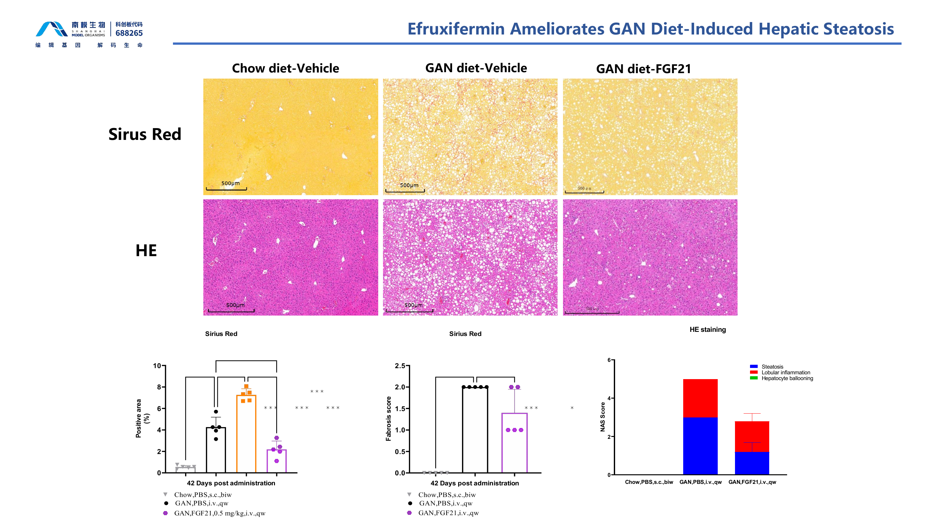
MASH Model | Liver Histopathology
FGF21 improves steatosis and histopathology
Sirius Red and H&E panels benchmark diet-induced pathology against treated animals with quantitative fibrosis, steatosis and NAS readouts.
LIVER HISTOPATHOLOGY
Fig. 2. FGF21-treated GAN-diet mice show less steatosis and improved H&E appearance, with lower fibrosis and NAS-related pathology than GAN-diet vehicle animals. Source slide 32.
Notes:
[Sources]
- /Users/lx/Downloads/2026南模生物代谢模型数据总结 -liuxia-2026-07-09.pptx, slide 32 (primary figure and treatment-group evidence).
- /Users/lx/.codex/skills/brochure-blueprint/assets/layout.json (brochure geometry).
- /Users/lx/.codex/skills/brochure-blueprint/assets/brand/ (logo and English footer artwork).
[/Sources]

