Slide 1
TCGA whole genome sequence: data transfer to variant calling
PRO-seq with primary glioblastoma tissue samples from 4 anatomical sections
Xiaotong Yao
Advisor: Prof. Charles Danko

Slide 2
WGS: data transfer
TCGA data access:
Processed, small data (MAF variant, metadata, etc.) → TCGA Data Portal
Raw, large data (BAM alignments) → UCSC Cancer Genome Hub (CGHub)
Query CGHub:
Browser

Slide 3
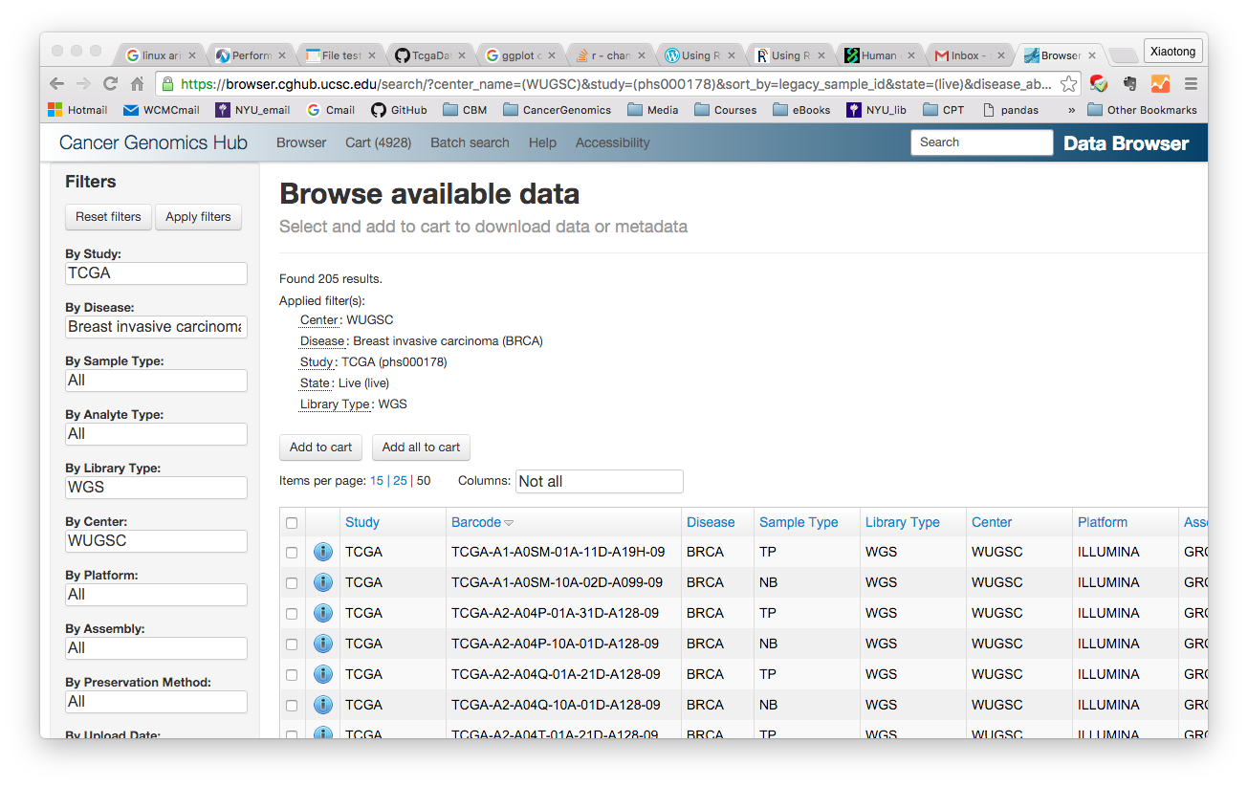

Slide 4
WGS: data trasfer
TCGA data access:
Processed, small data (MAF variant, metadata, etc.) → TCGA Data Portal
Raw, large data (BAM alignments) → UCSC Cancer Genome Hub (CGHub)
Query CGHub:
Browser
Commandline: cgquery
cgquery -vv -o $manifest.xml 'analysis_id=someAnalysis' > info.txt

Slide 5
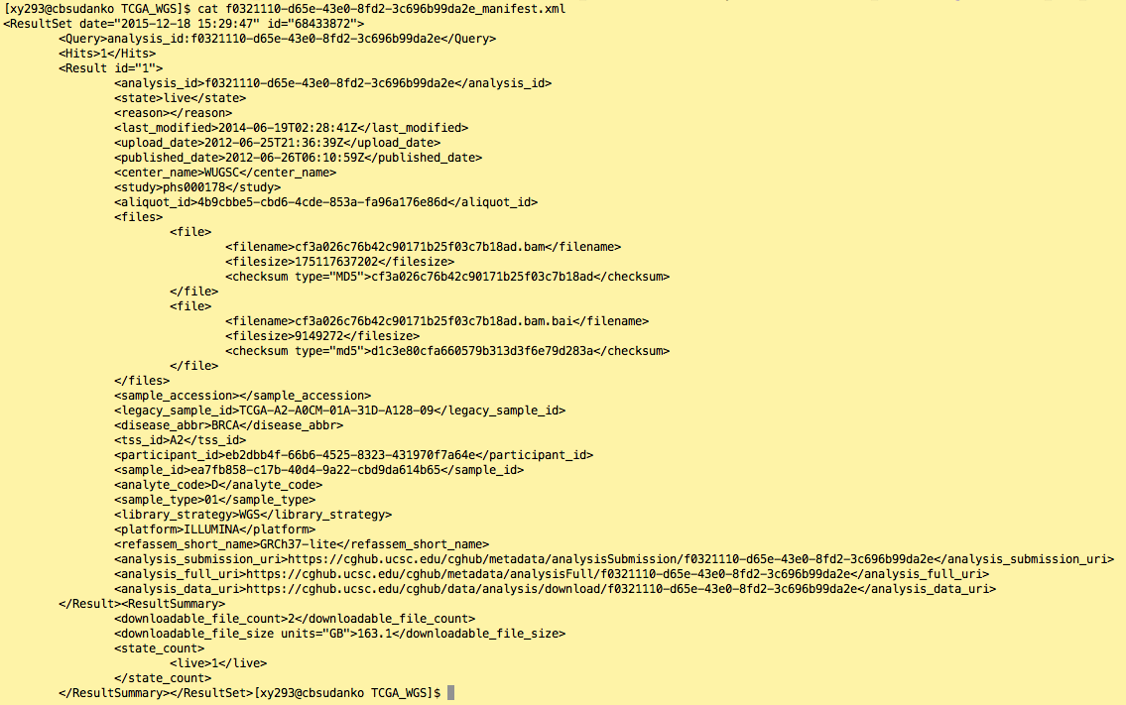
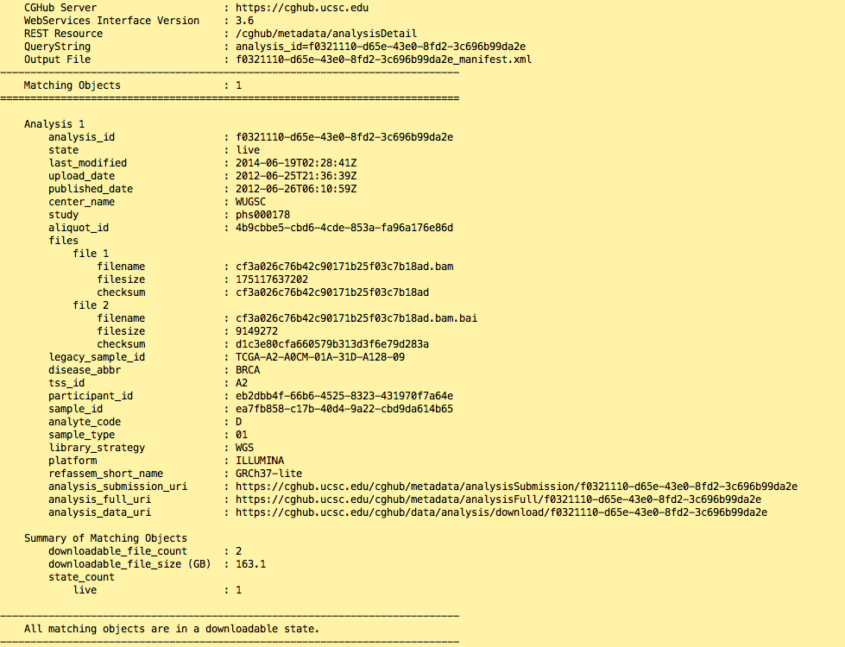

Slide 6
WGS: data trasfer
TCGA data access:
Processed, small data (MAF variant, metadata, etc.) → TCGA Data Portal
Raw, large data (BAM alignments) → UCSC Cancer Genome Hub (CGHub)
Query CGHub:
Browser
Commandline: cgquery
cgquery -vv -o $manifest.xml 'analysis_id=someAnalysis' > info.txt
Download from CGHub:
TcgaData/batchDownload.sh patientUuidList.txt
this script will: find analysis_id, file name, start downloading when space allows, check file integrity, start variant calling

Slide 7
!CAUTION
Match your reference genome:
https://browser.cghub.ucsc.edu/help/assemblies/ → find the right one
Make sure each patient samples only sequenced at one center
Uses normal solid tissue as reference prior to blood-derived
Current max storage set to 2TB; if exceed program will stop

Slide 8
Somatic SNV calling group voter: callerSquad
Combining 3 callers: improve specificity & maintaning sensitivity
MuTect2: bayesian test + heuristic filter + dbSNP/COSMIC reference
Varscan2: heuristic filter + fisher exact test
Speedseq(freebayes): local reassembly haplotype-based
Meanwhile, germline mutations are also detected by GATK
Last time on synthetic data (tumor purity = 1), every caller performed exceptionally, however
On real patient sample (A15K):
MuTect: 278567 (4726)
Varscan: 9596 (4210)
Speedseq: 9995 (4961)
Total >=2 called: 5464 (2989 agreed by all)

