Slide 1
RTFBSDB package tutorial
Zhong Wang
Danko Lab (http://www.dankolab.org/)
Baker Institute for Animal Health College of Veterinary Medicine Cornell University
03/26/2016

Slide 2
Contents:
Package Features & pipeline
Motif Databases
Installation
Usage
Step 1: Loading the Cis-BP data file
Step 2: Selecting motif data
Step 3: Clustering
Step 4: Visualizing and summarizing tfbs object
Step 5: Finding TF binding sites across the genome
Step 6: Comparison between two case-control groups
References
FAQ
Links

Slide 3
How to cite this package
Wang, Z., Martins, A. L., & Danko, C. G. (2016). RTFBSDB: an integrated framework for transcription factor binding site analysis. Bioinformatics, 32(19), 3024-3026.

Slide 4
Package Features & Pipeline:
Provides a framework to integrate the Cis-BP database and the statistical model in the rtfbs package.
Designed a pipeline to implement the following goals:
1) Loading and filtering motif data from Cis-BP database, MotifDb package, or other data source.
2) Searching the genome for motif occurrences.
3) Identifying motifs enriched between two sets of genomic loci.
4) Visualizing motif data by heat-map, motif logos and reports.

Slide 5
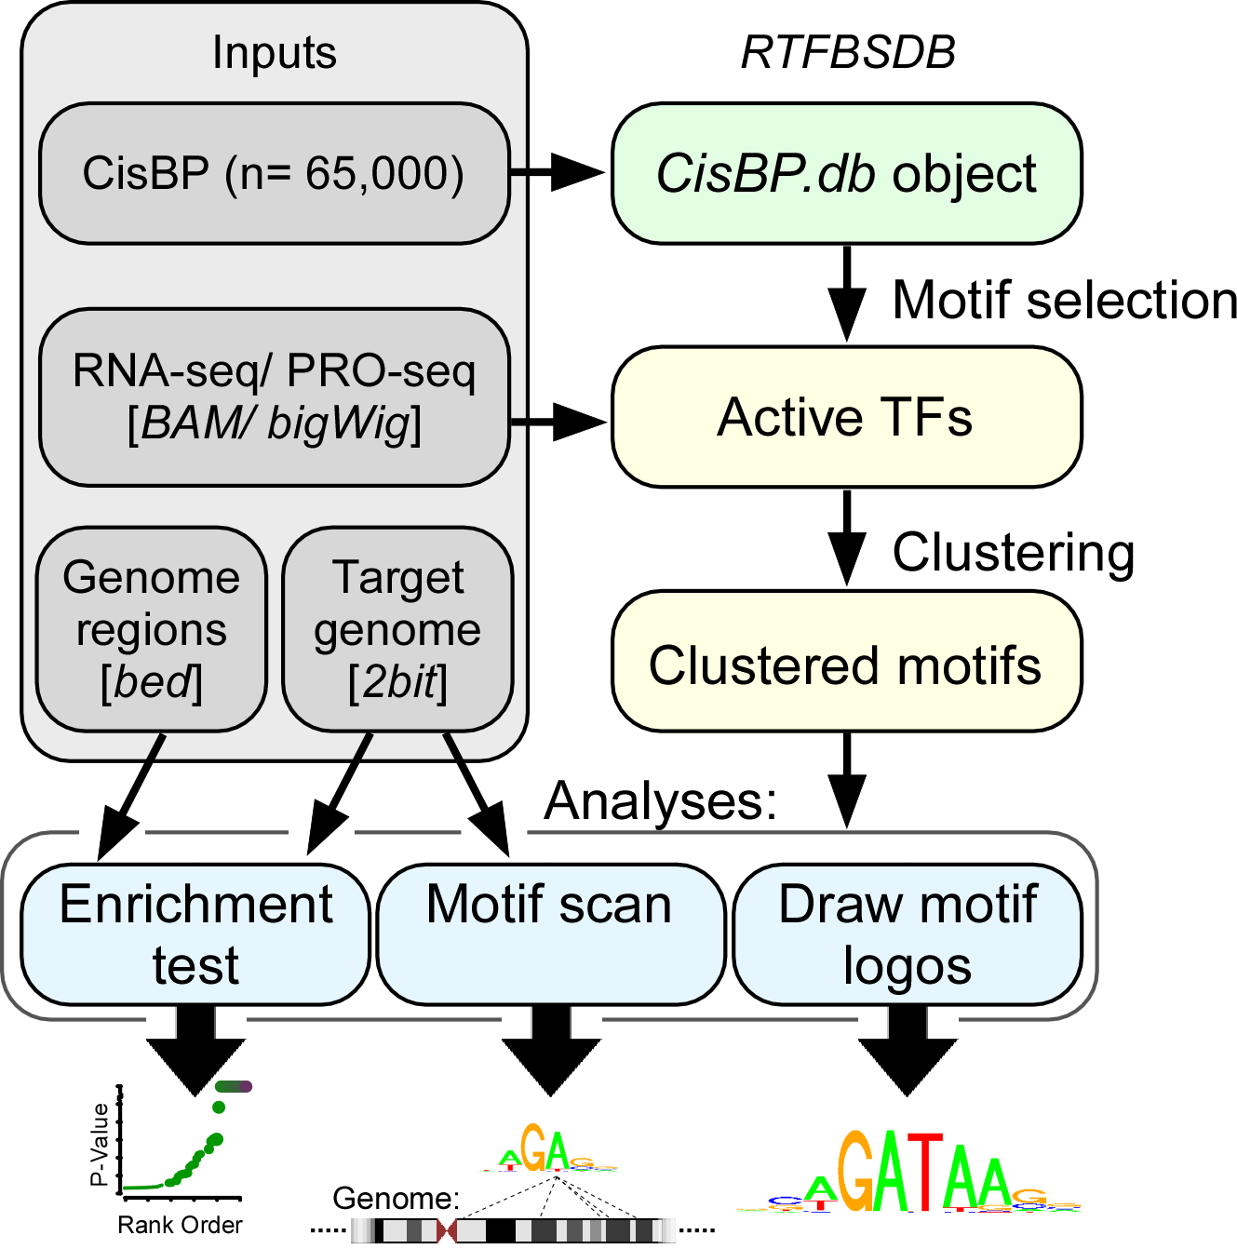
Package Features & Pipeline:
Uses: Parse TF motifs from public databases, read into R, and scan using 'rtfbs'

Slide 6
Motif Databases
(1) Cis-BP database (Catalog of Inferred Sequence Binding Preferences)
(2) MotifDb package
(3) Other data sources can be imported to this pipeline.
-- pfm.matrix
-- Jaspar
-- Meme
-- Mscan
-- Transfac
-- HOCOMOCO

Slide 7
Cis-BP database
Cis-BP (Catalog of Inferred Sequence Binding Preferences) is a public online dataset of TFBS.
http://cisbp.ccbr.utoronto.ca
> 25 sources, including Transfac, JASPAR, HOCOMOCO, FactorBook, UniProbe, Fly Factor Survey, and dozens of additional publications
>300 species covering >250 TF families, totaling >160,000 TFs (of which, >65,000 have at least one DNA binding motif)
Zipped data file includes the meta files, PWM data files and motif logos.
Some missing or empty motifs (PWM data files) require paid licenses.
## Programming Notes:
Select the species database from Cis-BP website, copy the Latin name.
http://cisbp.ccbr.utoronto.ca/bulk.php
e.g. Homo_sapines, Mus_musculus, Drosophila_erecta, Danio_rerio.
Cite: Weirauch, Matthew T., et al. "Determination and inference of eukaryotic transcription factor sequence specificity." Cell 158.6 (2014): 1431-1443.

Slide 8
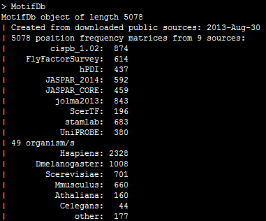
MotifDb package
MotifDb is a public package in Bioconductor.
http://bioconductor.org/packages/release/bioc/html/MotifDb.html
## summary information of MotifDb
Cite: Shannon P (2015). MotifDb: An Annotated Collection of Protein-DNA Binding Sequence Motifs. R package version 1.12.0

Slide 9
Installation:
R package Dependencies:
bigWig, rphast, rtfbs, cluster, latticeExtra, lattice, apcluster, vioplot, Rcurl,
parallel (included in R software from 2.14.0)
Requisite Unix Command:
awk
Requisite Bioinformatics tools:
(1) bedops (starch, starchcat, sort-bed)
http://bedops.readthedocs.org
(2) Kent source (twoBitInfo)
http://hgdownload.cse.ucsc.edu/admin/exe/
(3) bedtools (bedtools)
http://bedtools.readthedocs.org/en/latest/
## Installation Notes:
1) Install R dependencies from CRAN repository.
>install.packages("rphast");
>install.packages("…");
2) Install bigWig package from source codes
$ git clone https://github.com/andrelmartins/bigWig.git
$ cd bigWig
$ R CMD INSTALL bigWig
3) Install rtfbsdb package from source code
$ git clone https://github.com/Danko-Lab/rtfbs_db.git
$ cd rtfbs_db
$ R CMD INSTALL rtfbsdb
4) Test library
> library(rtfbsdb)

Slide 10
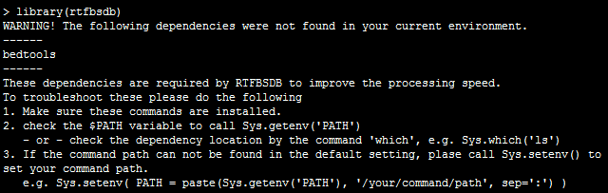
Installation/Troubleshooting
Dependency check
1) If the package can’t run the prerequisite Unix commands or bioinformatics tools, the package will show warning messages after it is loaded.
2) Try to use Sys.which() or system() command to troubleshooting
e.g. Sys.which('awk'), system('awk');
If you can not modify '.bashrc' in your system, use Sys.setenv() to append the paths in current environment.
In Mac OS, R GUI uses different $PATH variable than R console, please check FQA in page 31.
## Dependency check
>Sys.which(c('bedtools', 'bedops', 'twoBitToFa', 'awk', 'sort-bed'))
>Sys.setenv( PATH = paste(Sys.getenv('PATH'), '/your/command/path', sep=':') )

Slide 11
Step 1: Loading the Cis-BP data file
Three methods to load Cis-BP data file.
(1) Loading the pre-installed data copy from package.
(2) Using the local file (zip format) of Cis-BP database.
(3) Directly downloading and using from Cis-BP website.
Only checking zip file and loading the meta file (TF_Information.txt) at the first step
##Programming Notes:
library(rtfbsdb);
#Create db object from pre-installed dataset
db <- CisBP.extdata("Homo_sapiens");
db <- CisBP.extdata("Mus_musculus");
db <- CisBP.extdata("Drosophila_melanogaster");
# Create db object from a zipped downloaded dataset
db <- CisBP.zipload("ZIP_FILE_FROM_CISBP.zip", species="Mus_musculus");
# Create db object from downloaded dataset
db <- CisBP.download("Mus_musculus");

Slide 12
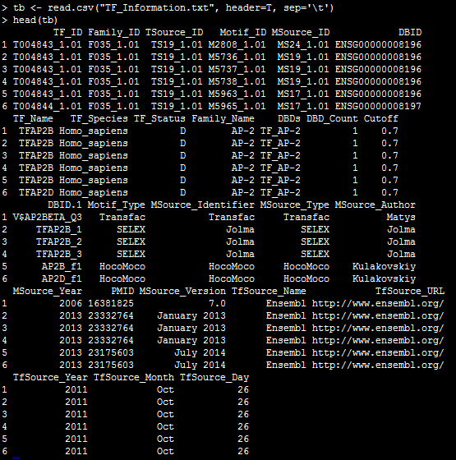
Peeking at TF_information.txt
Three meta files included.
(1) TF_Information.txt:
(direct determined motifs) and (no direct but inferred motifs with >90%)
(2) TF_Information_all_motifs.txt:
(direct determined motifs) and (inferred motifs above the threshold)
(3) TF_Information_all_motifs_plus.txt:
All direct motifs

Slide 13
Step 2: Selecting motif data
Simple way:
(1) No optional parameters ➔ Selecting all.
(2) Using one or more variables(s) to filter motif data. e.g. family_name:
and more other parameters:
or tf_name,
or tf_status,
or motif_type,
or msource_id
(3) Even different TF_Information.txt can be specified.
1: TF_Information.txt
2: TF_Information_all_motif.txt
3: TF_Information_all_motifs_plus.txt
## Programming Notes:
# Select all motifs from CisBP dataset
tfs <- tfbs.createFromCisBP(db);
# Query the CisBP dataset and select the motifs for a
# transcription factor of interest
tfs <- tfbs.createFromCisBP(db, family_name="AP-2");
# Use all direct and inferred motif data to query AP-2
tfs <- tfbs.createFromCisBP(db, family_name="AP-2", tf.information.type = 2);

Slide 14
Step 2: Selecting motif data (continued)
Advanced way:
Motifs for expressed TFs can be selected according to gene expression values in GRO-seq or PRO-seq experiment.
Data required:
(1) Gencode annotation file.
http://www.gencodegenes.org/releases/19.html (human)
(2) 2-bit genome sequence file.
(hg19.2bit, mm10.2bit)
(3) Bigwig files of plus and minus strand
Optional parameters:
(1) expressed.only must be TRUE
(2) include.DBID.missing:
(3) ncores: Parallel cores
It takes a long time to compute!
## Programming Notes:
# Select all motifs from CisBP dataset
tfs <- tfbs.createFromCisBP( db );
# Specify the bigwig files to filter the expressed TFs only
# (PRO-seq)
tfs <- tfbs.selectExpressedMotifs( tfs,
file.twoBit="hg19.2bit", file.gencode.gtf="gencode.v19.annotation.gtf.gz", file.bigwig.plus="bw.plus", file.bigwig.minus="bw.minus", seq.datatype="PRO-seq");

Slide 15
Step 2: Selecting motif data (continued)
Advanced way:
Access the ‘tfbs’ object directly and check the attributes
ntfs: number of motifs in the tfbs object
pwm: a list including PWM matrices
filename: string vector, filenames for all PWMs
mgisymbols: string vector, unique gene symbols for all PWMs
tf_info: Data frame, including extra information for all existing PWMs, it maybe different with motif dataset
tf_missing: data frame, including extra information for missing PWMs, it maybe different with motif dataset
expressionlevel: data frame indicating the result of expression level returned by tfbs.selectExpressedMotifs or tfbs.getExpression
## Programming Notes:
# show the structure of ‘tfbs’ object. It may be very long
# if the object has many PWMs
str(tfs);
# Access the first 6 rows of TF information
head(tfs@tf_info) ;
# Access the first 6 rows of gene expression levels head(tfs@expressionlevel) ;
# Check the first PWM
tfs@pwm[[1]]

Slide 16
Step 2: Or loading motifs from MotifDb package
If you use the MotifDb package and want to perform analysis by this package:
Create a tfbs object by querying MotifDb object.
Same subsequent performance as Cis-BP dataset.
## Programming Notes:
# Load the subset of MotifDb generated by the method in
# 'MotifDb' package
library(MotifDb);
mdb.human <- query(MotifDb, 'hsapiens');
tfs1 <- tfbs.createFromMotifDb(mdb.human, organism=NULL);
## Use the specific criteria to create a tfbs object
tfs2 <- tfbs.createFromMotifDb(organism = "Hsapiens", tfFamily="AP2");

Slide 17
Step 2: Or importing from other data sources
If you have licensed motif data for missing and empty motifs in Cis-BP database or motif data from other data sources
Importing external motif data:
Licensed PWM files for Cis-BP data set
Transfac, Jaspar, meme, mscan, HOCOMOCO text file containing multiple PFM information.
New released data file parsed by rtfbsdb
User customized data file
Simple parser implemented in the package.
## Programming Notes:
db <- CisBP.extdata("Homo_sapiens");
tfs <- tfbs.createFromCisBP(db, family_name="AP-2");
## import 2 motifs to fill the licensed motifs in Cis-BP and 1 new motif
## from other source
motif_ids <- c( "M2938_1.02", "M3591_1.01", "M3590_1.01" );
path <- system.file("extdata", package="rtfbsdb");
file_pwms <- paste(path, c( "fake_M2938_1.02.pwm",
"M3591_1.01.pwm",
"M3590_1.01.pwm"), sep="/");
tfs <- tfbs.importMotifs(tfs, "pwm.matrix", file_pwms, motif_ids, header=T );
## import the data file in Jaspar format
tbs <- tfbs();
data.jaspar <- system.file("extdata", "pwm.example.jaspar.2015.txt", package="rtfbsdb");
tfs.jaspar <- tfbs.importMotifs(tfs, "jaspar", data.jaspar, skip.lines=0);

Slide 18
Step 3: Clustering
Some details:
Distance matrix with Pearson's R values obtained from comparing each combination of motifs
AGNES (Agglomerative Nesting) is employed to merge nodes that have the least dissimilarity.
(By default group k equals 1/3 motifs)
APCluster is also employed to cluster the similarity measures used in the rtfbsdb package.
## Programming Notes:
tfs1<- tfbs.clusterMotifs(tfs, method="agnes", group.k=100, pdf.heatmap=“agnes.hm.pdf" )
tfs2 <- tfbs.clusterMotifs(tfs, method=“apcluster", pdf.heatmap=“apcluster.hm.pdf" )
# Draw motif logos with one group of TF per page
tfbs.drawLogosForClusters( tfs1, file.pdf=“agnes.logos.pdf" );
tfbs.drawLogosForClusters( tfs2, file.pdf=“apcluster.logos.pdf" );
Bodenhofer, Ulrich, Andreas Kothmeier, and Sepp Hochreiter. "APCluster: an R package for affinity propagation clustering." Bioinformatics 27.17 (2011): 2463-2464.

Slide 19
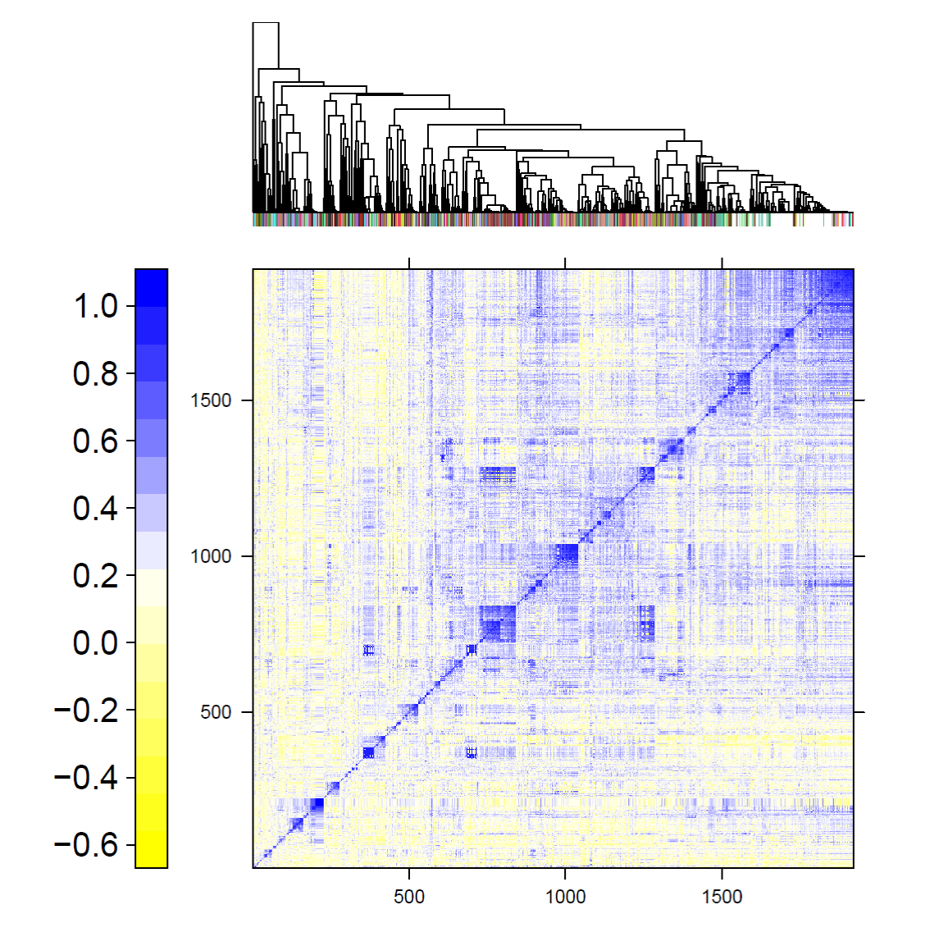
Step 3: Clustering (Continued)

Slide 20
Step 3: Clustering (Continued)
Why do we make clustering for motifs?
To get a heat-map for publishing.
To minimize the number of identical results.
To reduce the penalty for multiple hypothesis testing.
(Avoid using big number to adjust in whole set)
To select the expressed motifs as representative for every cluster.
(Expressed motifs are calculated in step2 )
## Programming Notes:
# Select a representative motif randomly from each cluster
tfs1 <- tfbs.selecteByRandom(tfs1)
# Select the most expressed motif from each cluster
tfs2 <- tfbs.selecteByGeneExp (tfs2)

Slide 21
Step 4: Visualizing and summarizing tfbs object
Now a tfbs object has been built with the following features:
(1) all PWMs or partial PWMs filtered by step 2.
(2) TF information imported from Cis-BP.
(3) Gene expression values (optional).
(4) Distance matrix with Pearson's R values (optional).
(5) motifs index for each cluster (optional).
Methods used to visualize the content of this object:
(1) Showing brief information (show)
(2) Drawing motif logos(tfbs.drawLogo)
## Programming Notes:
# Showing brief information
show(tfs)
# Drawing motif logos
tfbs.drawLogo( tfs, motif_id="M5736_1.01", file.pdf="M5736_1.pdf");
tfbs.drawLogo( tfs, file.pdf="logos.pdf",
motif_id =c("M4376_1.01", "M4440_1.01") )

Slide 22
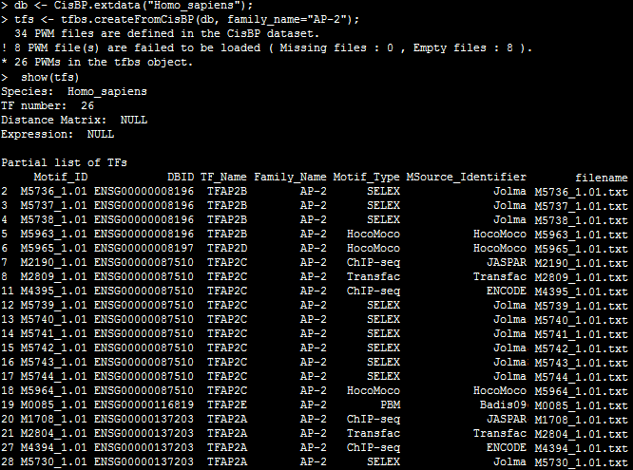
Step 4: Summarizing tfbs object (continued)

Slide 23
Step 5: Finding TF binding sites across the genome
1. The tfbs.scanTFsite function locates TF binding sites across a genome
2. Genome location can be specified by the bed-formatted data frame.( the ‘tre.bed’ parameter )
3. Five options are available for the output results.
(a) matches: returns all matching TF sites for all motifs.
(b) writedb: writes a bed file with matches sites.
(c) posteriors: returns the posteriors at each position in bed-formatted loci.
(d) maxposterior: returns the max(posterior) in bed-formatted loci.
(e) maxscore: returns the max(posterior difference) in bed-formatted loci.
4. Two different thresholds ( score or FDR )
Score threshold: default 6, only binding sites with scores above this value are returned
FDR threshold: default 0.1, only binding sites with FDR (False Discovery Rate) less than this value are selected.
## Programming Notes:
file.twoBit <- "hg19.2bit"
# Example 1: Scan the whole genome
# Scan 2bit file within whole genome to find motif binding sites
r1.scan <- tfbs.scanTFsite( tfs, file.twoBit, ncores = 7);
# Example 2: Scan a specified range
# Get a data frame from a plain-text bed file for your range of interest
dREG_H_change_bed <- read.table("./dREG.H.change.bed", header=FALSE);
# Scan 2bit file within all bed regions to find motif binding sites
r2.scan <- tfbs.scanTFsite( tfs, file.twoBit, dREG_H_change_bed, return.type="writedb", ncores = 7 , threshold=8);

Slide 24
Step 5: Finding TF binding sites (Continued)
The tfbs.scanTFsite function returns a list object consisting of four parts:
a) $result: the result of the motif scan.
b) $summary: a summary of TF scan, including the number of binding sites matched for each motif.
c) $parm: the values of control parameters.
d) $bed: the bed-formatted loci information with 6 columns.
The tfbs.reportFinding function outputs a PDF report including motif names, counts of TF site and motif logos.
## Programming Notes:
#show the basic information about the result
r1.scan
#show the summary information in the result
show(r1.scan$summary);
#show the matched TF sites for first motif
show(r1.scan$result[[1]]);
#Output a PDF report for all finding motifs.
tfbs.reportFinding( tfs, r1.scan, file.pdf="Scanning Results");

Slide 25
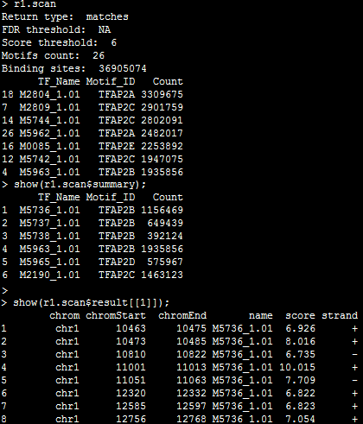
Step 5: Finding TF binding sites (Continued)

Slide 26
Step 6: Comparison between two case-control groups
The tfbs.enrichmentTest function is to identify motifs enriched in a user-specified set of genomic coordinates compared to a background set.
Required parameters:
1) 2-bit file (file.twobit)
2) Positive bed-formatted genomic loci(positive.bed)
3) Negative bed-formatted genomic loci(negative.bed)
4) GC correction? (gc.correction)
5) Score or FDR threshold (threshold, threshold.type)
6) Parallel cores (ncores)
## Programming Notes:
file.twoBit <- "hg19.2bit"
file.positive.bed <- "dREG.H.change.bed"
file.negative.bed <- "dREG.all.bed"
# Convert the bed file for each condition to a data frame
pos.bed <- read.table(file.positive.bed, header=FALSE);
neg.bed <- read.table(file.negative.bed, header=FALSE);
# Compare motifs between two conditions
t.comp <- tfbs.enrichmentTest( tfs,
file.twoBit,
pos.bed,
neg.bed,
gc.correction=TRUE,
file.prefix="enrich.db",
ncores = 3);

Slide 27
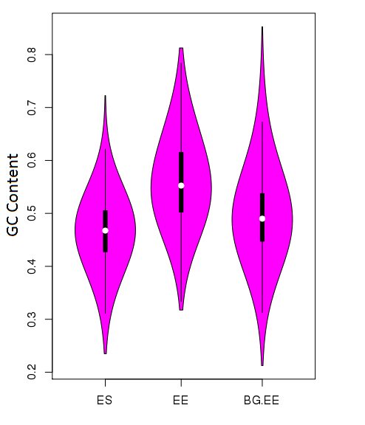
Step 6: Comparison between two case-control groups(Continued)
The analysis results are often distorted by systematic differences in the GC content between groups.
The tfbs.enrichmentTest checks the mean of the GC content between the two groups by Wilcox test.
If the difference is significant, the package suggests to set gc.correction to TRUE (default) and resamples the background (i.e. negative) sequences
The right figure shows the effects after resampling the background sequences.
It is important to check the violin figure.

Slide 28
Step 6: Comparison between two case-control groups(Continued)
The output of tfbs.enrichmentTest includes a data frame with 8 columns, including :
a) motif ID,
b) TF name,
c) occurrence in positive group,
d) expected in negative group ,
e) enrichment ratio,
f) p-value of fisher test,
g) correction value by multiple comparison methods (e.g., Bonferroni or FDR).
The tfbs.reportEnrichment function draws a motif list with visual p-value bar, enrichment ratio bar, and motif logos.
## Programming Notes:
# showing summary information including top or
# significant motifs
show(t.comp);
# draw the report including p-value, enrichment ratio, logos
tfbs.reportEnrichment( tfs, t.comp,
file.pdf="test-enrich.pdf",
report.title="Significant Report",
sig.only=TRUE,
pv.threshold=0.01,
pv.adj="fdr");
#plot QQ-like plot for the pvalues of all motifs
tfbs.plotEnrichment(tfs, t.comp, file.pdf="plot-elf1-enrich-enriched.pdf",
enrichment.type="enriched",
plot.type="nonpolar",
options=list(title="QQ plot", top.motif.labels=3, color.scheme=2) );

Slide 29
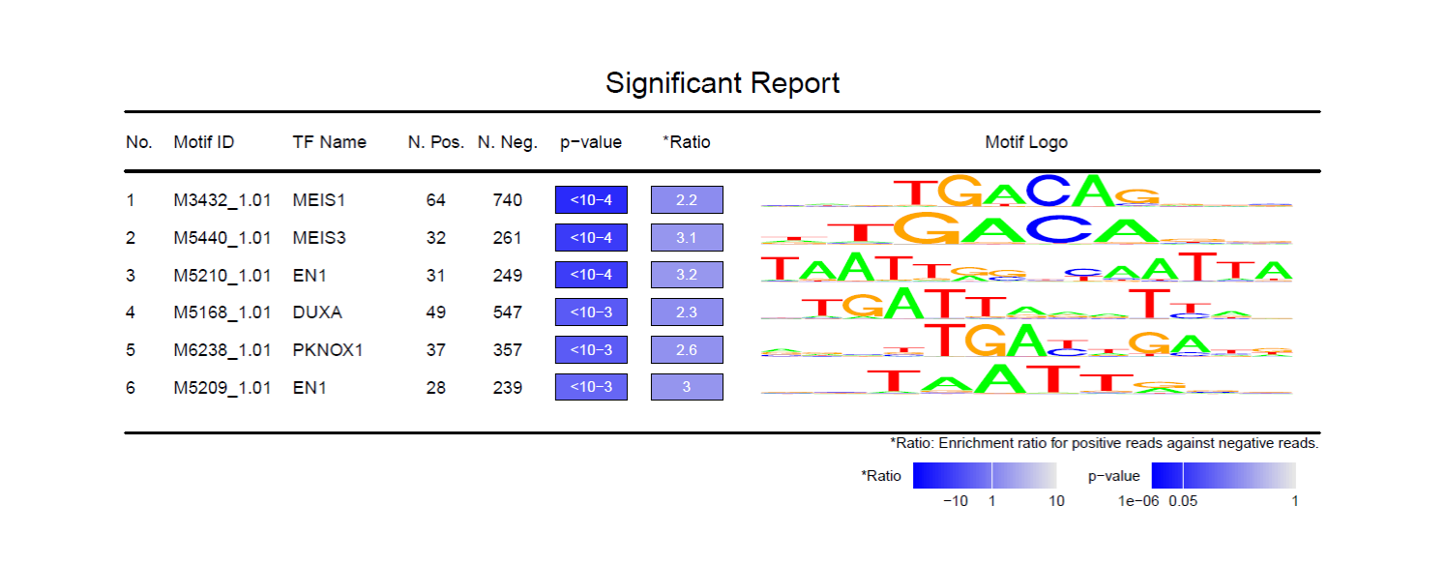
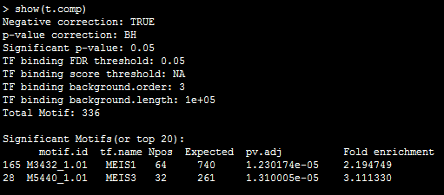
Step 6: Comparison between two case-control groups(Continued)

Slide 30
Step 6: QQ-like plot for Comparison Results

Slide 31
References:
Weirauch, Matthew T., et al. Determination and inference of eukaryotic transcription factor sequence specificity. Cell 158.6 (2014): 1431-1443.
Bodenhofer, Ulrich, Andreas Kothmeier, and Sepp Hochreiter. APCluster: an R package for affinity propagation clustering. Bioinformatics 27.17 (2011): 2463-2464.
Quinlan, Aaron R., and Ira M. Hall. BEDTools: a flexible suite of utilities for comparing genomic features. Bioinformatics 26, no. 6 (2010): 841-842.
Shane Neph, M. Scott Kuehn, Alex P. Reynolds, et al. BEDOPS: high-performance genomic feature operations. Bioinformatics (2012) 28 (14): 1919-1920
Shannon P (2015). MotifDb: An Annotated Collection of Protein-DNA Binding Sequence Motifs. R package version 1.12.0
Bembom O. seqLogo: Sequence logos for DNA sequence alignments. R package version 1.36.0.

Slide 32

FAQ:
1. Rtfbsdb package can not find Bedtools or samtools on Mac computer.
When the package is loaded, the following warning message would be displayed if these two commands can not be executed normally.
Firstly you need to check whether these commands are accessible on the Mac terminal. If it works on the terminal, you should try to run R under the terminal and execute the commands by the system or system2 function.
> system(“bedtools”)
> system(“samtools”)
In most cases, if the ‘samtools’ and ‘bedtools’ can not be executed normally on the terminal, it should be the configuration problem, check the $PATH by the following command.
> Sys.getenv("PATH")
If the commands work normally on the terminal, but they don’t run on R GUI window, check the $PATH again on the R GUI window.
> Sys.getenv("PATH")
The same problem is discussed in the following links.
http://gis.stackexchange.com/questions/130710/system-call-gdal-function-in-r-on-mac

Slide 33
Links
CIS-BP database
http://cisbp.ccbr.utoronto.ca/
MotifDb Package
http://bioconductor.org/packages/release/bioc/html/MotifDb.html
Gene annotation files
http://useast.ensembl.org/info/data/ftp/index.html

Slide 34

Package Information:
Source:
https://github.com/Danko-Lab/rtfbs_db.git
Manual:
https://github.com/Danko-Lab/rtfbs_db/blob/master/rtfbsdb-manual.pdf
Vignette:
https://github.com/Danko-Lab/rtfbs_db/blob/master/rtfbsdb-vignette.pdf
Bug reports/Comments/Suggestions
zw355@cornell.edu
dankoc@gmail.com

