Slide 1
Making it Big in the Movie Biz
Daniel Bradley and Alex Williams

Slide 2
Goals and Game Plan
Microsoft wants to make money by investing in the movie business
We believe the best path is to invest in several small-to-medium budget movies
Follow the profits, not the critics

Slide 3
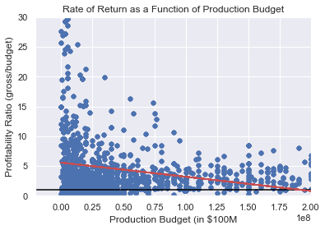
Budget vs. Rate of Return
Maximize returns and diversification
Minimize startup costs
Recommendation:
Make several low budget movies in different genres

Slide 4
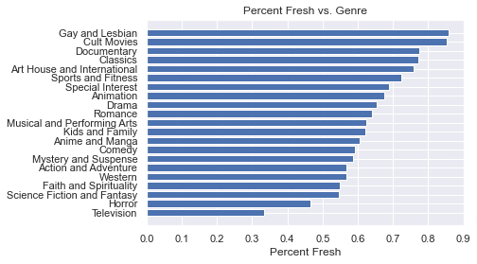
But which genre?
We compared what genres are loved most by the critics
Critics like these, but does the box office?

Slide 5
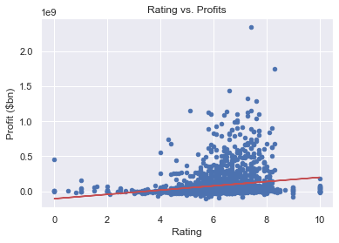
Do you really want a perfect 10?
Movie rating and profits are weakly correlated
Recommendation:
Shoot for a 7, not a 10

Slide 6
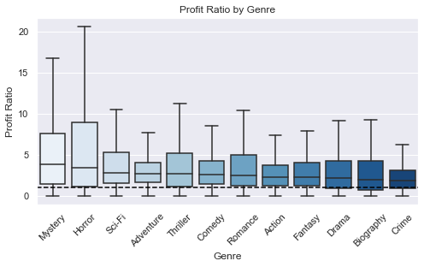

Slide 7
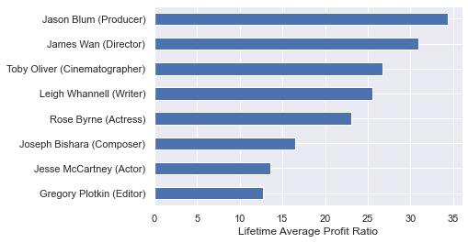
Mystery
top_performers(data,'Mystery’):
Role | Names
Editor | Gregory Plotkin, Abhro Banerjee, Eliot Piltz
Actor | Jesse McCartney, Patrick Wilson, James Ransone
Composer | Joseph Bishara, Benjamin Wallfisch, Todd Weaver
Actress | Rose Byrne, Catherine Keener, Mary Elizabeth Winstead
Writer | Leigh Whannell, Christopher Landon, Oren Peli
Cinematographer | Toby Oliver, Chris Hunt, Eduard Grau
Director | James Wan, Ariel Schulman, Henry Joost
Producer | Guymon Casady, Jason Blum, Oren Peli
Sorted professionals by average profit ratio over their entire careers
Limited to only professionals who have repeatedly performed well (3+ movies in their portfolio)

Slide 8
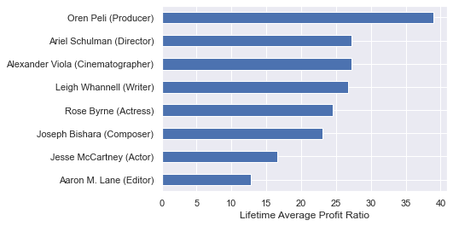
Horror
top_performers(data,’Horror’):
Role | Names
Editor | Aaron M. Lane, Robin Paredes, Gregory Plotkin
Actor | Jesse McCartney, Patrick Wilson, Aman Chaudhry
Composer | Joseph Bishara, Dustin Richardson, Matt Gates
Actress | Rose Byrne, Charline Chavarria, Heather Dorff
Writer | Leigh Whannell, Christopher Landon, Oren Peli
Cinematographer | Toby Oliver, Alexander Viola, Chase Jonathan Azimi
Director | James Wan, Ariel Schulman, Henry Joost
Producer | Guymon Casady, 'Oren Peli, Eric Newman
Sorted professionals by average profit ratio over their entire careers
Limited to only professionals who have repeatedly performed well (3+ movies in their portfolio)

Slide 9
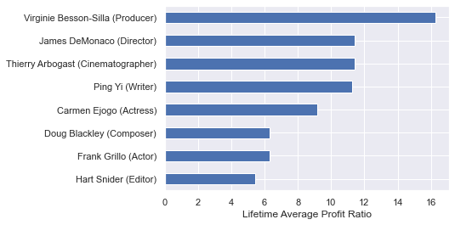
Sci-Fi
top_performers(data,’Sci-Fi’):
Role | Names
Editor | Hart Snider, Julien Rey, Alexander Johnson
Actor | Frank Grillo, Amr Waked, Ed Fong
Composer | Doug Blackley, Éric Serra, Jon Hopkins
Actress | Carmen Ejogo, Annalee Jefferies, Qing Liu
Writer | Ping Yi, Yung Huang, James DeMonaco
Cinematographer | Thierry Arbogast, Elliot C. Rosen, Mitchell Wenkus
Director | James DeMonaco, Elisa Chee, Luc Besson
Producer | Sébastien K. Lemercier, Virginie Besson-Silla, Allan Niblo
Sorted professionals by average profit ratio over their entire careers
Limited to only professionals who have repeatedly performed well (3+ movies in their portfolio)

