Slide 1
tasks
Emotion Analysis
Comments Generation
Key Frame Recommendation
Video Ranking

Slide 2
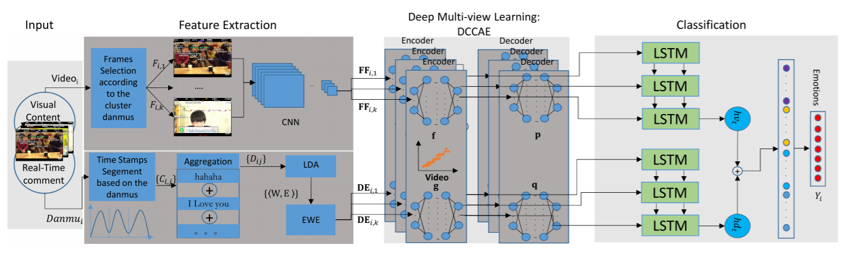
Emotion Analysis
Visual-Texual Emotion Analysis With Deep Coupled Video and Danmu Neural Networks
2020 IEEE TRANSACTIONS ON MULTIMEDIA

Slide 3
Comments Generation
VideoIC: A Video Interactive Comments Dataset and Multimodal Multitask Learning for Comments Generation
2020 ACM MM
dataset called VideoIC: 4951 videos spanning 557 hours and 5 million comments

Slide 4
Key Frame Recommendation

