Slide 1
Simplelife
App done by Jiancai Hou and Danila Morozov

Slide 2
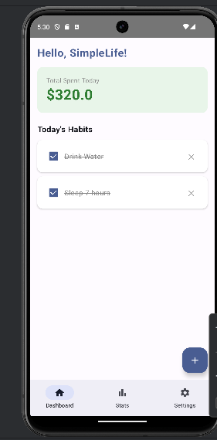
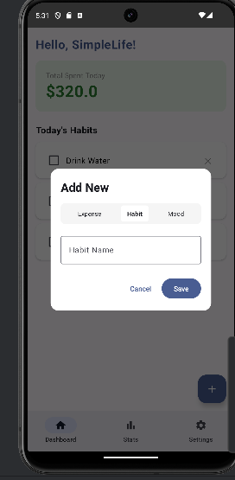
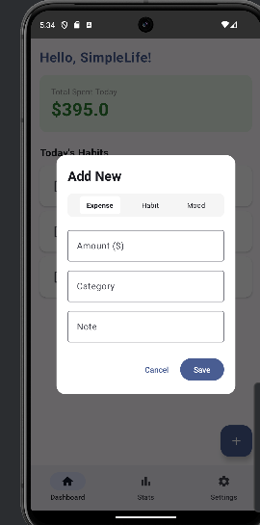
Description
Simple Life is a modern Android application designed to help users take control of their everyday life by tracking expenses and habits.

Slide 3
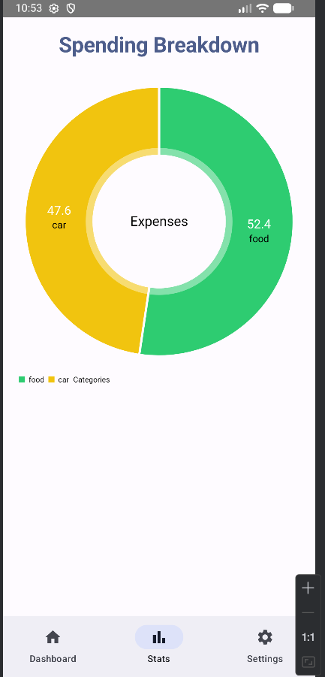
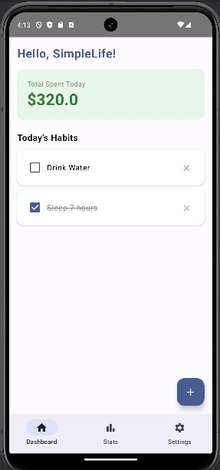
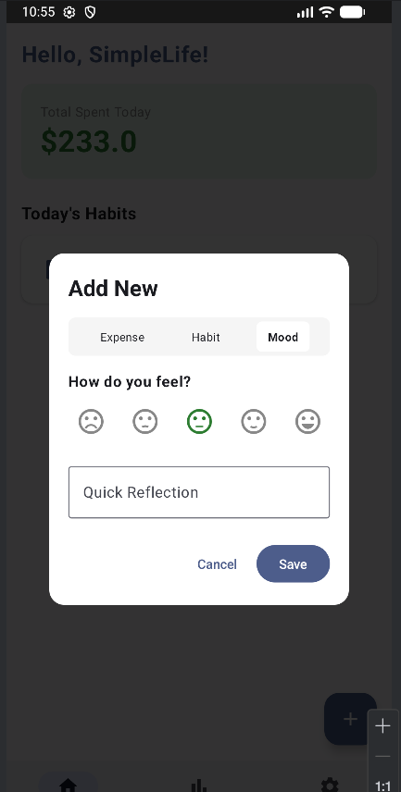
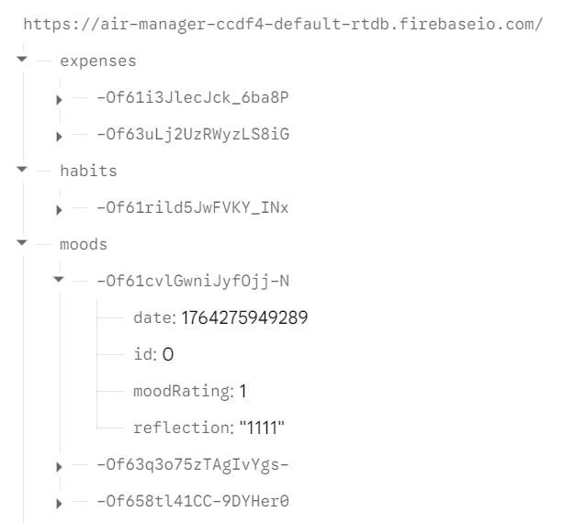
Tech Stack
PieChart(context)

Slide 4
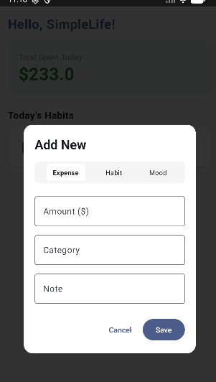
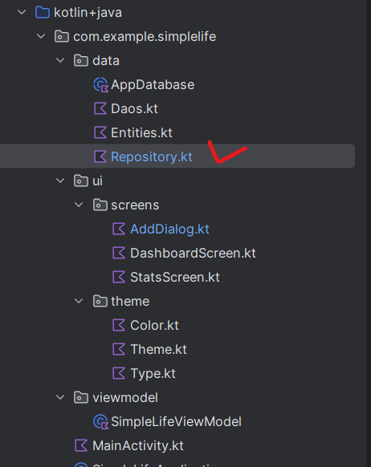
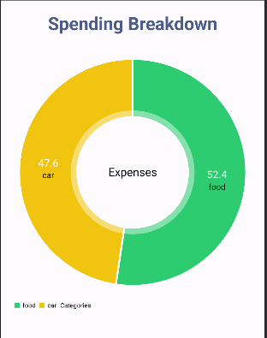
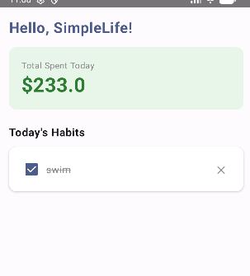
Features
Expense Tracker
Habit Tracker
Data Visualization
Local Storage

Slide 5
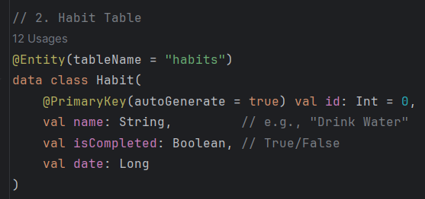

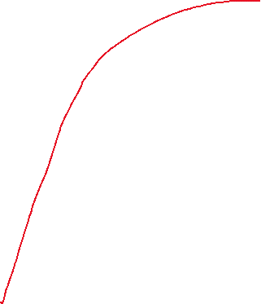
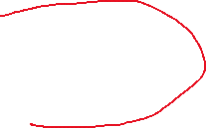
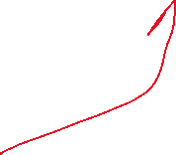

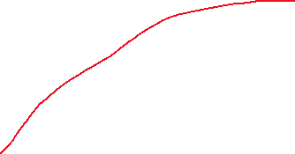
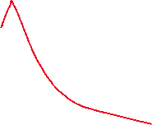
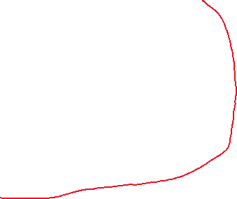





Features
The local database (Room) is connected to the cloud-based real-time database (Firebase Realtime Database).
Expense Tracker
Habit Tracker
Data Visualization
Local Storage
marks an interface as a Room Data Access Object. Room generates the implementation at compile time.

Slide 6
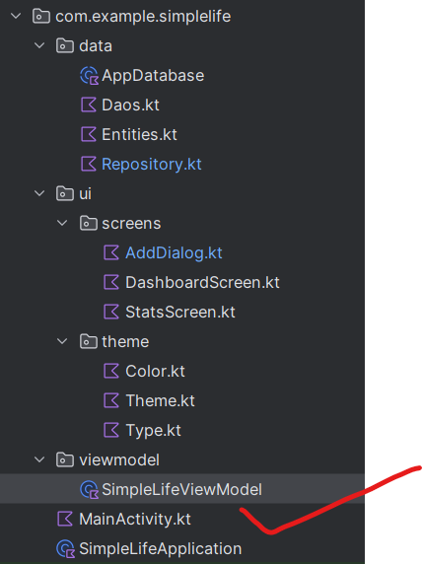

Features
import com.example.simplelife.ui.screens.DashboardScreen
import com.example.simplelife.ui.screens.StatsScreen
import com.example.simplelife.ui.theme.SimpleLifeTheme
import com.example.simplelife.viewmodel.SimpleLifeViewModel

Slide 7
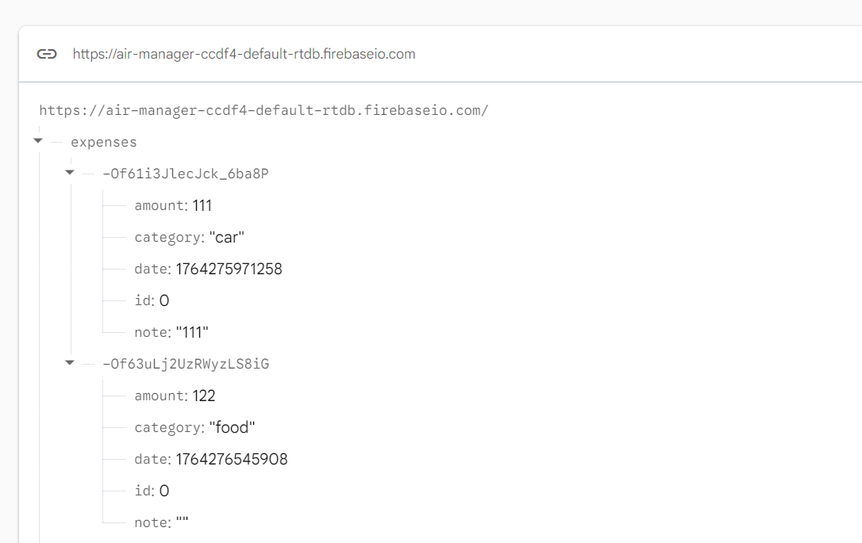
Database, where all information saved

Slide 8
Tech Stack
Simple Life is a modern Android application designed to help users take control of their everyday life by tracking expenses and habits.
Language: Kotlin
UI: Jetpack Compose (Material 3 Design)
Architecture: MVVM (Model-View-ViewModel)
Database: Room (SQLite) with Coroutines(DAO → Repository → ViewModel → Compose)
Navigation: Navigation Compose
Charts: MPAndroidChart
Async: Kotlin Coroutines & Flow API used: Firebase Studio

Slide 9
Language: Kotlin
UI: Jetpack Compose (Material 3 Design)
Architecture: MVVM (Model-View-ViewModel)
Database: Room (SQLite) with Coroutines(DAO → Repository → ViewModel → Compose)
Navigation: Navigation Compose
Charts: MPAndroidChart
Async: Kotlin Coroutines & Flow API used: Firebase Studio

Slide 10
Installation
1. Clone the repository (please open master).
2. Open in Android Studio.
3. Sync Gradle dependencies.
4. Run on an Emulator or Physical Device (Min SDK 24).

Slide 11
Link for downloading
https://github.com/Danmoroz96/Simplelife_kotlin_public/tree/master
(OPEN MASTER!!!)
https://github.com/Danmoroz96/Simplelife_kotlin_public/releases/tag/V1.0

Slide 12

Thank you!

