Slide 1
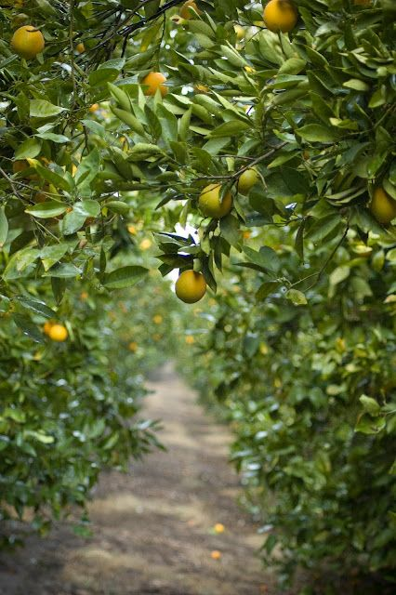
GrowKita
AI-powered farm intelligence.
HERO FARM PHOTO
Starting with citrus yield estimation
for Nueva Vizcaya farms.
Perante citrus tree or farm landscape
NVSU Business Pitch Competition 2026
TEAM NAME | NUEVA VIZCAYA STATE UNIVERSITY
Notes:
Open with the decision, not the drone.
GrowKita helps farms plan harvest and buyer commitments before the exact fruit volume is known.

Slide 2
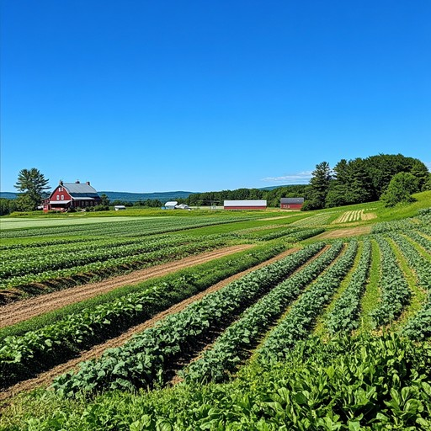
OUR VISION
GROWKITA | 02
Practical AI-powered farm intelligence for Philippine agriculture
GrowKita turns field observations into decisions that farms can act on.
1
2
3
FARM LANDSCAPE OR AERIAL IMAGE
Use a real wide farm photo
Observe
Understand
Act
Capture farm conditions
with guided monitoring
Use AI and computer vision
to analyze what is seen
Deliver clear insights
for farm decisions
FIRST STEP: CITRUS YIELD ESTIMATION
A platform vision, proven through one focused first product.
Notes:
Agriculture is entering an AI era, but local farms need practical tools, not technology for its own sake.
Our first step is citrus yield estimation in Nueva Vizcaya.

Slide 3
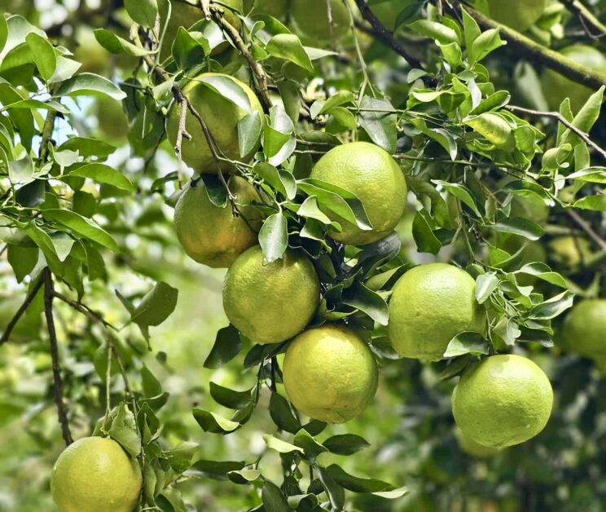
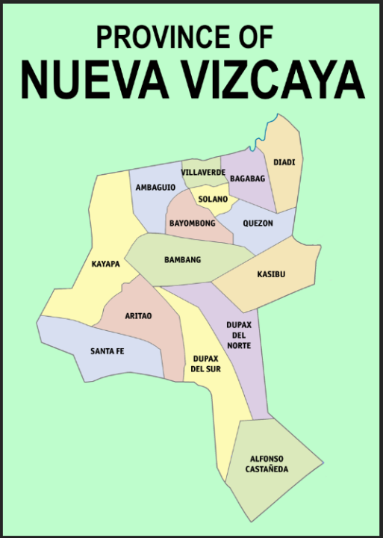
WHY CITRUS
GROWKITA | 03
Start local. Prove value. Then scale.
Citrus gives GrowKita a focused first market.
Build a local, crop-specific AI dataset
PERANTE ORANGES ON TREE
NUEVA VIZCAYA
Paste a clear local citrus photo
PASTE A SIMPLE
PROVINCE MAP HERE
Work with nearby farms and agricultural partners
Prove farmers will pay for yield insights
LOCAL CROP. LOCAL DATA. LOCAL PROOF.
First product: citrus yield intelligence.
Notes:
Nueva Vizcaya's Perante orange focus makes this a practical local entry point.
[Sources]
- PROJECT_OVERVIEW.md (local crop focus)

Slide 4
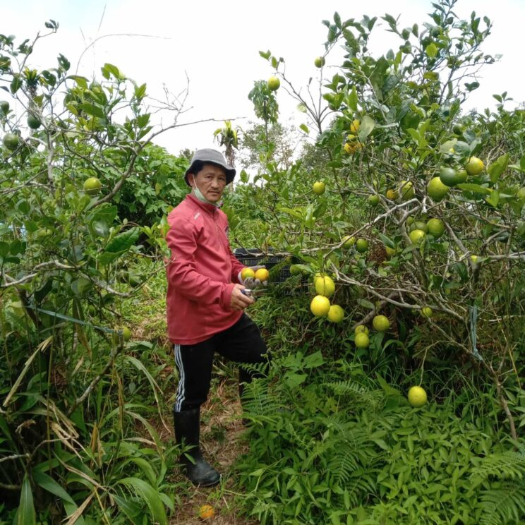
THE PROBLEM
GROWKITA | 04
Before harvest, farms are forced to estimate.
Farms need earlier answers to three costly questions.
How much fruit can we expect?
WORKER INSPECTING FRUIT TREE
How many workers should we prepare?
Paste a real field-inspection photo
What volume can we commit to buyers?
Manual counting is slow, inconsistent, and difficult across many trees.
Notes:
The issue is not that farmers lack information. They lack timely, consistent information at the scale needed for planning.

Slide 5
THE SOLUTION
GROWKITA | 05
A scan becomes a harvest estimate.
GrowKita sells a decision-ready report, not simply a drone flight.
Guided scan
AI detection
Farm report
Better plan
Scan the citrus
farm block
Detect visible
fruit in images
Yield estimate
and farm map
Harvest, labor,
packing, and sales
The early workflow is operated or supervised by GrowKita to protect data quality.
Notes:
The product is a useful report and planning insight. The drone is how we collect consistent evidence.

Slide 6
WHAT THE FARM RECEIVES
GROWKITA | 06
A report a farm can act on.
Clear outputs for a better harvest decision.
Estimated visible fruit count
DASHBOARD SCREENSHOT
Map by farm block
Paste your actual project dashboard or mockup
Areas needing a manual check
Scan history for seasonal comparison
VISIBLE FRUIT-COUNT ESTIMATE
Be precise: results are a visible fruit-count estimate, not a guaranteed total harvest.
Notes:
Honesty builds trust: leaves and branches can hide fruit, so we use the phrase visible fruit-count estimate.

Slide 7
BUSINESS MODEL
GROWKITA | 07
Start with a service. Grow into a platform.
NOW
NEXT
LATER
Paid farm scan
Seasonal monitoring
Managed on-site system
We operate or supervise
the scan and report.
Repeat scans, history,
and comparison reports.
Guided farm-staff scans
with software and support.
Initial price tests
Pilot: PHP 1,500-3,000 | Farm/block scan: PHP 5,000-15,000 | Large/co-op/custom: PHP 20,000+
Prices are hypotheses to validate against operating cost and customer willingness to pay.
Notes:
We begin with paid results because that keeps quality under our control.
Seasonal monitoring is the repeat-revenue goal.

Slide 8
WHY WE CAN WIN
GROWKITA | 08
Our advantage is the system, not the drone.
Perante orange dataset, farm maps, repeat scan history, and the NVSU agricultural network create a local advantage.
Local data
AI model
PERANTE CITRUS OR FIELD TEST PHOTO
Use a real project or local farm image
LOCAL
SYSTEM
Field workflow
Trusted partners
Notes:
Anyone can buy a drone. The defensible asset is local data plus a repeatable workflow that produces useful reports.

Slide 9
DATA FLYWHEEL
GROWKITA | 09
Every permissioned scan improves the system.
Customer trust turns data collection into a compounding product advantage.
More farm scans
Trusted data
Better citrus AI
Better reports
Real-world images
and scan conditions
Quality-checked data
with clear consent
Improved detection
and evaluation
More useful insight
and repeat customers
Farm-identifiable data stays protected. Any aggregate insight product requires clear consent.
Notes:
We do not build a business by reselling a farm's private records.
With consent, data improves the AI. Later, aggregated and anonymized insights may serve co-ops, buyers, and agricultural organizations.

Slide 10
GROWTH PATH
GROWKITA | 10
Citrus first. Farm intelligence next.
Prove paid citrus scans
Build seasonal monitoring
Enable guided farm-staff scans
Run paid pilots for the next crop
1
2
3
4
Nueva Vizcaya
Repeat reports
Software + support
Research + controlled environments
DO NOT BUILD EVERY CROP SOLUTION AT ONCE
Expand only after the first use case is paid and repeatable.
Notes:
The platform is scalable because the workflow repeats, but we expand only after the first market is working.

Slide 11
Our next step: prove value with local farms.
We are seeking
TEAM AND PROTOTYPE PHOTO
Pilot citrus farms or cooperatives
Paste a real field-test or team photo
Agricultural mentors and validation partners
Support for field testing, data collection, and model improvement
SUCCESS = A farm uses our report to make a better harvest decision and pays to use it again.
Notes:
We are asking for a chance to prove a useful local product with measurable farm value.

Slide 12
The future of farming
will not be guessed.
It will be measured.
CLOSING BACKGROUND PHOTO
Paste a real citrus-farm sunrise or team field-test image
GROWKITA
AI-powered farm intelligence, starting in Nueva Vizcaya.
Notes:
This is an original GrowKita closing statement.
End on the mission: local data, AI, and practical automation for better farm decisions.

