Slide 1
Natural Language Processing
Week 1
J. R. R. Tolkien project 1
Group members: Adilya Korkmaz , Vladyslav Stupak, Daniil Zykov

Slide 2
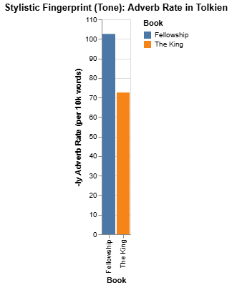
Stylistic Fingerprint:
Adverb Use
Using "spaCy" Python module we measured Adverb Use Rates in each book and compared them.

Slide 3
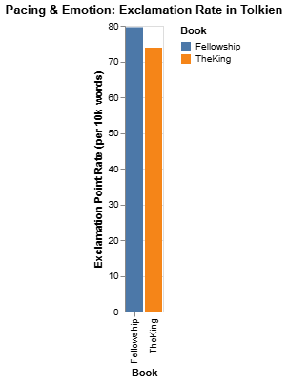
Pacing & Emotion:
Exclamation Rate
We researched the amount of emotional sentences in both books and if the tone shifts from the first book to third.

Slide 4
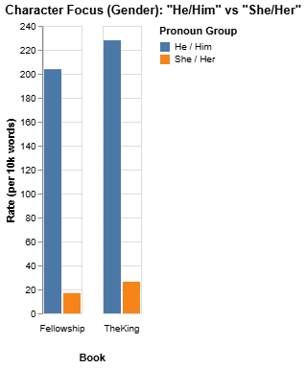
Character Gender:
Use of Pronouns
Considering the time, when the trilogy was written we decided to research name and pronoun use in these books to see which characters are more frequent, male or female.

Slide 5
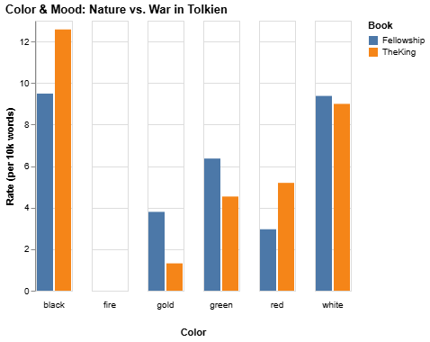
Change of Color and Mood Throughout the Trilogy
We decided to look at the tone shift from the first book to the third. How does the mood change and which colors appear more in which book.

Slide 6
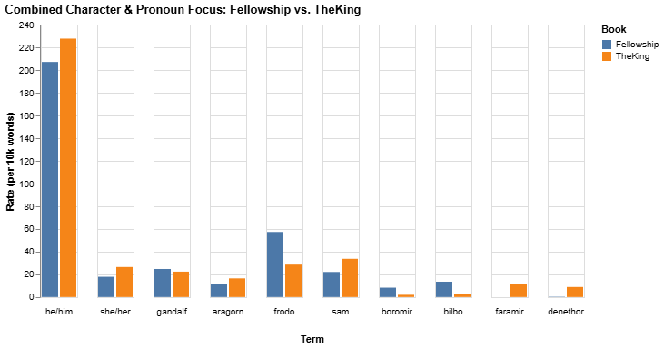
Own research task:
Character & Pronoun Focus
We compared the how the author addresses the characters in both books, comparing the number of pronouns to the names.

Slide 7
Thank you for your attention

