Slide 1
Spatial

Slide 2
Introduction
Research question

Slide 3
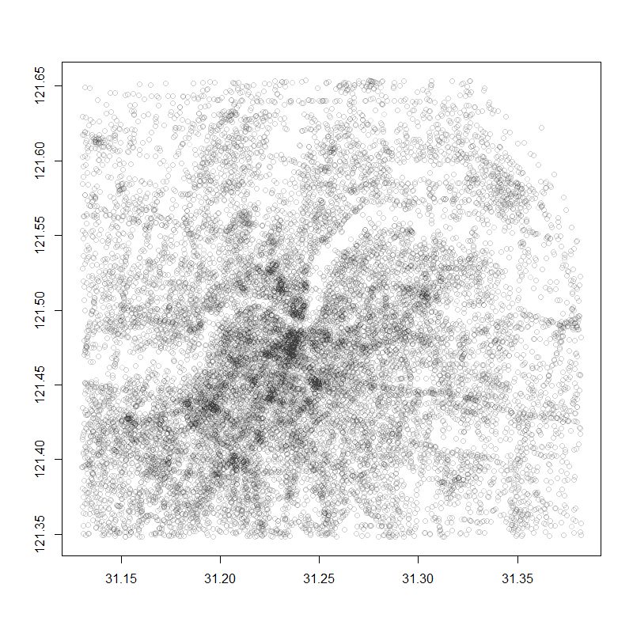
Data manipulation
Data description

Slide 4
Exploratory Data Analysis
Surf plot
Histogram
Qq plot
Box plot
Summary statistisc

Slide 5
Spatial trend
Longitude
Lattitude
Regression on coord
Box-cox

Slide 6
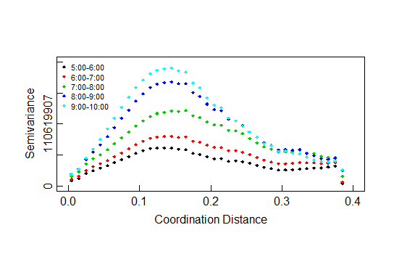
Semivariogram

Slide 7
Semivariogram
Anisotropy

Slide 8
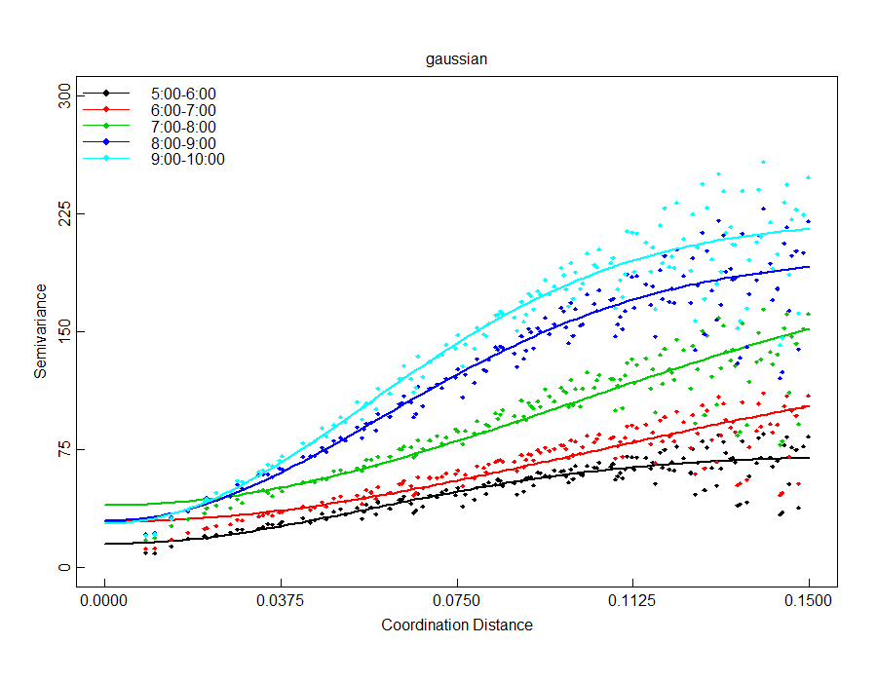
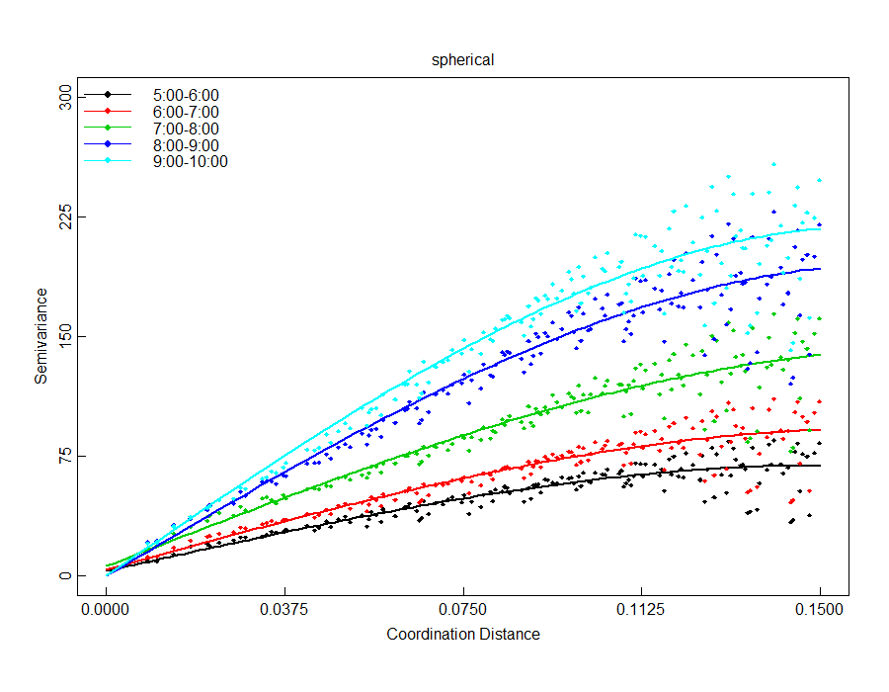

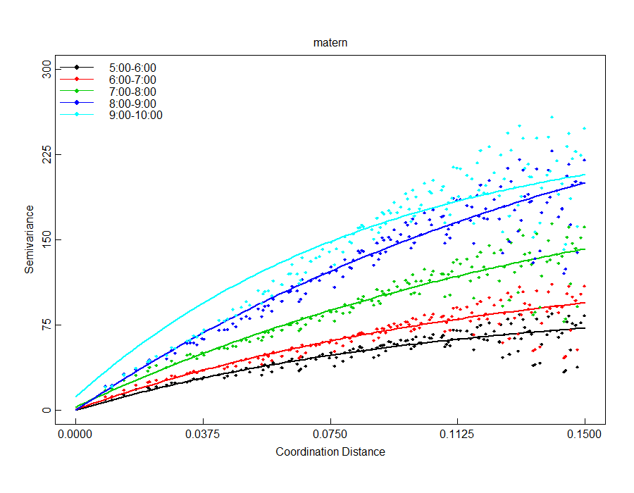

Model fitting—semivariogram fitting

Slide 9
AIC BIC
Summary table

Slide 10
Prediction
Image vs
Semivariog pred
MLE pred

