Slide 1
Spatial pattern of population movement during morning peak hours
STAT 5544 Final Report
Wenyu Gao, Danni Lu
Dec.1st, 2016

Slide 2
Contents
Introduction
Exploratory Data Analysis
Spatial Trend
Anisotropy
Model Fitting
Prediction
Conclusion

Slide 3
Contents
Introduction
Exploratory Data Analysis
Spatial Trend
Anisotropy
Model Fitting
Prediction
Conclusion

Slide 4
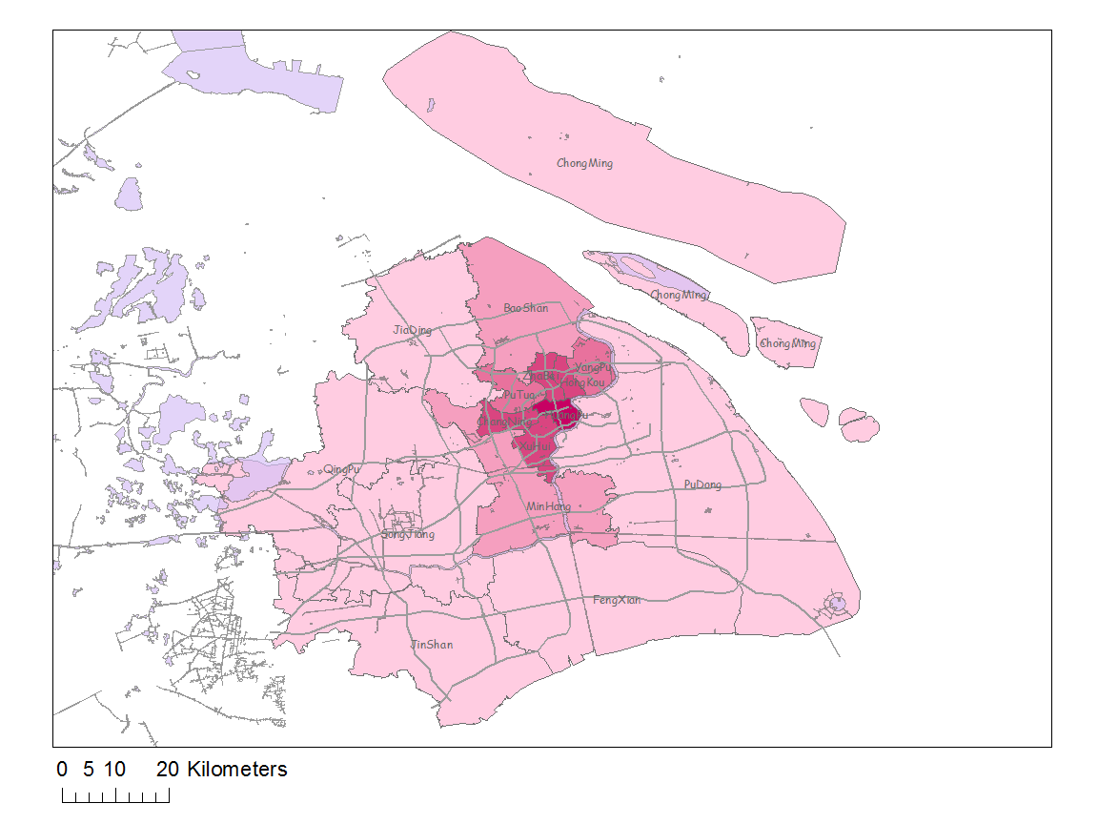
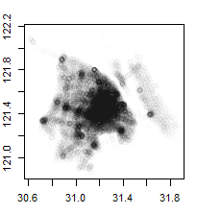

Introduction
Data source
Shanghai
Cell Tower Data
Area
• Municipality 6,341 $km^{2}$
Population (2015)
• Municipality 24 million
• Rank 1st in China
• Density 3,800/$km^{2}$
Cell towers: 37,450
Density: 5.91 /$km^{2}$
Time: consecutive 24 hour
Records: 1.1 billion (80 GB )
Notes:
the most populous city in China^{[9][10]} as well as the most populous city proper in the world.^{[11]} with a population of more than 24 million as of 2014.^{[12]} It is a global financial centre,[

Slide 5
Introduction
Original Dataset
Privacy
Records are anonymized
Records are aggregated by areal unit and time period
No personal information is involved and displayed

Slide 6
Introduction
Research question
Where do people go during morning rush hours?
How does the pattern change over time ?

Slide 7
Contents
Introduction
Exploratory Data Analysis
Spatial Trend
Anisotropy
Model Fitting
Prediction
Conclusion

Slide 8
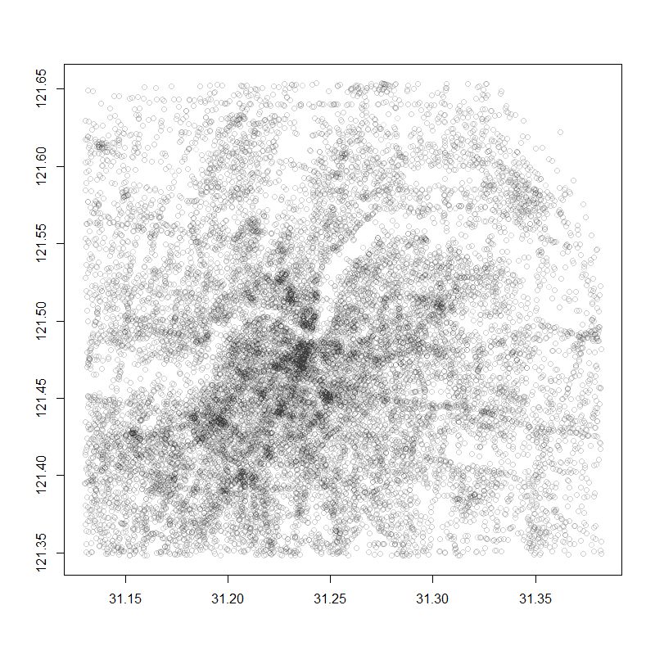
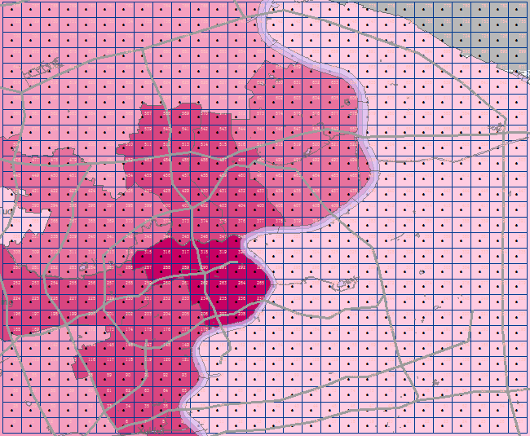
Exploratory Data Analysis
Data aggregation
Urban area
28*28 grid
each areal unit is one square kilometer

Slide 9
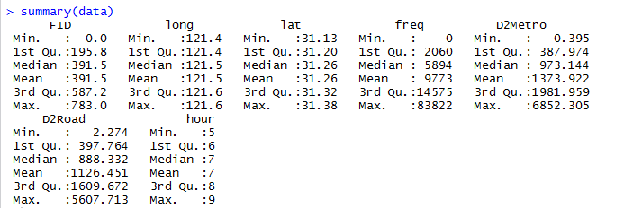
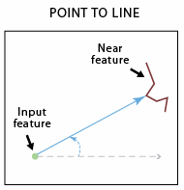
Exploratory Data Analysis
Data aggregation
Calculate more covariates:
Distance to metro line
Distance to expressway
Longitude Latitude Density
D2Metro D2Road Hour

Slide 10
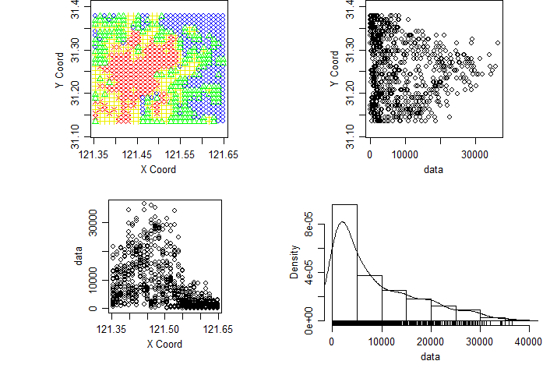
Exploratory Data Analysis
Population density at 5:00-6:00 am

Slide 11
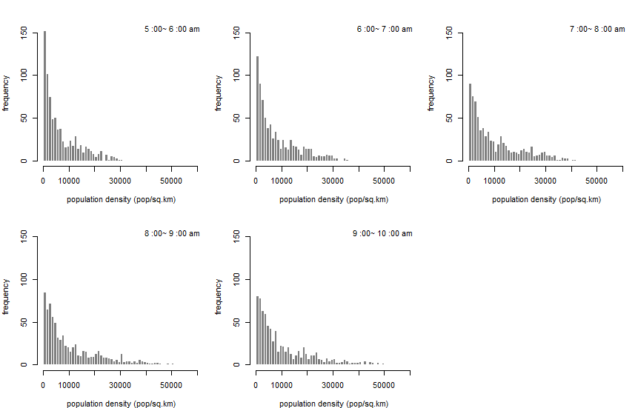
Exploratory Data Analysis
Population density at each hour
 | Min. | 1st Qu. | Median | Mean | 3rd Qu. | Max.
5:00-6:00 | 0 | 1378 | 4217 | 7003 | 11200 | 33550
6:00-7:00 | 0 | 1849 | 5322 | 8421 | 13430 | 36390
7:00-8:00 | 0 | 2452 | 6940 | 10550 | 16050 | 47720
8:00-9:00 | 0 | 2588 | 7033 | 11440 | 16990 | 68800
9:00-10:00 | 0 | 2554 | 6772 | 11450 | 17050 | 83820

Slide 12
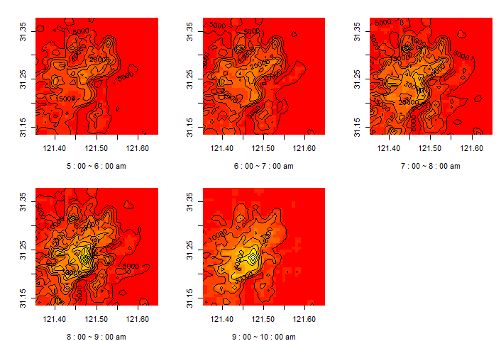
Exploratory Data Analysis
Population density at each hour
Image Plot
Surface Plot
(appendix)

Slide 13
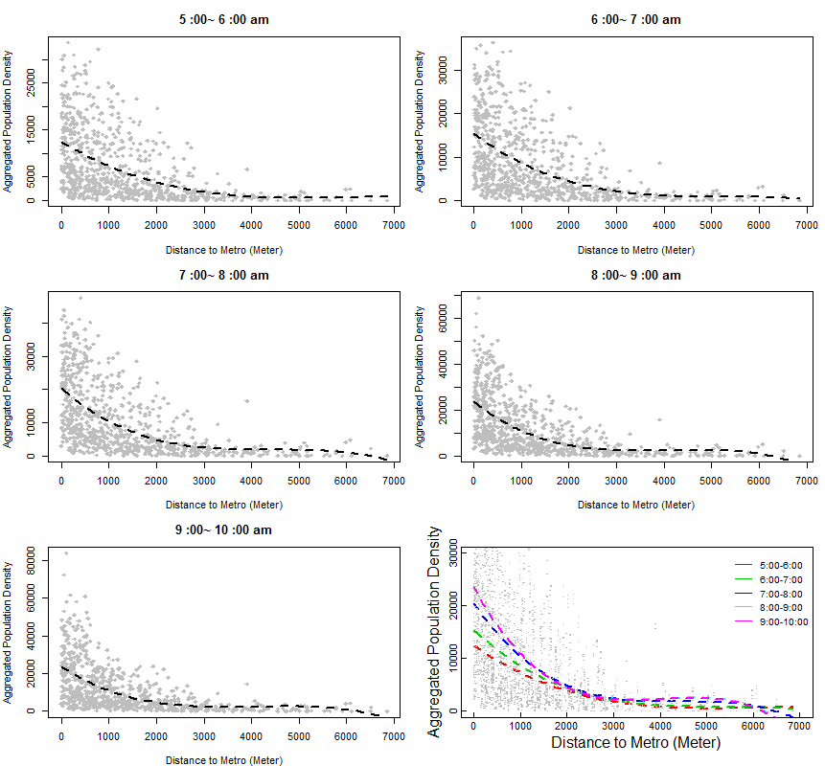
Exploratory Data Analysis
Covariates – Distance to Metro Line

Slide 14
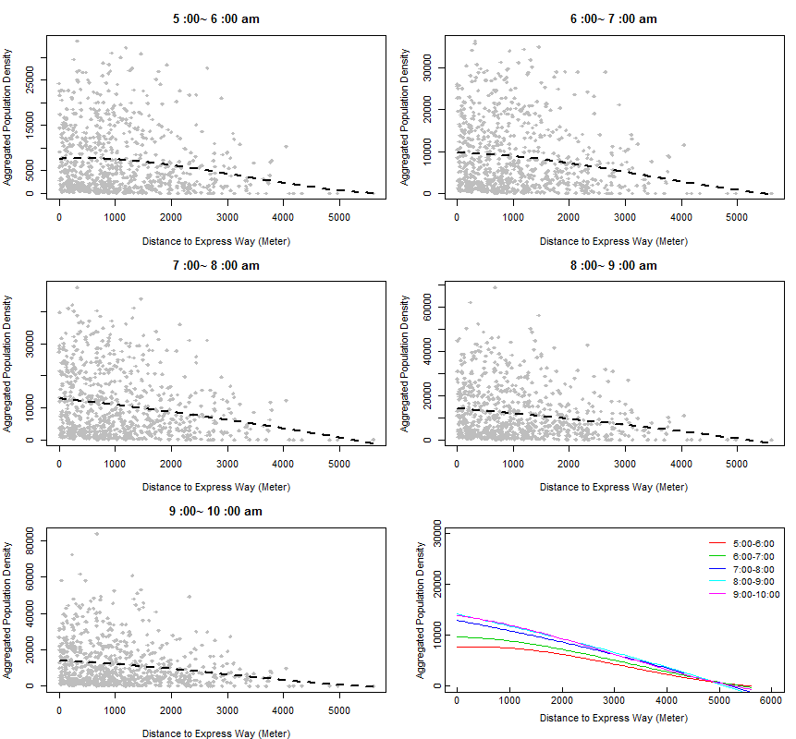
Exploratory Data Analysis
Covariates – Distance to Expressway

Slide 15
Contents
Introduction
Exploratory Data Analysis
Spatial Trend
Anisotropy
Model Fitting
Prediction
Conclusion

Slide 16
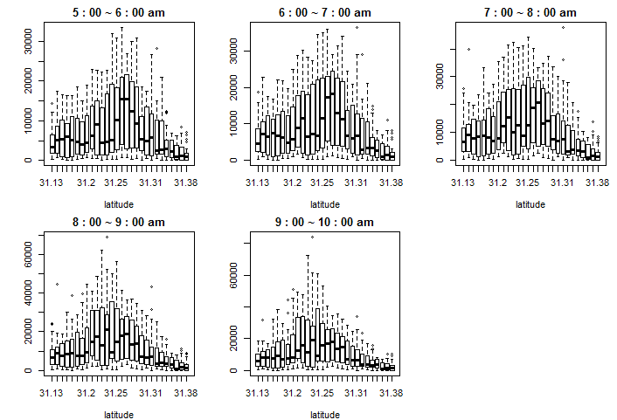
Spatial trend
Latitude

Slide 17
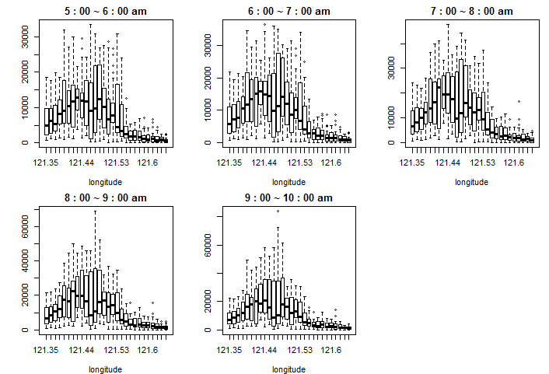
Spatial trend
Longitude

Slide 18
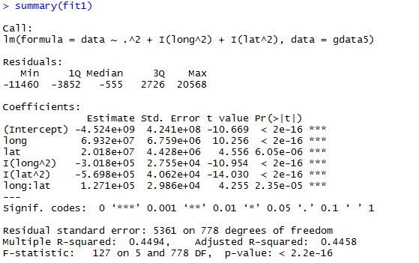
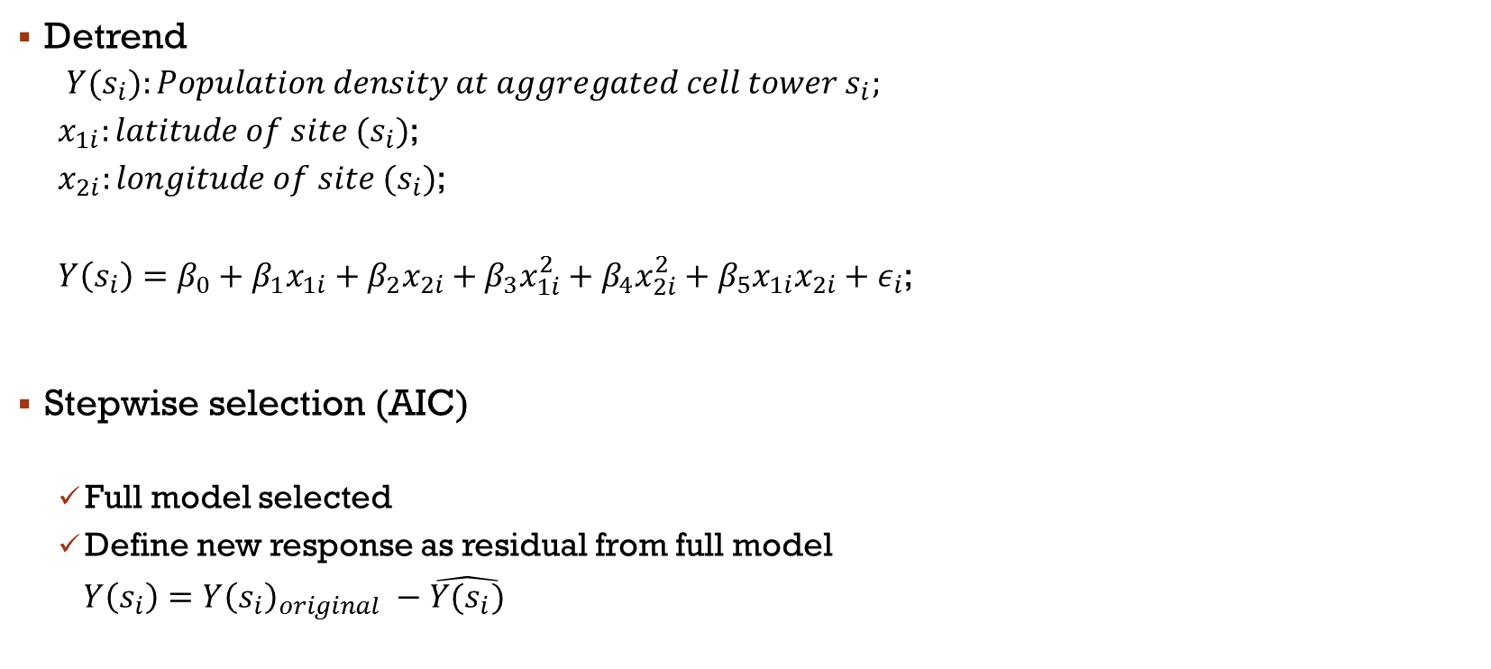
Spatial trend
Detrend
${Y(s}_{i}):Population density at aggregated cell tower s_{i};$
$x_{1i}:latitude of site (s_{i})$;
$x_{2i}:longitude of site (s_{i})$;
$Y\left(s_{i}\right)=β_{0}+β_{1}x_{1i}+β_{2}x_{2i}+β_{3}x_{1i}^{2}+β_{4}x_{2i}^{2}+β_{5}x_{1i}x_{2i}+ε_{i}$;
Stepwise selection (AIC)
Full model selected
Define new response as residual from full model
$Y\left(s_{i}\right)=Y{\left(s_{i}\right)}_{original} −\hat{Y(s_{i})}$

Slide 19
Contents
Introduction
Exploratory Data Analysis
Spatial Trend
Anisotropy
Model Fitting
Prediction
Conclusion

Slide 20
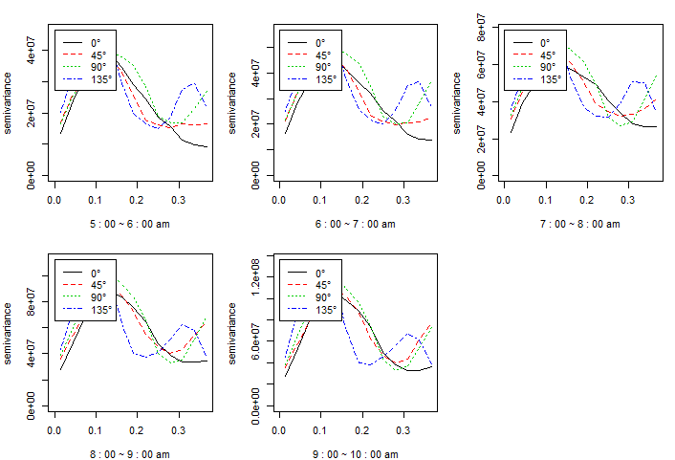
Anisotropy
Directional
semivariogram

Slide 21
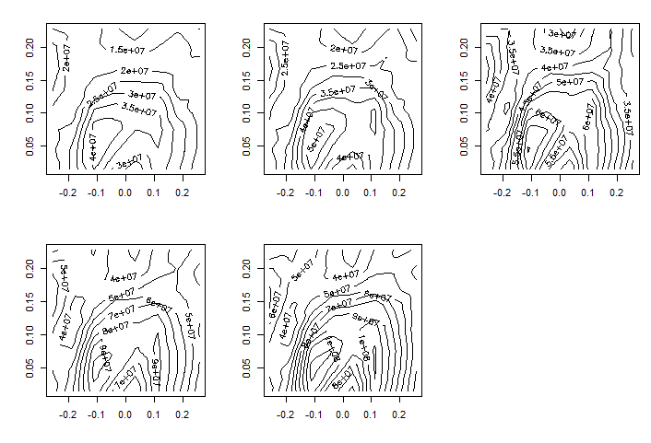
Anisotropy
Contour Plot

Slide 22
Contents
Introduction
Exploratory Data Analysis
Spatial Trend
Anisotropy
Model Fitting
Prediction
Conclusion

Slide 23
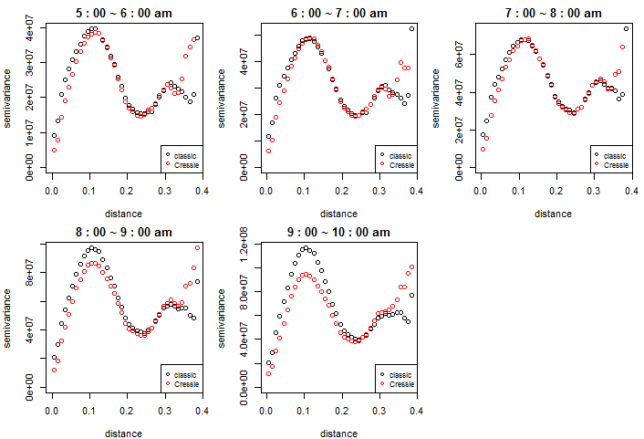
Model Fitting
Semivariogram
Classical & Cressie

Slide 24
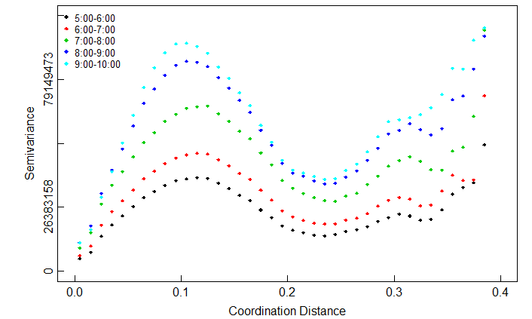
Model Fitting
Semivariogram
28 km
(about 40 km)

Slide 25
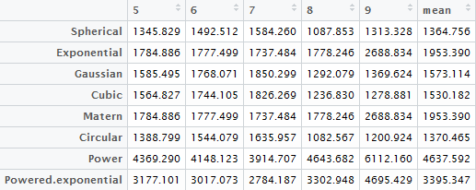
Model fitting
Semivariogram fitting – WLS with Cressie weight
Residuals for fitted model:

Slide 26
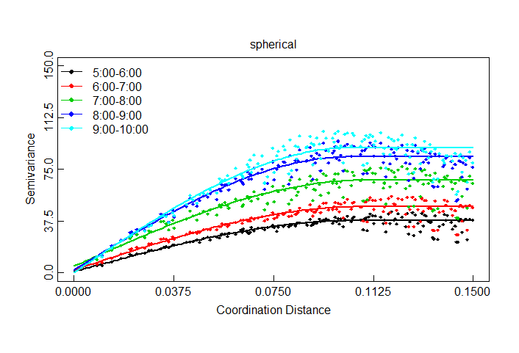
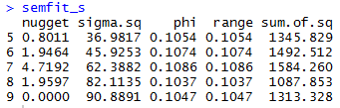
Model fitting
Semivariogram fitting – WLS with Cressie weight
Spherical model:

Slide 27
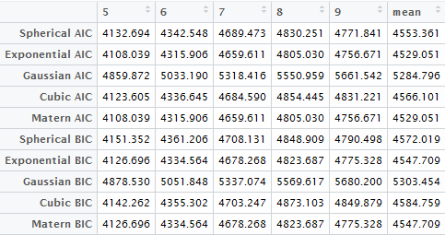
Model fitting
Likelihood method
AIC and BIC for fitted model:

Slide 28
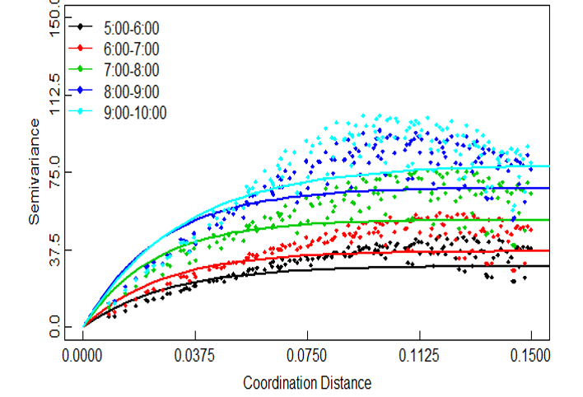

Model fitting
Likelihood method
Exponential and Matern model:

Slide 29
AIC BIC
Summary table

Slide 30
Contents
Introduction
Exploratory Data Analysis
Spatial Trend
Anisotropy
Model Fitting
Prediction
Conclusion

Slide 31
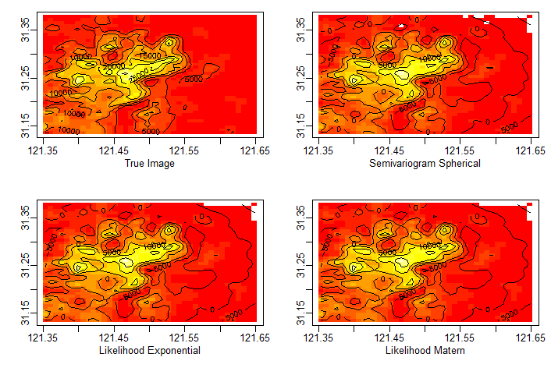
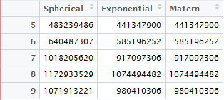
Prediction

Slide 32
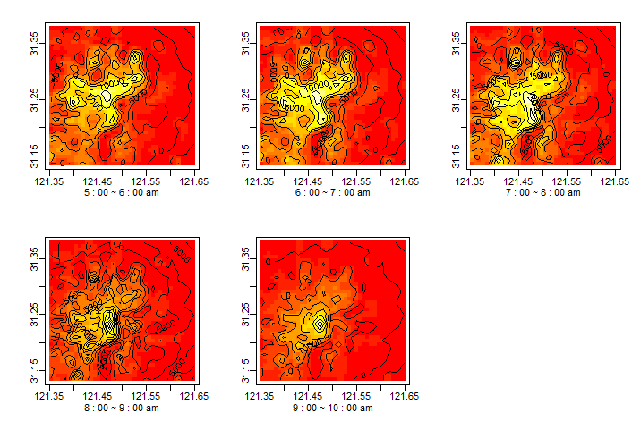
Prediction
Image vs
Semivariog pred
MLE pred

Slide 33
Contents
Introduction
Exploratory Data Analysis
Spatial Trend
Anisotropy
Model Fitting
Prediction
Conclusion

Slide 34

Spatial pattern of population movement during morning peak hours
Thank You!
STAT 5544 Final Report
Wenyu Gao, Danni Lu
Dec.1st, 2016

Slide 35
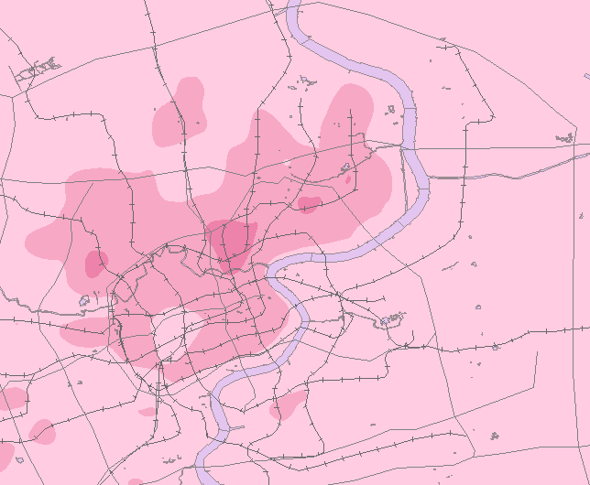
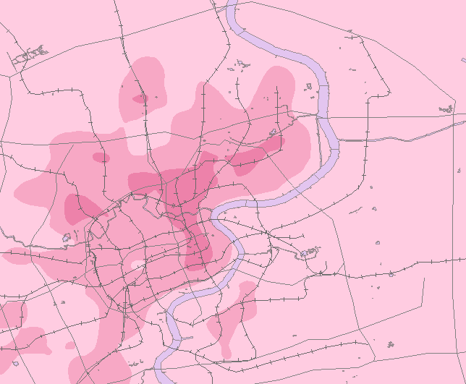
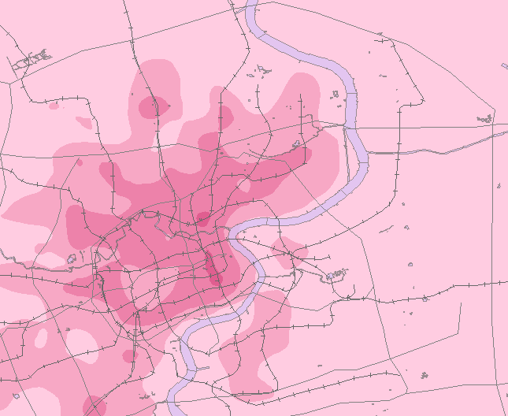
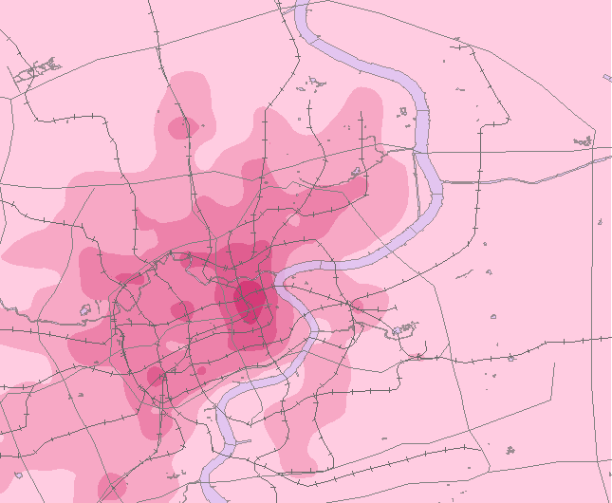
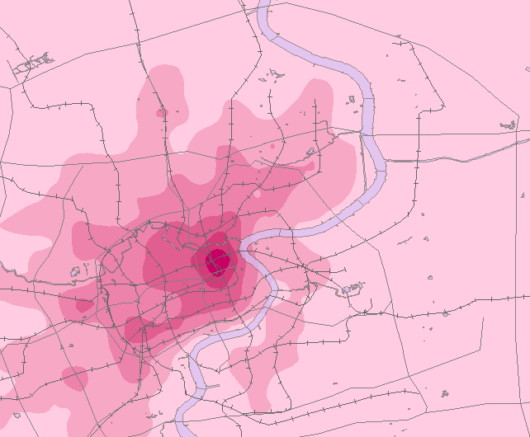
5:00~6:00 6:00~7:00 7:00~8:00
8:00~9:00 9:00~10:00

Slide 36
5:00~6:00 6:00~7:00 7:00~8:00
8:00~9:00 9:00~10:00

Slide 37
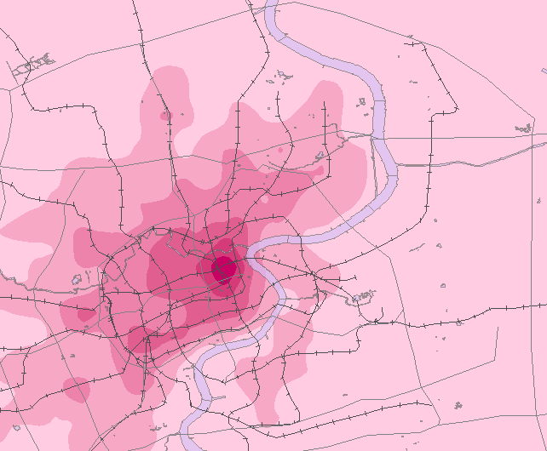

Slide 38
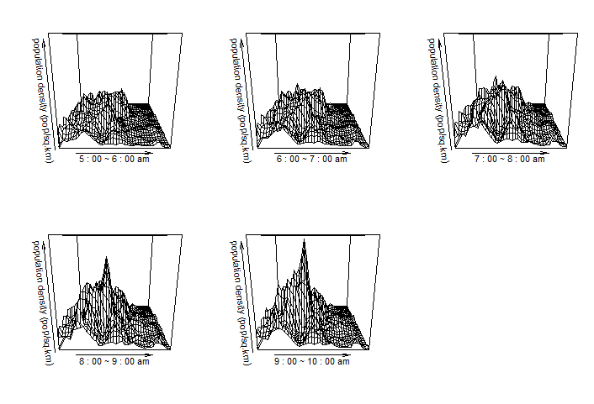
Appendix

