Slide 1






$$x(n)$$
Far-end Talker
Adaptive
Filter
Real
Echo
Path
$$x’(n)$$
$$y(n)$$
$$e(n) = d(n) – y(n)$$
+
$$d(n)$$
+
$$v(n)$$
Near-end Talker

Slide 2
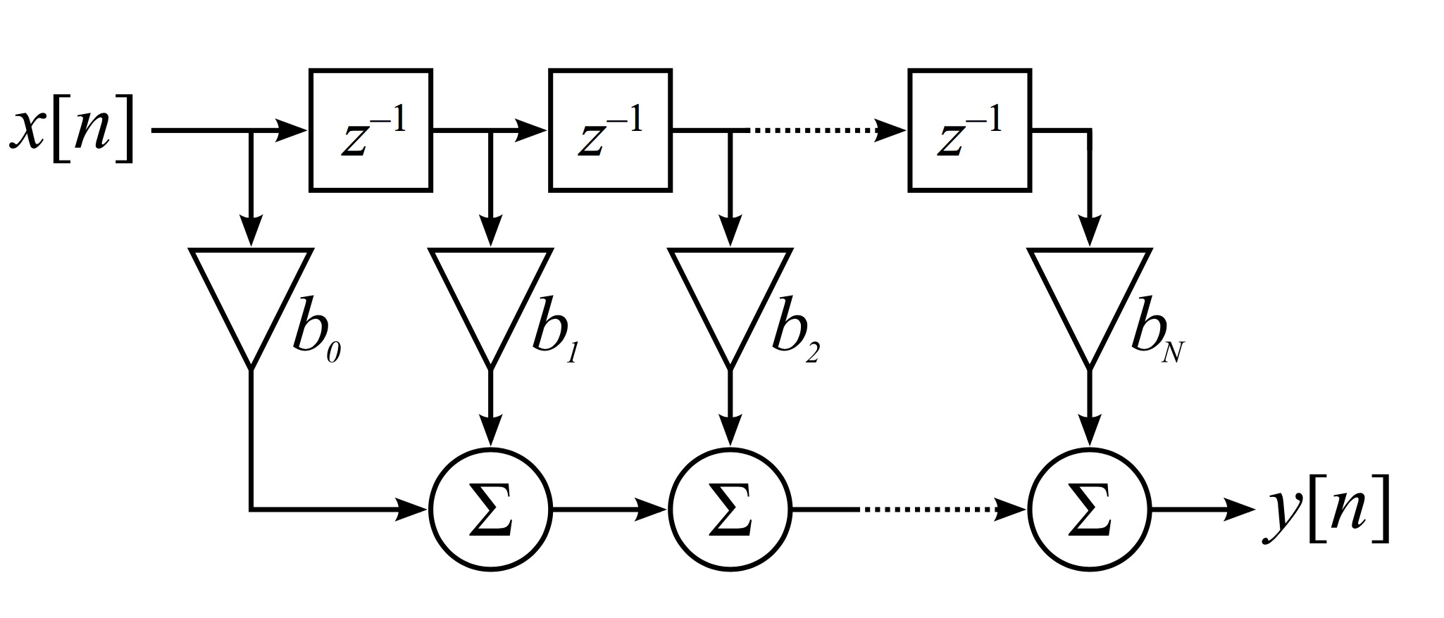




$$w_{2}$$
$$w_{3}$$
$$w_{M}$$
$$w_{1}$$

