Slide 1
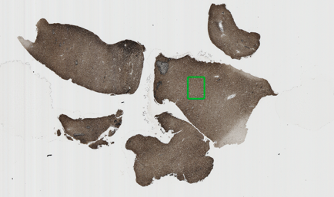
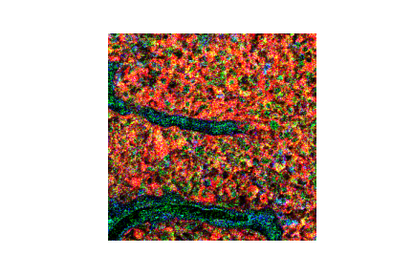
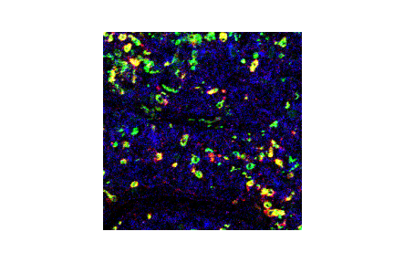
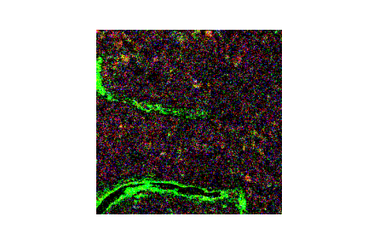
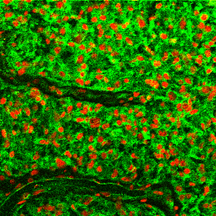
Hyperion: pixel-level mass cytometry for multiplexed protein profiling
UV laser
Mass Cytometer
Data Acquisition
Nuclei
Membrane
CD44
CD11c
CD4
CD16
CD163
PD-L1
CD8
CD31
PD-1

Slide 2
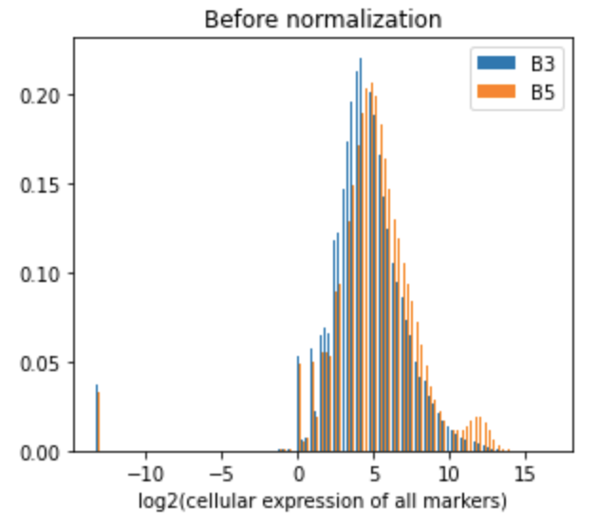
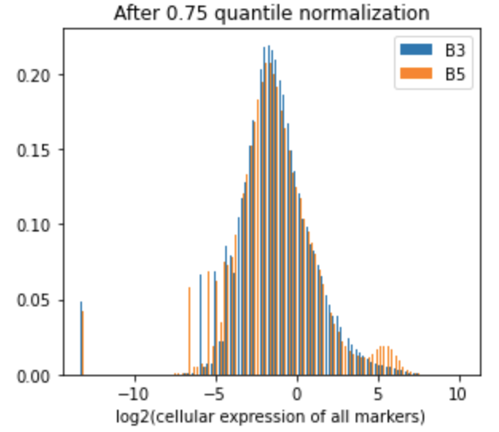
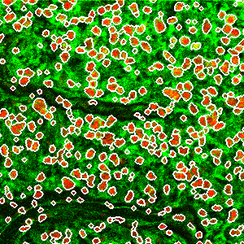
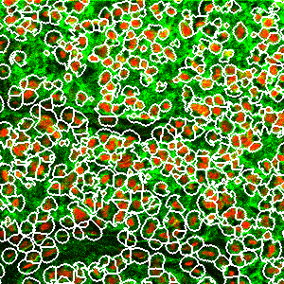
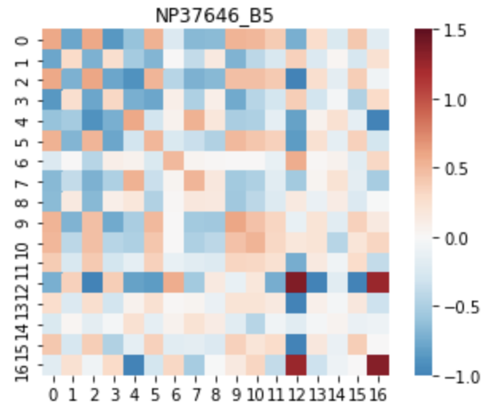
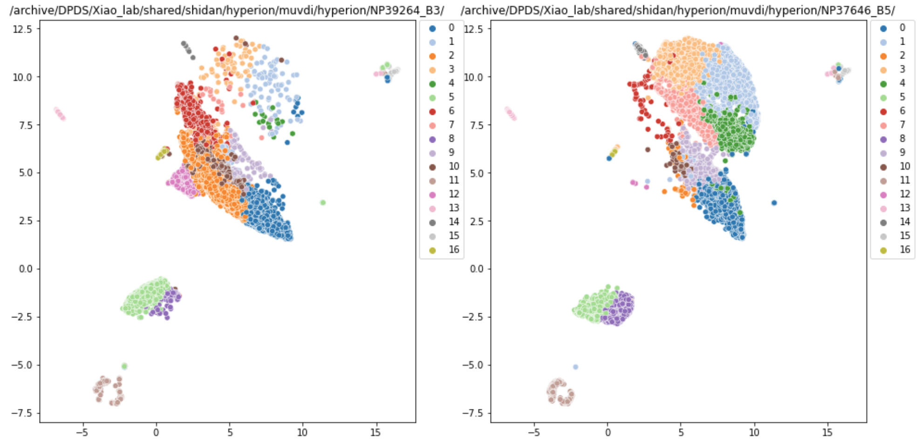
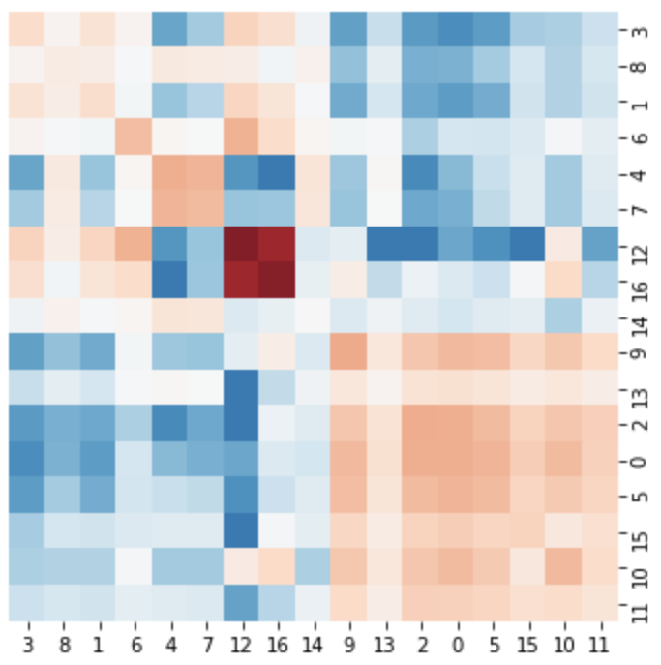
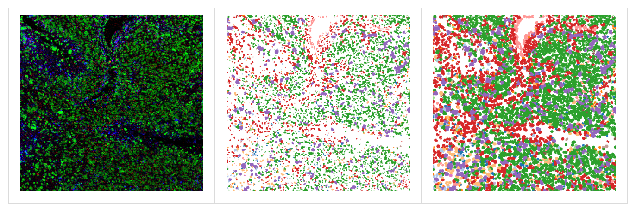
Pipeline (1) for phenograph analysis
1. Nuclei and cell segmentation
2. Expression level quantification
3. Normalization
6. Interaction analysis
5. Mapping back
4. Phenograph

Slide 3
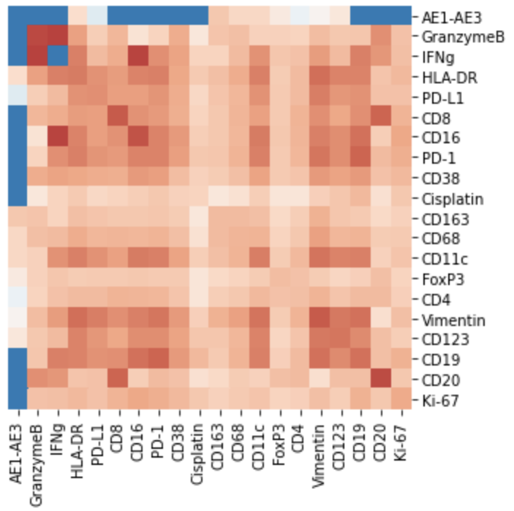
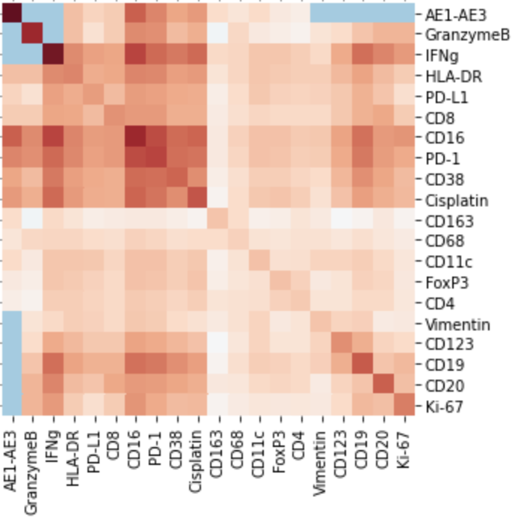
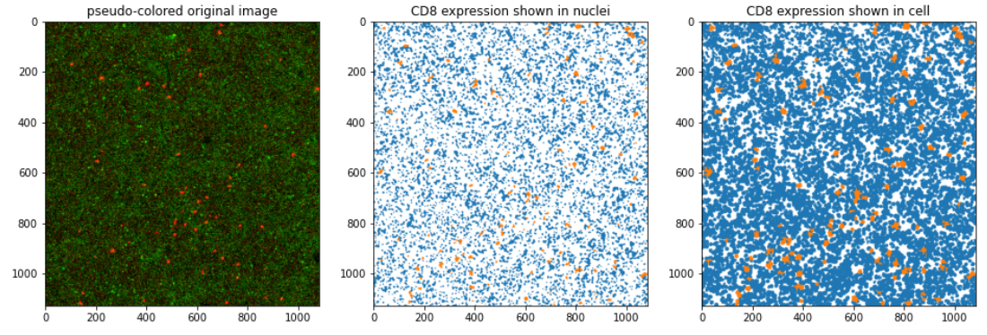
Pipeline (2) for marker-positive cells analysis
1. Nuclei and cell segmentation
2. Expression level quantification
3. Normalization
6. Interaction analysis
5. Co-expression analysis
4. Positive cell identification

