Slide 1
ECE 528 Project
By: daniel pUGA

Slide 2
Project Overview
Project:
Load Strain Gauge Motor Control
Goal:
Create an interface between a load strain gauge sensor to control a motor
Devices:
Zybo Z7-10 SoC FPGA
HX711 Load Cell Amplifier
DFR0601 Motor Driver

Slide 3
System Architecture
ZYBO Z7-10 FPGA
Serial Communication between firmware logic and ADC component
Used to develop PWM signal to control motor based on sensor’s readings
Load Cell Amplifier (ADC)
Used for serial communication between FPGA to send Load Strain Gauge sensor’s value when being loaded via ADC component
DFR0601 Motor Driver (PWM switching)
Used for switching the motor at a specific speed based on PWM signal’s duty cycle

Slide 4
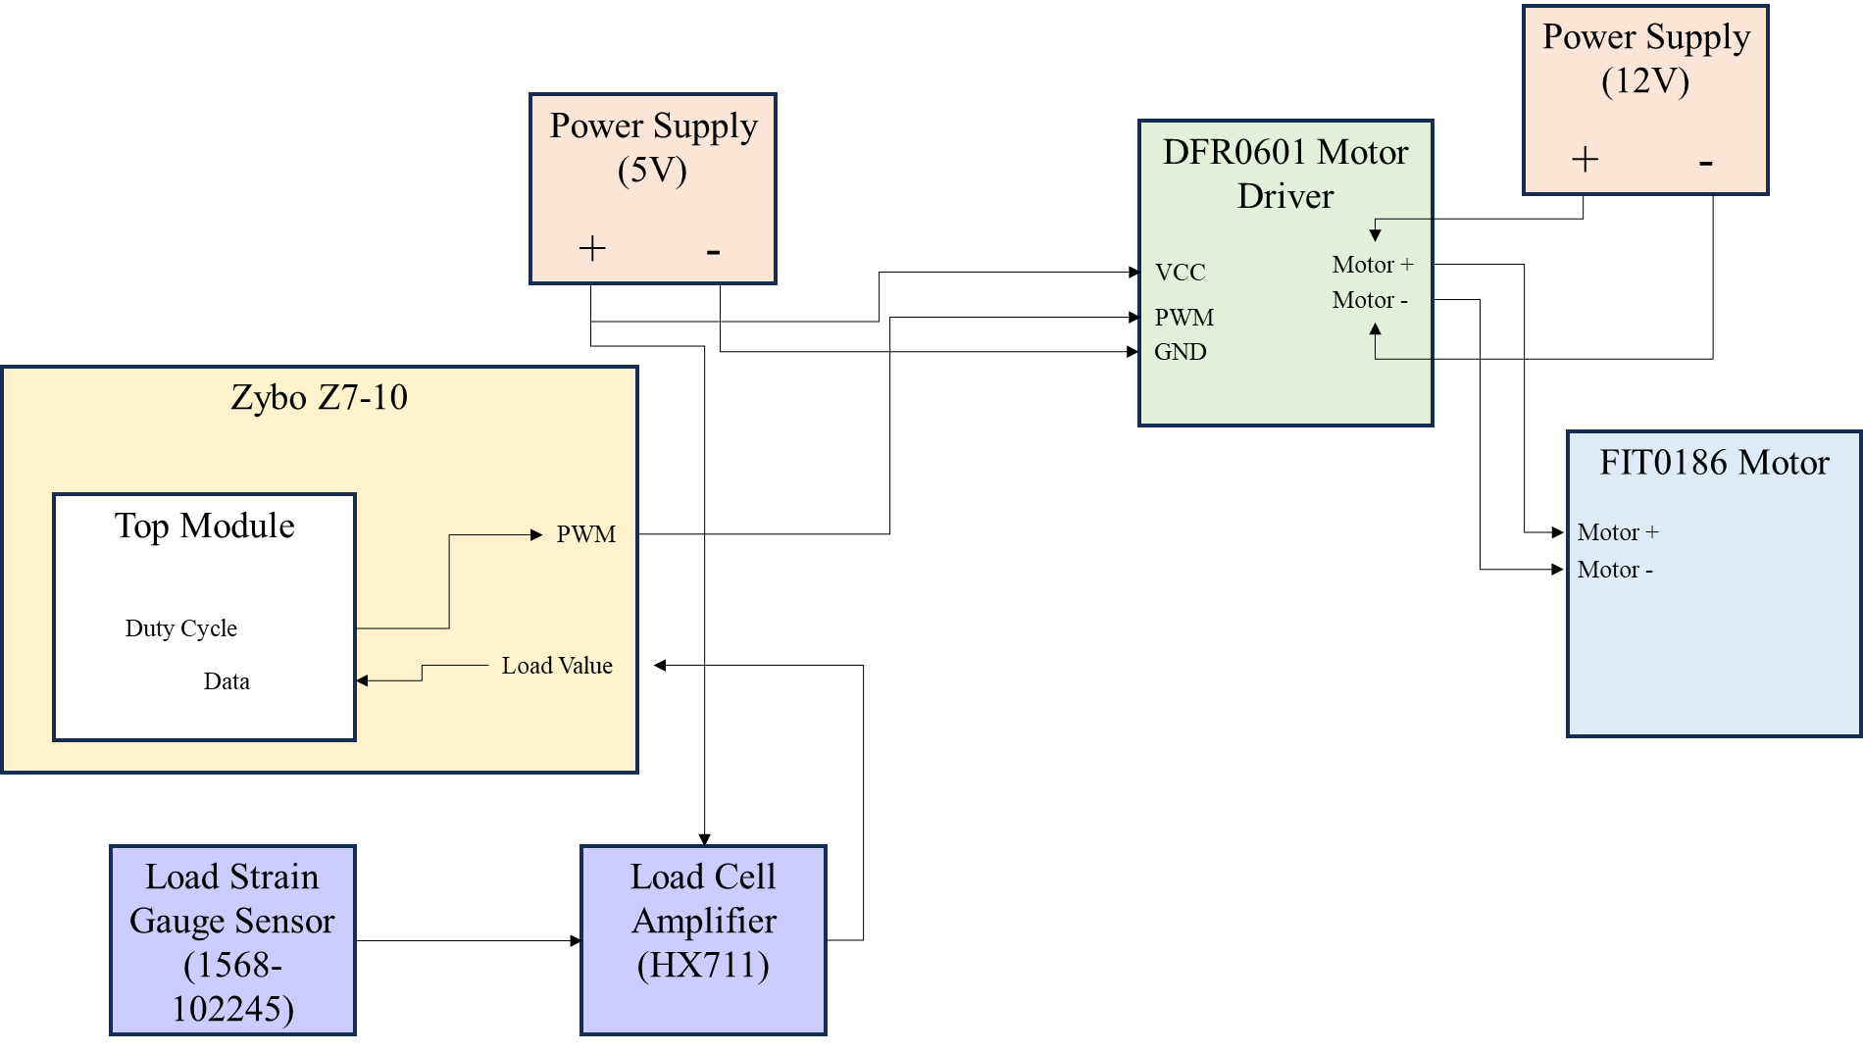
Interfaces and Peripheral used
FPGA Pin | Name
V12 | PWM
+3.3V | VDD
H15 | DAT
V13 | PD_SCK
GND | GND
K17 | CLK

Slide 5
Verification and testing
Designed top module in VHDL to interface with submodules for PWM and serial communication
Created testbenches to verify the functionality of modules
Interfaced with hardware to test firmware

Slide 6
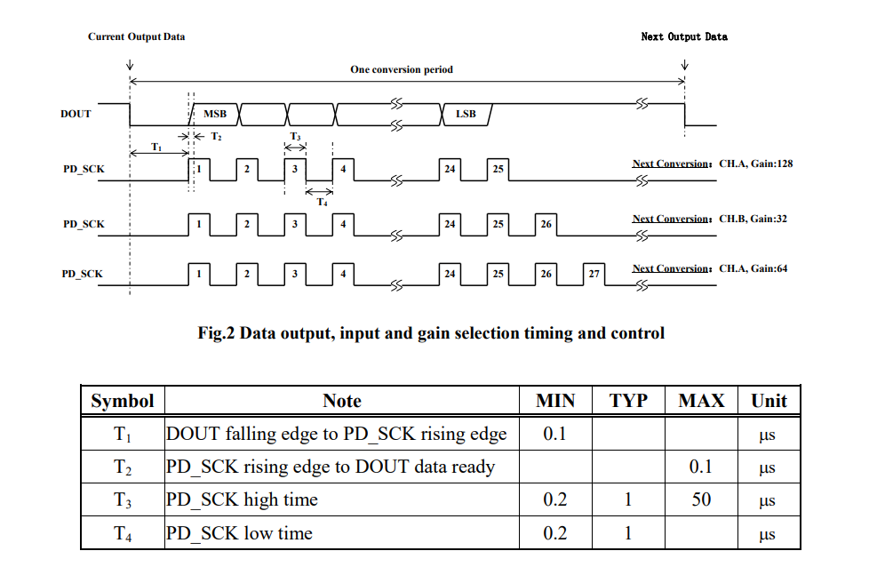
ADC Datasheet

Slide 7
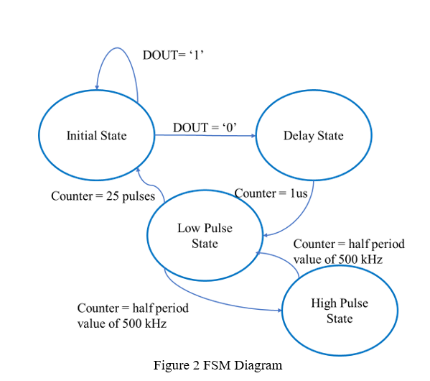
ADC FPGA FSM Logic

Slide 8
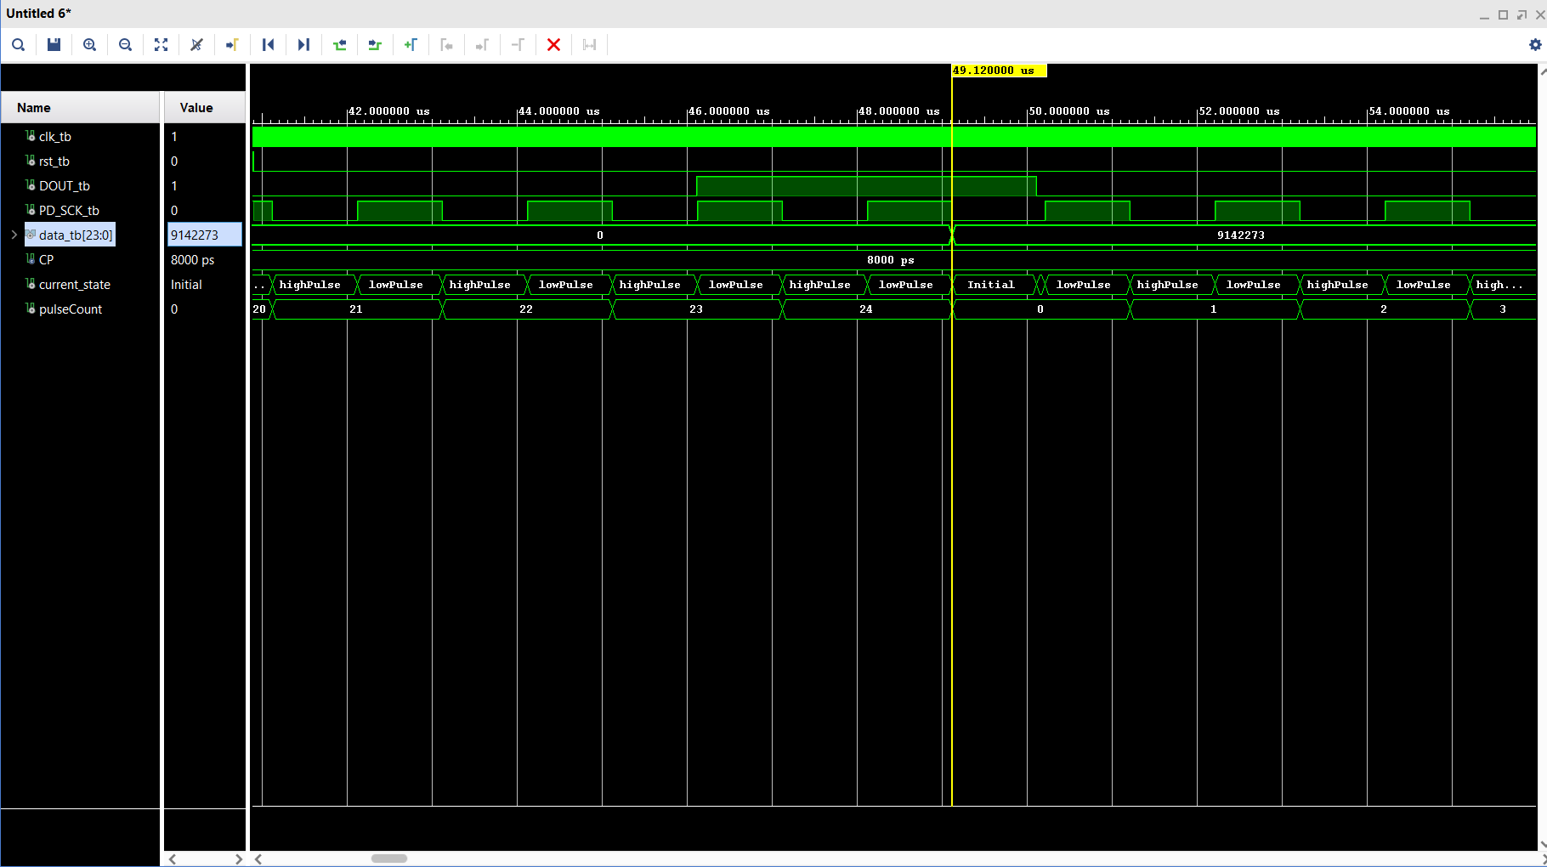
ADC FPGA Simulation

Slide 9
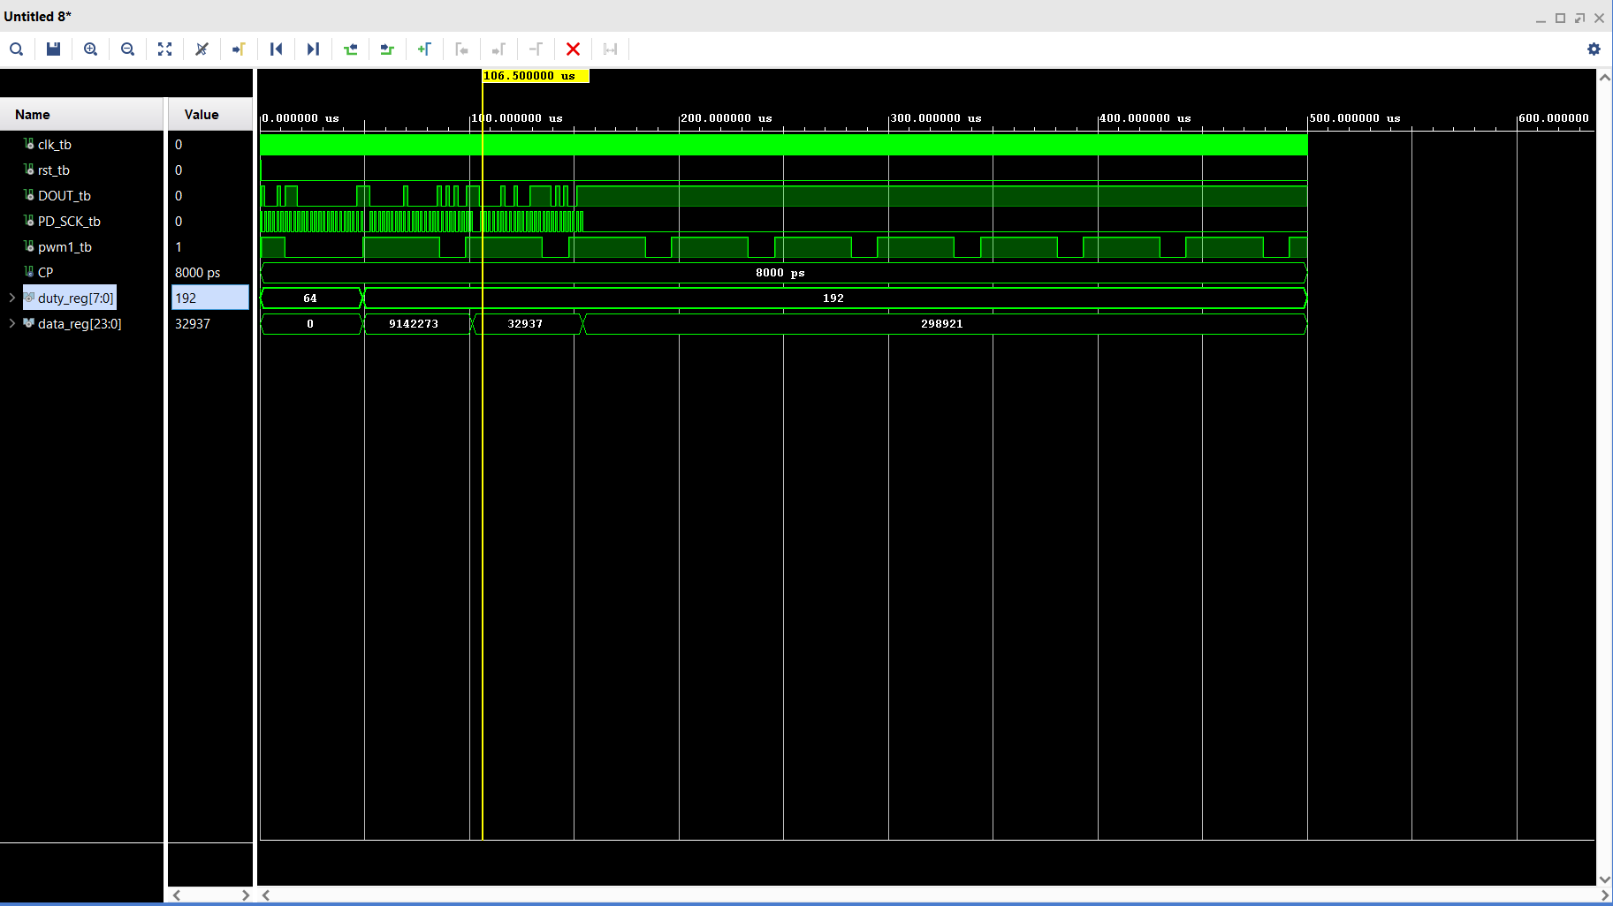
Top Module simulation

Slide 10
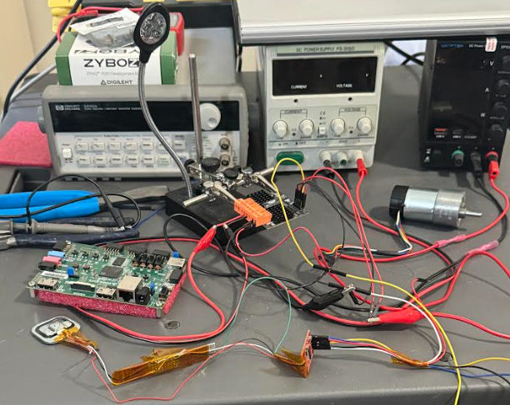
Hardware sETUP

Slide 11
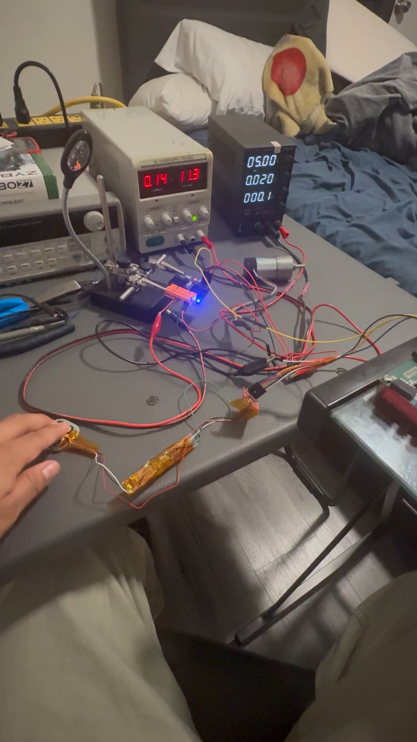
VIDEO

Slide 12
Conclusion
Accomplished interface between load strain gauge sensor and motor via firmware logic
Challenges encountered was creating a finite state machine for serial communication
Learned more about serial communication protocols

Slide 13
References
https://mm.digikey.com/Volume0/opasdata/d220001/medias/docus/864/Load_Cell_Amp_HX711_HookupGuide.pdf
https://cdn.sparkfun.com/assets/b/f/5/a/e/hx711F_EN.pdf
https://digilent.com/reference/programmable-logic/zybo-z7/start?__cf_chl_tk=FnIjEIdsYphcOEP8PRRqJPGqR0DndaE4oR6BzCgPU5U-1774497152-1.0.1.1-o7kanW2yYK6V37WnRpZVQU34.7h7d2R0aiotLLyNNqc

