Slide 1

King County Dataset AIML Assignment 2
Name: Dannon (P1922503)
Class: DIT/2A/14

Slide 2
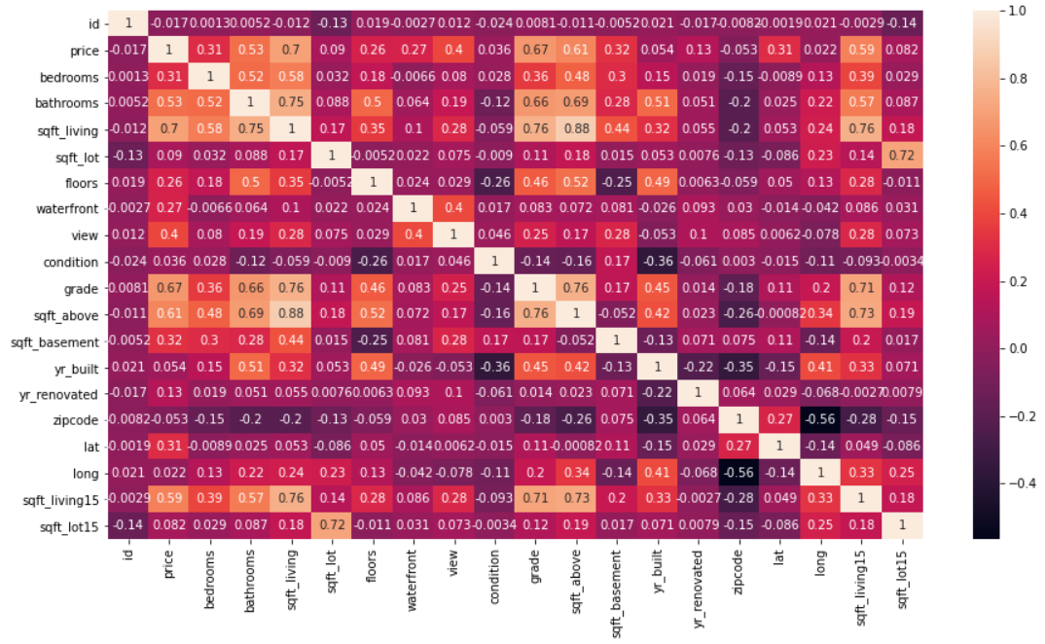
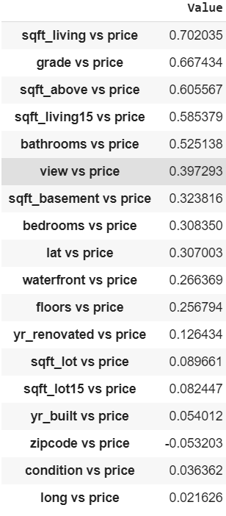
EDA
Fig 1
Fig 1
Heatmap to show the correlation between features
Sqft_living and sqft_above have a very high correlation of 0.88
Fig 2
Dataframe using Pearsonr for clearer comparison
Sqft_living has the highest correlation to price (0.70)
Fig 2

Slide 3
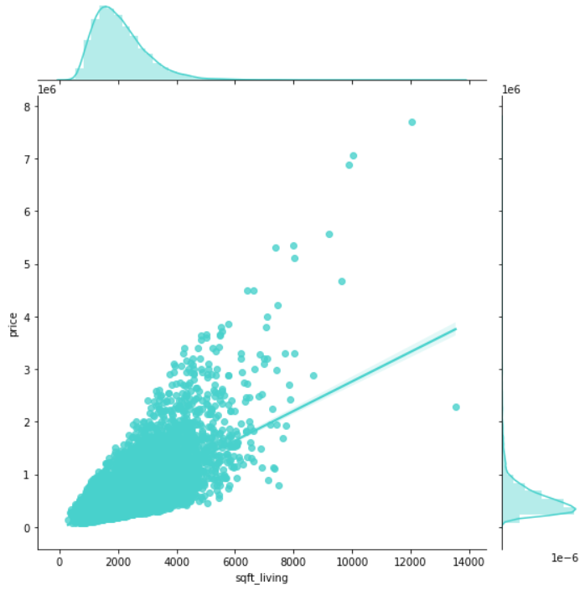
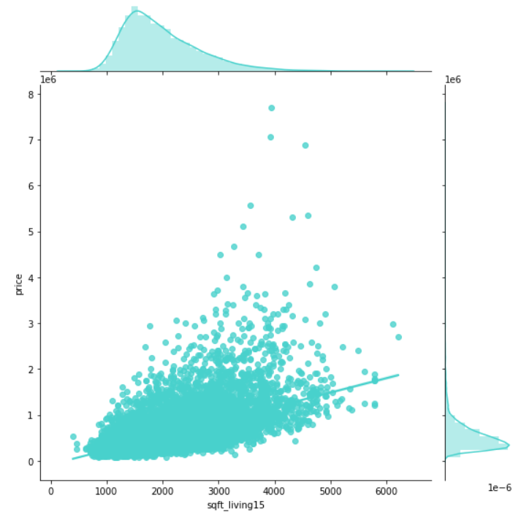
EDA
Fig 3
Fig 3 (sqft_living vs price)
Sqft_living and price have a high positive correlation with each other
Both variables are positively-skewed
Fig 4 (sqft_living15 vs price)
Sqft_living15 and price have a high positive correlation with each other
Sqft_living15 is positively-skewed
Fig 4

Slide 4
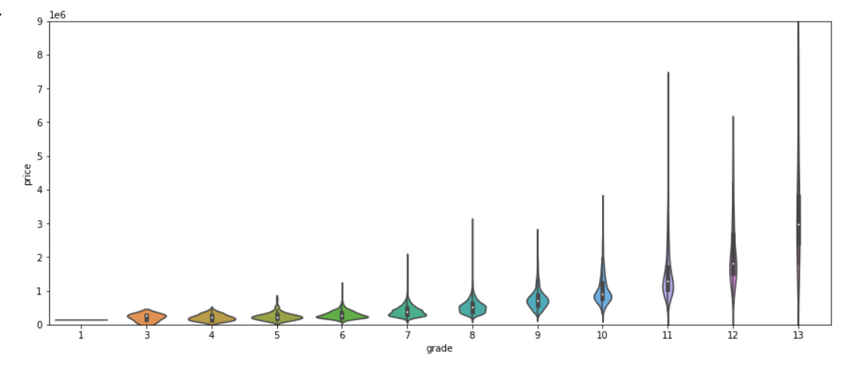
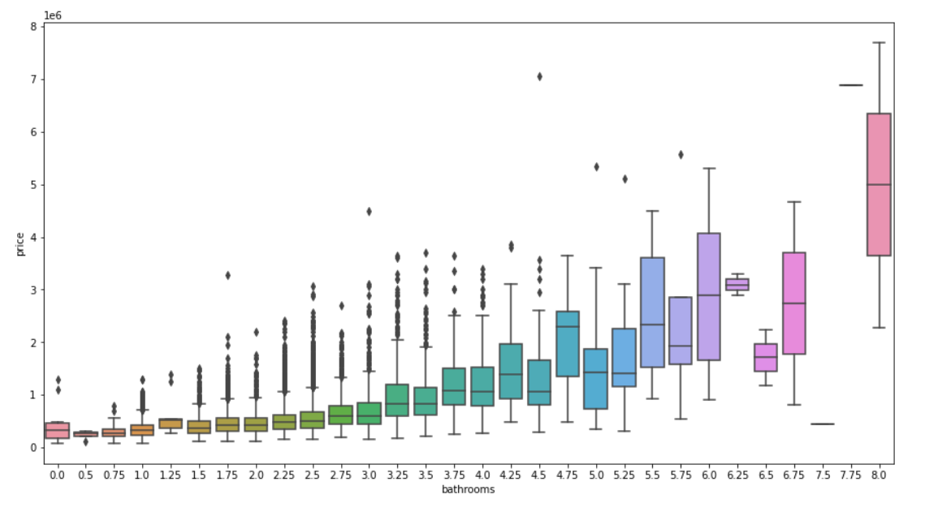
EDA
Fig 5
Fig 5 (grade vs price)
The median price increase as the grade increases
Grade of 13 has the largest range of prices
Fig 6 (Bathrooms vs price)
Houses with 1.0 to 4.5 bathrooms have many outliers
Bathrooms that are 7.5 and 7.75 have the smallest range of prices
Fig 6

Slide 5
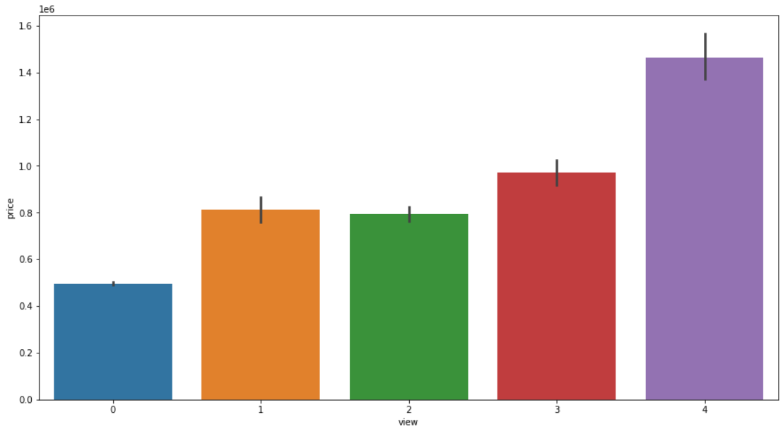
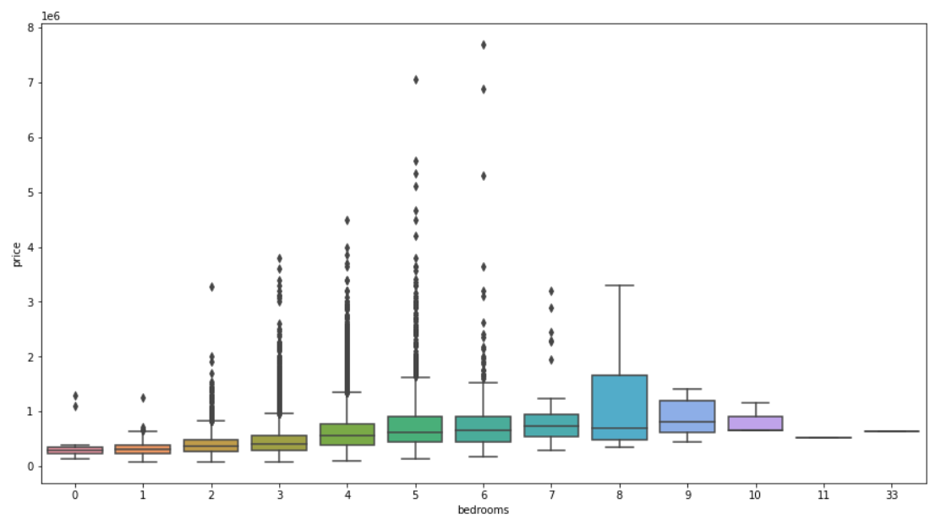
EDA
Fig 7
Fig 7 (view vs price)
Houses with view of 4 have the highest summed price
Houses with view of 1 have the least summed price
Fig 8 (bedrooms vs price)
Houses with 3 to 7 bedrooms have many outliers
Houses with 8 bedrooms have the largest price range
The house with 33 bedrooms is most likely a wrong value
Fig 8

Slide 6
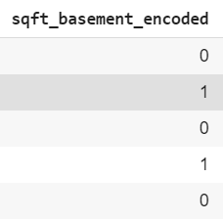
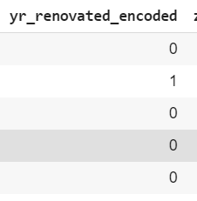
Data Preparation & Feature Engineering
Creating data for training
Sqft_basement was changed to 0 and 1 (no or yes) to indicate of the house has a basement or not
Yr_renovated was changed to 0 and 1 (no or yes) to indicate if the house was ever renovated
The row which has 33 bedrooms is dropped from the data as it is most likely an error and there is enough data to afford dropping it
The price and sqft_living were normalised with np.log as they are very skewed
Sqft_living was chosen instead of using above and basement as it has the highest correlation to price.
Sqft_living15, sqft_above and sqft_basement were dropped to avoid multicolinearity

Slide 7
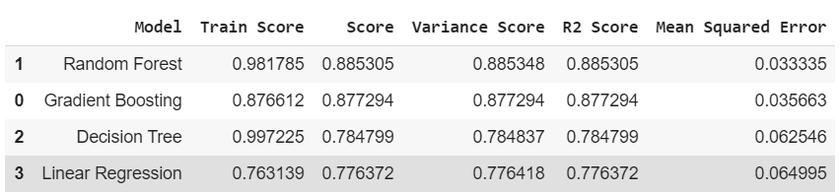
Training and Scoring Models
R2 Scores
The models used are Random Forest, Gradient Boosting, Decision Tree and Linear Regression
Random Forest has the highest R2 score of 0.885305
Linear Regression has the lowest R2 score of 0.776418

Slide 8
Hyperparameter Tuning
Parameter Tuning
Used GridSearchCV to find the best parameters
Used Kfold with 10 splits
R2 score of Gradient Boosting Regressor increased to 0.900
R2 score of Random Forest Regressor increased to 0.8858
R2 score of Decision Tree Regressor increased to 0.8438
Decision Tree had the largest improvement of around 0.06

Slide 9
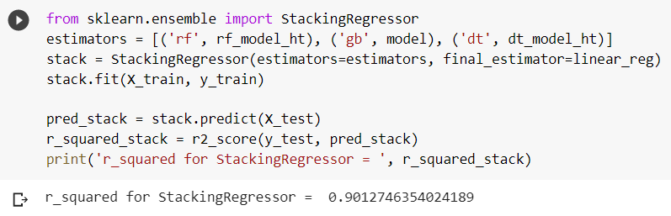
Ensemble
StackingRegressor
Stacked the tuned models of Random Forest, Gradient Boost and Decision Tree on Linear Regression model using StackingRegressor
The R2 score of the StackingRegressor increased to 0.901, which is a slightly better score than the tuned Gradient Boosting Regressor (0.900)

Slide 10
Conclusion
EDA is useful for finding correlations between each feature
Hypertuning Parameters can increase the performance of models
Using ensemble methods such as StackingRegressor, where the strength of each model used increases its performance, can improve the R2 score as well

