Slide 1
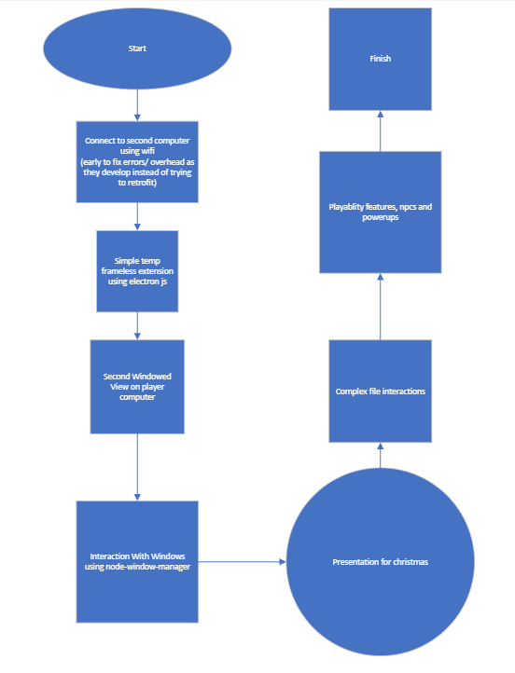
Original Plan
Get 2 machines connected
Make the frameless extension
Use the built in desktop capturer to send video to the other moniter
Get in depth in functionality

Slide 2
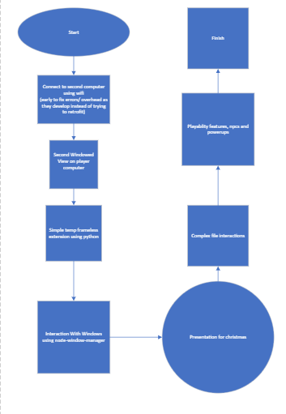
Actual timeline
I got 2 machines connected
Tried using Desktop capturer and had a sequence of issues I suspect were related to electon version
Switched and tried to use a VM with Apache Quacamole
Had issues with VM setup and connecting to the Apache Server
Switched the project to python and sent the screen via a jpg
Implemented basic functionality

Slide 3
System Architecture
The project is structured around two components that communicate over the network.
- One component broadcasts visual updates.
- The other reconstructs and displays them.
- Control inputs flow back in the opposite direction.
This creates a real‑time feedback loop.

Slide 4
Video Streaming
A continuous stream of visual data is sent between machines.
To reduce bandwidth usage, only changed regions are transmitted when possible.
The receiver blends these regions into the previous frame, maintaining smooth visuals.

Slide 5
Control System
User input is translated into compact messages.
Movement, interactions, and actions are encoded numerically.
The remote host interprets these messages to update the state.
Timers and rules help prevent jitter and maintain consistent behavior.

Slide 6
Overlay & Interaction Logic
A visual overlay represents the interactive element.
Animation states change depending on movement, actions, or physics.
Elements on the screen can act as platforms or boundaries.
The logic ensures smooth transitions, grounding behavior, and interaction rules.

Slide 7
Future Plans
Improve Frame Rate issues
More animations
Specific file interactions (spreadsheets, text, etc)
Powerups / enemies

