Slide 1





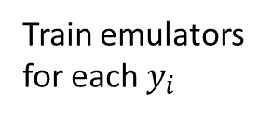

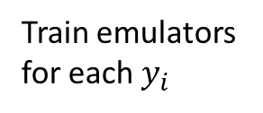








$${ D}_{y_{1,}1}^{1}$$
If there is bimodality for $y_{1},$split $D^{1}$
$${ D}^{1}$$
$${ D}_{y_{1,}2}^{1}$$
$${ D}_{y_{2,}1}^{1}$$
Train emulators
for each $y_{i}$
If there is bimodality for $y_{2},$split $D^{1}$
$${ D}_{mode 1}^{ }$$
$${ D}_{y_{2,}2}^{1}$$
…
Collate data for
each mode
$$D$$
Split D into unique
parameter sets
$${ D}_{y_{1,}1}^{2}$$
$${ D}^{2}$$
If there is bimodality for $y_{1},$split $D^{2}$
$${ D}_{y_{1,}2}^{2}$$
$${ D}_{mode 2}^{ }$$
Train emulators
for each $y_{i}$
…
…

