Slide 1
Software Nomina
Johann S. Martinez Gonzalez
Hector D. Fernandez Colon

Slide 2
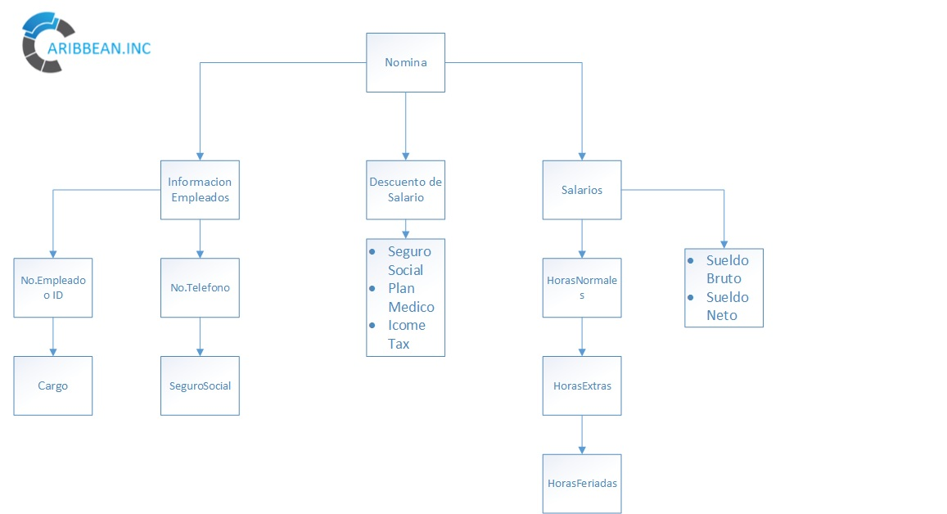

Slide 3
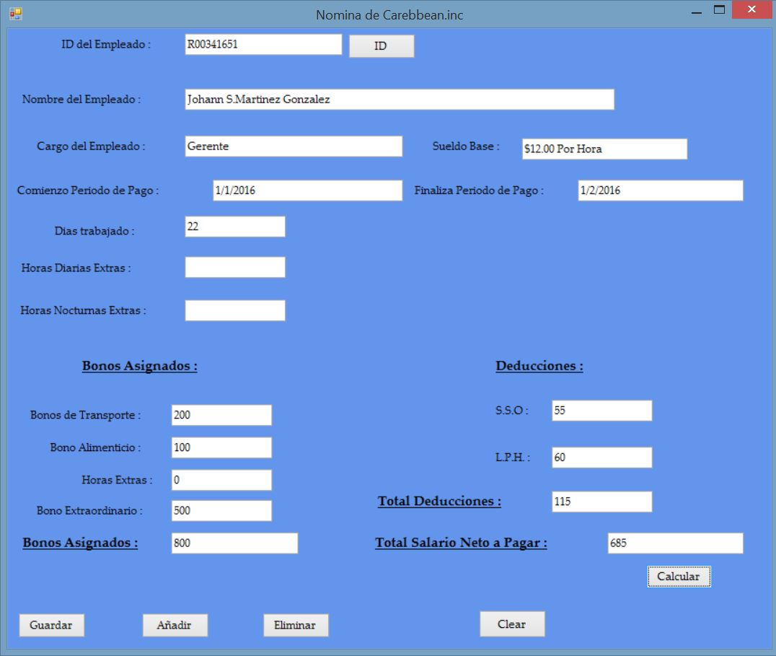

Slide 4
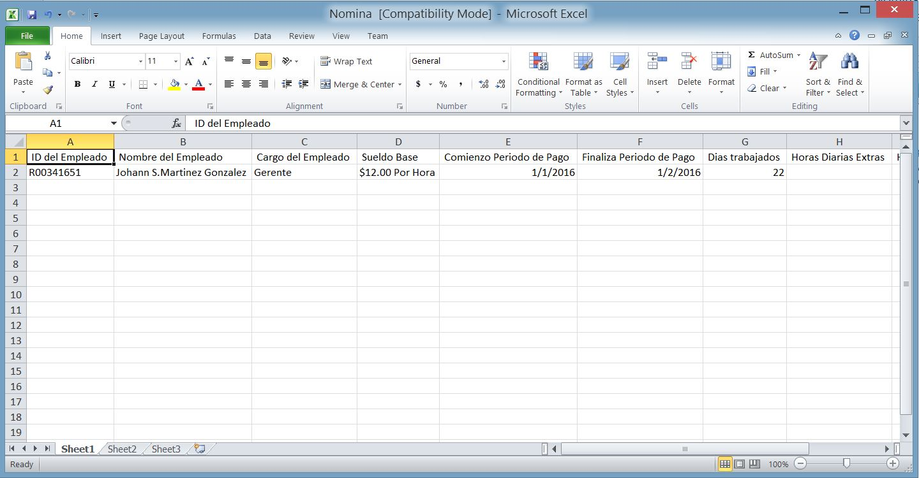

Slide 5
