Slide 1

Project 4: HQF Campaign Model
Danny Bruzzese

Slide 2
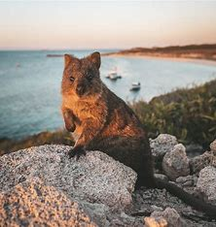
Background
Dataset containing information on recent advertising campaign aimed at existing insurance customers
Based on Kaggle Dataset https://www.kaggle.com/datasets/imsparsh/jobathon-analytics-vidhya
Aim: Create functional model to predict whether a customer will respond to future campaigns

Slide 3
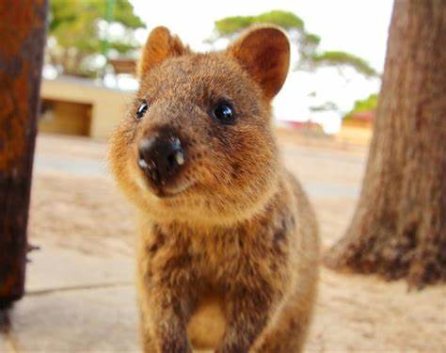
Data ETL
Use of Google collab
Unnecessary columns removed
2x csv’s created (city1.csv & visual.csv)

Slide 4
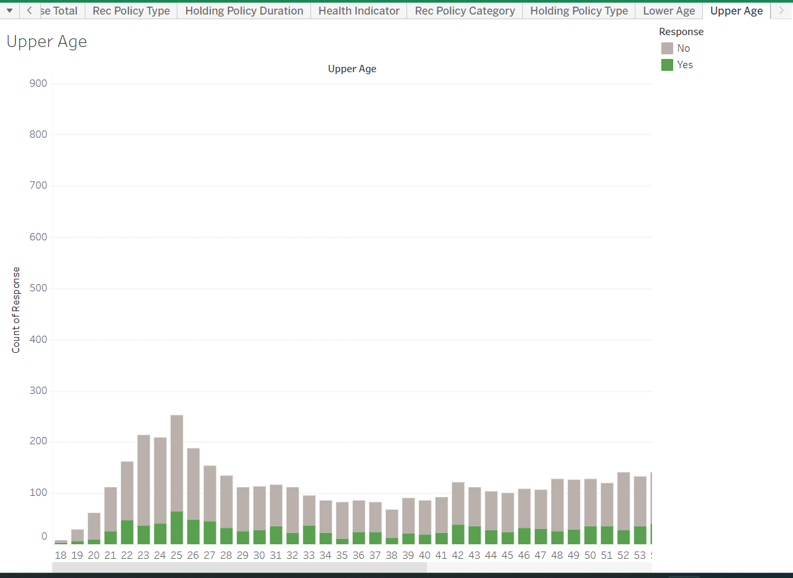
Visualisations

Slide 5
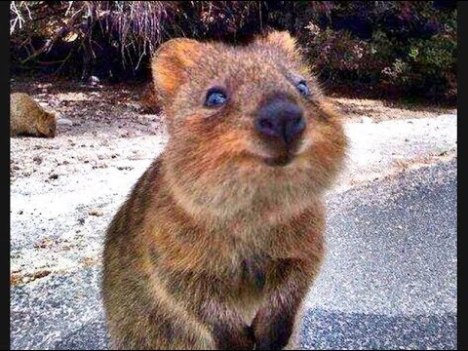
Model Creation
Logistic Regression Model created
Model undergoes hyperparameter tuning via LogisticRegression, RandomForestClassifier, ExtraTreesClassifier & AdaBoostClassifier
Saved in h5 file

Slide 6

Demonstration
Please coding Gods be good

Slide 7
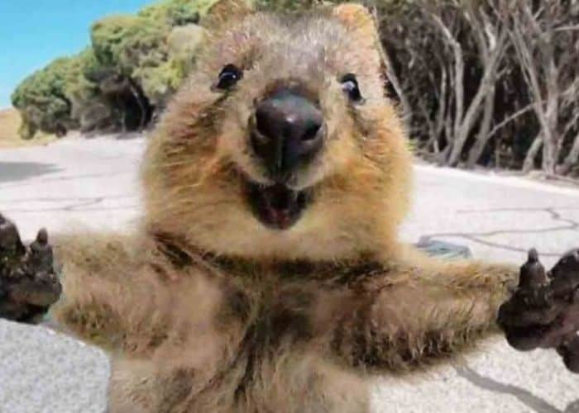
Improvements
Better presentation of webpage
Filtering of tableau columns in Flask
Taking into account different insurance offerings

Slide 8
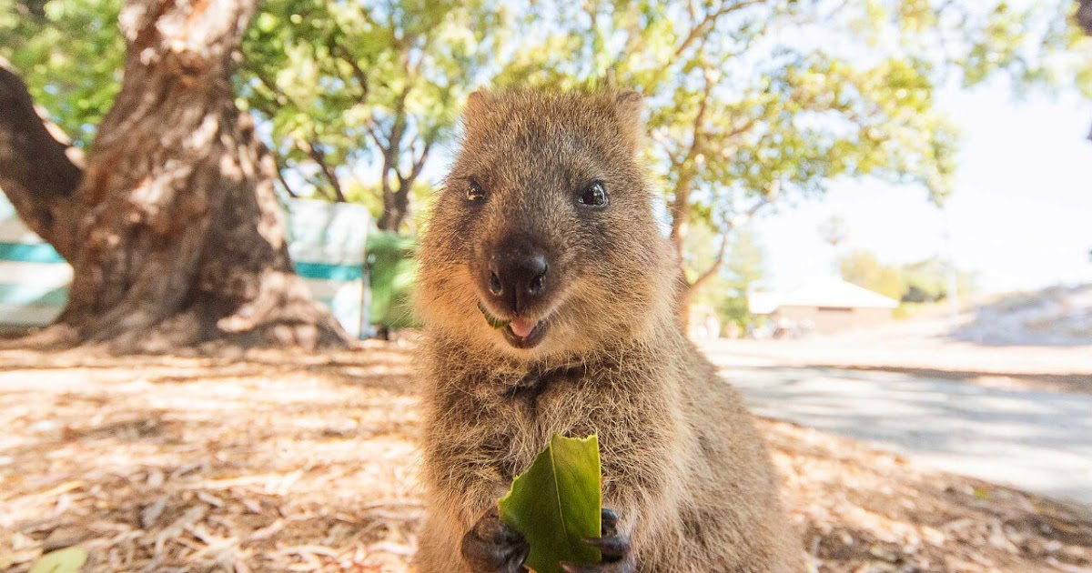
Questions? Comments?
Sources:
Description of dataset: https://www.kaggle.com/code/manabendrarout/lets-find-a-job-eda-visualize-fe-ensemble/notebook
Dataset Source: https://www.kaggle.com/datasets/imsparsh/jobathon-analytics-vidhya
Help & assistance of Vicki, Kirstie & Tutoring team.

