Slide 1

GALIL
Brand refresh · options for decision
Logo directions, colour system, typography, and how each choice carries into the website and into WorkDesk.
Prepared for the CEO and management · September 2026
Notes:
This deck asks for four decisions: one logo direction, one colour palette, one type pairing, and confirmation that green stays primary. Everything else follows from those four.

Slide 2
What we are deciding
Four choices. Everything downstream — website, WorkDesk, documents, email signatures — follows from these.
1
The mark
2
The palette
Six logo directions on the following slides. Pick one to develop, or two to test.
Three colour systems, all built around the existing company green.
3
The typeface
4
The wordmark
Three pairings. Noto Sans leads the recommendation.
Whether GALIL is set in Latin only, or Latin and Hebrew as a paired lockup.
A decision sheet is on the final slide.

Slide 3
Where the brand is now
An honest read of the current identity at galiltc.co.il.
What works
What holds it back
What is missing
The green is distinctive and already recognised by clients.
The Hebrew brush lettering has real character and warmth.
The bilingual toggle is prominent and correctly placed.
The mark does not survive being made small. At favicon size the lettering is unreadable.
There is no Latin equivalent of the mark, so English-language material has no logo.
The wordmark, the strapline and the sub-line are three competing weights in one block.
No defined type system. Headings and body drift between weights and sizes.
No secondary palette, so every accent falls back to the same green.
No application to interface, which is now needed for WorkDesk.
Notes:
The point of this slide is that the refresh is not cosmetic. The current mark cannot be used in an application interface or as a favicon, and that is now a practical problem.

Slide 4
Five principles
Applied to every option that follows.
The company green leads. Every option below is built on #8CC63E or a controlled variant of it.
1
Green stays
The mark must be legible as a favicon and as an app icon. This is the test the current mark fails.
2
Works at 16 pixels
Latin and Hebrew lockups designed together, not one retrofitted to the other.
3
Bilingual by construction
GALIL's own product is a dense interface. The identity must not fight tables, charts and status colours.
4
Quiet enough to work behind data
Website, WorkDesk and documents share one palette and one type scale. No separate 'app brand'.
5
One system, three surfaces

Slide 5
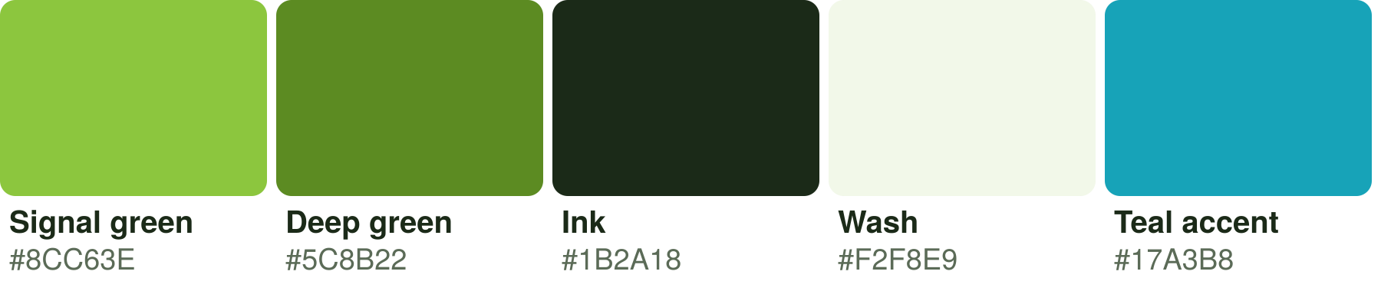
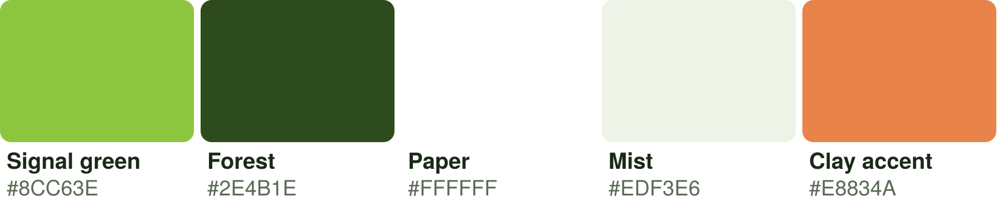
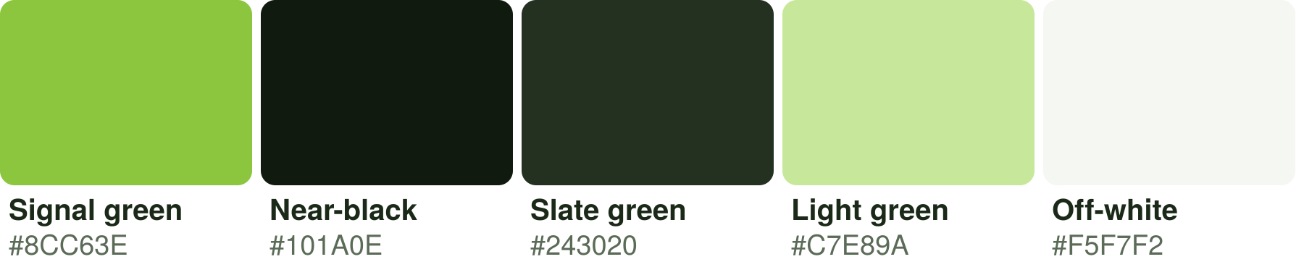
Colour — three systems
All three keep #8CC63E as the primary. They differ in what sits beside it.
A · Continuity
Closest to today. Green plus a deep green and the existing WorkDesk teal as a data accent. Lowest risk, least change to existing material.
B · Warm contrast
Green against a forest base with a clay accent. Warmer and more human; the clay gives a genuinely distinct highlight colour that green cannot supply on its own.
C · Technical
Green against near-black. High contrast, confident, and the strongest fit for a defence-sector client list. Reads as engineering rather than lifestyle.
Hex values are printed under each swatch. Palette A is the safe choice; C is the ambitious one.

Slide 6
Typography — three pairings
Your manager suggested Noto Sans. Option 1 takes that suggestion and builds the full scale around it.
1 · Noto Sans
2 · Inter + Source Serif
3 · Assistant
RECOMMENDED
Aa Bb Cc אבג
Aa Bb Cc אבג
Aa Bb Cc אבג
Heading 24 / Body 14 / Caption 12
Heading 24 / Body 14 / Caption 12
Heading 24 / Body 14 / Caption 12
Data: 8.5 h WO-IAI-004182
Data: 8.5 h WO-IAI-004182
Data: 8.5 h WO-IAI-004182
Recommended. Complete Hebrew and Latin coverage in one family, which no other option here matches. Open licence, so it can be embedded in documents, in the website and in WorkDesk with no cost and no legal question. Neutral enough to sit behind dense data.
Sharper and more contemporary on screen. Inter has no Hebrew, so Hebrew material would need a second family — which is the reason this is not the recommendation for a bilingual company.
Designed for Hebrew first, with a competent Latin set. The reverse trade-off of option 2: excellent Hebrew, slightly less refined in English.
Notes:
Specimens render in whichever of these fonts is installed on the viewing machine. If a specimen looks identical to the others, that font is not installed locally; the recommendation is unaffected.

Slide 7


Logo directions 1 and 2
Each direction is shown as a mark only. Wordmark lockups follow on slide 11.
01
02
The Ring
The Gimel
A ring cut by a single rule. Reads as a G, and as a sheet rolled and seen end-on — which is what the word galil means. The rule is the editorial mark: the line a reviewer draws.
A single continuous stroke abstracted from the Hebrew letter ג. Keeps a direct line to the current brush lettering while becoming geometric enough to reproduce cleanly.
At interface sizes
At interface sizes
Trade-off: Strongest at small sizes of anything here. Two colours only. Works reversed on dark.
Trade-off: The most distinctly Israeli option. Also the least self-explanatory to an international client.

Slide 8


Logo directions 3 and 4
03
04
The Cycle
The Bracket
Four arcs with clear gaps around a solid centre: draft, review, approve, deliver. The company's actual process, drawn.
A G held inside square brackets. Brackets are the universal mark of structured content — markup, documentation, specification.
At interface sizes
At interface sizes
Trade-off: Meaningful and ownable. Slightly busier; needs care below 24 px.
Trade-off: The clearest statement of what GALIL does. Also the most conventional.

Slide 9


Logo directions 5 and 6
05
06
The Sheet
The Leaf
Stacked pages with a folded corner and a set of rules. Literal, warm, immediately legible.
A single organic sweep, carrying forward the fluid brush quality of the current mark without the lettering.
At interface sizes
At interface sizes
Trade-off: Instantly understood. Risks looking like a generic document icon; would need a strong wordmark beside it.
Trade-off: The most graceful and the closest in feeling to today's brand. The least specific about the business.

Slide 10




All six, reversed on dark
Every mark must hold up white-on-green and green-on-dark. This is where weak marks fail.
01 The Ring
02 The Gimel
03 The Cycle
04 The Bracket
05 The Sheet
06 The Leaf
Reproduces best below 24 px
01 Ring, 04 Bracket
Most distinctly GALIL
02 Gimel, 06 Leaf
Says most clearly what we do
04 Bracket, 05 Sheet
Most defensible over ten years
01 Ring, 04 Bracket

Slide 11
Wordmark lockups
Shown with direction 04. The same three constructions apply to whichever mark is chosen.
GALIL
Horizontal · primary
Mark left, wordmark right. Website header, letterhead, email signature, presentation title.
Technical Writing · Training · Implementation
Stacked · secondary
Mark above, wordmark below, centred. Social avatars, roll-up banners, square formats.
GALIL
Mark alone · tertiary
Technical Writing
Favicon, application icon, WorkDesk header, watermark. Never used where the company is unfamiliar to the audience.

Slide 12
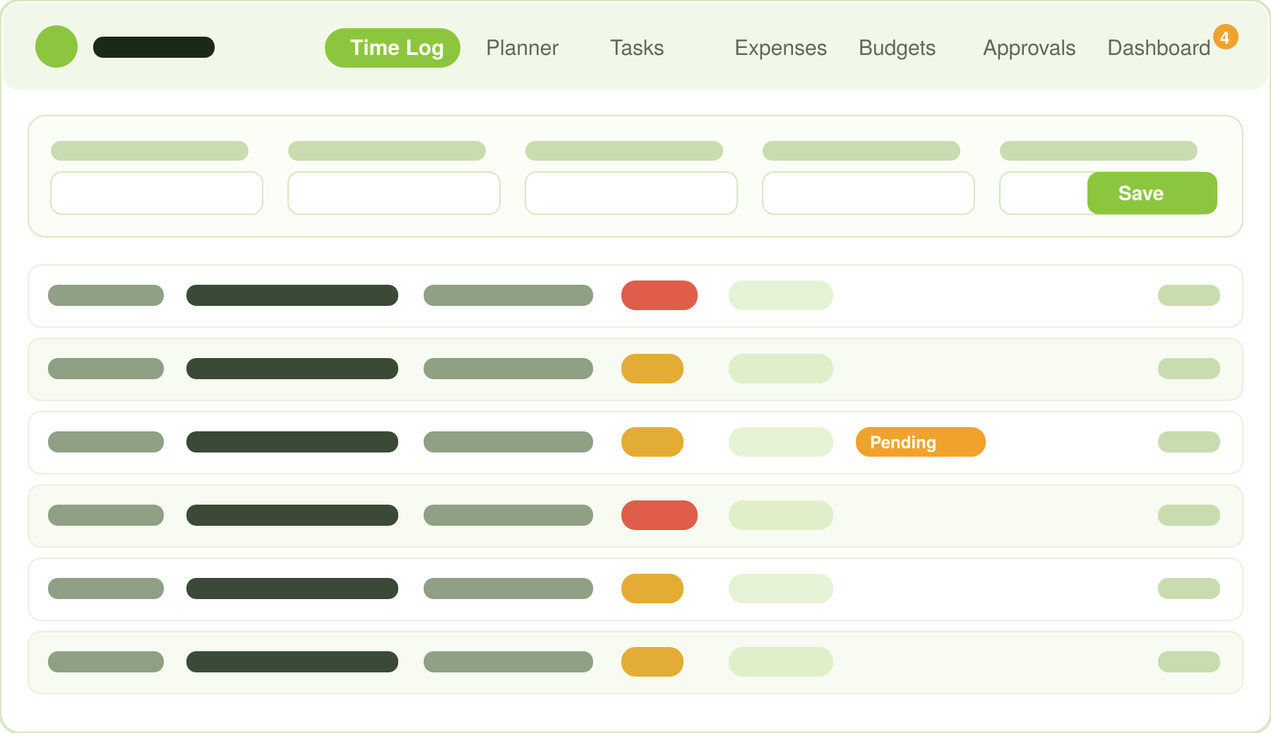
Applied — WorkDesk
Green leads the interface. Red and Yellow keep their existing meaning as company and client hours.
Green is structural
Active tab, primary action, brand mark. Nowhere else.
Red and Yellow are data
They mean company and client hours. They are never used for error or warning.
Amber means pending
A distinct third signal for entries waiting on approval.
Wash for banding
#F2F8E9 on alternate rows keeps long tables readable without borders.

Slide 13
Applied — website
A working single-page concept accompanies this deck as galil-website-concept.html. Open it in any browser.
One sentence on what GALIL does, one primary action, one supporting action. The current site opens on a product photograph with no statement; this opens with the statement.
1
Hero
Three cards: technical writing, training, implementation. Each with a plain-English description, not a capability list.
2
Services
Numbers the company can stand behind — years, clients, deliverables, sectors — and the client logo wall.
3
Proof
The four-step cycle from direction 03, used as a real section: brief, draft, review, deliver.
4
Process
A short form and the direct channels already on the current site. No chat widget.
5
Contact
The concept file uses palette A and Noto Sans, and swaps to any other option by changing five CSS variables at the top of the file.

Slide 14
Recommendation
One position, offered for you to argue with.
Mark
It says what GALIL does, it survives at 16 px, and it gives English-language material a mark it currently does not have. 01 The Ring is the alternative if you want something less literal.
04 The Bracket
Palette
Least disruption to existing material, and the teal is already carrying data in WorkDesk. Choose C if you want the identity to feel more technical to defence clients.
A · Continuity
Type
The only option that handles Hebrew and Latin in one family at no licence cost. This matches your manager's suggestion.
Noto Sans
Lockup
Two locked variants, designed together, switched by the site's language toggle.
Latin and Hebrew paired
None of this is settled. The purpose of the deck is to give you something specific to disagree with.

Slide 15
Decision sheet
Circle one per row and return. Build starts from this page.
Logo direction
01 Ring · 02 Gimel · 03 Cycle · 04 Bracket · 05 Sheet · 06 Leaf
Palette
A Continuity · B Warm contrast · C Technical
Typeface
Noto Sans · Inter + Source Serif · Assistant
Wordmark
Latin only · Latin + Hebrew paired · Hebrew primary
Website scope
Refresh existing pages · Rebuild as single page · Rebuild multi-page
Timing
Brand first, then site · Both together · Site first, brand later
Once these six are answered: the chosen mark is drawn as production vector artwork in all lockups and formats, the palette and type scale are written into the WorkDesk design tokens, and the website concept is rebuilt against the decision. Two weeks.

