Slide 1
Capstone Project Notes

Slide 2
Overview
 | Time spent | Notes
Understanding the data | 4 hours
Data exploration | 8 hours | Understanding & exploration were really one activity.
Feature selection & engineering | 4 hours
Building the model | 2 hours
Evaluating the model | 1 hour
Operationalizing | 15 minutes | Build new script that calls predict() on saved models, can be deployed on OpenCPU.

Slide 3
Data

Slide 4
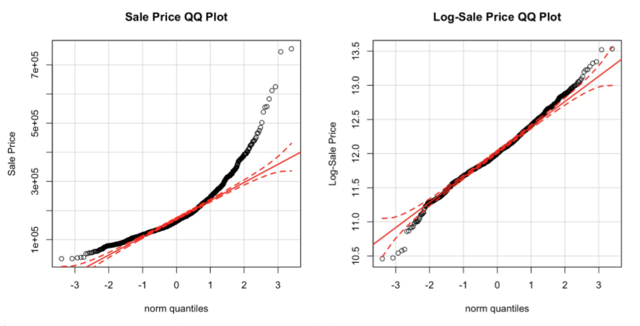
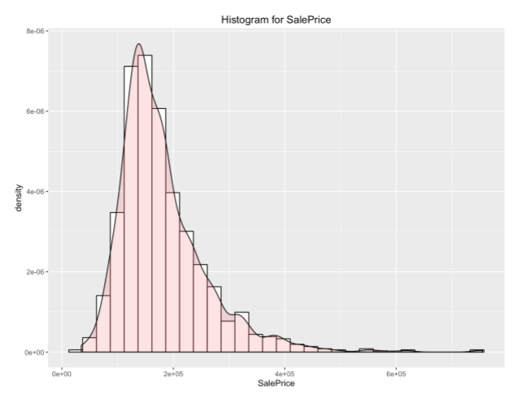
Data
The target column for this competition was the SalePrice data. Initial review of SalePrice shows that prediction may benefit from a log transformation to more closely reflect a normal distribution.

Slide 5
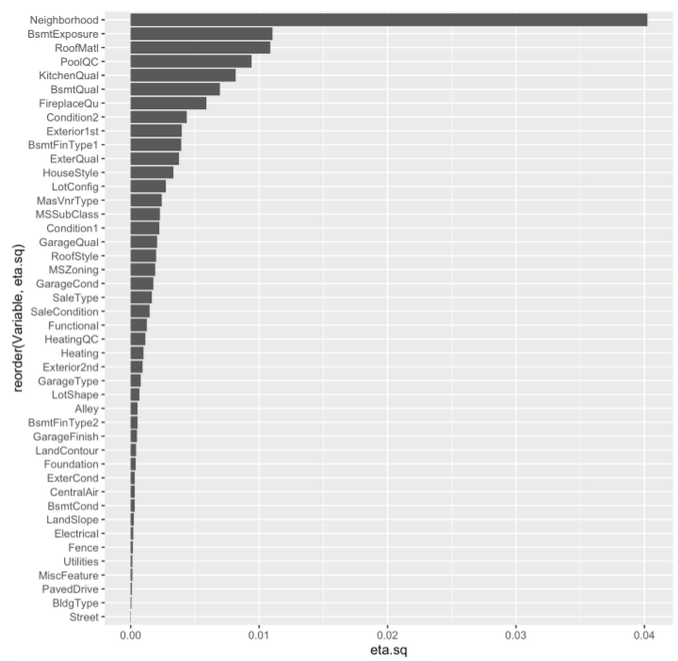
Data
Eta-square analysis was used to estimate the predictive power of categorical features.
This shows the importance of Neighborhood.

Slide 6
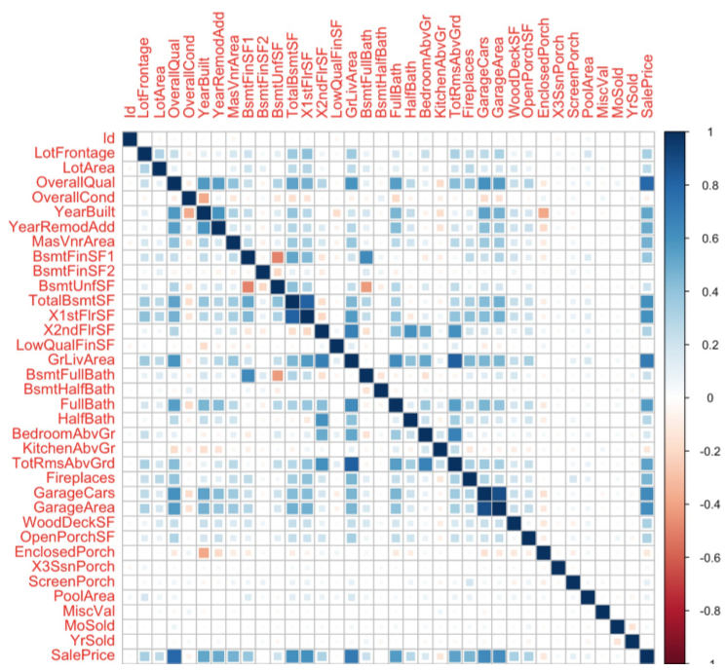
Data
For numerical features, a correlation matrix highlights strong relationships to SalePrice.
We see the importance of quality and size on home price.
The correlation plot also show co-linearity between features that can inform feature reduction activities.

Slide 7
Features

Slide 8
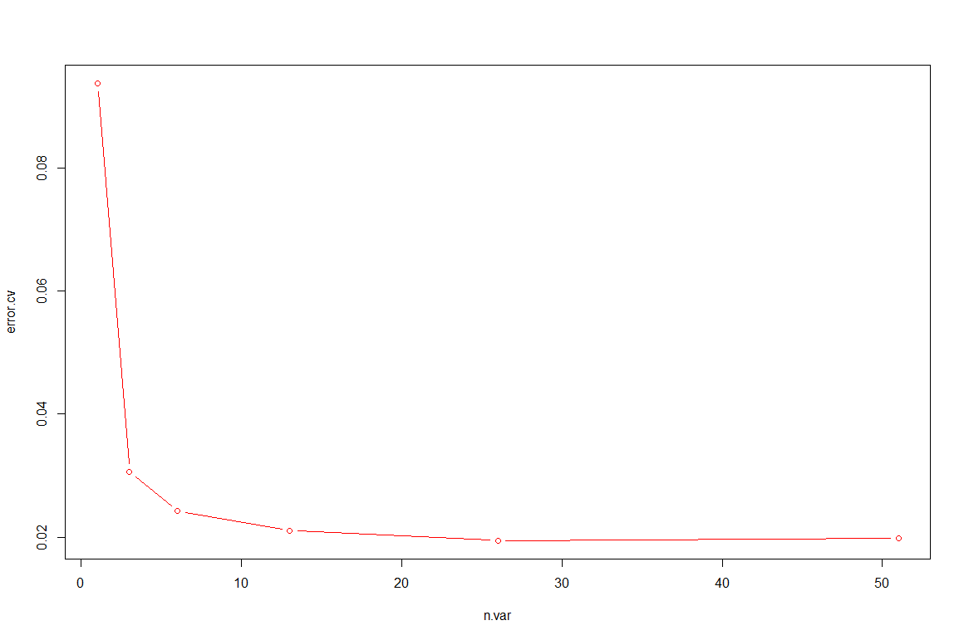
Features
Features were iteratively down-selected by building and evaluating models with varying feature sets.
Initial Random Forest model was built using all features, and rfcv (random forest cross validation) implied strong performance could be achieved with < ~30 variables

Slide 9
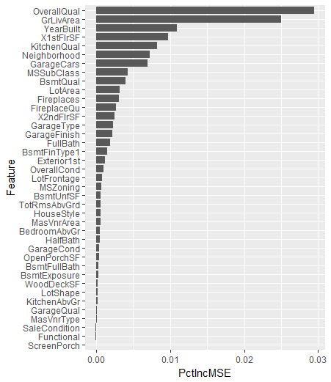
Features
By relying on the eta-square, correlation plot and feature importance outputs of the random forest, features were iteratively eliminated.

Slide 10
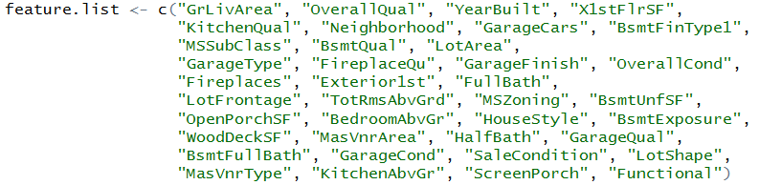
Features
Of the original data columns, the selected features are as follows:

Slide 11
Feature Engineering
Feature engineering was used to:
Handle missing values
Re-label with “None” or 0, or impute values based on column means
Re-categorize categorical features with small sub-populations (e.g. Neighborhood levels with only a few homes)
Log-transformation of non-normal distributions
Generate calculated synthetic features that may better predict home prices
Relative size of lot for the neighborhood it’s in (e.g. 0.5 acre is a lot in the city, but not much in the country)
Lot coverage (e.g. how much yard is left after we take out the home footprint)

Slide 12
Model Building

Slide 13
Model Building
Random Forest was used in the early exploratory stages due to:
Simplicity of model, very few hyper-parameters to tune for decent performance
Built-in cross-validation functions
Built-in feature importance indicators
Ensemble methods were used to fine tune model performance after data exploration & engineering were more mature
Used a stacked learning approach, with a top-level Random Forest merging predictions from:
Random Forest
xgBoost
Linear Model

Slide 14
Evaluation

Slide 15
Evaluation
Key achievements
Main metrics

Slide 16
Evaluation
Metrics
To align with the competition metric, RMSE of SalePrice (not log-SalePrice!) was the critical learning metric of focus.
Accordingly, RMSE was used as the learning metric in the xgBoost model.
R² output of the linear model was also used as a qualitative check of model fit.
Achievements
The inclusion of calculated features and ensemble methods had a dramatic impact on RMSE- reducing the Kaggle score from .14522 to .13002

Slide 17
Key Learnings
Simply applying an ML model to raw data doesn’t produce good results
Model will be skewed by missing data, outliers, errors, etc…
… if the prediction runs at all, as one-off categorical levels will crash the model
In data cleansing, feature engineering and modeling phases, we see diminishing returns over multiple iterations. We shouldn’t put all of our time & effort into any one activity, but rather make sure we are consistently good through the full pipeline.
That said, testing “ah-ha” ideas in feature engineering seem like the best opportunity for squeezing more performance out of models.
In terms of team data science, the project highlights the importance of team alignment and tool standards to ensure repeatability and reproducibility of results.
Good coding practice, while maybe slightly slower up front, pays off later when it allows for fast, broad experimentation with multiple models, feature sets, and engineered features.

