Slide 1


Slide 2

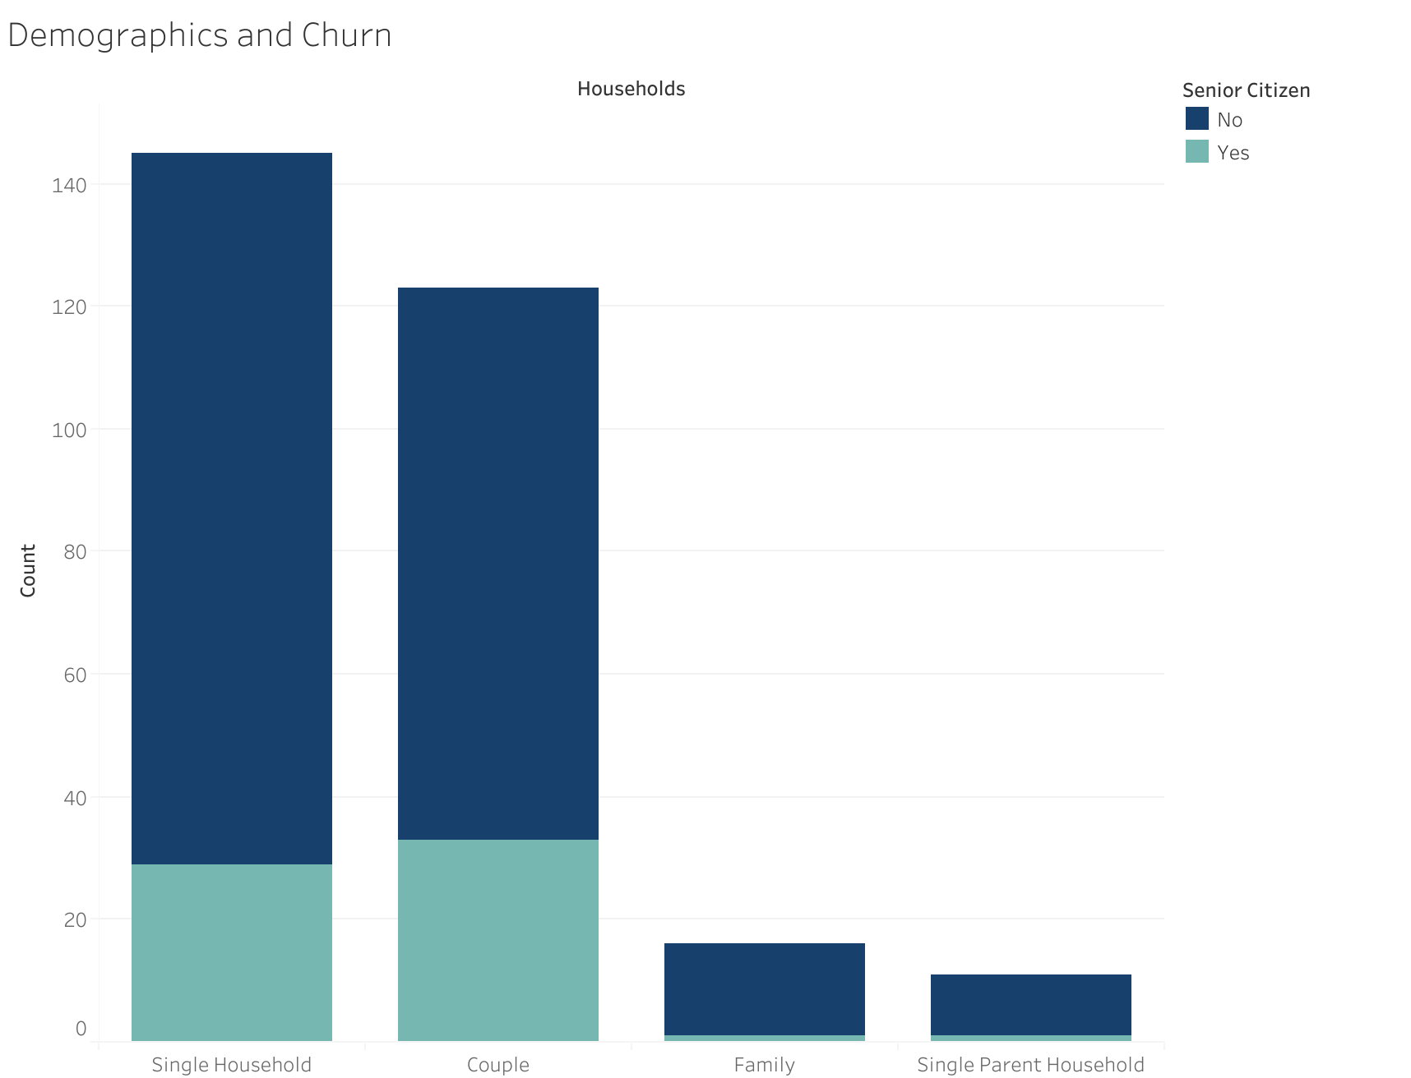
Demographic of Churners
Over half of churners have:
No dependents and no spouse
Majority of churners have:
Phone service
Internet Service: Fibre Optic
Electronic Check is the payment method that has the most churners
Two main reasons for churn:
Attitude of support person
Competitor offered higher download speeds
Monthly Charges: Churners on average pay more ($74 vs $61)
Single Household = no dependents and spouse
Couple = spouse but no dependents
Family = dependents and spouse
Single Parent Household = dependents but no spouse

Slide 3
Top 5 Customer Factors Leading to Churn
Month-to-month contracts
High monthly charges
Internet Service: Fibre Optic
No dependents
Payment Method: Electronic Check

Slide 4

What should we incentivise?

Slide 5
What should we incentivise?
Two-year contracts
Lower churn rate even after contract completion
Longer customer tenure
Family Plans
Customers with dependents stay longer
Customer satisfaction within the first 6 months
High churn of customers within 6 months of contract start date

Slide 6
Final Recommendations:
Promote longer term contracts
Promote Discounted Family Plans
Onboard Electronic check users to other offered payment methods
Competitor analysis of download speeds for Fibre Optics
Customer Service

