Slide 1

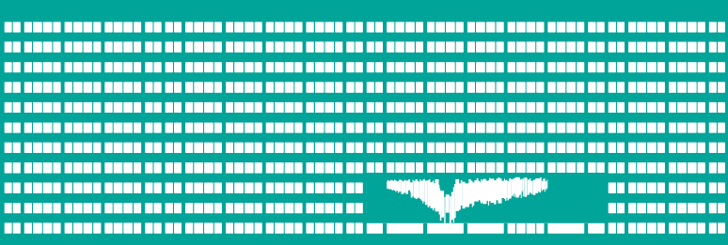
Introduction
Computer Networks
Laboratory 0

Slide 2


Instructors
Ing. Pavel MORAVEC, Ph.D. (lectures, labs)
Mgr. Ing. Michal KRUMNIKL, Ph.D. (labs)
Web pages:
  www.cs.vsb.cz/PS
  http://wh.cs.vsb.cz/pos (English version)
What about the break? – start/finish soon/later

Slide 3


About the lessons
work in lesson
  work guided by the teacher
  2 tests
  graded tasks
semestral project
homework
  read up the study materials for next lesson

Slide 4

Work safety in EB425
Valid safety training in working in the laboratories FEI
Do not take apart equipment, sockets, etc.
Do not connect the devices from racks to the school network

Slide 5
Operation rules in laboratory
main circuit-breaker
in case of fire – 3111
workplace
  sockets: school, testing network
  WiFi
  racks
Your workplace and the devices you used have to be in original state before leaving the laboratory.

