Slide 1


Getting known the laboratory
Computer networks
Seminar 1

Slide 2


Structured cabling
Network sockets:
  School network – TUO sockets
  Laboratory – sockets R1-4 (leading to the corresponding rack)
Computer network cards
  Integrated on the motherboard (by default school network) – eth1 / eth0 for our tasks
A label with MAC addresses, school IP address, computer name and domain name for DNS

Slide 3

Operating systems
Ubuntu
  Common user: cnap (password: cisco)
  Superuser: change with command su (password: cisco)
MS Windows
  Only common user – is allowed to change the IP address

Slide 4
Ubuntu 18.04
Internet browser Firefox
File manager mc
Editors
  mcedit – part of mc
  nano
  vim (gvim)
  gedit
Serial communication – minicom
telnet, ssh, ftp, …

Slide 5



Ubuntu
All locally saved files are temporary, they will be lost after restart!
Possible to connect USB drive
  Automatic connection
  manual: mount -t <fs> <device> <lacation>
Remote copying with scp:
  scp <source> <target>
  <source/target>: local or remote file user@machine:path
    for example:
    scp ./test.txt abc123@homel:~
    scp abc123@homel:~/test.txt .

Slide 6


Manual settings of network parameters
Linux (requires superuser - root)
  ifconfig [ethX [<address> netmask <mask>]]
  ip addr add <ip address/mask> dev ethX
  route add default gw <gateway>
  DNS servers and default domain set in /etc/resolv.conf
    Commands: nameserver A.B.C.D ; search <domain>
Windows
  Settings → Control Panel → Networks connection → eth0 → Properties → Protocol TCP/IP → Properties
    Choose use the following IP address, fill address, mask, gateway, addresses of DNS servers
  To display the settings: ipconfig (or ipconfig /all), or Settings → Control Panel → Networks connection → eth0 → Status → Support (+Details)

Slide 7
Connectivity
ping – check the accessibility of target device
  Linux:
  ping [–c <count>] [-i <pause>] [-f] [-s <size>] <target>
  Windows:
  ping [-t] [–n <count>] [-l <size>] [-i <ttl>] <target>
traceroute – path to target device
  Linux: traceroute [-m <max. of hops>] <target>
  Windows: tracert [-h <max. of hops>] <target>
wireshark (ethereal)
  List of received packets on network interface
dig/nslookup – DNS lookup utilities
dhclient – acquire IP address from DHCP serv.
  Linux: dhclient <ethX>

Slide 8
Building the network with the hub
Network card
  Network PCMCIA card
Hub (rozbočovač) – serves to distribute – broadcast the signal in network but it doesn't care about the transmitted data

Slide 9
Cables usage
Crossover
Crossover
  PC – PC
  Switch – Switch
  Hub – Hub
  Router – Router
  Router - PC
Straight-through
  PC – Switch (Hub)
  Router – Switch (Hub)
PC
router
Straight-through
hub
switch
Crossover

Slide 10
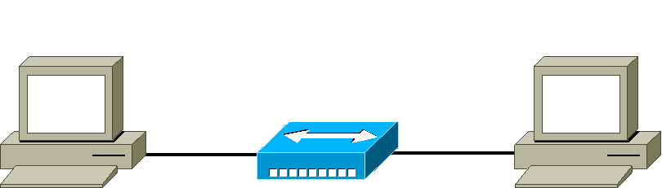
Practical task
Description: Connecting two computers using hub or switch
Straight-through cable

Slide 11
Traffic analysis
Wireshark
  http://www.wireshark.org
  Full graphic interface
  Cross-platform program (Linux, Windows, Solaris, …)
Tcpdump
  http://www.tcpdump.org

Slide 12
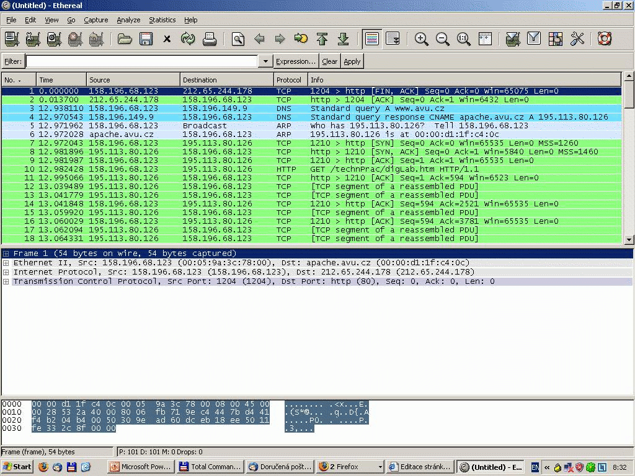
Wireshark

