Slide 1

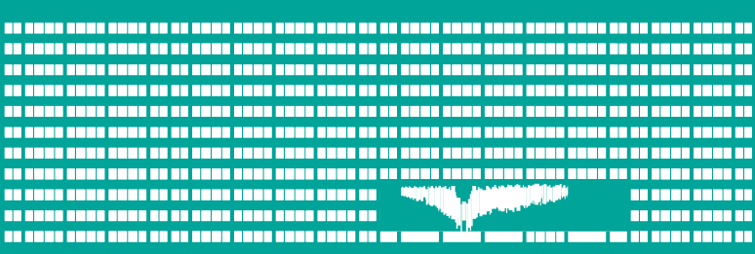
IOS basics – switches
Cabling systems
Computer networks
Seminar 2

Slide 2

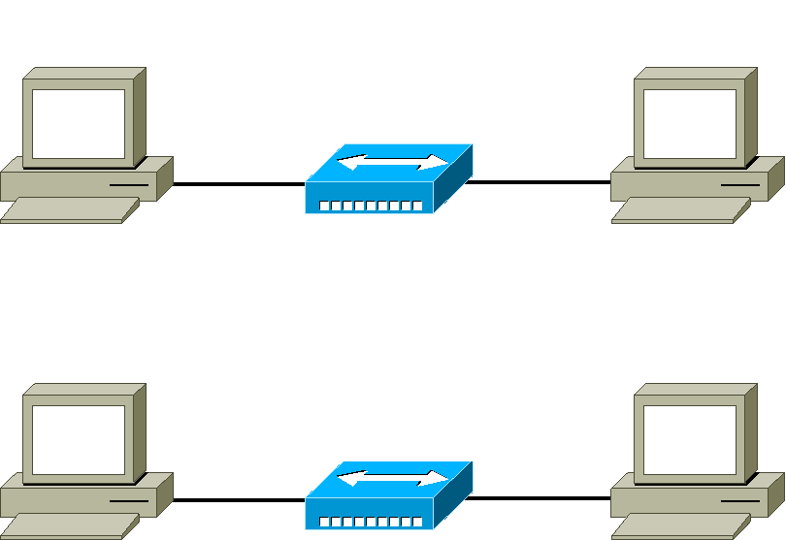

Assignment
Description: Interconnect two switches
Straight-through cable
Cross-over cable

Slide 3
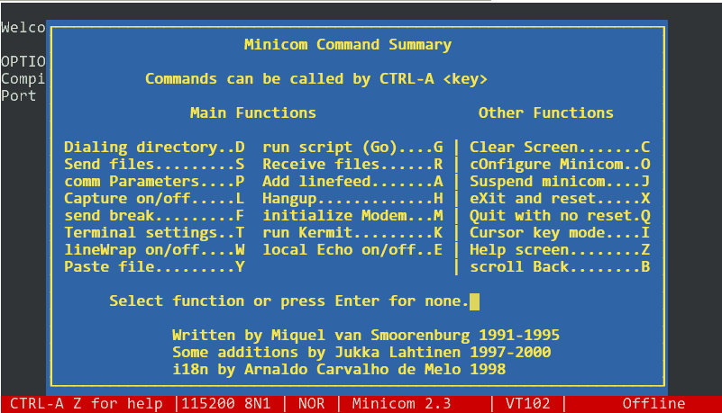
minicom

Slide 4

IOS principles
IOS is operating system managing the device
Configuration can be done
  In text mode
  Over WWW interface (works on many devices)
During work with the device we can be in several modes. Depending on the mode there is different set of functions we are allowed to use.

Slide 5
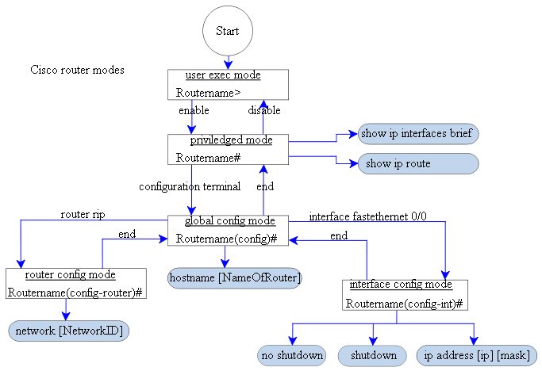
Changing the modes

Slide 6


Notes
If we don't know the exact syntax of command, we can help ourselfs using question mark. IOS tells us possibilities of the command.
  For example: we don't know names of interfaces – IOS will show us available possibilities.
  show interface ?
Sometimes it is not necessary to enter whole command but it is enough to enter only unique part (unique prefix) instead.
sh int (show interface)
TAB key (tabulator) completes the command. (analogous to Unix based operating systems).
  For example: if we write sh, tab will complete the command to show
If you want to cancel the effect of configuration command, write down same command and put no before it.
If you want to execute (without help) priviledged-mode command in configuration mode, prepend it with do

Slide 7




Basic commands of Cisco 2950
Privileged mode
  show version – version of the IOS
  show mac-address-table – MAC address/CAM table
  clear mac-address-table dynamic – clear CAM table
  show interface [<interface>] – port information
  show run – print complete configuration
  show cdp neigh – neighbouring CISCO devices
Configuration mode
  interface fastethernet0/1 – port configuration
    description <desc> – port description
    duplex {half|full|auto} – half/full duplex mode
    speed {100|10|auto} – transmition speed
  hostname <name> – device name
terminal length <NN> – number of lines of the screen

Slide 8

Assignment – IOS
Working with minicom
  startup, help, shortcuts, closing
  Serial port configuration, line wrapping
  Capturing to file
Cisco IOS
  Moving between modes
  (enable, conf t, ^Z, exit, disable)
  Interface, version, configuration info, etc.
  (sh ver, sh run) and configuration erase
  Number of
    screen lines (terminal length YY)
    screen columns (terminal width XX)

Slide 9
Assignment – switch functions
The example of automatic filling MAC address table (CAM)
  Problem discussion
  Displaying MAC address table entries
  (show mac-address-table)
  Clearing MAC address table
  (clear mac-address-table dynamic)
Interface statistics
(show int)
Displaying „Cisco“ neighbours
(show cdp neighbours)

Slide 10
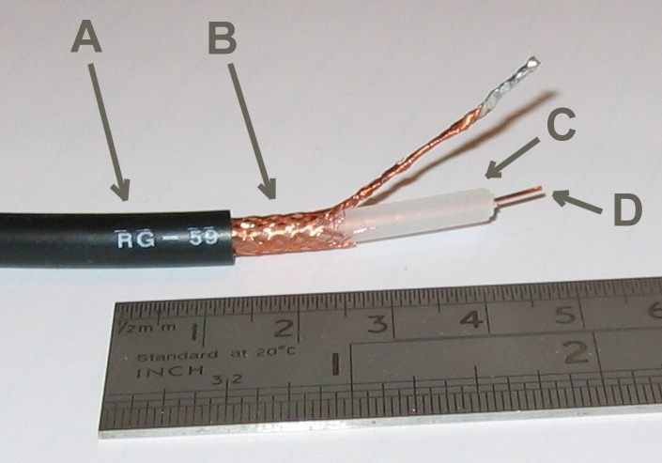
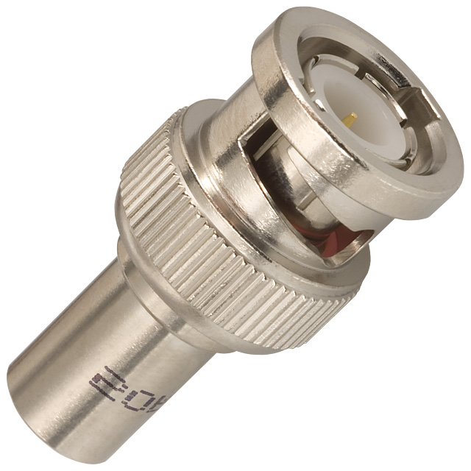
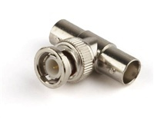
Metallic cables
Coaxial cable + connector BNC, T, terminator
  Thicknet (10 BASE 5) – up to 500 m
  Thinnet (10 BASE 2) – up to 185 m
  50 ohm, 75 ohm

Slide 11
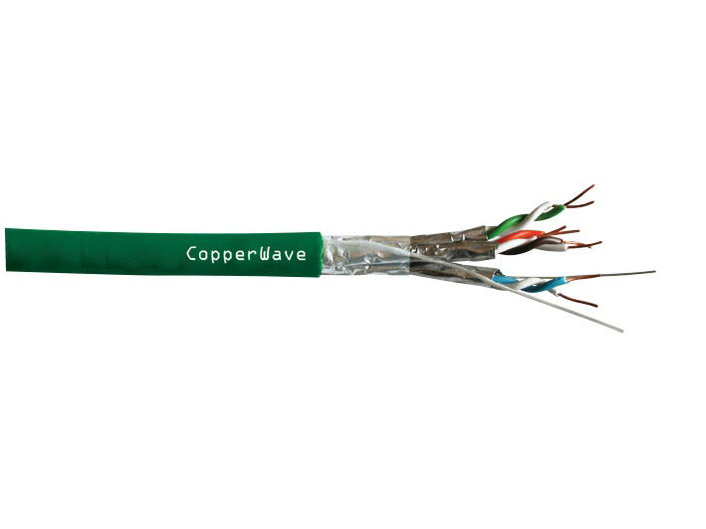
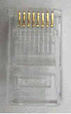

Metallic cables
Twisted pair
  UTP (Unshielded), FTP (Foil Screened) = ScTP, STP (Shielded)
  RJ-45 connector
  stranded vs solid wire
RJ-45
RJ-11

Slide 12
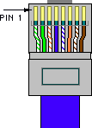
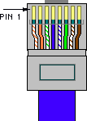


RJ-45 connector types
Standard EIA/TIA 568A and 568B
  USA: 568A – green pair on the left
  Europe: 568B – orange pair on the left
Cables
  Straight – 568B connectors on both sides (in USA 568A)
  Crossover – 568A on one side and 568B on the other – crossover of Tx (1,2) and Rx (3,6) pair
  Console – one side uses 568B connector, second one is turned by 180 degrees
568A
568B
console

Slide 13
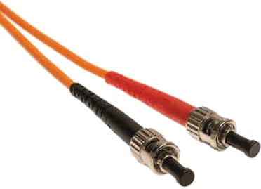
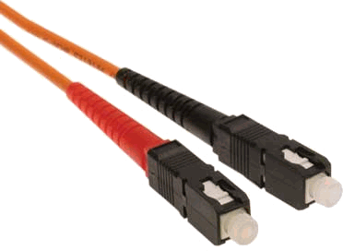
Optical cables
Connectors ST, SC ...
Single-mode, multi-mode
connector ST
connector SC

Slide 14
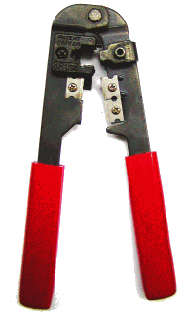
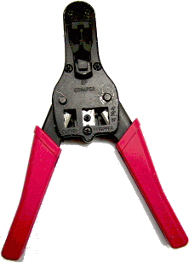

RJ-45 connector assembling
Remove external isolation using carpet cutter (Be careful not to cut the inside wires – short circuit)
Untwist the wires and order them by colors
Push them into the connector in the way all of them are pushed to the end of the connector and external isolation is under the plastic clip.
Use the connector pliers to clamp the connector
rotating
sliding
!!!

Slide 15
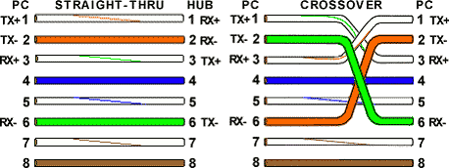


Assignment – assembling and verifying the functionality of the cables
According to the teacher's instructions assembly straight/crossover cable and check the functionality using the tester
Mark both ends of crossover cable with the sticky tape (near to the connectors)
Note: Let the teacher check your cable before using the pliers to clamp the conn.

Slide 16
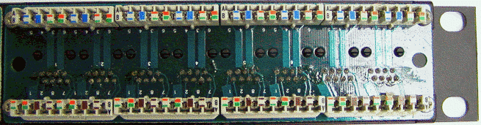
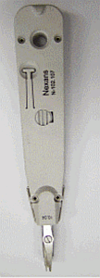


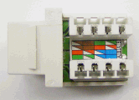
Socket installation
Remove external isolation using carpet cutter (Be careful not to cut the inside wires – short circuit)
Untwist the wires and lay down them on the patch panel
Use a punch tool to push a wire between two metal pins and to cut off the extra wire
Patch panel

