Slide 1

VLSM
Static routing
Computer networks
Seminar 5

Slide 2



IP address (network and host part)
Address classes – identified by first three bits
Subnet mask – determines how the IP address is divided into network and host parts
  Decimal notation, for example. 255.255.255.240
  /<bits for network> for example /28
Reserved addresses – not allowed to assign:
  There are only 0 bits or 1 bits in host part of the IP address: only 0b – network address, only 1b – broadcast
Router interface also requires one „host“ IP address
network
subnet
host
Maska: 1111111111111111111111 0000000000b

Slide 3

Special IP addresses
Any from IP addresses of local station (see bind())
0.0.0.0
Universal broadcast (multiaddress)
255.255.255.255
Private network ranges (not propagated to Internet)
10.0.0.0/8
172.16.0.0/16 – 172.31.0.0/16
192.168.0.0/16
100.64.0.0/10 (CGN)
Local loop
127.0.0.1

Slide 4


Special IP addresses
Link-local address
169.254.0.0/16
Reserved addresses (not allowed to assign to the hosts)
  Network address
    In host part only 0 bits
  Broadcast
    In host part only 1 bits
  Note: Subnet mask says if it is reserved address or not, for example 10.0.0.224/24 vs. 10.0.0.224/27

Slide 5

Assigned prefix (CIDR)
Todays you get prefix instead of classful address, for example:
100.75.50.64/28 (255.255.255.240)
Bits intended for host address can be further divided between subnet and host addresses.
Required maximum length of the prefix can be count as:
32 - (bits_for_subnets + bits_for_hosts)
prefix
subnet
host

Slide 6
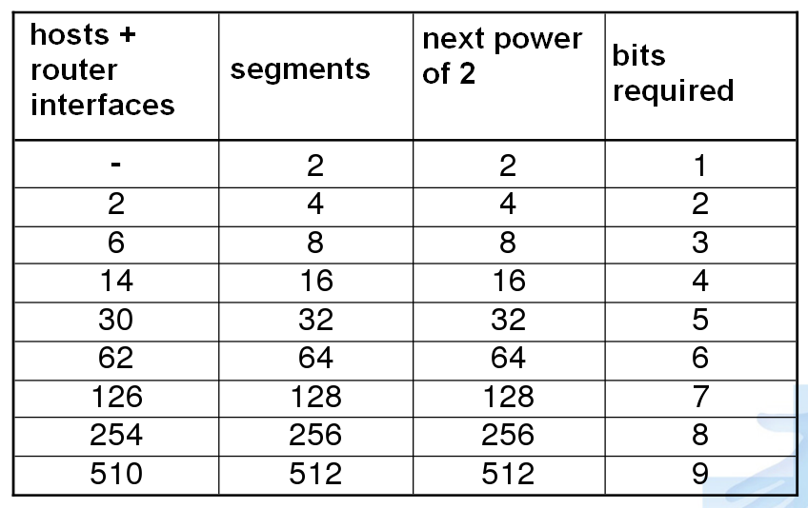
Maximum numbers of hosts and subnets

Slide 7
WAN address plan
We determine the mask same for all subnets or different masks for single segments as necessary (VLSM)
We determine subnet addresses for all segments
We assign the address to router interfaces (including point-to-point links) and to all stations
Write down broadcast address of all subnets

Slide 8
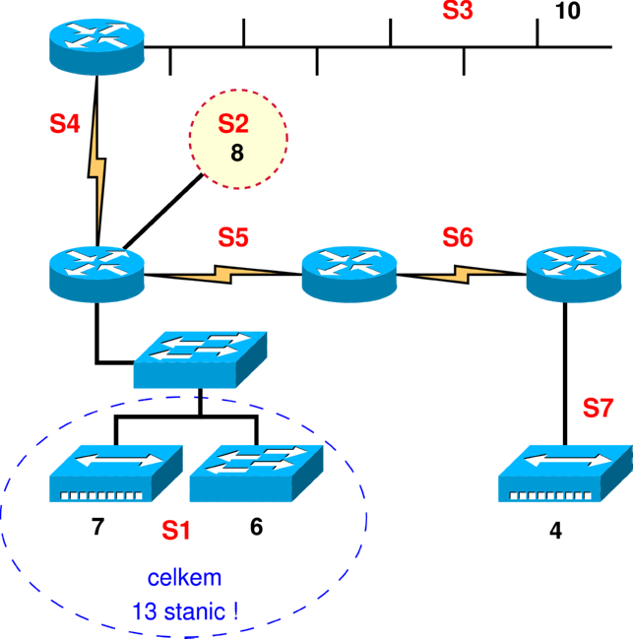
Subnetting (i)
Assigned:
100.75.50.0/24
13 stations
total!

Slide 9


Subnetting (i)
Prefix 100.50.40.0/24
We start with the biggest subnet (S1) using VLSM
  13 stations + 1 router interface
  14 + 2 (reserved) ( <= 2⁴) (4 bits for addresses)
  We assign the smallest possible prefix to network S1 (0000 XXXX )
Segment | Prefix | Subnet | Usable addresses | Broadcast
S1 | 100.75.50. 0000XXXX | 100.75.50.0/28 | 100.75.50.1-100.75.50.14 | 100.75.50.15

Slide 10
Subnetting (ii)
We continue with the second biggest subnet (S3)
  10 stations + 1 router interface
  11 + 2 (reserved) ( <= 2⁴) (4 bits for addresses)
  We assign prefix for S3 subnet ( 0001 XXXX )
Segment | Prefix | Subnet | Usable addresses | Broadcast
S1 | 100.75.50. 0000XXXX | 100.75.50.0/28 | 100.75.50.1-100.75.50.14 | 100.75.50.15
S3 | 100.75.50. 0001XXXX | 100.75.50.16/28 | 100.75.50.17-100.75.50.30 | 100.75.50.31

Slide 11
Subnetting (iii)
Continuing with next subnet (S2)
  8 stations + 1 interface
  9 + 2 (reserved) ( <= 2⁴) (4 bits for addresses)
  We assign next prefix to S2 subnet ( 0010 XXXX )
Segment | Prefix | Subnet | Usable addresses | Broadcast
S1 | 100.75.50. 0000XXXX | 100.75.50.0/28 | 100.75.50.1-100.75.50.14 | 100.75.50.15
S3 | 100.75.50. 0001XXXX | 100.75.50.16/28 | 100.75.50.17-100.75.50.30 | 100.75.50.31
S2 | 100.75.50. 0010XXXX | 100.75.50.32/28 | 100.75.50.33 - 100.75.50.46 | 100.75.50.47

Slide 12
Subnetting (iv)
Continuing with next segment (S7)
  4 stations + 1 interface
  5 + 2 (reserved) ( <= 2³) (3 bits for addresses)
  We assign next prefix to S7 subnet ( 00110XXX )
Segment | Prefix | Subnet | Usable addresses | Broadcast
S1 | 100.75.50. 0000XXXX | 100.75.50.0/28 | 100.75.50.1-100.75.50.14 | 100.75.50.15
S3 | 100.75.50. 0001XXXX | 100.75.50.16/28 | 100.75.50.17-100.75.50.30 | 100.75.50.31
S2 | 100.75.50. 0010XXXX | 100.75.50.32/28 | 100.75.50.33 - 100.75.50.46 | 100.75.50.47
S7 | 100.75.50. 00110XXX | 100.75.50.48/29 | 100.75.50.49- 100.75.50.54 | 100.75.50.55

Slide 13
Subnet (S4)
  2 interfaces
  2 + 2 (reserved) ( <= 2²) (2 bits for addresses)
  We assign next prefix to S4 subnet ( 0011 1XXX )
Segment | Prefix | Subnet | Usable addresses | Broadcast
S1 | 100.75.50. 0000XXXX | 100.75.50.0/28 | 100.75.50.1-100.75.50.14 | 100.75.50.15
S3 | 100.75.50. 0001XXXX | 100.75.50.16/28 | 100.75.50.17-100.75.50.30 | 100.75.50.31
S2 | 100.75.50. 0010XXXX | 100.75.50.32/28 | 100.75.50.33 - 100.75.50.46 | 100.75.50.47
S7 | 100.75.50. 00110XXX | 100.75.50.48/29 | 100.75.50.49- 100.75.50.54 | 100.75.50.55
S4 | 100.75.50. 001110XX | 100.75.50.56/30 | 100.75.50.57-100.75.50.58 | 100.75.50.59

Slide 14
Subnet (S5)
  2 interfaces
  2 + 2 (reserved) ( <= 2²) (2 bits for addresses)
  We assign next prefix to S5 subnet ( 0011 11XX )
Segment | Prefix | Subnet | Usable addresses | Broadcast
S1 | 100.75.50. 0000XXXX | 100.75.50.0/28 | 100.75.50.1-100.75.50.14 | 100.75.50.15
S3 | 100.75.50. 0001XXXX | 100.75.50.16/28 | 100.75.50.17-100.75.50.30 | 100.75.50.31
S2 | 100.75.50. 0010XXXX | 100.75.50.32/28 | 100.75.50.33 - 100.75.50.46 | 100.75.50.47
S7 | 100.75.50. 00110XXX | 100.75.50.48/29 | 100.75.50.49- 100.75.50.54 | 100.75.50.55
S4 | 100.75.50. 001110XX | 100.75.50.56/30 | 100.75.50.57-100.75.50.58 | 100.75.50.59
S5 | 100.75.50 001111XX | 100.75.50.60/30 | 100.75.50.61-100.75.50.62 | 100.75.50.63

Slide 15
Subnet (S6)
  2 + 2 (reserved) ( <= 2²) (2 bits for addresses)
  We assign next prefix to S6 subnet ( 0100 00XX )
Segment | Prefix | Subnet | Usable addresses | Broadcast
S1 | 100.75.50. 0000XXXX | 100.75.50.0/28 | 100.75.50.1-100.75.50.14 | 100.75.50.15
S3 | 100.75.50. 0001XXXX | 100.75.50.16/28 | 100.75.50.17-100.75.50.30 | 100.75.50.31
S2 | 100.75.50. 0010XXXX | 100.75.50.32/28 | 100.75.50.33 - 100.75.50.46 | 100.75.50.47
S7 | 100.75.50. 00110XXX | 100.75.50.48/29 | 100.75.50.49- 100.75.50.54 | 100.75.50.55
S4 | 100.75.50. 001110XX | 100.75.50.56/30 | 100.75.50.57-100.75.50.58 | 100.75.50.59
S5 | 100.75.50 001111XX | 100.75.50.60/30 | 100.75.50.61-100.75.50.62 | 100.75.50.63
S6 | 100.75.50. 010000XX | 100.75.50.64/30 | 100.75.50.65-100.75.50.66 | 100.75.50.67

Slide 16
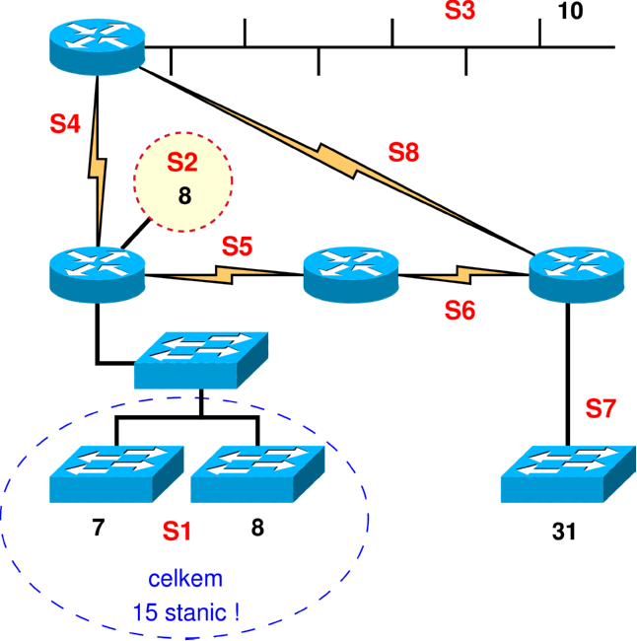

Subnetting (iii)
More stations have been added to the network from example 2, also backup line S8 has been added
Hubs have been replaced by switches (VLANs are not used)
15 stations
total!

Slide 17

Subnetting (iii)
Segment S7 has now
31 + 2 ( <= 2⁶)
(6 bits for addresses)
.00XXXXXX
15 stations
total!

Slide 18
Segment | Prefix | Subnet | Usable addresses | Broadcast
S7 | 100.75.50. 00XXXXXX | 100.75.50.0/26 | 100.75.50.1-100.75.50.62 | 100.75.50.63
S1 | 100.75.50. 010XXXXX | 100.75.50.64/27 | 100.75.50.65-100.75.50.94 | 100.75.50.95
S3 | 100.75.50. 0110XXXX | 100.75.50.96/28 | 100.75.50.97 - 100.75.50.110 | 100.75.50.111
S2 | 100.75.50. 0111XXXX | 100.75.50.112/28 | 100.75.50.113- 100.75.50.126 | 100.75.50.127
S8 | 100.75.50. 100000XX | 100.75.50.128/30 | 100.75.50.129-100.75.50.130 | 100.75.50.131
S4 | 100.75.50. 100001XX | 100.75.50.132/30 | 100.75.50.133-100.75.50.134 | 100.75.50.135
S5 | 100.75.50. 100010XX | 100.75.50.136/30 | 100.75.50.137-100.75.50.138 | 100.75.50.139
S6 | 100.75.50. 100011XX | 100.75.50.140/30 | 100.75.50.141-100.75.50.142 | 100.75.50.143

Slide 19


Static routing
Router interface settings
  (config)# interface <type> <port number>
    type – serial, GigabitEthernet, FastEthernet, vlan, …
    port number – various on different routers , for example: 0, 1, 0/0, 0/1, 1/0, 1/1, 0/1/0, …
  (config-if)# ip address <address> <mask>
  (config-if)# clock rate <speed-bps>
    only DCE on serial link
  (config-if)# no shutdown
PC default gateway settings
  route add default gw <gateway>

Slide 20
Switched module in routers
The module provides more (typically 4 or 8) Ethernet switched ports (fast or gigabit Ethernet)
We need to use VLANs to configure these ports
  (config)# interface gi0/1/0
  (config-if)# switchport mode access
  (config-if)# switchport access vlan 123
  (config-if)# no shutdown
The created virtual interfaces for VLANs are then configured as normal interfaces
  (config)# interface vlan 123
  (config-if)# ip address …
We can check the interfaces in normal way:
  # show ip interface brief
  # show interface vlan 123

Slide 21

Static routing
Static route (configuration mode)
  (config)# ip route <network> <mask> <gateway>
    network – address of network to be added to the routing table
    mask – decimal mask
    gateway – ip address of next router on the way
  Network address of default route is 0.0.0.0/0
Routing table entries (privileged mode)
  # show ip route [<network>]
To see the configuration of the device
  # show running-config

Slide 22
Static routing - assignment
Interconnect 3 routers into the triangle topology
Connect PC to each router
Set the IP addresses acording to the topology plan
(Don't forget to set default gateway on PC)
Set static routes to the networks which are not directly connected
Test the connectivity (Ping all IP addresses in the topology plan)

Slide 23
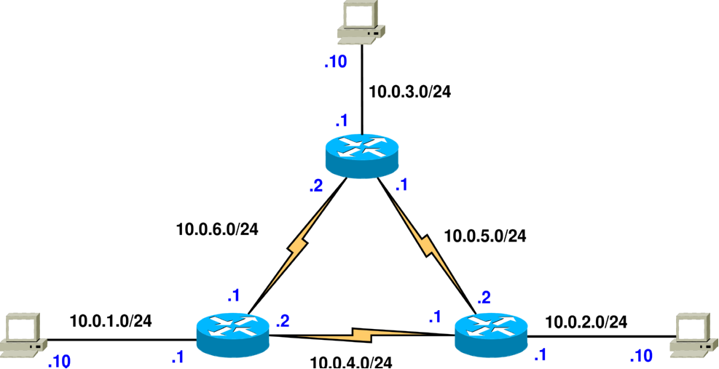
Static routing
last byte
in IP address

