Slide 1

IPv6
Computer networks
Seminar 6

Slide 2



IPv6 address space
IPv6 address size is 128 bits (RFC 4291)
  space: 2^128 addresses
Like IPv4 is divided to the network address and host address
  Usually with mask /64
IANA address ranges released
  2000::/3 Global Unicast [RFC4291]
  FC00::/7 Unique Local Unicast [RFC4193]
  FE80::/10 Link Local Unicast [RFC4291]
  FF00::/8 Multicast [RFC4291]

Slide 3


IPv6 address notation
Full notation
  eight groups of four hexadecimal digits separated by colon „:“
    2001:0000:0db8:0000:0000:0000:1428:57ab
Short notation
  Four zeros in a group can be written as one zero
    2001:0:0db8:0:0:0:1428:57ab
  One or any number of consecutive groups of 0 value may be replaced with two colons
    2001:0:0db8::1428:57ab
    It is not possible: 2001::0db8::1428:57ab
    - ambiguous

Slide 4
IPv6 address assignment methods
Manually configured
IPv6 autoconfiguration based on known network prefix and MAC address of NIC (ICMPv6)
using DHCPv6
Manual configuration
  administratively difficult
  long addresses are mistake-prone

Slide 5

IPv6 Autoconfiguration
Easier configuration of IPv6 on local network
Address derived from advertised network prefix and from NIC MAC address
Required the presence of the device which is able to provide necessary ICMPv6 messages
  ICMPv6 server
  stateless configuration
  Potentially dangerous
    Every connected client is able to derived the address

Slide 6
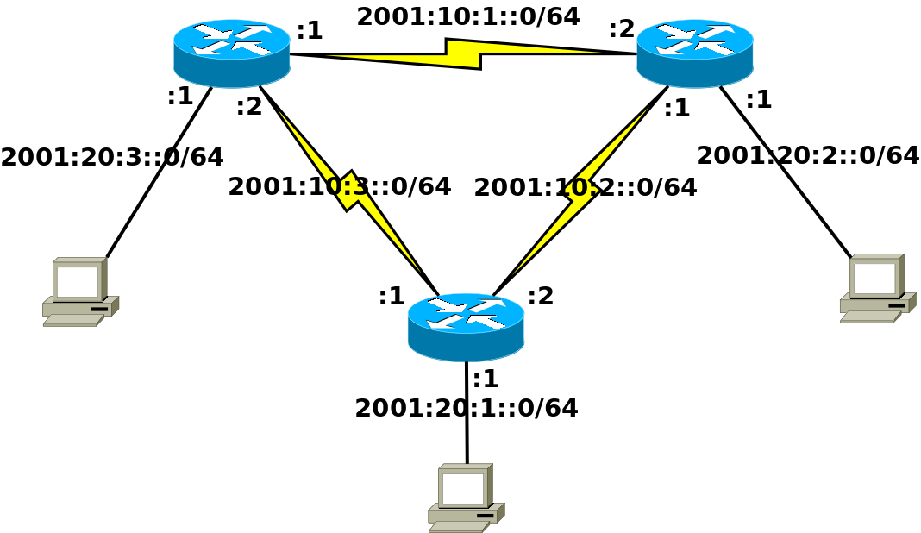
Address plan and network topology
It is required to ensure
appropriate routing in the network
Host chooses local address itself within assigned subnet

Slide 7
IPv6 configuration on Cisco router
Enabling routing process
  (config)#ipv6 unicast-routing
IPv6 configuration on interface
  (config)#interface <type><num>
  (config-if)#ipv6 address <ipv6>/<mask>
  (config-if)#no shutdown

Slide 8

Switched module for routers
The module provides more (typically 4 or 8) Ethernet switched ports (fast or gigabit Ethernet)
We need to use VLANs to configure these ports
  (config)# interface gi0/1/0
  (config-if)# switchport mode access
  (config-if)# switchport access vlan 123
  (config-if)# no shutdown
The created virtual interfaces for VLANs are then configured as normal interfaces
  (config)# interface vlan 123
  (config-if)# ip/ipv6 address …
We can check the interfaces in normal way:
  # show ip interface brief
  # show interface vlan 123

Slide 9
IPv6 configuration in Linux
Iproute2 usage
  Assigning IPv6 address to interface
    ip addr add <ipv6>/<mask> dev <dev>
  Removing IPv6 address from interface
    ip addr del <ipv6>/<mask> dev <dev>
  Removing all configured IP addresses from interface
    ip addr flush <dev>
  Default gateway configuration
    ip route add default via <ipv6_gw>

Slide 10
Configuration example in Linux
Removing addresses from int. eth0
  ip addr flush eth0
    ip a f eth0
Setting the address 2001:2345::0120/64 on eth0
  ip addr add 2001:2345::0120/64 dev eth0
    ip a a 2001:2345::0120/64 dev eth0
IPv6 default gateway configuration
  ip route add default via 2001:2345::0001
    Ip r a default via 2001:2345::0001

Slide 11
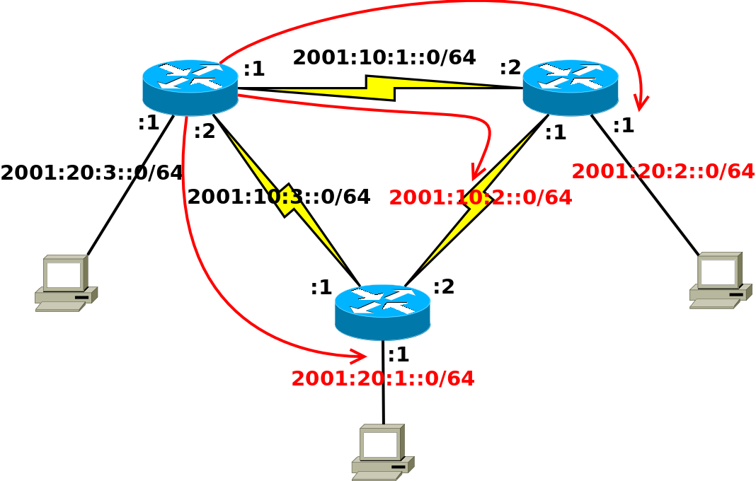

Static routing
IPv6 static routing
  (config)#ipv6 route <ipv6_net>/<mask> <next_hop>
  It is necessary to add routes leading to not connected parts of network topology on routers
  Every router has 3 static routes

Slide 12
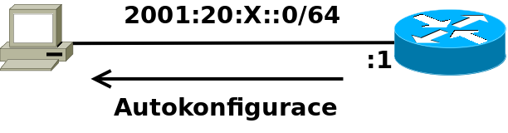
IPv6 autoconfiguration
Configuration of Ipv6 network prefix propagation from router
  (config)#interface <type><num>
  (config-if)#ipv6 nd prefix <IPv6_pref>/<mask>
Setting sending interval of router advertisements
  (config-if)#ipv6 nd ra-interval <num_sec>
Generating IPv6 address on computer
  ip link set <dev> down
  ip link set <dev> up

Slide 13
Configuration checking
Device accessibility
  ping6 <IPv6_addr>
Path to the device from L3 view
  traceroute6 <IPv6_addr>
  tracepath6 <IPv6_addr>

