Slide 1

DNS
Computer Networks
Seminar 12

Slide 2


DNS Introduction
(Domain Name System)
Naming system used in Internet
Translate domain names to IP addresses and back
Communication works on UDP (port 53), large requests/responses are sent over TCP (port 53)
DNS server processes requests, which gets from Resolver, and responses to them
Resolver is system component, which communicates with DNS server

Slide 3
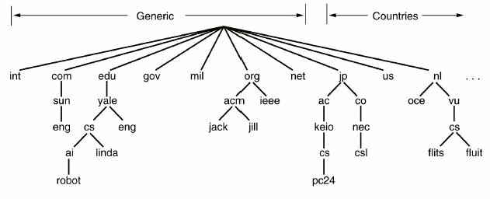


Domains
Domains:
  generic: .edu, .com, …
  country codes : .cz, .it, .uk, …
Domain names are hierarchically organized
(root of the tree is domain “.”)
Maximum domain name length is 256 char.
(1 subdomain max. 63 characters)

Slide 4
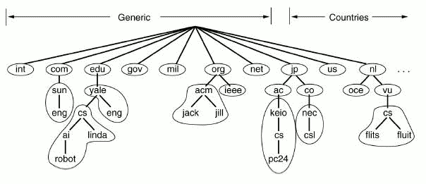
Zone
Zone is a part of the tree stored on single DNS server
DNS is authoritative for domains which are contained in the zone the server controls

Slide 5
DNS record types
SOA – Start of authority – specifies authoritative information about a DNS zone, including the email of the domain administrator and several timers relating to refreshing the zone.
NS – Name server – delegates a DNS zone to use the given authoritative name servers
MX – Mail exchange – maps a domain name to a list of mail exchange servers for that domain
A/AAAA – Address – returns IPv4/IPv6 address to given domain name
CNAME – Canonical name – alias of one name to another
PTR – Pointer – for storing reverse records

Slide 6



Getting the information from DNS server – nslookup program
Alternatives of dig program used in OS Windows
Commands:
  set type=<record_type>
    (NS,A, … or ANY, which displays all the records)
Example:
  C:\> nslookup
  > server DNS_server
  > set type=A
  > homel.vsb.cz
Another utility – host

Slide 7

Getting the information from DNS server – command dig
Looks for and displays the information from DNS server (Linux)
Parameters of program dig:
  @<server> - name or IP address of DNS server
  -t <record_type> - specifies record type
  -p <port> - if we are using nonstandard port
Example: dig -t A homel.vsb.cz (or dig homel.vsb.cz A)
DNS server response:
  QUESTION SECTION – request on DNS server
  ANSWER SECTION – response to the request
  AUTHORITY SECTION – tells which DNS server is authority
  ADDITIONAL SECTION – additional information, usually contains IP addresses of authoritative DNS servers

Slide 8

Example of command DIG requests
Gets IP address of yahoo.com
  dig yahoo.com –t A or dig yahoo.com A
Gets a list of mail servers for yahoo.com
  dig yahoo.com MX +noall +answer
List of authoritative DNS servers for yahoo.com
  dig yahoo.com NS +noall +answer
Displays all we tried with previous commands
  dig yahoo.com ANY +noall +answer
Gets PTR record
  dig 49.149.196.158.in-addr.arpa. ANY +noall +answer
  dig -x 158.196.149.9

Slide 9


Configuration of DNS server
BIND
Bind is DNS server implementation for OS OS Linux, Windows and FreeBSD. Configuration is split into few files.
/etc/bind/named.conf – main configuration file. There are zones defined for which the server is authoritative (in named.conf.*).
  options { //in named.conf.options file nowadays
  directory "/var/cache/bind";
  //where bind looks for configuration files
  recursion yes; //allows recursive lookup
  // uncomment forwarders and set them to 158.196.0.53
  // set dnssec-validation to false if it causes problems
  …
  };
  zone "." { // link to the zone file with root servers
  type hint;//means that contains only list of root servers
  file "/etc/bind/db.root";
  };
/etc/bind/db.* – records definition for particular zone (e. g. db.testEB4x)

Slide 10

testEB4 zone definition
In bind distribution we implicitly find some zones pre-configured (localhost, 127.in-addr.arpa, 0.in-addr.arpa)
  Definition of next zone in file named.conf.* could look like following:
    zone "testEB4x.cs.vsb.cz" {
    type master; //this name server will be //primary and authoritative
    //for this domain.
    file "/etc/bind/db.testEB4x";
    //File with definitions of the records
    };

Slide 11

Configuration of zone testEB4 file db.testEB4
$ORIGIN cs.vsb.cz.
  The value ORIGIN is implicitly added to the names, which doesn't end with dot.
$TTL 604800
  How long the record will be kept in cache
SOA record must always be written one time at the beginning of zone file:
testEB4x IN SOA ns.testEB4x admintestEB4.vsb.cz.
(2018092414 ;
604800 ;
… )
  ns.testEB4x
    Name of domain primary DNS server (ns.testEB4.cs.vsb.cz.)
  admintestEB4x.vsb.cz.
    E-mail of domain administrator (use “.” instead of @)

Slide 12

Configuration of zone testEB4x file db.testEB4x
SOA record should be followed by NS record specifying DNS server for given domain ($ORIGIN testEB4.cs.vsb.cz.)
NS a.ns
a.ns A 158.196.135.88
Assigning IP address to pc1.testEB4.cs.vsb.cz.
pc1 A 158.196.135.66
TXT "computer No.1"
Alias definition for pc1
www CNAME pc1
Subdomain NS defintion
subdom NS ns.subdom
ns.subdom A 158.196.135.66

Slide 13
DNS server configuration for reverse lookup
It serves for IP address to domain name mapping
We put zone definition for reverse lookup into file named.conf
Domain name of the record for reverse lookup of address A.B.C.D is
D.C.B.A.in-addr.arpa.
  zone "135.196.158.in-addr.arpa" {
  type master;
  file "/etc/bind/db.135.196.158.in-addr.arpa";
  };

Slide 14
Zone configuration
135.196.158.in-addr.arpa.
Based on same rules used for configurating nomrmal zone. There must exist records SOA a NS (name server responsible for domain)
Instead of record A we use record PTR, which maps IP addresses to domain names
  $ORIGIN 135.196.158.in-addr.arpa.
  66 PTR pc1.testEB4x.cs.vsb.cz.

Slide 15

resolv.conf, hosts, host.conf
Files contaning resolver configuration (Linux), in /etc
  resolv.conf – configuration of DNS on client's side
    commands:
      search <domain> – implicit added domain
      nameserver <DNS server IP address>
  hosts – manually (staticaly) configured addresses (also in Windows)
    <IP address> <name> [<name2> …]
  host.conf – order of record sources (static and DNS addresses) in resolving (no effect in new OS)
    order hosts, bind – first file hosts, after DNS

Slide 16
Tools for checking BIND DNS server configuration
Syntactic check of configuration files
  named-checkconf /etc/bind/named.conf
    Or for individual named.conf.* config files
  named-checkzone zone zone_db_file
    Out-of-zone data or missing A records for domains where part of DN is repeated twice mean there is an error as well.
Running named in foreground (sudo)
  named -g
  If not possible, try: service bind9 stop

Slide 17
First Task – basic DNS records
Bind DNS server configuration
  Add your DNS server for testEB4x.cs.vsb.cz
    In named.conf.local
  Add SOA, A and TXT
  records
  Enable Reverse lookup
    In named.conf.options
  Set client resolver (/etc/resolv.conf)
  Test the whole solution
vsb.cz
decsys.vsb.cz
cs.vsb.cz
nfs460.cs.vsb.cz
testEB4x.cs.vsb.cz
pcfeib425x.vsb.cz

Slide 18
Second task - subdomain
vsb.cz
Add another level (subdomain) into DNS tree.
Add an SOA record and all necessary NS and A records, for the subdomain add also MX and TXT records.
decsys.vsb.cz
cs.vsb.cz
nfs460.vsb.cz
testEB4x.cs.vsb.cz
pcfeib425x.vsb.cz
moje.testEB4x.cs.vsb.cz

Slide 19
Third task – reverse records
Configure the DNS server to be authoritative for the Z.Y.X.0/24 subnet’s
X.Y.Z.in-addr.arpa zone, which will be assigned to you.
Insert the PTR records for some addresses to this zone and test the reverse translation.
  When checking the reverse translation, make sure the client is communicating directly with your DNS server.

