Slide 1
Final Project
Daniel Jamieson s180676

Slide 2
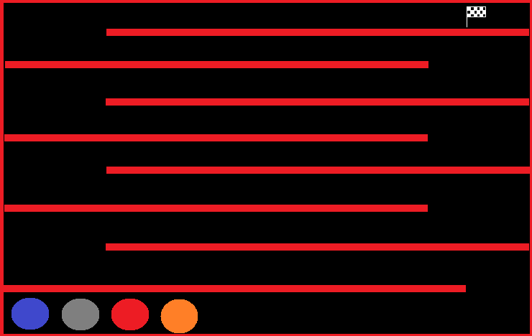
Grand Ideas
Networking
Game Engine
SFML & Box2D
CSV files

Slide 3
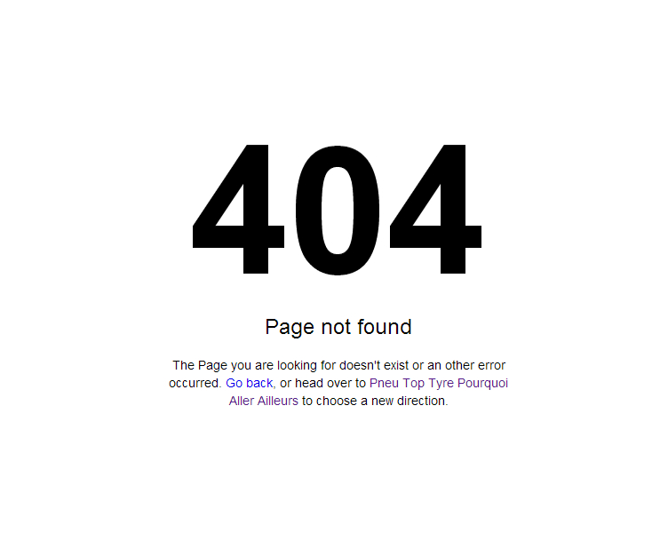
Current State
Physics
Graphics
Networking

Slide 4
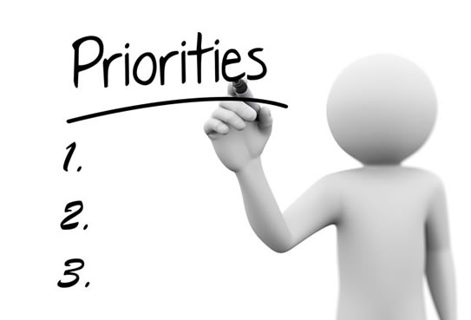
Explanation
Other Modules
Scoping
Project Priorities

Slide 5

Learning From Mistakes
Time management
Dynamic Scoping
Communication with Tutors
Blog Posts
Consistency

Slide 6
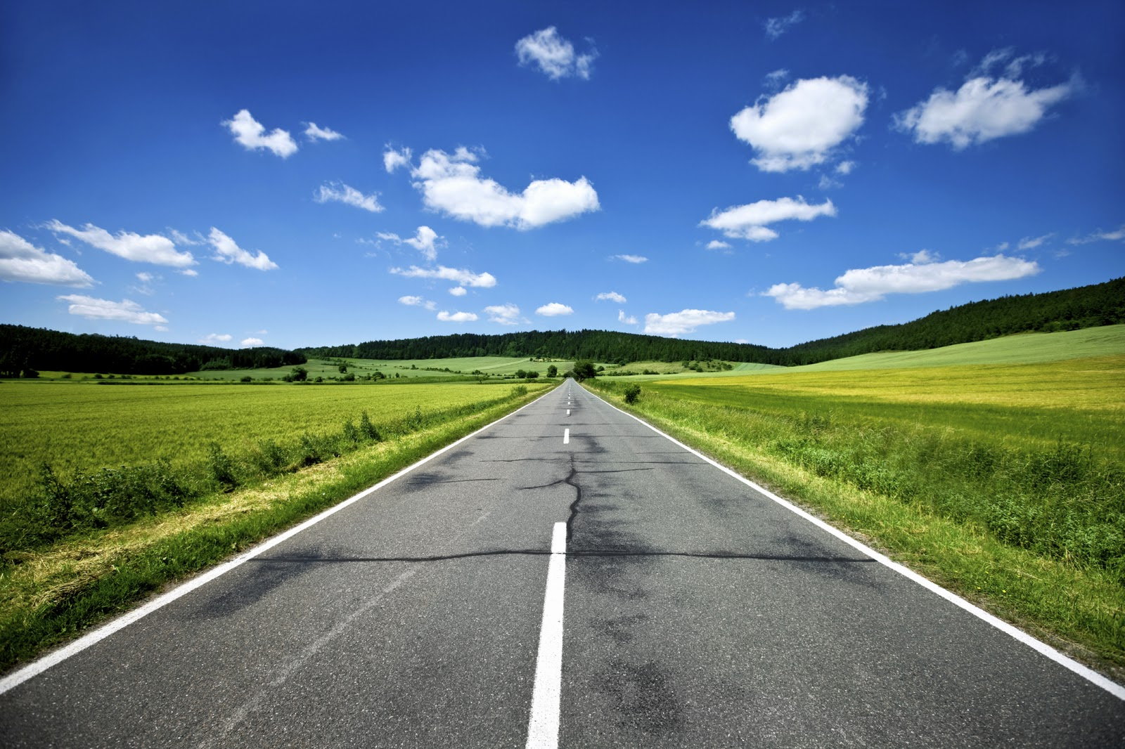
Fresh Start
Research
Basic prototype
Networking
1 configuration
Ack [Data Identifier]
Serialised Struct
Blog Post

Slide 7

Current Research
Client Input
Client side prediction
Server overrules clients
https://developer.valvesoftware.com/wiki/Source_Multiplayer_Networking https://gamedev.stackexchange.com/questions/117954/how-should-a-server-handle-client-actions https://www.gamedev.net/forums/topic/533735-who-should-handle-the-collision-client-or-server/

Slide 8

Current Scope
Working with inputs
Networked client and server
Save communications in CSV

Slide 9
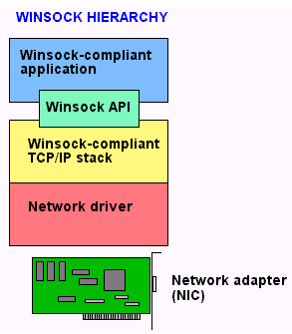
Current Progress
Client Input
Basic UDP

Slide 10
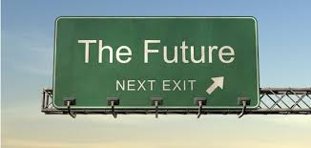
Next Steps
Inputs create a message
Struct to send
Ack
Output to CSV

Slide 11
Questions

