Slide 1
Develop products to sell on Amazon
How to do product research on Amazon
By: Ling Ge Zeng

Slide 2
Why selling on Amazon?
More than 50% of U.S online transactions take place on Amazon *
eBay 6.6% *
Apple 3.9% *
Walmart 3.7% *
90% consumers price check a product on Amazon
Average more than 200M unique visitors per month
More than 100M Amazon prime member
Low start-up costs
* Data from www. statista.com

Slide 3
What to sell?
Amazon has 12 million products, books, media, wine, and services.
350 million products including Amazon Marketplace sellers
Ideal product
Low risk
High profit margin
Low shipping costs
Less competition
Low Amazon selling fee

Slide 4
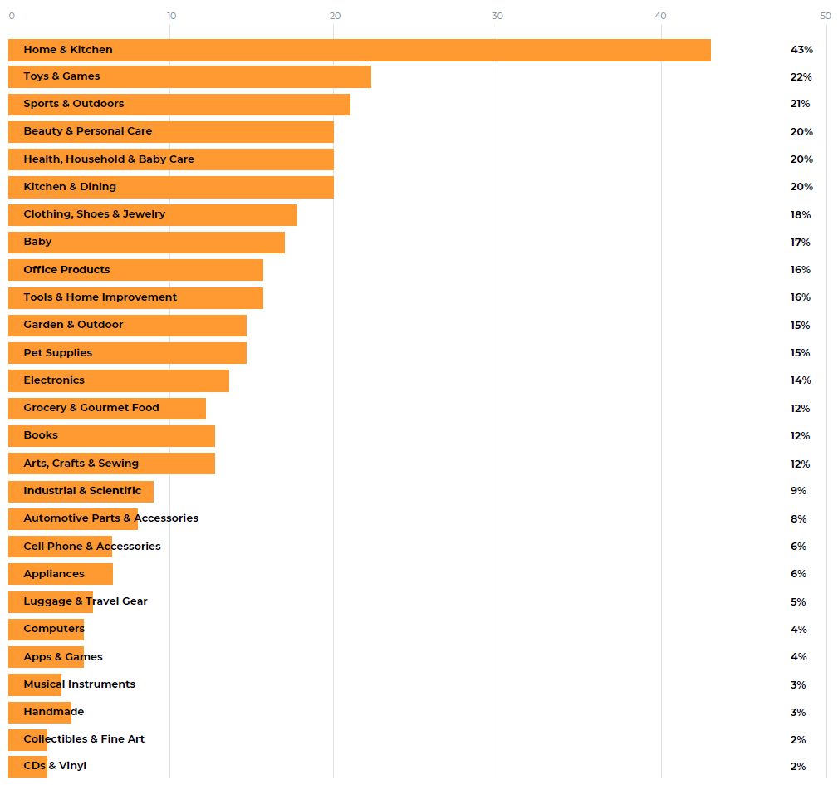
Most popular Amazon product categories to sell in
Pro
Lower barrier to entry
More intuitive product ideas
Fewer complicated requirements
Easy to manufacture
Con
Competing with lots of other sellers
Lower profit margin
Higher ad cost
* Sellers might choose multiple categories
** Data from amazon-seller-report 2020

Slide 5
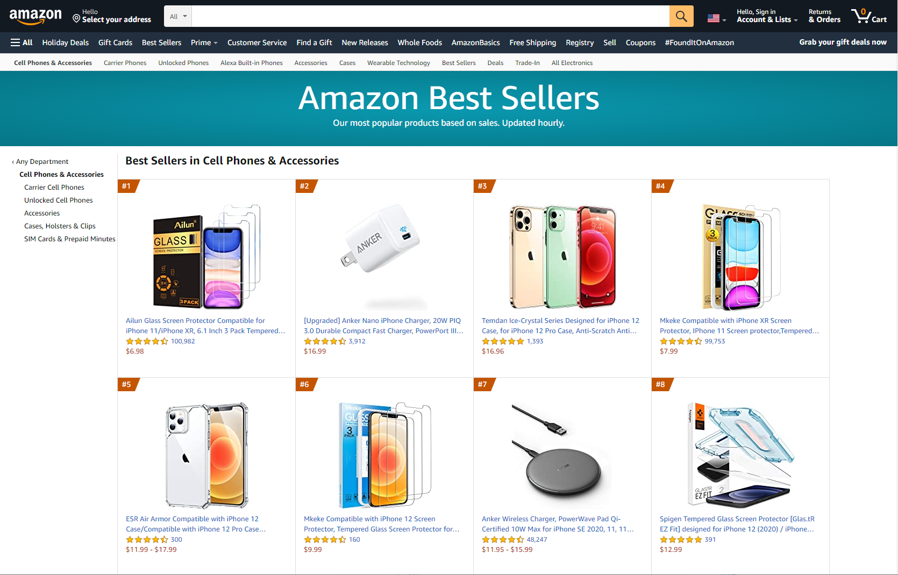
How to do product research on Amazon
Check the best-selling list
Find out high demanding products

Slide 6
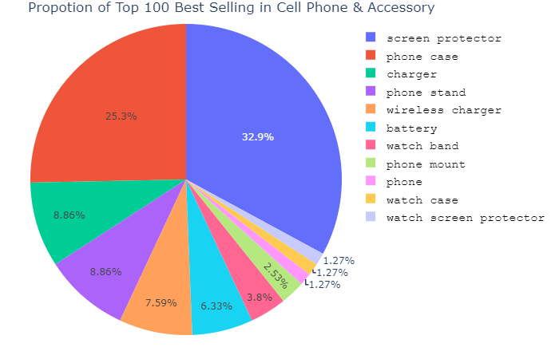
What are Top 100 Best Sellers selling ?
Screen Protector
Phone Case
Wall Charger
Phone Stand
Wireless Charger

Slide 7
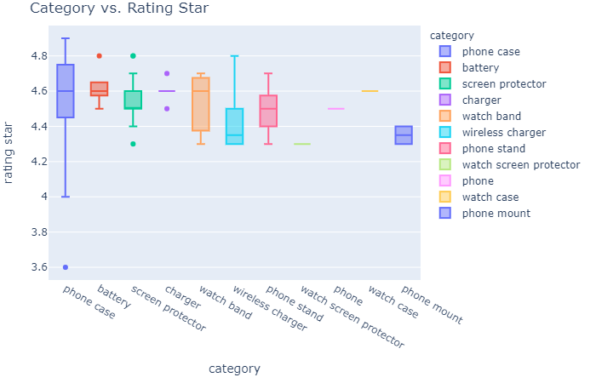
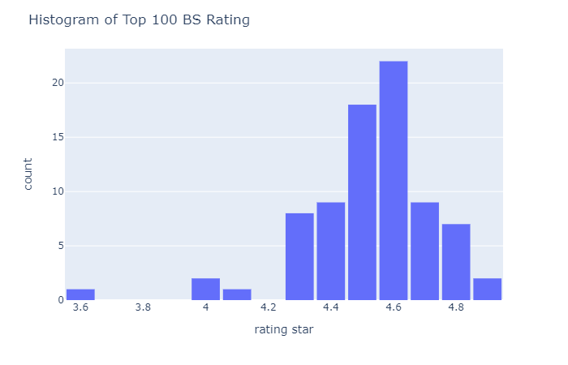
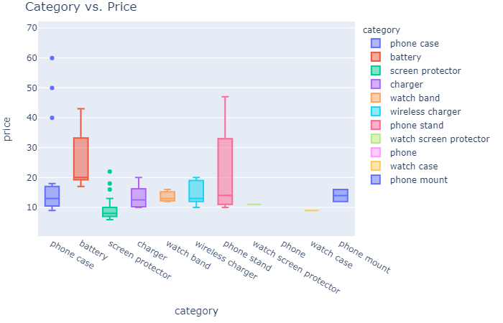

Slide 8
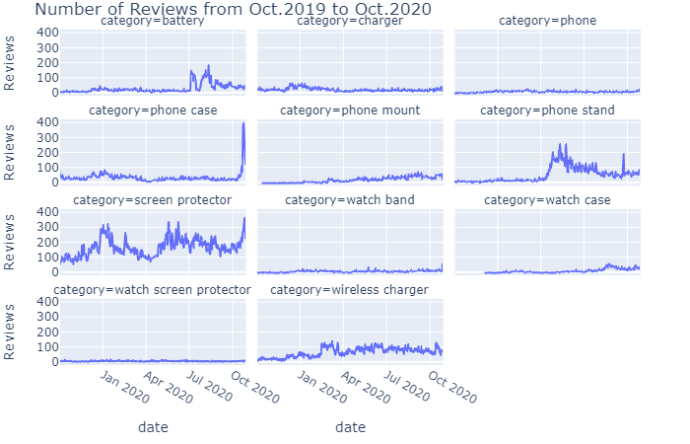
Summarize the key benefits provided by the product or service you are promoting.
Example:
Investment in market research is an investment in your product’s success!
Know your customer
Know your competition
Timing is everything
Track and adjust

Slide 9
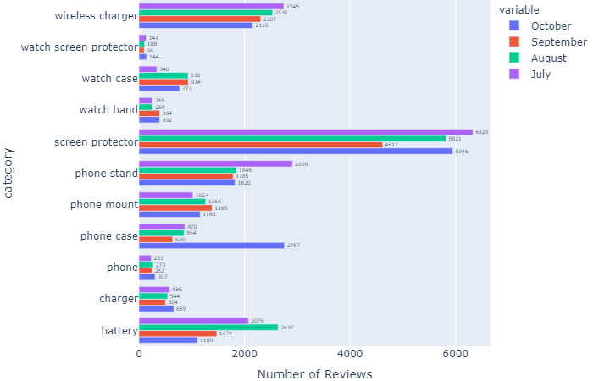
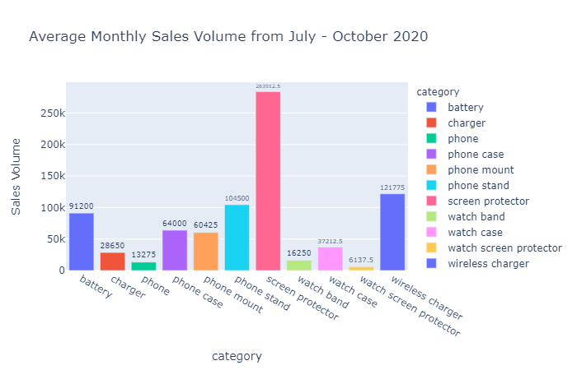
Review percentage: 1% – 3%

Slide 10
Next Steps: Keyword Analysis on creating effective listing title on target product.
Conclusion:
Screen protector is ALL TIME high demanding product, means high competition.
External battery is high seasonality product to sell during summer time.
Wireless charger is in upward demanding trend
Watch case is a great product to sell
As holiday season approaching, all this cell phone accessories will have a decent sales boost because the prices are in $10 - $25.

Slide 11
THANK YOU

