Slide 1
Internet of Things, Connectivity, Network Topology and Theory and Cybersecurity
Monday, November 25th 2019
Danny Lionel 100616831

Slide 2
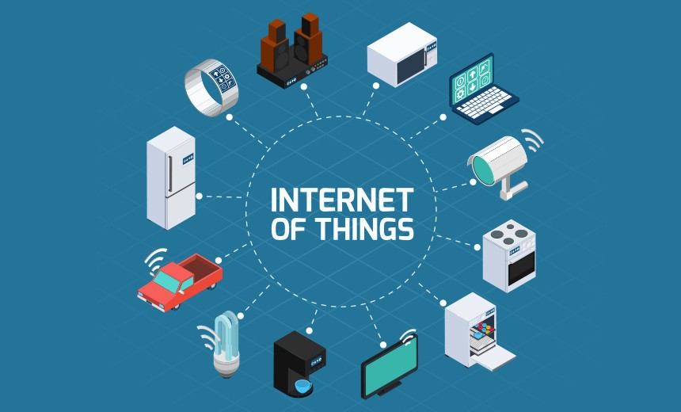
Internet of Things
Internet of Things refers to the connectivity of our devices, how they communicate with each other and how they affect our daily lives
The modern world relies on the internet of things in order to function and is still trying to further the concept forward. The concept of the Internet of Things can be applied to bluetooth, smart homes. businesses , etc.

Slide 3
Connectivity
Fibre Optic and Wireless Communication

Slide 4
Introduction
Electromagnetic radiation (light) and wave theories provide the scientific and mathematical tools for understanding connectivity.
Infrared light (fibre optics)
Radiowaves and Microwaves (cellular mobile networks, wi-fi)
Signals that carry information in these forms use light.
We will briefly examine these concepts and see how they apply to communication technology today and in the future.

Slide 5
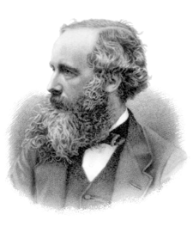
What is Light?
When a charged particle undergoes acceleration, it emits energy. Some of this energy is electromagnetic radiation (EM) - known as light.
James Clerk Maxwell determined that “changes in the electric field are always accompanied by a wave in the magnetic field in one direction, and vice versa” [1].
Maxwell concluded that the relationship between these fields “form a propagating electromagnetic wave, which moves out into space and need never again interact with the source” [1].
These unique properties of light are ideal for transmitting energy and information.

Slide 6
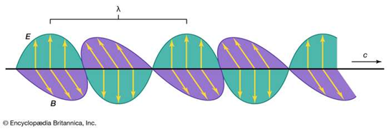
EM Waves
Electric field (noted as E) and magnetic field (noted as B) vectors are perpendicular to each other.
Transverse waves oscillate perpendicular to the direction of wave travel (noted as c).
We can analyze waves based on their wavelength, frequency, and speed: v=fλ
v is the speed of the wave (c in a vacuum, or less in other media)
f is the frequency, and λ is the wavelength
As waves cross boundaries between different media, their speeds change but their frequencies remain constant [2].
Figure 1: A light wave [2]

Slide 7
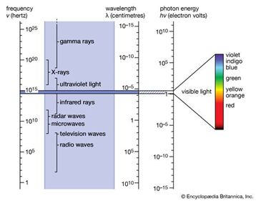
The EM Spectrum
Light varies depending on its frequency, wavelength, and energy.
For example, the light we see with our eyes is in the visible light range, fibre optic communication mainly uses infrared, and wireless transmission uses radio/microwaves
Figure 2: light waves in EM spectrum [2]

Slide 8
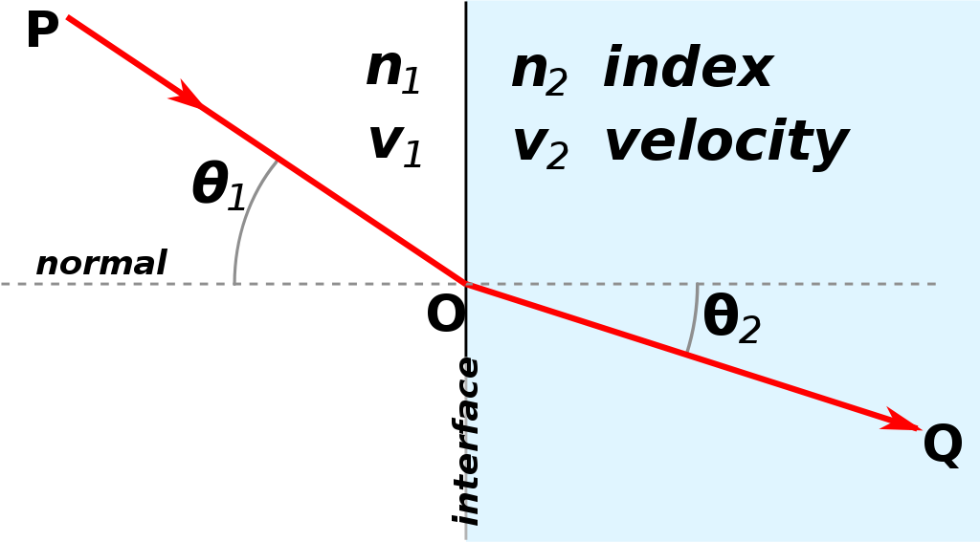
Index of Refraction
We must consider the refractive index (n) when we use light waves :
n=c/v
and Snell’s law:
n₁sin⁡θ₁=n₂sinθ₂
In a vacuum, light travels with a constant speed, c, approx. 300,000,000 m/s [2].
There is a low latency for a signal to travel long distance.
When constructing fiber optic cable and radio transmitters, we must consider how light is reflected and refracted.
Figure 3: Refractive light interface [2]

Slide 9
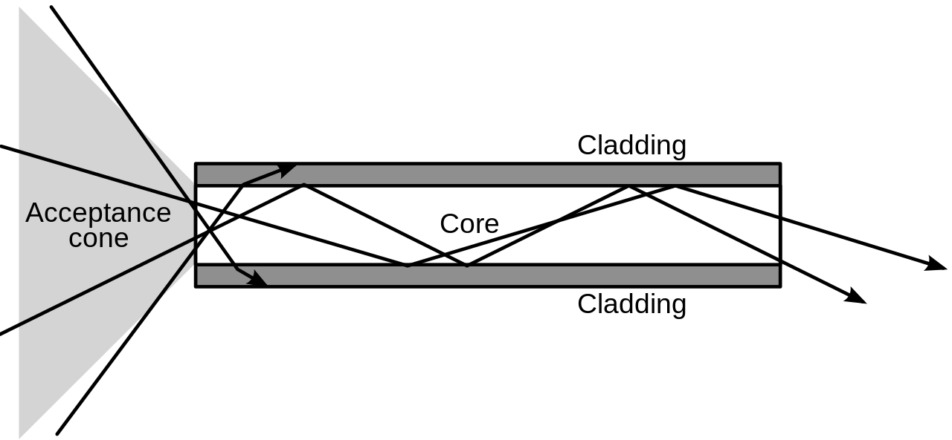
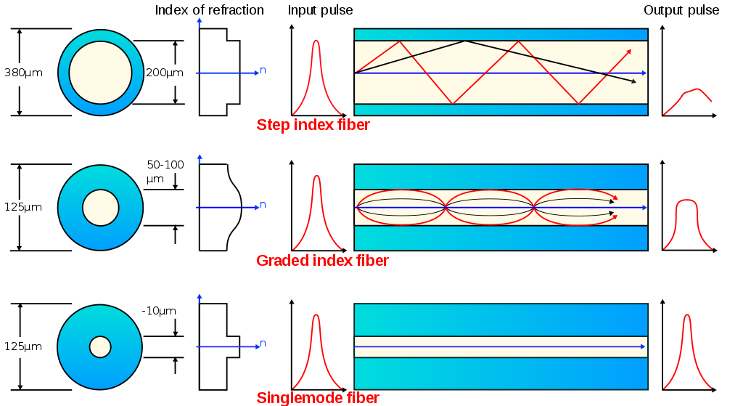
Fibre Optic Communication
Figure 5: Different optical cable types depending on purpose [3]
Figure 4: Using refraction, infrared light can be ‘guided’ through a conduit or cable [3]

Slide 10
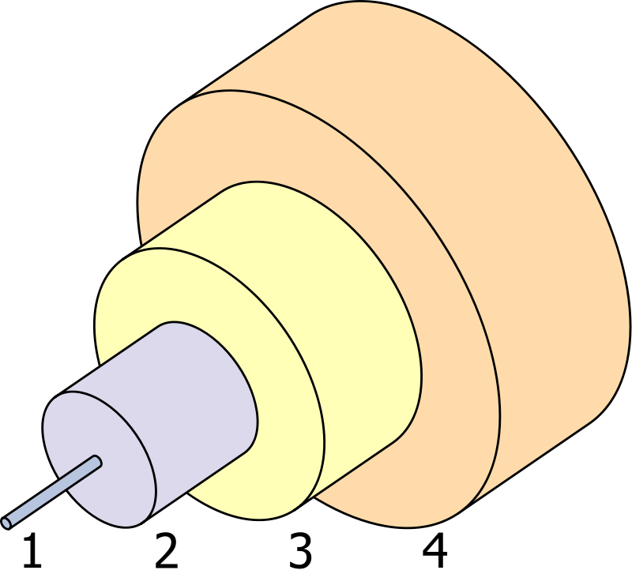
Fibre Optic Communication
Infrared light - longer wavelength than visible light, between 800-1600 nm.
Signal can travel farther without losing quality and strength (less attenuation).
Fibre optical cables consist of:
Silica (glass) composite fibres
Glass is used because of its refractive index and wave guiding properties.
Future designs of consist of ‘twisting’ fibres, this will increase bandwidth over 100x from today’s standard.
Figure 6: Optical cable cross section [3]
1-Core 2-Cladding 3-Buffer 4-Jacket

Slide 11
Advantages of Optical Fibre
High bandwidth
Immunity to electromagnetic interference
Low attenuation loss over long distances
Electrical insulator
Low materials/manufacturing cost
Security of information

Slide 12
Wireless Communication
EM waves propagate signals without using an electric conductor or physical connection between two points.
Transistor radios, cell phones, wi-fi devices, and satellites in outer space are a few applications of wireless communication using light.
Principles of EM waves used to understand and build wireless communication networks.

Slide 13
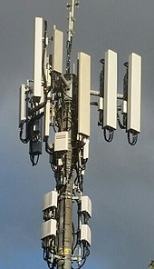
Wireless Communication
Frequencies can range from a few KHz to few hundred GHz.
Radio and Microwaves can penetrate most materials without change in frequency
Wireless data communications allows wireless networking between computers, cell phones and other digital devices.
Technologies differ in signal strength, coverage range, and performance (bandwidth).

Slide 14

Wireless Data Communication
Wireless data communications are used to span a distance beyond the capabilities of typical cabling in point-to-point communication.
We can use wireless signals to where cabling is difficult or costly, or to remotely connect mobile users or networks.
Wi-Fi, GSM, CDMA, GRPS, 2G, 3G, 4G, and 5G are examples of different cellular networks that are linked to form extensive communication networks.
5G will operate with waves shorter than microwaves, this will allow for increased bandwidth, but will require more power and antennas to transmit signals over far distances.
Figure 7: Wireless networks are divided into small geographical areas called cells [4].

Slide 15
Wireless Communication Networks
Wireless devices in a cell communicate by radio waves with a local antenna array and low power automated transceiver (transmitter and receiver) in the cell [4].
Local antennas are connected with telephone networks and the Internet by a high bandwidth optical fiber or a dedicated wireless connection.
5G and other wireless technologies utilize MIMO (multiple-input multiple-output) systems [5]. Parallel bitstreams of data can be transmitted simultaneously between devices.
Using beamforming, communication systems will calculate the best path for radio waves to reach each wireless device in real time
Multiple antennas work together as phased arrays to connect devices. For example, 5G can support up to a million devices per sq. km, while 4G supports only up to 100,000 devices for same area [5].

Slide 16
Connectivity
Principles derived in science and mathematics provide the means to understand how light is used to connect various networks.
Combining optical fibre and wireless radio waves, we can connect networks and devices in the ‘Internet of Things’ with high bandwidth, low latency capabilities over large distances.
These systems provide the connectivity of today’s networks.
Demand for faster and larger information is driving the evolution of communication networks.

Slide 17
Connectivity References
[1] “James Clerk Maxwell”. Wikipedia 2019, https://en.wikipedia.org/wiki/James_Clerk_Maxwell
[2] Hellmut Fritzsche and Melba Phillips “Electromagnetic radiation”. Encyclopædia Britannica. Published: October 18, 2017 URL: https://www.britannica.com/science/electromagnetic-radiation
[3] “Optical fiber”. Wikipedia 2019, https://en.wikipedia.org/wiki/Optical_fiber
[4] “Cellular networks”. Wikipedia 2019, https://en.wikipedia.org/wiki/Cellular_network
[5] “5G”. Wikipedia 2019, https://en.wikipedia.org/wiki/5G

Slide 18
Network Theory

Slide 19
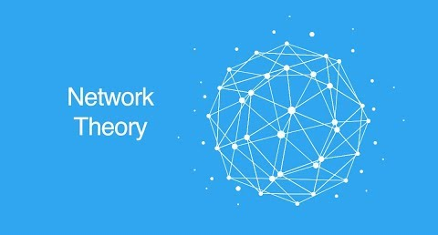
Definition - What is Network Theory
Network Theory delves into the connectivity of devices inside a network. It states that a network of devices isn’t defined by the number of devices, but rather the connectivity between these devices
Network Theory can also be considered the main building block for the Internet of things as network theory

Slide 20
Understanding Graph Theory
Networks can also be considered as graphs (from a mathematical perspective)
In order to fully grasp network theory, you must have a understanding of what graph theory is
graph theory is the study of the mathematical properties of graphs and builds the theoretical foundation for modern network theory
Graph theory is a tool to look at the underlying structure of complicated objects and dynamic phenomena by simplifying the structure

Slide 21
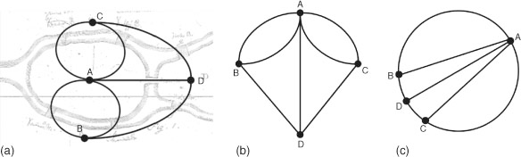
Graph Theory-History
-Problem:, the German city of Konigsberg was settled on the river Pregel. It was set on both sides of the river and had two islands in which all of it was connected by seven bridges. The problem was discovering a route through the city that would cross each and every bridge once and only once.
Solution:Leonhard Euler declared that there was no such route. Euler pointed out that regular measurements and calculations wouldn’t account for this type of issue and instead created a new kind of geometry (graph Theory). Euler was able to come up with the observation by constructing a network with 4 nodes and 7 edges.

Slide 22
Graph Theory-Concepts
Network-Graph with associated numerical values
Arcs
-connections between nodes.
-Arcs can either be directed (defined direction to node 1 to 2) or undirected (undefined direction between 2 nodes). These properties define if the graph is defined or undefined
Connectivity
defines number of arcs connected to a node.
In undirected and unweighted networks, the nodal degree is calculated from the sum of all edges connected to a network
in directed and weighted networks, the degree could be split into either a inward or outward degree
inward degrees are equivalent to number of nodes connected to a certain node
outward degrees are equivalent to number of nodes the certain node connects to
the degree of the node decides the rate of speech at which the node can get data, the higher degree the node the bigger the chance of the node receiving data But if network is compromised, the first victims will be the higher degree nodes.
Centrality
Tool to measure the importance of a selected node in a network
Degree centrality:importance of a node based on the number of direct arcs to its other nodes
Closeness Centrality: the importance of a node based on its total shortest distance to the rest of the network
Betweenness Centrality: quantifies how often a node appears on the shortest path connects to the other nodes
Eigen vector centrality : assigns relative scores to all nodes in the network based on the concept that connections to highly connected nodes contribute more than connections to nodes with lower degrees of connectivity

Slide 23
Network Topologies

Slide 24
Definition-Network Topology
-The layout of a network and how the different nodes in a network are linked together and how they send and receive messages
-The most commonly used in the modern world are star and mesh networks
-The 5 main topologies are :
-Bus Topology
-Star Topology
-Ring Topology
-Mesh Topology
-Tree Topology

Slide 25
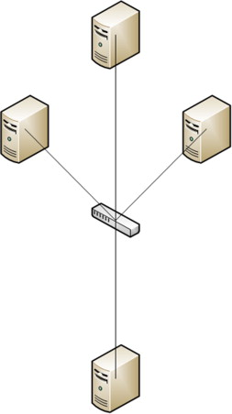
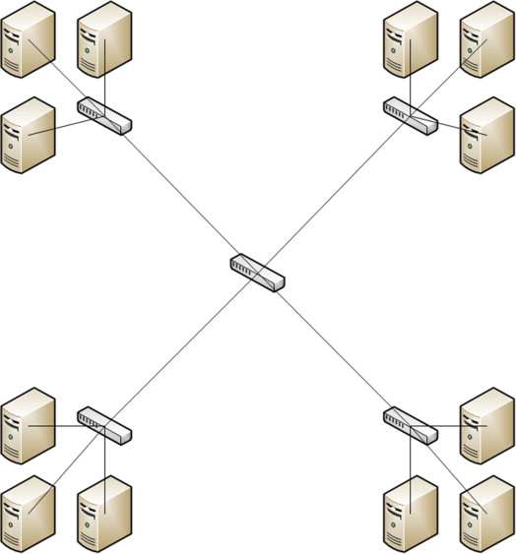
Star Topology
-When multiple devices are connected to a central computer (referred to as a hub). These devices can communicate with each other by passing info through the hub, then the hub will direct the message to the desired device
-If a physical limitation occurs inside of a star network (cable length, number of ports, etc.), star networks handle this by extending the network into multiple star topologies with a central core in the center of the multiple star topologies (referred to a backbone of the network)
Pro’s
High data speed transfer
Good expandability in terms of the network
Easy to manage problems
Con’s
-if hub device goes down, then entire network will die with it
Entire performance of network depends on the hub

Slide 26
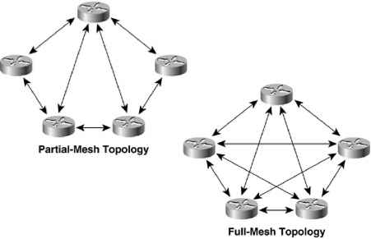
Mesh Topology
-A mesh network involves connecting all the computers to each other in a network. This setup allows for the devices to not only send signals but can relay data from the other nodes in the network
-There are two types of mesh networks: full mesh network (connects all devices to each other) and partial mesh network (some devices are connected to each other)
-Full mesh can be very redundant but is more expensive and vice versa for partial mesh
Pro’s
Provides high privacy and security
No traffic problems (since there is point to point links)
Fault identification is easy (due to being point-to-point links)
Con’s
Requires high number of cables and I/O ports for communication
Costly compared to other topologies

Slide 27
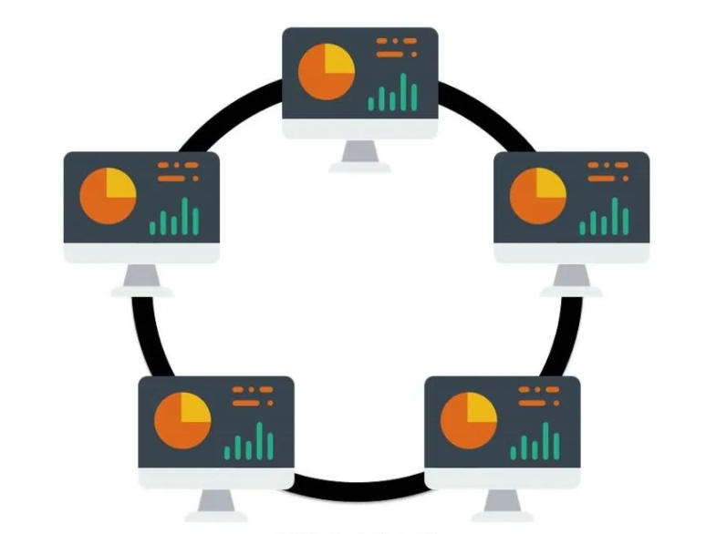
Ring Topology
-Each device/node is connected with its neighboring node forming the shape of ring hence it is known as Ring Topology. The flow of data messaging (from one device to the other) is either unidirectional or bi-directional
-Unidirectional ring networks transfers data in either clockwise and counterclockwise direction. Bi-directional ring networks can transfer data and receive data at the same time (referred to as a full duplex network)
Pro’s
High speed data transfer (unidirectional)
Can handle high number of nodes in network
Less costly compared to other topologies (mesh, hybrid, etc)
Con’s
Addition/Removal of nodes is difficult
Single break in cabling can cause disturbance in whole network

Slide 28
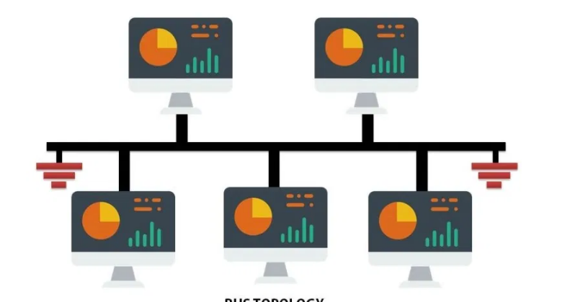
Bus Topology
-Consists of a single cable with the terminator at each end. All present nodes are connected to the single cable. There is no limit to the no: of nodes that can be attached to this network, but the no: of connected nodes can actually affect the performance of the network
-one of the nodes in a bus network will act as a server and sends and transmits data from one end to the other end of the wire. When the data is sent to the terminator, the terminator removes the data entirely
Pro’s
Easy to expand (combine two cables together)
A node failure will not result to affecting other devices in network
Con’s
Difficult to find faults in network in terms of device failure
Slower due to only one device transmitting data at a time
If backbone cable is damaged, then entire network will fail

Slide 29
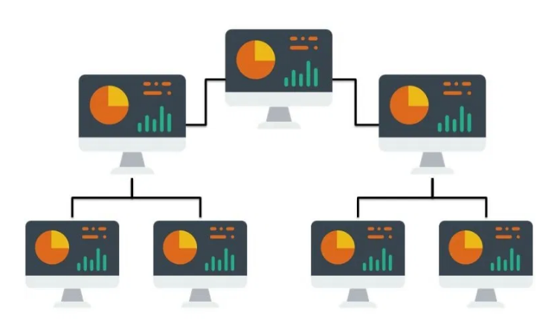
Tree Topology
-In Tree Topology, all the computer are connected like the branches of a tree. In Computer Networking, tree topology is known as a combination of a Bus and Start network topology
-Tree network topology is the simplest topology in which only one route exists between any two nodes on the network. The pattern of connection resembles a tree in which all branches spring from one root
Pro’s
Provides high expandability in terms of network
A damaged node will not affect the other nodes in the network
Provides easy maintenance and fault identification
Con’s
On the failure of the hub, entire network will fail
Difficult to configure

Slide 30
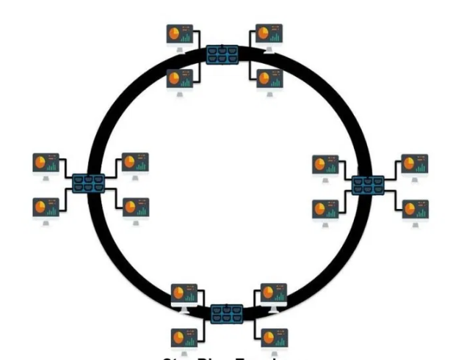
Hybrid Topology
-considered a combination of two or more topologies. It inherits the advantages and disadvantages of the used topologies. Each combination is used for different uses
-Star-ring topologies and Star-Bus networks are the most commonly used in the real world
Pro’s
Combines the advantages of different topologies
Flexible
Good scalability
Very reliable
Con’s
Very Expensive
Design and structure can be complex

Slide 31
Cyber Security

Slide 32
Definition - What is Cybersecurity
Defending Network Systems, software applications from digital attacks
Digital attacks- Unauthorised access to computers, software
Purpose? Steal Information, Sabotage

Slide 33
History of Cybersecurity Attacks
Morris worm in 1988
Calce DDOS in 2000

Slide 34
Common Cybersecurity Attacks
DDos
Phishing

Slide 35
Common CyberSecurity Attacks- DDoS
Hundreds of computers access a server at once
Floods the server traffic
Destabilising the server, hence crashing
Notes:
A denial-of-service attack overwhelms a system’s resources so that it cannot respond to service requests. A DDoS attack is also an attack on system’s resources, but it is launched from a large number of other host machines that are infected by malicious software controlled by the attacker.
Unlike attacks that are designed to enable the attacker to gain or increase access, denial-of-service doesn’t provide direct benefits for attackers. For some of them, it’s enough to have the satisfaction of service denial. However, if the attacked resource belongs to a business competitor, then the benefit to the attacker may be real enough. Another purpose of a DoS attack can be to take a system offline so that a different kind of attack can be launched

Slide 36
Common CyberSecurity Attacks- Phishing
Attackers sends “Trustworthy” emails to users
Utilises social engineering and trickery
Spear Phishing- hard to detect
Installs malware on network once successful
Notes:
Phishing attack is the practice of sending emails that appear to be from trusted sources with the goal of gaining personal information or influencing users to do something. It combines social engineering and technical trickery. It could involve an attachment to an email that loads malware onto your computer. It could also be a link to an illegitimate website that can trick you into downloading malware or handing over your personal information.
Spear phishing is a very targeted type of phishing activity. Attackers take the time to conduct research into targets and create messages that are personal and relevant. Because of this, spear phishing can be very hard to identify and even harder to defend against. One of the simplest ways that a hacker can conduct a spear phishing attack is email spoofing, which is when the information in the “From” section of the email is falsified, making it appear as if it is coming from someone you know, such as your management or your partner company. Another technique that scammers use to add credibility to their story is website cloning — they copy legitimate websites to fool you into entering personally identifiable information (PII) or login credentials.

Slide 37
Common Security Measures
Authentication
Intrusion detection
Data Fragmentation
Anti DDOS Protection

Slide 38
Conclusion - Cybersecurity
Cybersecurity attacks are here to stay
Need to come up with new solutions
Crucial for users to do play their part

