Slide 1
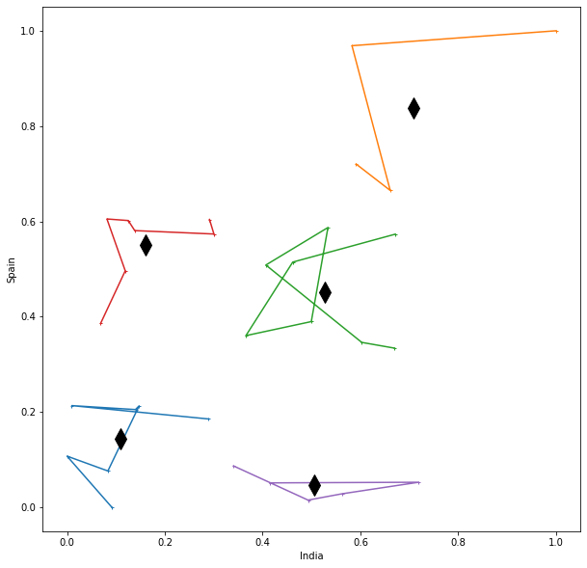
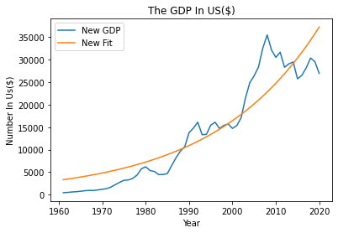
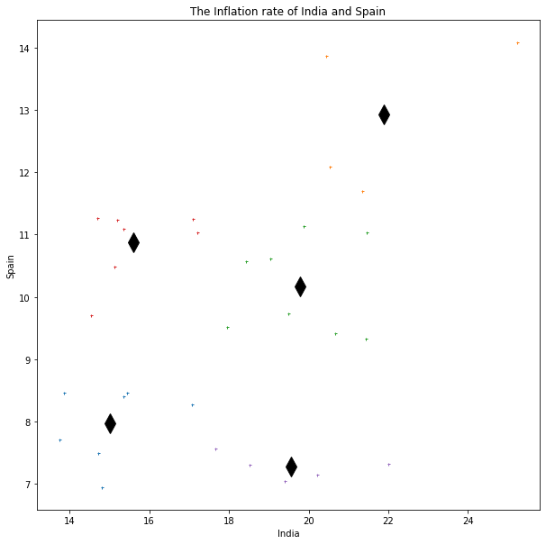
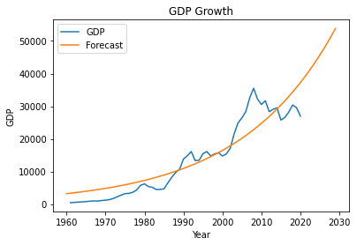
Clustering And Curve Fitting
Clustering:
Making a bunch of abstract things into classes of related objects is the process of clustering.
Market research, pattern identification, data analysis, and image processing are just a few of the many applications that clustering analysis is widely utilized in.
Fitting:
Finding a mathematical function with an analytical form that best fits this set of data is a procedure known as curve fitting.
Here, we can use appropriate modules for different curve fit and finding fruitful results.
Data : I have selected “INFLATION” rate data for clustering from the world bank data site.
Output :
We can see from the chart , there are 5 cluster in this graph. I selected two different countries for the clustering and used k-means clustering algorithm, which most widely and simplest algorithm.
In addition, there are two countries India and Spain. The inflation rate in “GDP” in these two countries using clustering.
Conclusion : As an overall assessment, we can directly see that these two graph represent clustering using one of the k-means algorithm and making meaningful result between two countries India and Spain which indicate Inflation rate of two nations.
Data : I have selected “GDP Per Capital” data for curve and fitting from the world bank data site.
Output:
Above the chart, we can see that the line chart respectively shoot up in from 1960 to 2000. After that its drastically increased over the decade.
Also, we are using exponential function for Calculates exponential function with scale factor “n0”and “growth rate g”.
Finally, above the graph represent the forecasting GDP for next 10 years . We used exponential function through predict the forecast curve for next decade.
Conclusion: In this report, we can talk about curve fit and we made two graphs. First define new fit curve for over the period of time and second estimated the GDP growth for next 10 years.
GitHub Link
https://github.com/DannyP007/ADS-1_ASSIGNMENT3.git

