Slide 1
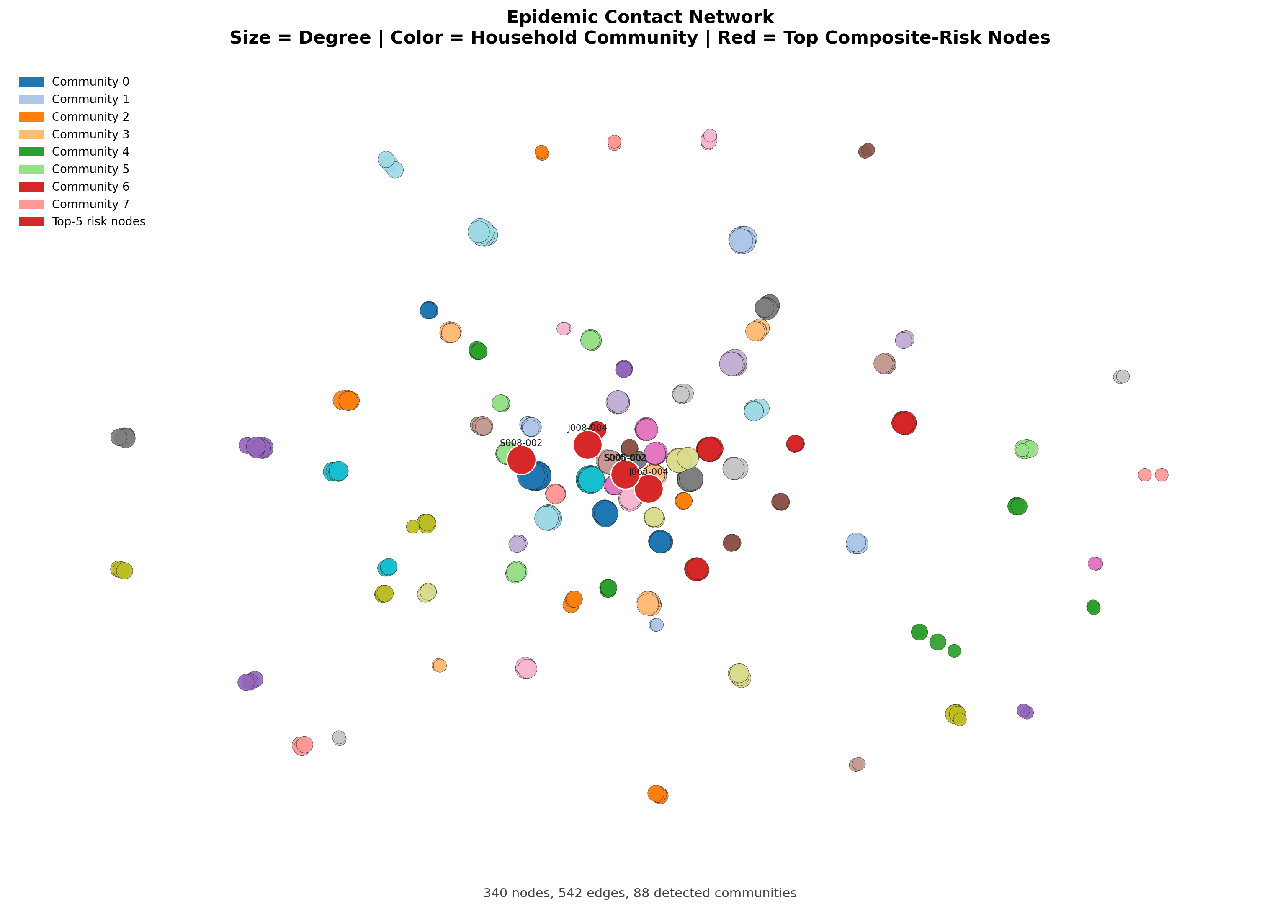
Budget-Constrained Epidemic Intervention using GNN
CostTrace Phase 05 | SASHTS household contact network
340
542
88
42.7%
nodes
weighted edges
households
best reduction at k=10%
CostTrace Phase 05
01

Slide 2
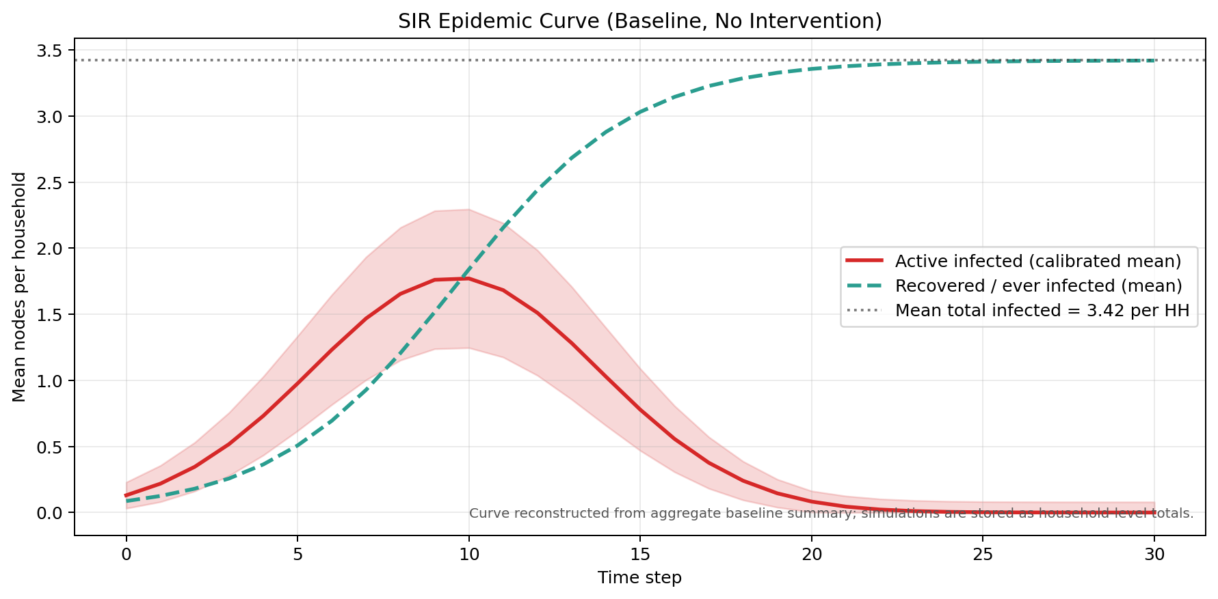
CONTEXT
Contact tracing becomes a resource-allocation problem
Knowing likely spreaders is only useful if the team can decide whom to isolate first.
Household transmission creates dense local contact structures.
Budgets are constrained: only k percent of nodes can be selected.
The objective is not only source discovery; it is reducing downstream infections.
3.42
70.9%
baseline infected per household
observed attack rate
CostTrace Phase 05
02

Slide 3
DEEPTRACE
DeepTrace solves the source question, not the budget question
CostTrace extends the story from who likely spread infection to who should be selected under limited capacity.
GNN signal
MLE source search
Likely F0
Action gap
Strength: graph learning helps identify influential sources.
Gap: it does not directly answer which k percent to isolate.
CostTrace evaluates the operational decision with SIR simulations.
CostTrace Phase 05
03

Slide 4
RESEARCH QUESTION
Which strategy reduces infections most when only k% of nodes can be removed?
The experiment compares four selection rules under identical budget and SIR settings.
Random
Degree
Betweenness
GNN risk
1%
5%
10%
Outcome metric: percent reduction in mean infected nodes per household vs baseline.
tight budget
medium budget
expanded budget
CostTrace Phase 05
04

Slide 5
DATASET
SASHTS is small, dense, and household-scoped
This makes the task a realistic test of intervention prioritization inside local contact components.
340
542
individuals
edges
0.963
0.970
avg HH density
Louvain modularity
Data source: South Africa Household Transmission Study.
Edges are weighted by proximity duration and contact count.
CostTrace Phase 05
05

Slide 6
METHOD
The pipeline turns contact data into comparable intervention decisions
Every strategy produces a selected top-k node set before the same SIR evaluator is applied.
Clean graph
Rank nodes
Select top-k
Run SIR
Topology and community metrics describe structural position.
GraphSAGE uses topology, contact, and metadata features.
SIR outputs are aggregated by household component.
CostTrace Phase 05
06

Slide 7
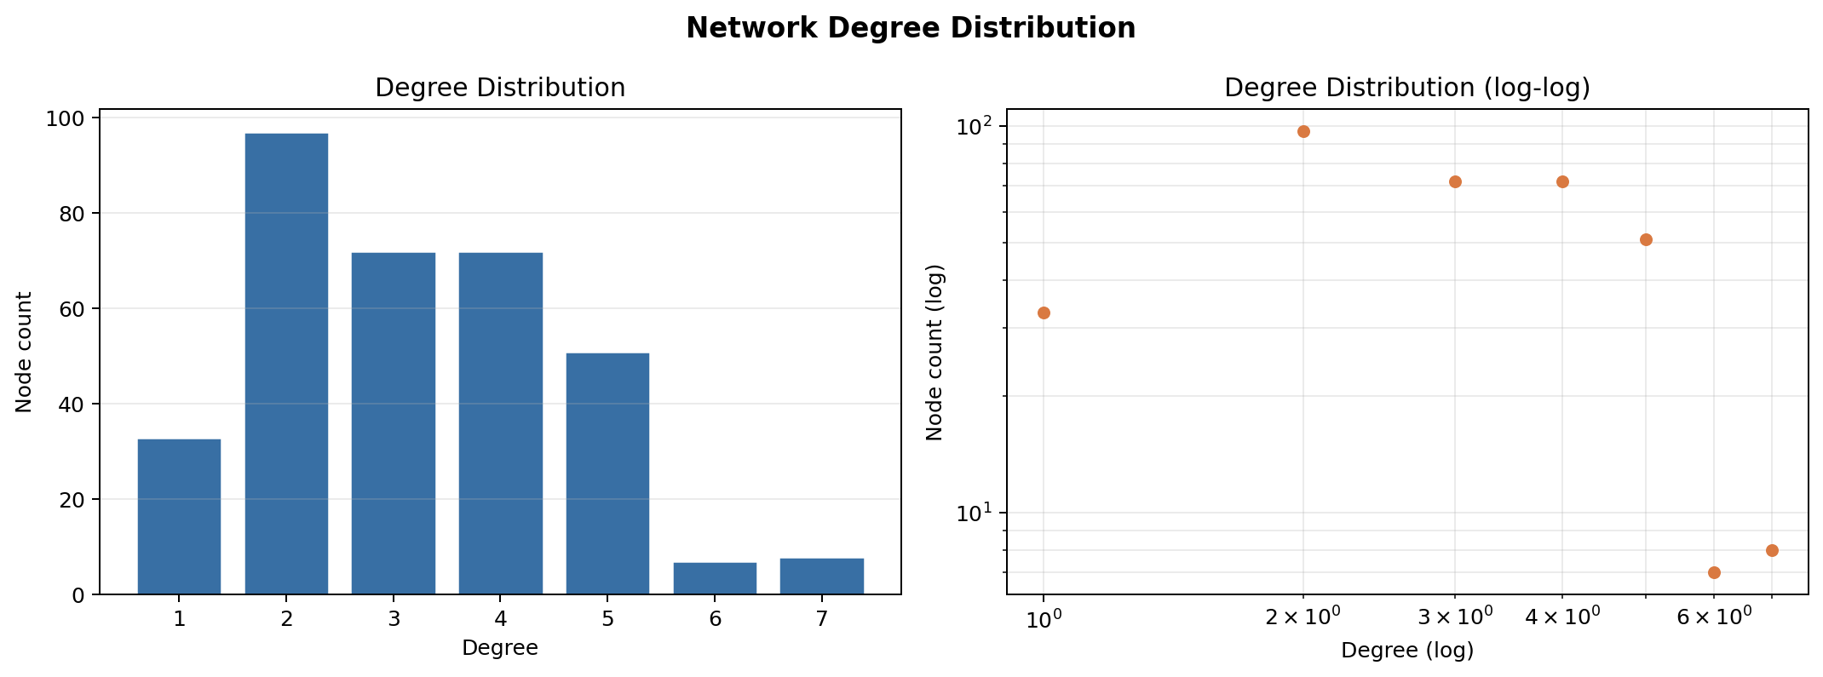
CENTRALITY + COMMUNITY
Dense household communities dominate the graph structure
Louvain aligns with household components, while degree and bridge measures still separate risk within households.
88
100%
communities
HH agreement
CostTrace Phase 05
07

Slide 8
GNN MODEL
GraphSAGE gives a learned risk signal beyond single centrality rules
The model combines graph position, contact strength, demographic fields, and index-case indicators.
Node features
Weighted mean aggregation
Classifier
Risk ranking
0.804
0.767
0.816
Training artifact: models/gnn_best.pt.
Risk scores exported to results/model/gnn_risk_scores.csv.
validation AUC
test AUC
test F1
CostTrace Phase 05
08

Slide 9
BUDGET SELECTION
Top-k selection converts scores into intervention sets
For each strategy, the top ranked k percent of nodes are removed before SIR simulation.
Input: graph G, budget k, strategy score s(v)
Rank nodes by s(v) descending
Select first ceil(k% * |V|) nodes
Remove selected nodes from household SIR runs
Return mean infected and reduction vs baseline
3
nodes selected at k=1%
Example high-risk node: S005-003
Example high-risk node: J008-004
Example high-risk node: J063-004
CostTrace Phase 05
09

Slide 10
SIR BASELINE
The no-intervention baseline sets the denominator for every result
All reductions are measured against the same household-level baseline simulation.
0.25
0.1
beta
gamma
30
50
time steps
runs
CostTrace Phase 05
10

Slide 11
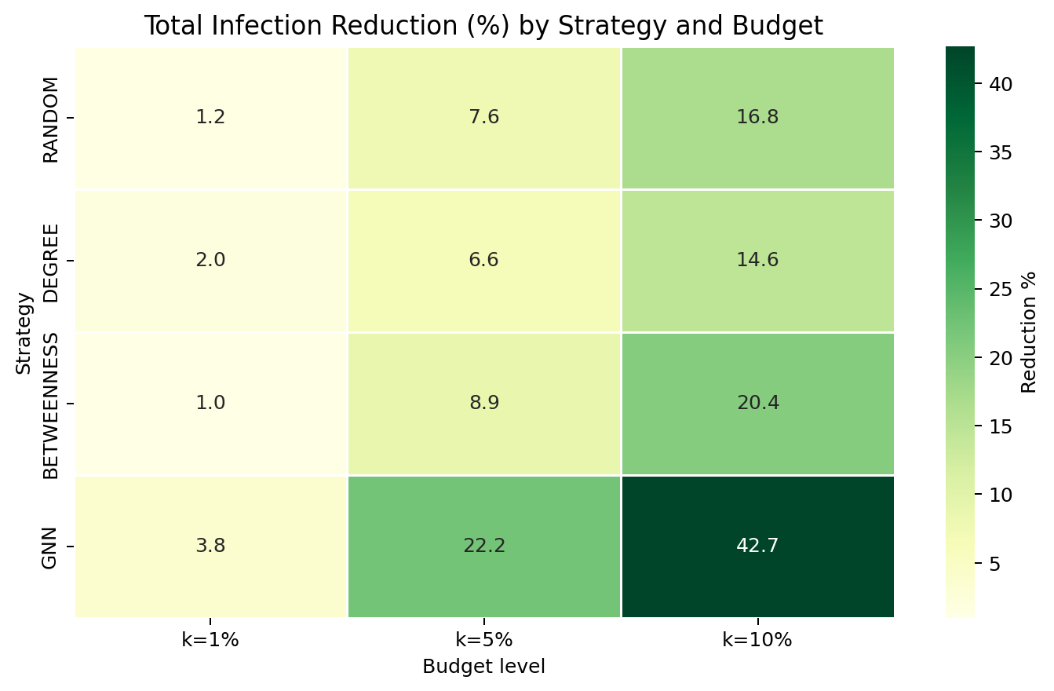
MAIN RESULT
GNN is the strongest strategy at every evaluated budget
The heatmap is the core result for the report and presentation.
3.8%
GNN reduction at k=1%
22.2%
GNN reduction at k=5%
42.7%
GNN reduction at k=10%
CostTrace Phase 05
11

Slide 12
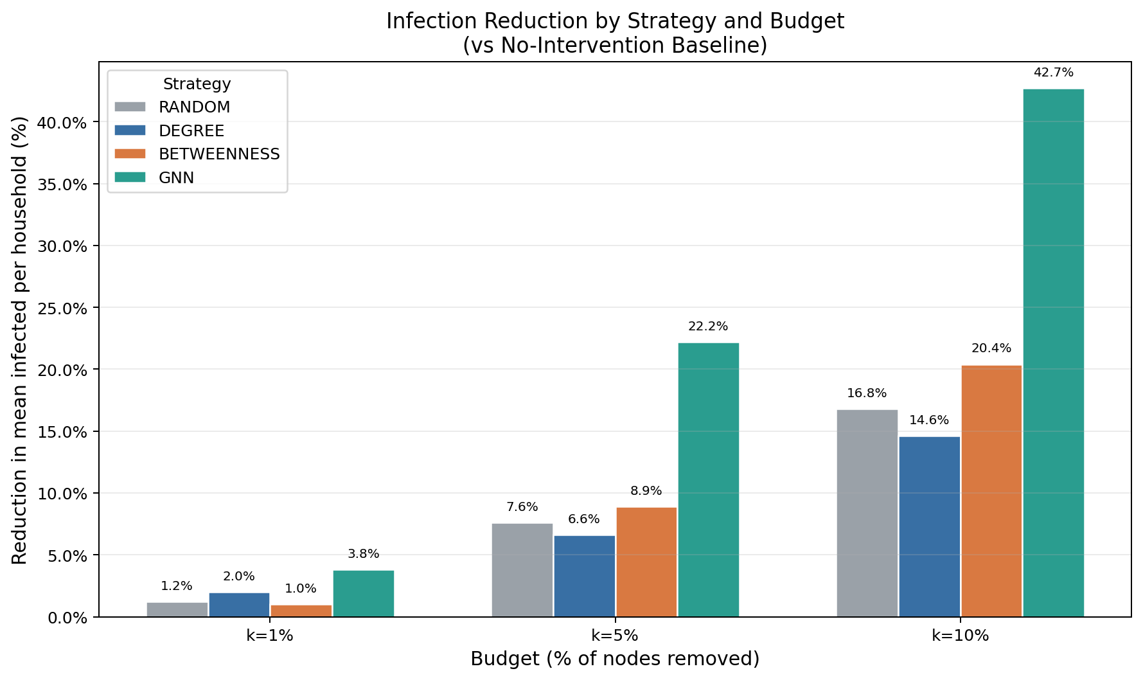
K=1% COMPARISON
At the tightest budget, GNN beats Degree by 1.8 points
The gap is modest at 1%, then widens sharply as the budget grows.
1.8 pts
GNN minus Degree at k=1%
28.1 pts
GNN minus Degree at k=10%
Interpretation: learned ranking becomes more valuable as intervention capacity expands.
CostTrace Phase 05
12

Slide 13
CONCLUSION
Learned risk ranking is the recommended intervention strategy
Phase 05 delivers the visual, report, and presentation artifacts needed for final submission.
GNN gives the best SIR reduction at 1%, 5%, and 10% budgets.
Gephi-ready node and edge tables are exported for manual refinement.
Future work: recovery-aware top-k, temporal graph modeling, spatiotemporal features, and online updates.
DONE
Phase 05 output status
CostTrace Phase 05
13

Slide 14
Q&A
Questions
All outputs are saved under visualizations/ and reports/.
File
Purpose
Status
Location
Console report prints: Phase 05 DONE. All outputs saved.
Heatmap
Main result
Ready
visualizations
Report
5 chapters
Ready
reports
Slides
Presentation
Ready
reports
CostTrace Phase 05
14

