Slide 1

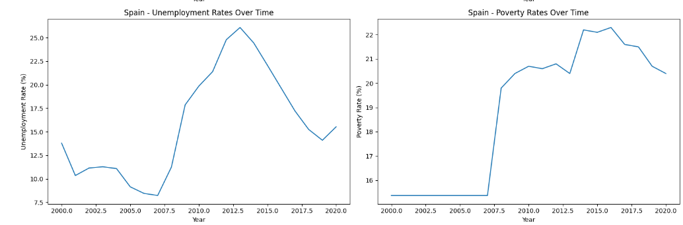
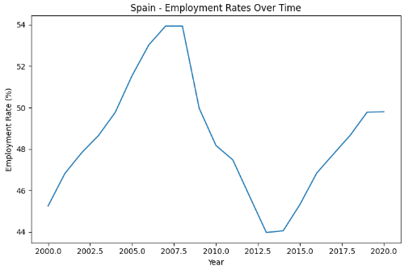
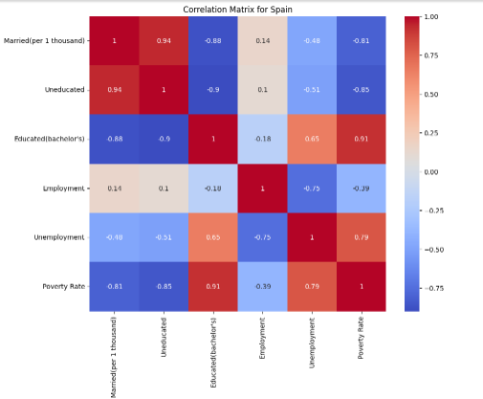
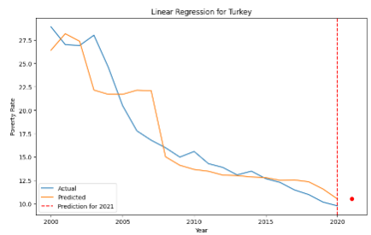
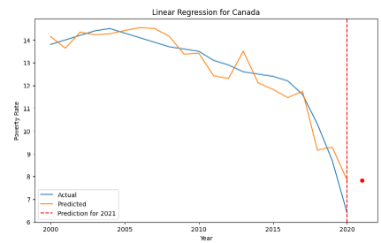
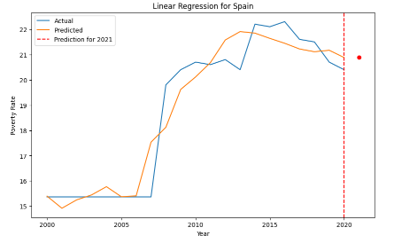
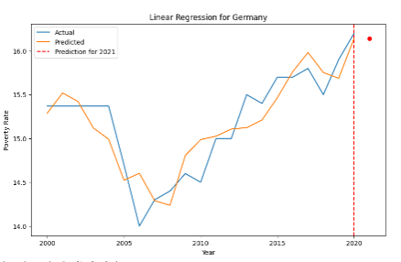
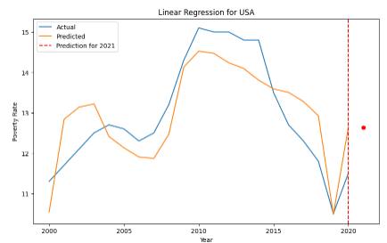
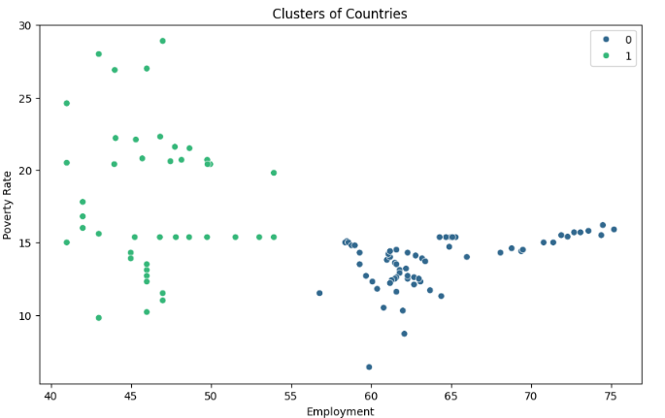
ISTANBUL NIŞANTAŞI UNIVERSITY
DATA MINING COURSE PROJECT EXHIBITION 2024
SDG 1: End poverty in all its forms everywhere
Name surname: Abdullah Khan 2021022189
PROJECT TEAM
30 MAY 2024
Name surname : Daniyar Sabitov 20212022029
Name surname: Jehad Mukahal 20212022240
Project Supervisor: Dr. Nesibe Manav Mutlu
Abstract
The Sustainable Development Goals are a global plan aiming to address issues worldwide. This study involves analyzing socio-economic factors influencing poverty, such as education, unemployment, marriages, uneducated, employment, poverty rate, across 5 OECD countries over a period of 20 years. The objective is to find information about how the socio-economic factors influence the trend of poverty rates annually and then finding respective solutions for OECD countries.
INTRODUCTION
MATERIALS AND METHODS
Data mining is a technique used to find and analyze patterns in the data. Data mining is a technique used to find and analyze patterns in the data. The steps involved in data mining are data collection, data cleaning, data integration, data selection, data transformation and knowledge discovery. The study helps us learn about the trends of the socio-economic factors annually and guide us to finding a solution to how we can implement better policy making decisions for OECD countries and that there can be a collaborative decision taken to improve and eventually end poverty in countries that follow a similar pattern. There are similar systems such as World bank poverty assessment and OECD better life index. Our study uses socio economic factors in a similar way that the world bank poverty assessment and uses multidimensional approach like the OECD better life index but unlike the existing systems that only provide a broad assessment, our study dives deep into data mining application techniques and uncovers patterns and relationships hidden in the data providing more detailed analysis to this approach.
The SDG1 Goal analysis includes the parameters namely, Poverty Rate, Education(Bachelor’s Degree, Uneducated rate, Employment rate, Unemployment rate and Marriage(per 1000 people). The data for each country was firstly adjusted for null values and then visualized by simple graphs to showcase the trend of each socio-economic factors and then a correlation matrix was applied to further support the results from these visualizations.
The following visuals is an example Spain to showcase pattern finding and similar trend.
Judging by these results we can see the direct relation of the unemployment rate on the poverty rate as they both have seen a big rise since 2007. We then used a correlation matrix was used on the data to further show the similarity between each factor influencing the poverty rate. This technique was used to analyze and find patterns in socio-economic factors from each country.
Linear regression is a technique used to predict the value of unknown data, in this case, future poverty rates for each country, with the aim of preventing the rise of poverty rates by improving socio-economic conditions for each country.
The model is evaluated by using Mean Absolute Percentage Error (MAPE) and predicts future poverty rates. The classification report provides a comprehensive overview of how well our model performed in classifying countries into those above or below the poverty threshold. The report showed a 100% accuracy for Canada and Germany, while USA, Turkey and Spain had an accuracy of 80% and we used this model to predict whether the future poverty rate for each country will go lower or higher that the mean poverty rate. The results suggest that predicted class for USA, Spain, Germany and turkey was false, meaning that the poverty rate would go below the threshold. For Spain, the predicted class was true which suggests that the poverty rate would rise in the future.
CONCLUSION AND RECOMMENDATIONS
The study helped us learn more deeply about the socio-economic factors that influence the poverty rate in each country and how a single factor can shape the poverty rate to change. The study led us to find the hidden pattern in the dataset and resulting in developing better socio-economic development policies. Using machine learning techniques namely, classification, linear regression and cluster provided us with different insights such as to predict the future value of the poverty rate for each country and that if it led to the poverty rate to increase, we can identify the countries at risk to this increase and this could be a valuable tool for policy makers to create targeted interventions to prevent the countries from being exposed to the increased. The study also provides us with the performance accuracy of our model and using a threshold value of poverty mean rate to predict if the poverty rate would rise for these countries in the following years. Lastly, the cluster algorithm provided us with grouping of countries according to their similarities in their dataset. This result can be used to understand which countries face similar challenges and opportunities and this allows for a collaborative decision to take place and perform effective and targeted interventions.
The research provides a better understanding of how socio-economic factors influence the poverty rate, that gives insight and guides policy making decisions. The predictive model for poverty rates enables to forecast the future poverty trend and this is crucial for future planning and resource allocation. Integration of machine learning in socio-economic research highlights the importance of data-driven decision-making. The clustering of countries allowed for a collaborative study or policy making decision due to their similarities in the challenges that they face.
The study can be expanded in various ways such as including broader socio-economic elements namely, health care, infrastructure and social services. Expanding the dataset over additional countries would allow us to better understand the effect of poverty globally and expanding the time period can help in identifying long-term trends and patterns. To improve the quality of the data, more accurate and up to date data should be used to ensure better quality. Using more advanced machine learning algorithms lead to better predictive accuracy, while the model validations should use more rigorous cross-validation techniques to prevent overfitting of data. Finally, a productive feedback with policy makers will continuously help refresh the model according to real world policies and outcomes.
REFERENCES
Pandurangan, P. R. (2020, December 28). Comparative studies on Sustainable Development Goals (SDG) in India using Data Mining approach. Retrieved from https://www.researchgate.net/publication/355168867_Comparative_studies_on_Sustainable_Development_GoalsSDG_in_India_using_Data_Mining_approachZaidi, A. (2009, March 26). Poverty and income of older people in OECD countries. SSRN. http://dx.doi.org/10.2139/ssrn.1992492Yüksel, H. (2014). General overview on poverty: The sample of OECD countries. Çankırı Karatekin Üniversitesi İktisadi ve İdari Bilimler Fakültesi Dergisi, 4(1), 341-358. Retrieved from https://www.researchgate.net/profile/Hasan-Yueksel-6/publication/366217653_General_Overview_on_Poverty_The_Sample_of_OECD_Countries/links/63986d9a484e65005b091397/General-Overview-on-Poverty-The-Sample-of-OECD-Countries.pdfMaaroof, A. (2015). Big data and the 2030 agenda for sustainable development. Retrieved from www.statcan.gc.caYCharts. (n.d.). Retrieved from https://www.ycharts.comStatista. (n.d.). Retrieved from https://www.statista.comBureau of Labor Statistics. (n.d.). Retrieved from https://www.bls.govCenters for Disease Control and Prevention. (n.d.). Retrieved from https://www.cdc.govUnited States Census Bureau. (n.d.). Retrieved from https://www.census.govWorld Bank. (n.d.). Retrieved from https://data.worldbank.orgTurkey Statistical Institute. (n.d.). Retrieved from https://data.guik.gov.trOur World in Data. (n.d.). Retrieved from https://ourworldindata.orgTrading Economics. (n.d.). Retrieved from https://tradingeconomics.comEurostat. (n.d.). Retrieved from https://ec.europa.eu/eurostat/statistics-explained/index.php?title=Main_PagePopulation Figures at 1 January 2020, Migrations Statistics 2019 (provisional).MacroTrends. (n.d.). Retrieved from https://www.macrotrends.netOrganisation for Economic Co-operation and Development. (n.d.). Retrieved from https://www.oecd.orgStatCan. (2015). Big data and the 2030 agenda for sustainable development. Retrieved from www.statcan.gc.ca
The study uses K-Means clustering to group countries based on their socio-economic indicators. The optimal number of clusters is determined using the Elbow Method. The elbow method resulted in using only a maximum of two cluster groups. The grouping of the countries is done based on their similarities between their socio-economic factors.
The green represents cluster group which includes the countries Turkey and Spain while the blue represents cluster group 0 which represent USA, Canada and Germany.
Understandably we can see the differences in the groups due to their distinctions in poverty rates and employment rates.
The K-Means clustered the group according to their similarities in poverty rate and Employment. The results suggests that a collaborative decision can be taken here for cluster group 1 i.e. if Spain and Turkey improve their employment rate, it could work towards the poverty rate to decease over time as cluster group 0 suggests.

