Slide 1




BIG QUESTON:
- Factors that influence customers’ repayment ability ?
AUDIENCE:
- Data Scientists who need additional features to improve the predictive model.
- Business Executives who needs
actionable insights.

Slide 2
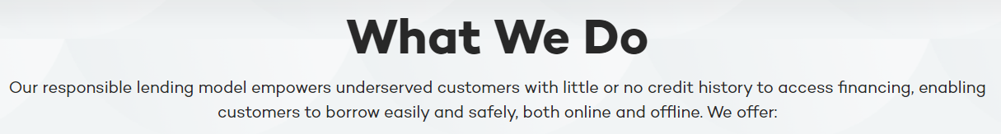








HOME CREDIT BUSINESS OVERVIEW
COUNTRIES OF OPERATION
Czech Republic
Slovakia
Kazakhstan
Indonesia
China
Vietnam
India
Philippines

Slide 3
Home Credit provide different products in different countries.
Loans of various types
Credit cards
Insurance
Fintech products: online shopping & payment
HOME CREDIT
PRODUCTS
In context of our analysis, we will focus on loans of various types that requires later repayment of the loans.
7 datasets were provided.
For our analysis, we focus on the 2 following:
application_{train|test}.csv:
Static data for all current applications
Informations such as: amount of credit applied, incomes...
bureau.csv :
Information on client's previous credits provided by other financial institutions reported to Credit Bureau.
DATASET OVERVIEW

Slide 4
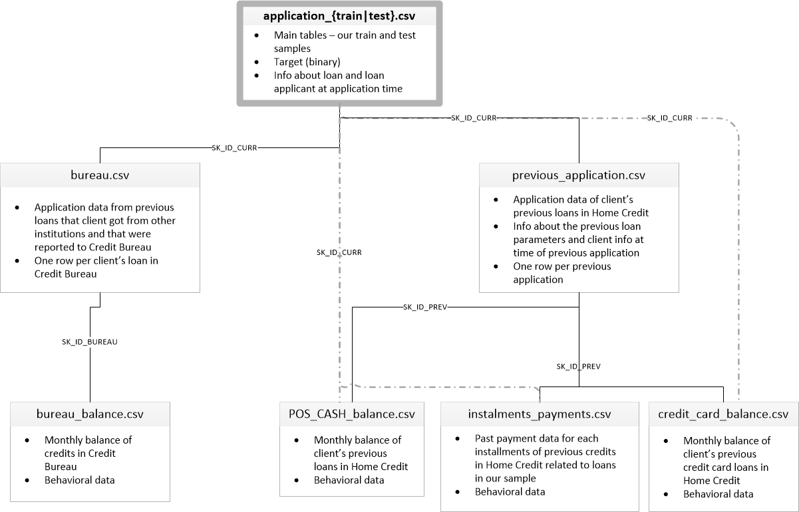
DATASET SCHEMA

Slide 5
ANALYSIS FLOW
FACTORS & SOME ACTIONABLE INSIGHTS
Age of Clients
External Score
Income / Annuity Ratio
Credit Term
MODELS & CONCLUSION
Choice of models
Conclusion &
Next steps

Slide 6
Effect of Age on repayment abilities

Slide 7
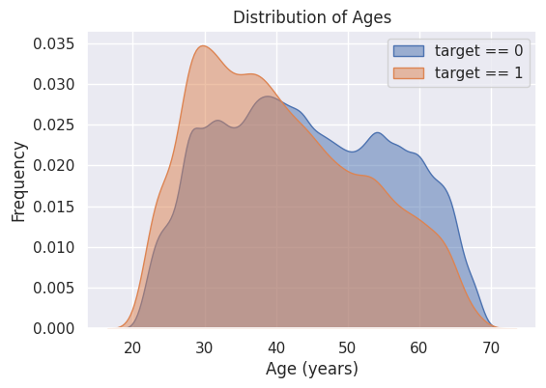
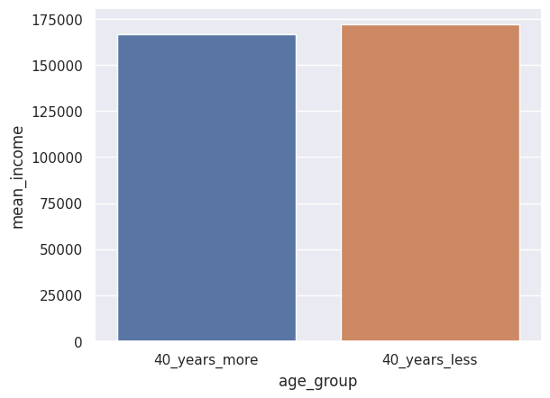
Younger customers (age 40 below) tend to have more difficulty repaying the loans.
Mean income of 2 age groups
1: Clients with repayment difficulties
0: Clients with no repayment difficulties
Income is not the problem

Slide 8
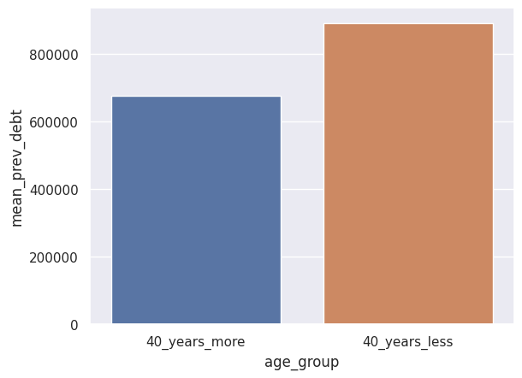
The amount of active previous debt is the problem.
Mean amount of active previous debt.
Insight:
Clients below age of 40 have more difficulty repaying loans not because of lower income, but because they tend to borrow more.
Actionable business decision:
For younger clients, evaluation process for new loan applications should emphasize more on documents related to previous debt.
Loans for younger clients should have higher interest rate to make up for repayment risk

Slide 9
Effect of scores from external data source on repayment abilities

Slide 10
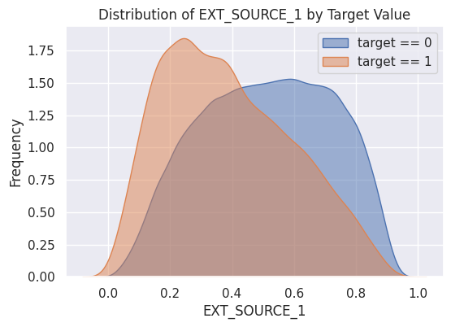
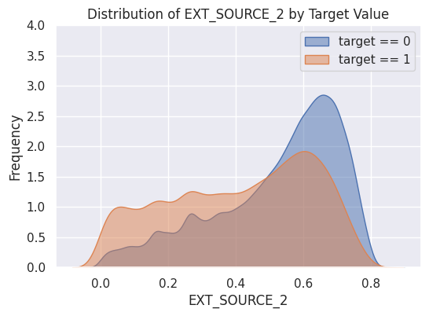
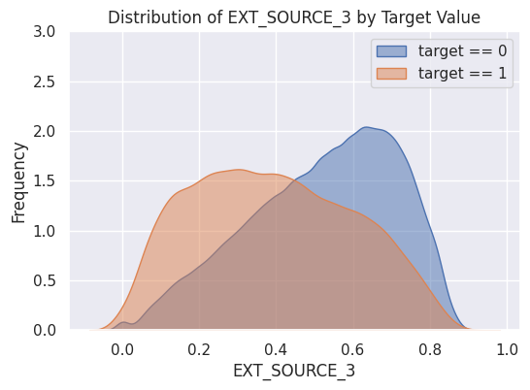
Customers who have lower external score tend to have difficulty repaying loans
EXT_SOURCE_1, 2, 3: Normalized score from external data source
These score come from other financial institutions and are comparable to Credit Score
Financial institutions usually have their own different scoring model.

Slide 11
Engineered feature 1:
Credit Term

Slide 12
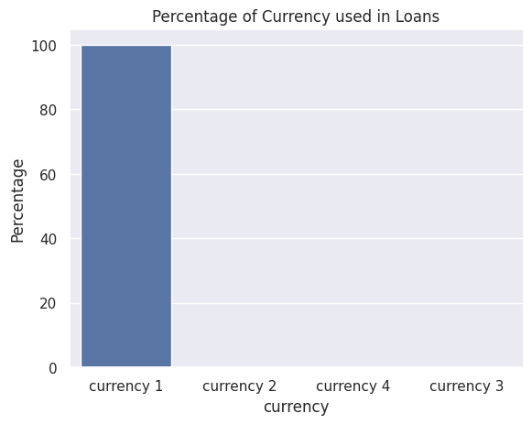
Are financial data coming from the same currency?
Our analysis have 2 financial ratios.
MODELS RECOMMENDATIONS

Slide 13
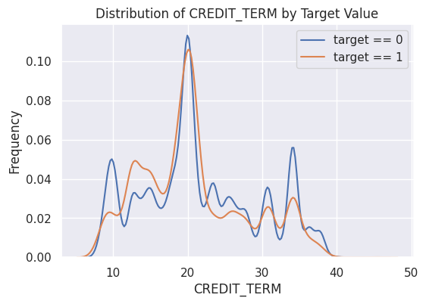
Longer credit term tend to help with clients’ repayment ability
Credit terms: the length of time the borrower must repay the loan (Unit = months)
In general, longer credit term tend to help with clients’ repayment ability (longer term ~ less annuity) as seen in the graph
However, credit term that is between 3 – 11 months have much less clients with repayment difficulty
Speculation: Loans with Credit terms that are less than a year tend to be small loans, thus clients have no difficulty repaying these small loans.

Slide 14
Engineered feature 2:
Income / Annuity ratio

Slide 15
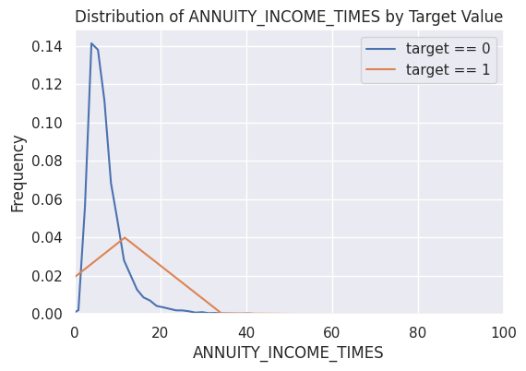
Too low or too high Income / Annuity ratio have more people with repayment difficulty
Income / Annuity ratio: How much income relative the amount of annuity each period (Unit = times)
Calculation: Total Income / Annuity of the debt
Most people have their Income / Annuity Ratio between 0.5 and 35 based on the graph
Pattern: when the Income / Annuity Ratio is too low ( ratio < 1) or too high (ratio > 15), more people have difficulty with repaying their loans.
Suggestion: learn the characteristics of various customers at different range of Ratio

Slide 16
Predictive Models &
The importance of features

Slide 17
Predictive models as a 2nd opinion for Loan Underwriters.
Target Variable
0 – No payment difficulty | 1 – Have payment difficulty
Model prediction for each loan
Loan ID | Prediction Probability
100001 | 0.268
100005 | 0.564
100013 | 0.173
100028 | 0.252
100038 | 0.637
100042 | 0.281
Features (123)
Provided features: | External scores
 | Amount of Income
 | Amount of Credit
 | Contract Type
 | Family Status
 | Housing Type
 | Age
 | Number of Children
 | …….
Engineered features: | Credit terms
 | Income / Annuity Ratio
0 – No payment difficulty
1 – Have payment difficulty

Slide 18
Models Comparison
Model Name | Test Score (ROC AUC)
Logistics Regression | 60.136%
Random Forest | 68.315%
Light Gradient Boosted Machine (LGBM) | 74.37%
LGBM + Engineered Features | 75.84%
Logistics Regression is suitable for simple dataset with linear relationship between features & target as an assumption
Home Credit datasets, however, are very complex with complicated non-linear relationship between features and between features and target.
Thus, Tree based models such as Random Forest and LGBM are more suitable for these datasets.
LGBM performs better than Random Forest because of the Gradient Boosting approach
Features engineering helped us improve the LGBM model even further

Slide 19
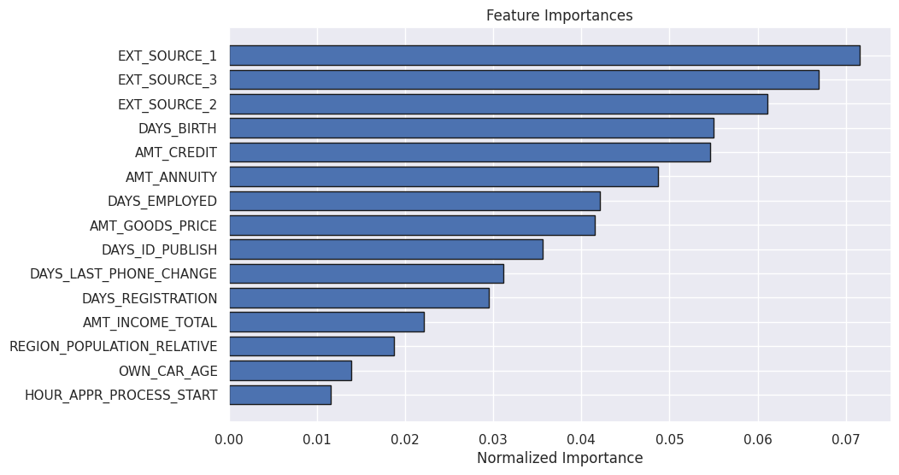
Feature Importance of LGBM baseline model
Based on the graph, we can see that Scores from external data sources (EXT_SOURCE_1, 2, 3) and age of our clients (DAYS_BIRTH) are among the most important features used by LGBM model

Slide 20
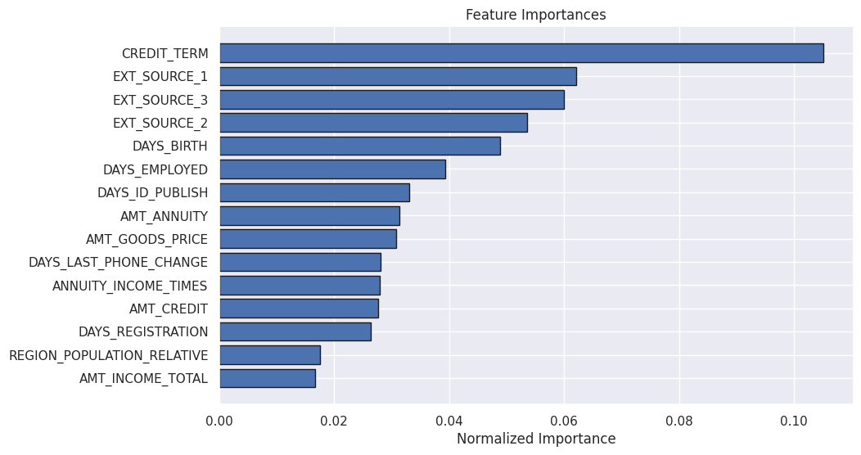
Feature Importance of LGBM + Engineered Features
Our 2 engineered features, the credit term (CREDIT_TERM) of the loan and the Income / Annuity Ratio (ANNUITY_INCOME_TIMES) are also among the most important features used by LGBM model, and these 2 extra features helped improve our model test accuracy by 1.3%.
This implies that feature engineering is crucial to the improvement of predictive models.

Slide 21
Conclusion &
Next Steps

Slide 22
For clients at younger age, evaluation process should focus more on documents of previous debt.
Loans for younger applications should have higher interest rates.
Age, scores from external data sources, credit term of the loan and Income / Annuity Ratio are all influential on clients’ repayment ability.
These factors should be incorporated into our predictive model.
CONCLUSION
Engineer more features to improve our predictive model
Dig deeper into our engineered features for actionable business insights.
Look at different datasets
Time series data => Deep Learning methods such as LSTM or CNN
Blending different models => Stacking, Boosting, Bagging…..
NEXT STEP

