Slide 1
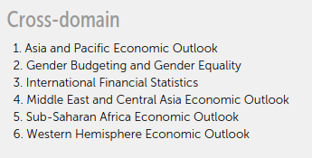
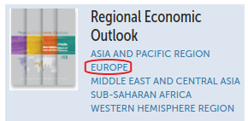
Data in hardcopy: Europe
Data via APIs: No Europe

