Slide 1


Income Dynamics in the Bottom 50:
Inequality, Poverty, and Political Upheaval
Danny Quah
Lee Kuan Yew School of Public Policy
2019 May 13

Slide 2
Inequality the Great Leveller
“”

Slide 3
Inequality the Great Leveller
“Everyone says so”

Slide 4
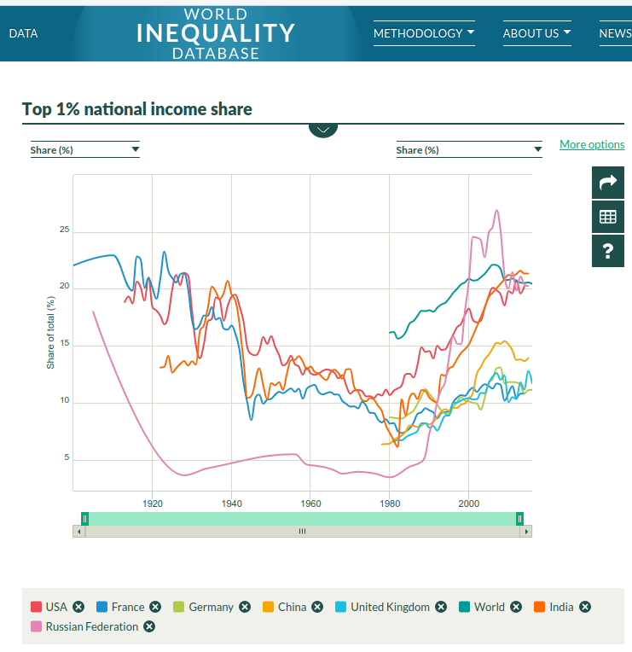

Slide 5
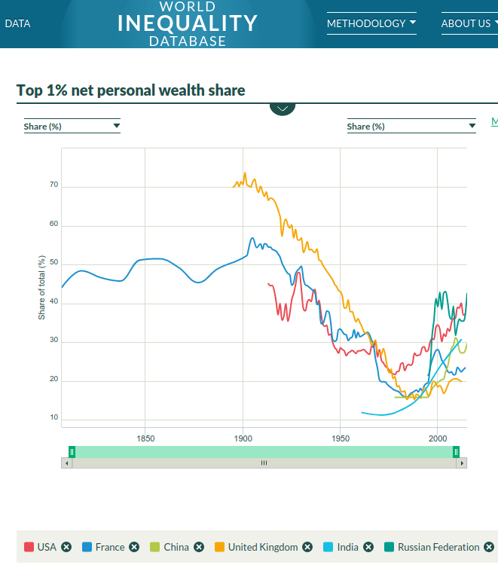

Slide 6
4. Conclusion

Slide 7
Summary
World Order traditionally geo-strategic rivalry
A Marketplace for World Order
Supply, Demand, and Small States Agency
  Liberal Outcomes from Realist Assumptions
  Further complications: Public goods and externalities

Slide 8
Income Dynamics in the Bottom 50:
Inequality, Poverty, and Political Upheaval
Danny Quah
Lee Kuan Yew School of Public Policy
2019 May 13

