Slide 1
PP5182 GEOECONOMICS
Why Geopolitics Is Important Again
Danny Quah
Li Ka Shing Professor in Economics, Lee Kuan Yew School of Public Policy, NUS
2026.08.17.Mon

Slide 2
How Is Geopolitics Important Again?
Three questions begin the framing for this course.
1
2
3
What's True Now
The Earlier Aspiration
Where Small States?
Mercantilism, cross-border cooperation failures, and power-based disagreement between nation states.
A rules-based multilateral order, and globalisation, built and led by America.
How a rewritten geoeconomics repositions smaller states across Asia.
Asia's New Geoeconomics | Danny Quah
1

Slide 3
PART ONE
Rules-Based Multilateralism and Globalisation
The postwar aspiration, and the logic that underwrote it.
Asia's New Geoeconomics | Danny Quah
2

Slide 4
What Multilateralism Promised
Three commitments underwrote the postwar system.
1
2
3
A Level Playing Field
Peaceful Dispute Resolution
Collaboration on Shared Challenges
Nations engage one another by common rules — not by raw power.
Disputes are settled through adjudication, not through coercion.
Coordinated action when no single state can effectively act alone.
Asia's New Geoeconomics | Danny Quah
3

Slide 5
And Globalisation
The economic logic paired with multilateral rules.
Anything made anywhere would become available everywhere — more and more cheaply.
That promise — not just peace among states, but rising material abundance — was globalization’s half of the postwar bargain.
Asia's New Geoeconomics | Danny Quah
4

Slide 6
PART TWO
America Built That Rules-Based Order
Reconstruction, ideology, and doctrine converged around one project.
Asia's New Geoeconomics | Danny Quah
5

Slide 7
Postwar Foundations
Reconstruction and ideology, together.
Reconstruction as Strategy
Democracy vs. Tyranny
At the end of the Second World War, the Marshall Plan rebuilt Western Europe under American leadership — binding recovery to the new order.
The cost 5% US GDP (USD1.5tn in 2026), matched by European funds; the result, recovery to pre-war output by 1950.
Eisenhower and Kennedy cast the Cold War as “democracy and freedom” against “totalitarianism and tyranny” — multilateralism as the free world’s shared project.
JFK’s “long twilight struggle”: Cold War competition against communism (misquote)
Asia's New Geoeconomics | Danny Quah
6

Slide 8
On the Free Market
“Underlying arguments against the free market is a lack of belief in freedom itself.”
Milton Friedman, Capitalism and Freedom (1962)
Asia's New Geoeconomics | Danny Quah
7

Slide 9
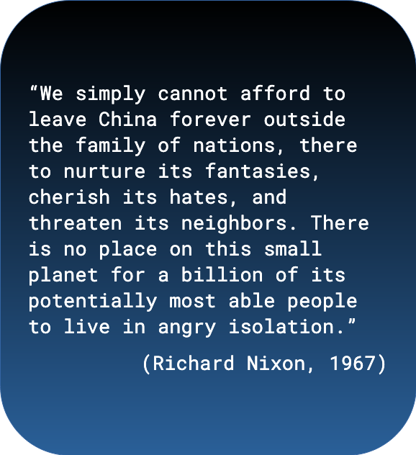
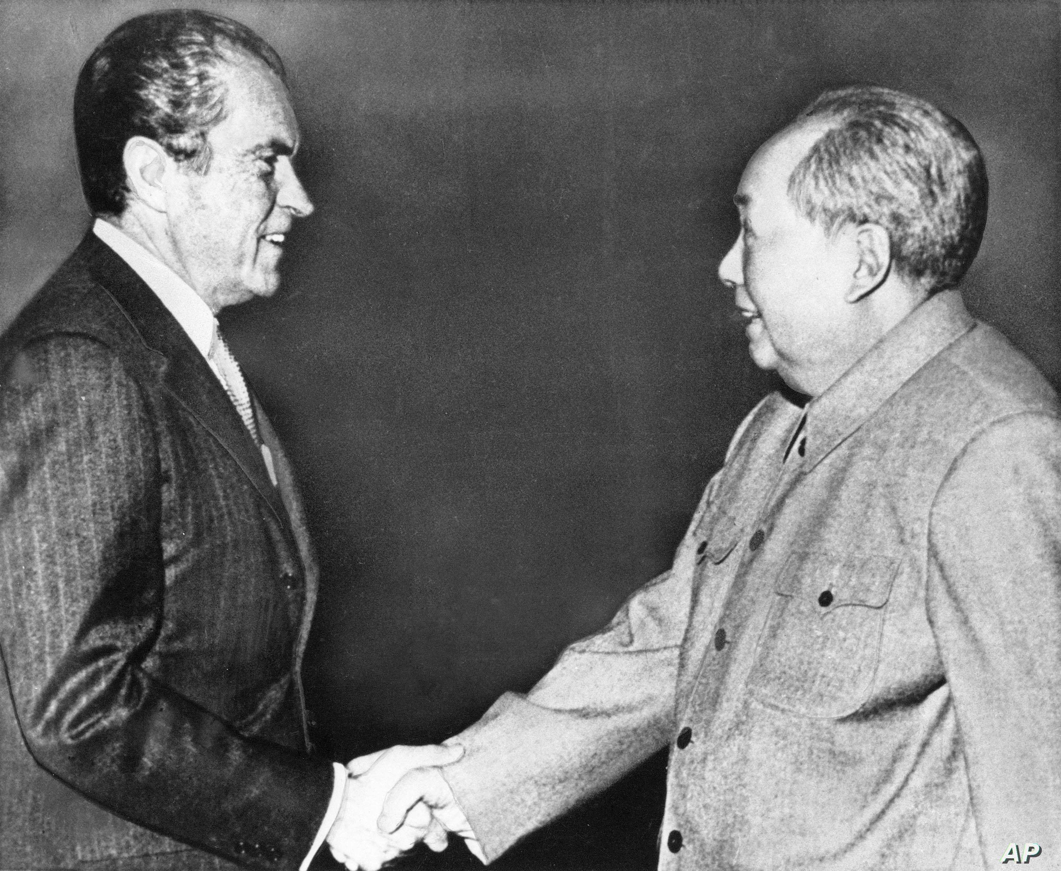

Slide 10
On China's Accession to the WTO
“China is a growing threat to Taiwan and its neighbors — we shouldn’t strengthen it. Or China violates labor rights and human rights — we shouldn’t reward it. Or China is a dangerous proliferator — we shouldn’t empower it. … The question is not whether we approve or disapprove of China’s practices. The question is what’s the smartest thing to do.”
Bill Clinton, on China's WTO accession (2000)
Asia's New Geoeconomics | Danny Quah
8

Slide 11
PART THREE
Compare to an Earlier American Mercantilism
Before free trade, America protected industry for a century.
Asia's New Geoeconomics | Danny Quah
9

Slide 12
A Century of Protection
Tariffs and subsidies as the older American doctrine.
1791
Alexander Hamilton, Report on Manufactures
Tariffs and subsidies to incentivize industrialization — protection from foreign producers until scale made industries globally competitive.
As framed by USTR (Jan 2026): this vision “laid the foundation for American, and even global, prosperity.”
1847
Abraham Lincoln (attributed)
“Give us a protective tariff, and we will have the greatest nation on earth.”
Widely attributed but never confirmed as an actual quotation.
1896
Republican Party Platform
“… policy of protection, as the bulwark of American industrial independence and the foundation of American development and prosperity.” “It secures the American market for the American producer … and founds the strength of all on the strength of each.”
Asia's New Geoeconomics | Danny Quah
10

Slide 13
Economic Efficiency: Hegemonic Stability Theory
Charles Kindleberger: a leading economy underwrites the international system's stability.
1930
1945 →
Smoot-Hawley tariffs worsened the Great Depression — leadership abdicated.
US economic leadership then anchored the postwar recovery — leadership assumed.
Economic leadership can stabilize the system — or destabilize it. Either way, calculation and incentive (mistaken for benevolence) does the work.
Asia's New Geoeconomics | Danny Quah
11

Slide 14
Shocks
The order that promised gains for all delivered shocks instead.
The “China Shock” (supply shock)
The “US Shock” (demand shock)
“Stealing our jobs, hollowing out our industry, turning into ghost towns what were once thriving middle-class communities.”
Power-asymmetric unilateralism — the hegemon turns the rules it built against the system it built, “from global insurer to extractor of profit. Instead of the insurer securing its clients against external threats, (…) the threat against which insurance is sold comes as much from the insurer as from the global environment.”
THE TURN
Multilateralism is an expensive public good — once you’re no longer dominant. Multipolarity makes the bill too high to pay alone.
Asia's New Geoeconomics | Danny Quah
12

Slide 15
Geopolitics Is Important Again.
Now: Mercantilism, cross-border cooperation failures, and power-based disagreement between nation states.
The earlier aspiration: A rules-based multilateral order, and globalisation, built under American leadership.
The open question: Where do small states fit — and how do they act — in what comes next?
Danny Quah | Li Ka Shing Professor in Economics, Lee Kuan Yew School of Public Policy, NUS

