Slide 1
PP5182 Globalisation to Strategic Interdependence, 3S
Danny Quah
Li Ka Shing Professor in Economics, Lee Kuan Yew School of Public Policy, NUS
2026.08.24.Mon

Slide 2
ONE
Globalisation
The postwar consensus: efficiency, comparative advantage, political convergence.

Slide 3
Free Trade as Cold-War Strategy
The postwar architects saw open markets as ideological ammunition.
Eisenhower administration, 1956
John F. Kennedy, Trade Expansion Act, 1962
“Failure on the part of the US, the world’s greatest trading nation, to join in setting up this organization would cause great dismay and disappointment throughout the free world at a time when the Soviet Union is stepping up its foreign economic efforts.”
“A vital expanding economy in the free world is a strong counter to the threat of the world Communist movement.”
On the Organization for Trade Cooperation / GATT
Free trade as containment strategy, not just economics.

Slide 4
On the Free Market
Milton Friedman, Capitalism and Freedom (1962)
“Our tariffs hurt us as well as other countries. We would be benefited by dispensing with our tariffs even if other countries did not. We would of course be benefited even more if they reduce theirs but our benefiting does not require that they reduce tariffs. Self-interests coincide and do not conflict.”
Milton Friedman, Capitalism and Freedom (1962)

Slide 5
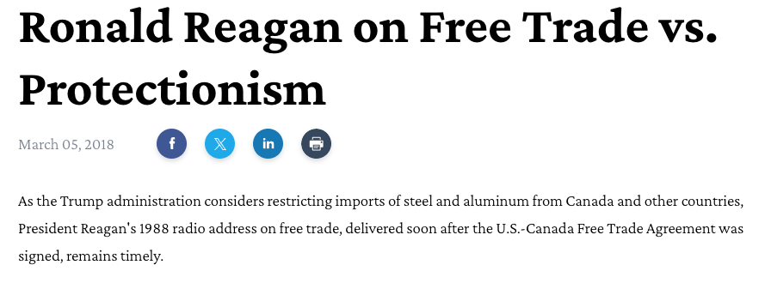
Ronald Reagan, 1988
“Take a moment to recognize that one of the key factors behind our nation’s great prosperity is the open trade policy that allows the American people to freely exchange goods and services with free people around the world.”
The expansion of the international economy is not a foreign invasion; it is an American triumph, one we worked hard to achieve, and something central to our vision of a peaceful and prosperous world of freedom.
“We should beware of the demagogues who are ready to declare a trade war against our friends — weakening our economy, our national security, and the entire free world — all while cynically waving the American flag.”
Reagan, 1988
Radio Address to the Nation, Camp David, 26 November 1988

Slide 6
The New Mantra
Efficiency. Comparative advantage. Political convergence.
1
2
3
Efficiency
Comparative Advantage
Political Convergence
David Ricardo: Nations gain from specialisation. Each trades what it makes best, buys what it makes worst. The global pie grows.
Even if one country is better at everything, trade is still mutually beneficial — it’s relative, not absolute, cost that matters.
Rising prosperity produces liberal democracy. Open markets and open societies reinforce each other — the Lipset-Fukuyama-Clinton hypothesis.

Slide 7
Prosperity, Democracy, History
The political logic behind the globalisation consensus.
Seymour Martin Lipset — Modernization Theory
Francis Fukuyama, The End of History and the Last Man (1992)
“…the more well-to-do a nation, the greater the chances that it will sustain democracy.”
“a remarkable consensus concerning the legitimacy of liberal democracy as a system of government had emerged throughout the world” … “liberal democracy may constitute the ‘end point of mankind’s ideological evolution’ and the ‘final form of human government.’”

Slide 8
The End of History
Fukuyama’s full argument: markets and democracy together.
“liberal democracy remains the only coherent political aspiration that spans different regions and cultures around the globe” … “liberal principles in economics — the ‘free market’ — have spread, and have succeeded in producing unprecedented levels of material prosperity, both in industrially developed countries and in countries that had been, at the close of World War II, part of the impoverished Third World.”
Francis Fukuyama, The End of History and the Last Man (1992)
The consensus: open markets produce prosperity; prosperity produces democracy; democracy produces peace.

Slide 9
On China’s Accession to the WTO
Bill Clinton, March 2000
“China is a growing threat to Taiwan and its neighbors — we shouldn’t strengthen it. Or China violates labor rights and human rights — we shouldn’t reward it. Or China is a dangerous proliferator — we shouldn’t empower it. … The question is not whether we approve or disapprove of China’s practices. The question is what’s the smartest thing to do.”
“We know how much the Internet has changed America, and we are already an open society. Imagine how much it could change China. Now there’s no question China has been trying to crack down on the Internet. Good luck! That’s sort of like trying to nail Jell-O to the wall.”
Bill Clinton, “Trade Is the Smart Thing to Do,” New York Times, March 2000

Slide 10
Deviation Needs Justification
The free-trade presumption held — but margins kept shifting.
National security:
Strategic industries, dual-use technologies, critical infrastructure — where commercial logic yields to security logic.
Level playing field:
Foreign subsidies, dumping, currency manipulation — countering others’ distortions with your own.
Dynamic comparative advantage:
Infant-industry arguments: protect today’s loser to create tomorrow’s winner (Hamilton, again).
Critical technologies:
AI, semiconductors, biotech — “technologies of the future” blur economic and strategic categories.

Slide 11
TWO
Strategic Interdependence
Win-win to zero-sum: when mutual advantage becomes leverage.

Slide 12
The Traditional Great-Power View
Mill-Bickerdike: the optimal tariff for a large economy.
1
2
Terms of Trade
The Large-Country Advantage
How much you get from what you sell, relative to how much you pay for what you buy. Tariffs can shift this in your favour.
Big importers can depress world prices by restricting demand. Small countries can’t; they face the full domestic cost of the tariff.
3
4
The Optimal Tariff Formula
Deadweight Loss
Inversely proportional to foreign export supply elasticity. Inelastic supply → large terms-of-trade gain, small domestic distortion.
Tariffs also distort domestic consumer and producer choices — the net gain requires that terms-of-trade gains exceed these losses.

Slide 13
The Toolkit of Economic Statecraft
Tariffs are just one instrument. The full set is wider and less visible.
Tariffs, quotas, import bans
Restrict market access for foreign goods; protect domestic producers
Export controls
Deny opponents access to advanced technologies (chips, AI, biotech)
Investment restrictions / CFIUS
Block foreign acquisitions that jeopardise national security
Sanctions / asset freezes
Weaponise dollar system and financial infrastructure (Russia, Iran)
State subsidies & industrial policy
Self-improvement: build domestic capacity in strategic sectors
Foreign aid, concessionary loans
Extend influence; shape partners’ infrastructure and political economy
Preferential trade agreements
Reward friends; exclude rivals from supply chains and standards

Slide 14
Characteristics of a Specific Instrument of Economic Statecraft
Two dimensions define where an instrument sits: how broadly it applies, and which direction it pushes.
CARROT
STICK
GENERAL
Broad-Based Incentives
Broad-Based Restrictions
Inducements offered to all partners alike: multilateral trade liberalization, general foreign-aid programs.
Restrictions applied across the board: global baseline tariffs, blanket export controls.
TARGETED
Partner-Specific Incentives
Partner-Specific Restrictions
Inducements aimed at one actor: bilateral investment pledges, country-specific concessionary loans.
Restrictions aimed at one actor: sanctions on named entities, export controls on specific technologies.

Slide 15
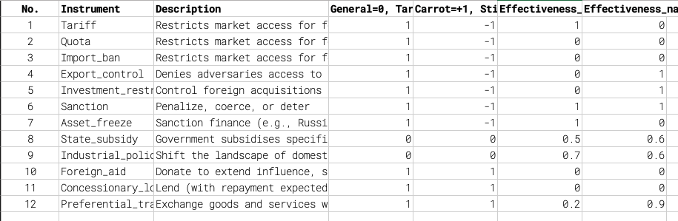
Multiple Characteristics, Sliding Scale
The full taxonomy: each instrument scored across several dimensions, not just binary.

Slide 16
Real-World Practice
From theory to actual policy interventions.
2018–2019
Trump 1.0 Tariffs:
25% on steel, 10% on aluminum under Section 232 national security; targeted Section 301 tariffs on Chinese goods citing forced technology transfer.
Apr 2025
Liberation Day Tariffs:
IEEPA-based 10% global baseline, plus bilateral variation by trade balance. Close to 150 nations affected — not just China.
Feb 2026
Supreme Court Ruling:
LDTs ruled invalid — not supported by IEEPA authority. Refunds to importers. Shift to Section 301 (Forced Labour and Overcapacity) and Section 122.
Ongoing
China: Critical Minerals Controls:
Export controls on gallium, germanium, graphite, rare earths — chokepoints in semiconductor and battery supply chains.
Ongoing
China: Manufacturing Prowess:
Mass-market competitiveness and scale advantages treated as strategic threat — especially in EVs, solar, steel.

Slide 17
THREE
Shocks
China Shock, US Shock, Multilateralism Shock.

Slide 18
Shocks
The order that promised gains for all delivered shocks instead.
The “China Shock” (supply shock)
The “US Shock” (demand shock)
“Stealing our jobs, hollowing out our industry, turning into ghost towns what were once thriving middle-class communities.”
Power-asymmetric unilateralism — the hegemon turns the rules it built against the system it built, “from global insurer to extractor of profit. Instead of the insurer securing its clients against external threats, … the threat against which insurance is sold comes as much from the insurer as from the global environment.”
THE TURN
Multilateralism is an expensive public good — once you’re no longer dominant. Multipolarity makes the bill too high to pay alone.

Slide 19
“China Is a Threat to America’s Economic Prosperity”
Autor, Dorn, Hanson (2016): the evidence.
1.2 million
10+ years
Permanent manufacturing jobs lost 1999–2011 due to competition from China
Wages and labour-force participation remained depressed after the shock commenced
“Alongside the heralded consumer benefits of expanded trade are substantial adjustment costs and distributional consequences. These impacts are most visible in the local labor markets in which the industries exposed to foreign competition are concentrated. Adjustment in local labor markets is remarkably slow, with wages and labor-force participation rates remaining depressed and unemployment rates remaining elevated for at least a full decade after the China trade shock commences.”
Autor, Dorn, Hanson, “The China Syndrome,” American Economic Review (2016)

Slide 20
“Japan as Number One”
Theodore White, 1985 — the story runs earlier than China.
Theodore White, 1985
Malcolm Baldrige, US Secretary of Commerce, 1981–1987
“Today not a single consumer radio is made in America, although Americans invented the modern radio; not a single black-and-white television set is made here, although America invented television.”
“We sent them blood-fractionating technology on humanitarian grounds. Today the company we gave the technology to competes with Americans around the world. We sent them technicians from the Underwriters Laboratory to certify that Japanese products were up to American standards, fit for export. Today U.S. companies fight to get their exports certified for entry into Japan.”
(Reported in Theodore White, 1985)

Slide 21
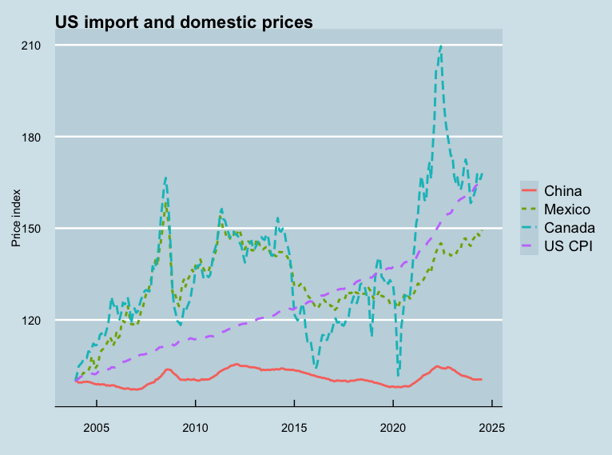
China’s SOEs, Subsidies, and Overcapacity
The US import and domestic price record.
The Key Insight
How much do we really need to know whether imports from China are cheap from genuine competitiveness, or from subsidies and state ownership?
Whatever their cause, low-priced high-quality imports disadvantage domestic competitors — even as they advantage domestic consumers and downstream producers.
What we should be concerned about is not why our people and middle-class communities are being overwhelmed and unable to reallocate — but that they are.
Two paths forward: stop looking for proof of China’s overcapacity; and improve our own efficiency while protecting the vulnerable.
Source: US Census Bureau / BLS

Slide 22
Liberation Day Tariffs: ASEAN Responses
02 April 2025 — and the negotiations that followed.
Country
LDT Rate
Post-negotiation
What was offered / context
Vietnam 🇻🇳
46%
20% + 40% on trans-shipments
Fast-track for Trump Organization projects; VN export growth declining.
Indonesia 🇮🇩
32%
19%
USD34bn commitments: Boeing, semiconductors, energy, KBR, blue ammonia in Louisiana.
Malaysia 🇲🇾
24%
19%
USD240bn commitments = 57% of GDP. Semiconductor risk: MY = 13% of global testing & packaging.
Singapore 🇸🇬
10%
10% (baseline)
No headline negotiation. Quiet diplomacy: preserve USSFTA, strengthen digital ties, adaptation.

Slide 23
Korea, the Supreme Court, and What Comes Next
The tariff architecture keeps shifting.
South Korea 🇰🇷
Supreme Court, Feb 2026
LDT 25% → 15% (07 Aug 2025)
Liberation Day Tariffs ruled invalid: IEEPA does not provide the statutory authority. Importers entitled to refunds.
USD350bn commitment in “US Projects”: USD200bn strategic industries (semiconductors), USD150bn shipbuilding partnership, plus USD100bn in energy purchases (LNG, LPG, crude oil) over 3.5 years.
Note: USD350bn = ~20% of KR annual GDP (USD1.71tn, 2023).
Aug 2026: Major US immigration raid at Korea-linked battery construction site in Georgia.
What replaced the LDTs
Section 122 (Trade Act 1974): 10% global baseline tariff for 150 days — Presidential temporary authority for balance-of-payments problems.
Section 301: Targeted tariffs on Forced Labour and Overcapacity grounds.

Slide 24
From Globalisation to Strategic Interdependence.
The consensus: Efficiency, comparative advantage, and political convergence built four decades of open globalisation — and a rules-based order.
The fracture: The China Shock revealed domestic distributional costs. The US Shock revealed that hegemonic benevolence is endogenous — and reversible.
The new reality: Channels of mutual advantage have become leverage points. Tariffs, export controls, sanctions, and industrial policy are all now economic statecraft.
For small states: Neither pure alignment nor pure autonomy is viable. The question is how to navigate a world where strategic interdependence has replaced rules-based openness.

