Slide 1
PP5182 Economic Security
Danny Quah
Li Ka Shing Professor in Economics, Lee Kuan Yew School of Public Policy, NUS
2026.08.31.Mon

Slide 2
Guns or butter?
Guns
Butter
National security protects people, territory, sovereignty, and political independence from threats.
Economic security protects the foundations of well-being: livelihoods and reliable access to essentials.
But what if butter becomes a weapon?
Notes:
[Sources]
Lecture definitions, adapted from supplied Economic Security lecture notes.

Slide 3
Two securities, two objects of protection
National security
Economic security
Diplomatic, military, intelligence, and cyber capabilities protect the nation from external and internal threats.
Economic, diplomatic, and other policy instruments protect livelihoods, trade, infrastructure, food, energy, and essential resources.
The distinction becomes harder—but more important—under interdependence.
Notes:
[Sources]
Lecture definitions, adapted from supplied Economic Security lecture notes.

Slide 4
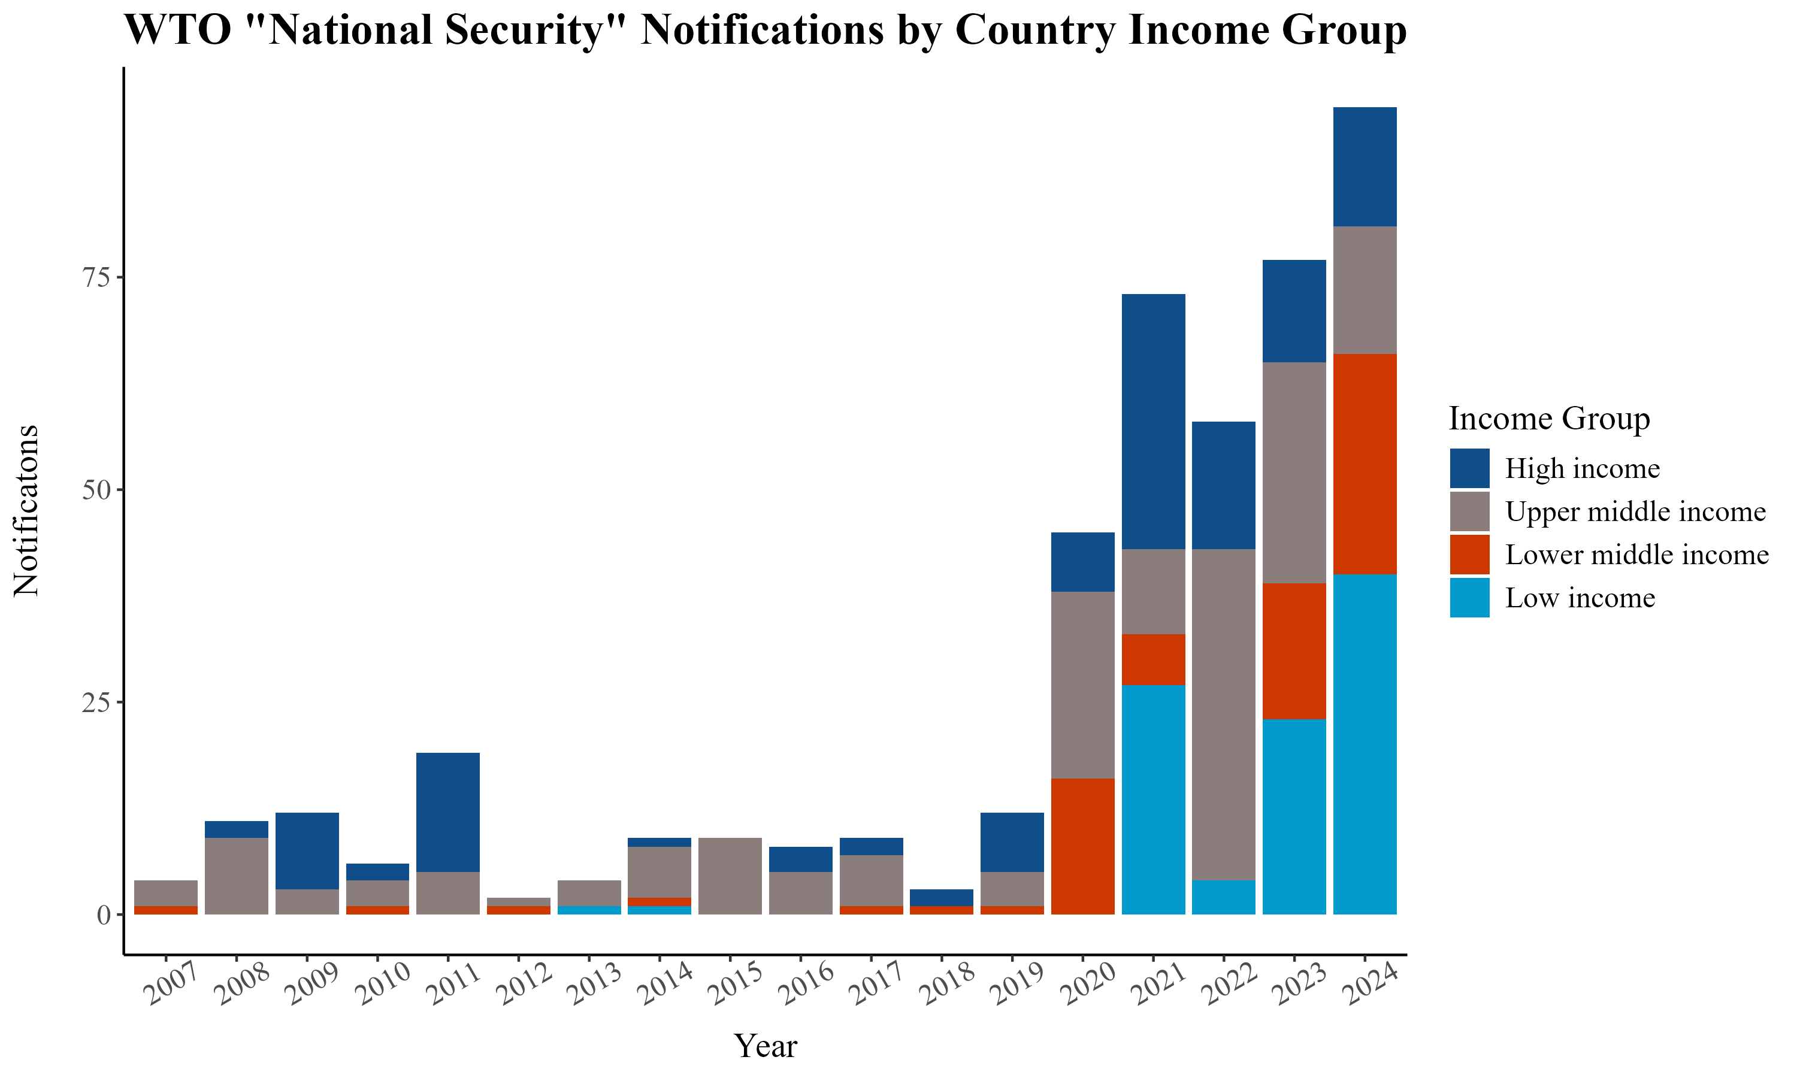
WTO Article XXI: the national-security exception is becoming normalised
Notifications rose sharply after 2019, across income groups.
The legal tension
GATT Article XXI permits action a member considers necessary for essential security interests.
It protects sovereignty in exceptional cases—but broad, self-judging invocation risks turning “security” into an all-purpose justification for protectionism.
Source: Steil & Harding (2024)
Notes:
[Sources]
Steil & Harding (2024), provided lecture asset; GATT Article XXI, WTO.

Slide 5
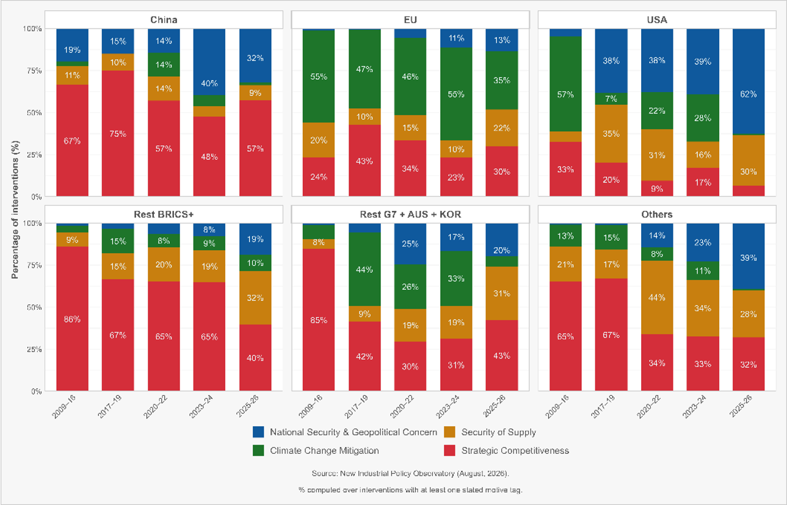
Notes:
[Sources]
Simon Evenentt (2026), provided lecture asset; NIPO, GTA.

Slide 6
Strategic interdependence turns mutual gains into potential leverage
The question is not whether countries depend on one another, but how dependency is distributed.
1
2
3
Dual-use systems
Concentrated exposure
Policy leverage
Semiconductors, grids, EV batteries, data, and logistics serve civilian welfare and national power.
A narrow supplier base can turn a commercial disruption into a security problem.
Export controls, sanctions, and investment screening act on those interdependencies.
Notes:
[Sources]
Supplied Economic Security lecture notes.

Slide 7
Not every disruption is a threat
Economic security must distinguish misfortune from intentionality.
Exogenous shock
Intentional pressure
Pandemic, earthquake, flood, or market failure: harmful, but not directed at you.
A state exploits a dependency, withholds a supply, or threatens access to change another state’s choices.
THE GEOCONOMIC TURN
Intentionality converts an economic vulnerability into a matter of economic statecraft.
Notes:
[Sources]
Supplied Economic Security lecture notes.

Slide 8
Economic security is neither autarky nor efficiency at any price
The objective is reliable well-being—not the smallest possible volume of trade.
1
2
3
Efficiency
Resilience
Proportionality
Specialisation, scale, and trade lower costs and improve choice.
Redundancy, stockpiles, and diversification reduce the damage from disruption.
Secure the genuinely essential nodes; do not treat every import as a strategic dependency.
Notes:
[Sources]
Supplied Economic Security lecture notes.

Slide 9
ONE
China: prosperity, supply, and dependency
Cheap green technology is both an opportunity and a strategic exposure.

Slide 10
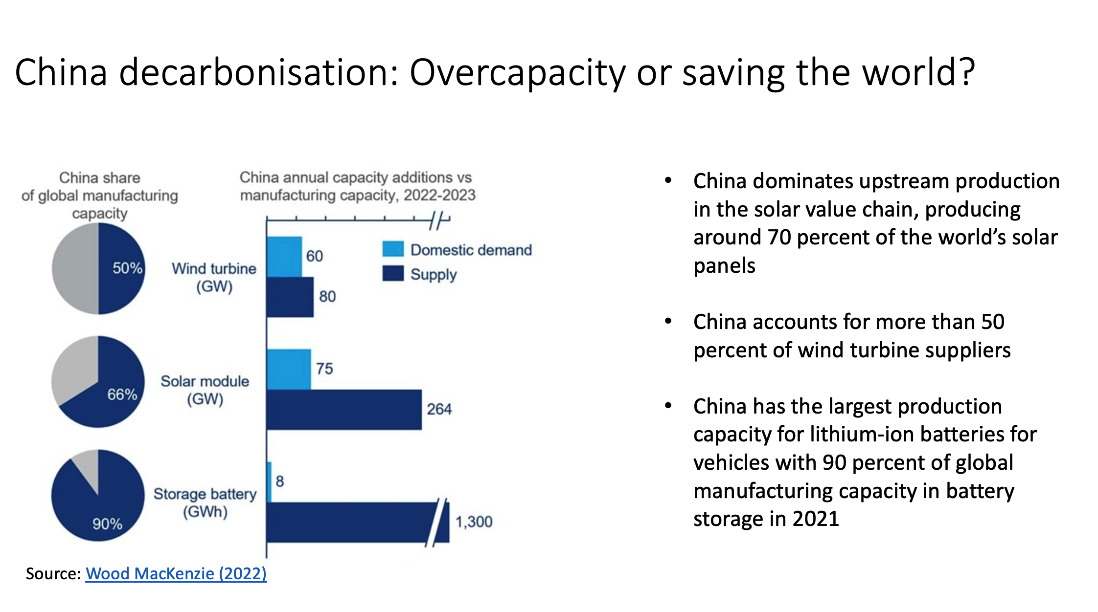
Notes:
[Sources]
Gill, I., The Green Great Game / Wood Mackenzie (2022), supplied lecture notes and asset context.

Slide 11
Cheap green technology: decarbonisation dividend or strategic dependency?
The same supply relationship can improve climate outcomes and increase exposure.
The dividend
The exposure
Scale in solar, wind, batteries, and EVs can reduce transition costs—and accelerate decarbonisation.
Dominant upstream capacity can narrow future options when supply, standards, or access become politicised.
Notes:
[Sources]
Gill, I., The Green Great Game / Wood Mackenzie (2022), supplied lecture notes and asset context.

Slide 12
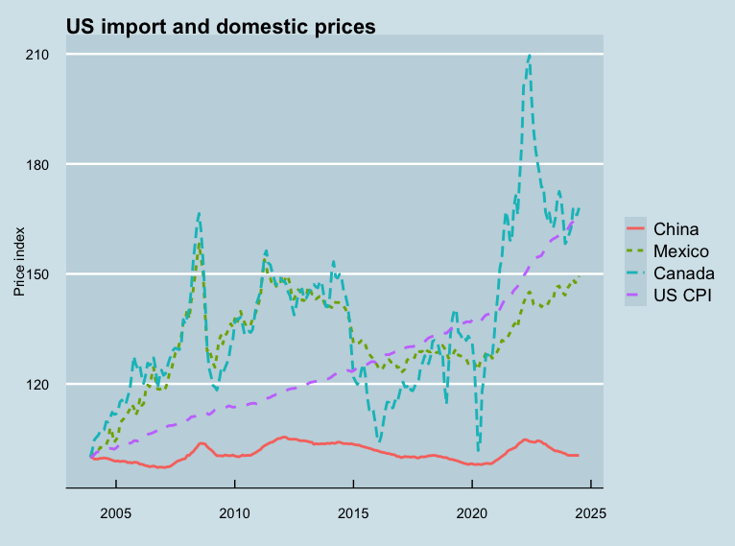
China’s manufacturing prowess creates a policy trade-off
Cheap imports can help consumers and downstream firms even as they pressure domestic producers.
The analytical question
Do not ask only whether low prices arise from “overcapacity.” Ask what a prolonged import shock does to livelihoods, capabilities, and the ability to reallocate.
Economic security is not licence to ignore consumer welfare. It is a way to recognise distributional and strategic consequences alongside it.
Source: US import and domestic price series (Quah, 2026)
Notes:
[Sources]
2024.08-US-import-domestic-prices.png (provided lecture asset).

Slide 13
TWO
Critical-mineral chokepoints
The physical foundations of clean energy and digital technologies.

Slide 14
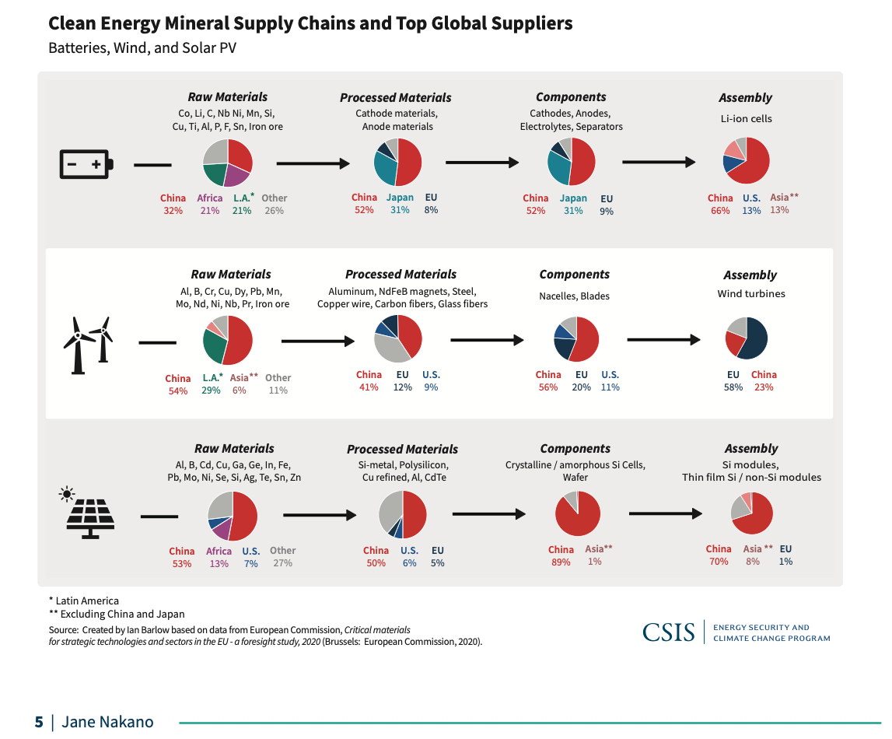
The choke point is often processing—not mining
Security analysis must follow a supply chain from raw material to finished system.
Why it matters
China is highly visible in processed materials, components, and assembly across batteries, wind, and solar.
Those stages take time, energy, know-how, and regulatory capacity to reproduce. A mine alone does not remove a bottleneck.
Source: Jane Nakano / CSIS (2021)
Notes:
[Sources]
Jane Nakano, “Geopolitics of Critical Minerals,” CSIS (2021), provided lecture asset.

Slide 15
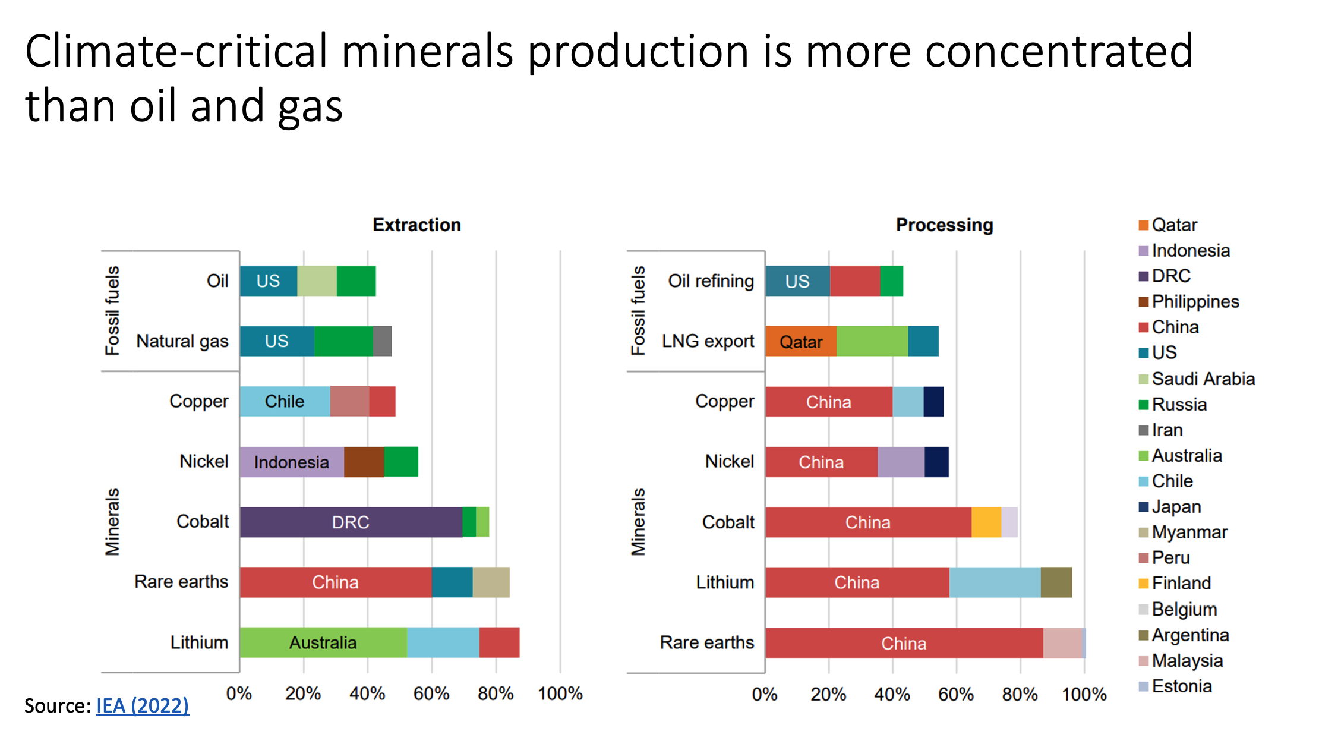
Concentration is a risk—especially when it converges at processing
Minerals may be geographically diverse at extraction and still concentrated after refinement.
The policy implication
For rare earths, lithium, cobalt, nickel, and copper, supply security depends on the entire value chain.
Diversification can mean new suppliers, recycling, substitution, strategic reserves, better demand management, and collaborative processing—not only reshoring.
Source: IEA (2022), via provided lecture asset
Notes:
[Sources]
IEA (2022), via Gill, Indra et al., supplied lecture asset.

Slide 16
ASEAN economic security is a regional portfolio problem
The region gains by being open—and by avoiding unnecessary common exposure.
Exposure
Response
Why it matters
Economic-diplomacy task
Critical minerals
Processing hub
Diversify + invest
Coordinate standards, finance, and sustainable refining partnerships.
Supply chains
Single node
Redundant links
Keep ASEAN embedded in multiple production networks rather than one bloc.
Great-power pressure
Alignment pressure
Hedge deliberately
Preserve policy options, compatible standards, and trusted institutions.
Rules erosion
More exceptions
Defend guardrails
Support workable rules while retaining capacity for genuine emergencies.
Notes:
[Sources]
Supplied Economic Security lecture notes; analysis and implications are instructional synthesis.

Slide 17
The rules dilemma: restraint safeguards a system that others may exploit
Economic security requires judgement about both real risk and the systemic cost of the response.
Sovereignty
Governments need room to protect essential interests when the danger is real and time-sensitive.
Credibility
If every commercial friction is securitised, commitments lose meaning and retaliation becomes rational.
Discipline
Evidence, proportionality, and review distinguish security policy from opportunistic protectionism.
The dilemma
Rules must be strong enough to constrain abuse, but flexible enough to survive genuine geopolitical shocks.
Notes:
[Sources]
GATT Article XXI, WTO; supplied Economic Security lecture notes.

Slide 18
States respond to risk by balancing, bandwagoning, or hedging
IR strategies of allocation under uncertainty.
1
2
3
Balancing
Bandwagoning
Hedging
Shift away from a risky power; coordinate with others to strengthen resilience and bargaining power.
Align with the stronger power to share gains or avoid punishment—despite doubts about reliability.
Spread commitments across rivals, suppliers, and institutions to preserve options and reduce exposure.

Slide 19
A policy portfolio should fit the vulnerability
Different instruments solve different problems—and impose different costs.
Diversify suppliers
Reduce single-point exposure through commercial and diplomatic partnerships.
Strategic reserves
Buy time during temporary disruption; costly if used as a substitute for strategy.
Domestic capability
Build selected processing, innovation, and workforce capacity where bottlenecks are durable.
Recycling & substitution
Reduce primary-material dependence by redesigning products and recovering inputs.
Investment screening
Protect sensitive assets and know-how without blocking productive capital indiscriminately.
Rules & coordination
Use standards, information-sharing, and credible commitments to make interdependence safer.
Use tests, not labels
Ask: essential? concentrated? hard to replace? susceptible to coercion?
Notes:
[Sources]
Supplied Economic Security lecture notes.

Slide 20
15-minute classroom exercise: build an economic-security response
Teams: take the perspective of an ASEAN government facing a critical-supply disruption.
1. Diagnose
Name the dependency
What is essential? How concentrated is supply? Is the shock accidental, commercial, or coercive?
2. Choose
Build a policy mix
Select two instruments: diversification, reserve, domestic capability, recycling, screening, rules, or diplomacy.
3. Position
Set an external strategy
Will you balance, bandwagon, or hedge? Identify the trade-off in cost, autonomy, and resilience.
4. Defend
Explain the rule test
Why is your response proportionate—and how will you stop it becoming permanent protectionism?
Report
One-minute briefing
State the risk, your chosen instruments, your strategy, and the cost you accept.

Slide 21
Economic security is the practice of keeping interdependence beneficial.
The starting point: Open markets can generate prosperity, innovation, and access to essential goods.
The risk: Concentrated, hard-to-replace dependencies can make that prosperity vulnerable to shocks and coercion.
The task: Build proportionate resilience—through markets, policy, and diplomacy—without treating every dependency as a threat.
For ASEAN: Economic diplomacy is the craft of preserving options: diversify relationships, strengthen regional capacity, and keep rules credible.

