Slide 1
PP5182 Industrial Policy
From economic heresy to geopolitical orthodoxy
Why are the countries that once criticised
East Asian industrial policy now practising it?
The instruments are familiar. The justification has changed.
Danny Quah
Lee Kuan Yew School of Public Policy, NUS • 7 September 2026
Notes:
Opening puzzle. Connect to Globalisation to Strategic Interdependence and Economic Security: intervention once required an exception to the free-trade presumption. Today strategic dependence itself provides a rationale. The argument is a change in emphasis and domain, not a claim that Western industrial policy began in 2022.

Slide 2
“Japan as Number One”
Theodore White, 1985 — the story runs earlier than China.
Theodore White, 1985
Malcolm Baldrige, US Secretary of Commerce, 1981–1987
“Today not a single consumer radio is made in America, although Americans invented the modern radio; not a single black-and-white television set is made here, although America invented television.”
“We sent them blood-fractionating technology on humanitarian grounds. Today the company we gave the technology to competes with Americans around the world. We sent them technicians from the Underwriters Laboratory to certify that Japanese products were up to American standards, fit for export. Today U.S. companies fight to get their exports certified for entry into Japan.”
(Reported in Theodore White, 1985)
Notes:
Reused from slide 20 of PP5182 Globalisation to Strategic Interdependence, DQ-drafted-C. Quotations and attribution retained as supplied: Theodore White (1985), with Malcolm Baldrige reported there. These statements illustrate contemporary American anxiety about Japanese competition. Treat them as historical rhetoric rather than independently verified production statistics.

Slide 3
East Asia changed what it could sell
South Korea’s early export transformation, 1960–1969
106-fold
increase in manufactured exports
in just nine years
By 1969, manufactures accounted for 77% of Korea’s exports.
Notes:
Source: IMF, Finance & Development, “Korea’s Export Success, 1960–69” (1971), https://www.elibrary.imf.org/view/journals/022/0008/001/article-A003-en.xml . The contemporary account reports a 106-fold increase in manufactured exports during 1960–69 and a 77 percent share of total exports in 1969. This is growth in export value from a small base, not a real productivity growth rate. It illustrates structural transformation before the 1980s technology boom. It does not identify how much industrial policy caused the increase.

Slide 4
Three Western reactions
Unfair. Futile. Imitate.
UNFAIR
“Japan Inc.”: subsidies, keiretsu, and chaebols.
Semiconductor dumping and barriers to market access.
FUTILE
Krugman (1994): rapid input accumulation alone
cannot sustain exceptional growth indefinitely.
IMITATE
SEMATECH (1987): government and industry
organise a collective response to Japanese competition.
Notes:
Lecture source: supplied Industrial Policy and Trade notes. Correct reference: Paul Krugman, “The Myth of Asia’s Miracle,” Foreign Affairs, November/December 1994. His growth-accounting argument distinguishes factor accumulation from efficiency gains; it is not a theorem that all industrial policy fails. Supplementary historical context: Plaza Accord (1985), automobile voluntary export restraints, the 1986 semiconductor agreement and Section 301 actions. Avoid describing the semiconductor agreement as an enforceable guarantee of a 20 percent foreign share: the language and status of that expectation were contested.

Slide 5
SEMATECH: America was already imitating
1987 • Semiconductor Manufacturing Technology consortium
THE PROBLEM
Japanese competition exposed weaknesses
in US semiconductor manufacturing.
THE RESPONSE
Federal funding and rival firms pooled resources
to improve shared manufacturing capabilities.
THE LESSON
Build the supplier ecosystem.
A subsidy to one champion cannot do that alone.
Notes:
SEMATECH background: formed in 1987, began operations in Austin, Texas in 1988. Fourteen US semiconductor manufacturers partnered with the federal government. Congress initially appropriated $100 million annually, matched by industry, through the Department of Defense/DARPA. Economic competitiveness and concern about military dependence on foreign semiconductor supply overlapped from the outset. Rival member priorities complicated joint work. The consortium increasingly concentrated on common manufacturing equipment and materials suppliers rather than competing product designs, including lithography-related capabilities. Do not equate this with exclusive US control of lithography. Federal matching support ended in 1996 as the organisation moved toward industry funding. US market recovery had multiple causes, so the funding transition is not causal proof that SEMATECH alone rescued the industry. Sources: GAO, Federal Research: SEMATECH’s Efforts to Strengthen the U.S. Semiconductor Industry, RCED-90-236 (1990), https://www.gao.gov/assets/rced-90-236.pdf ; GAO, Lessons Learned From SEMATECH, RCED-92-283 (1992), https://www.gao.gov/products/rced-92-283 ; GAO-19-409 (2019), https://www.gao.gov/assets/gao-19-409.pdf .

Slide 6
Industrial policy: definition and tools
Selective government intervention to reshape the domestic economy
Supporting or developing particular sectors, firms or industries
FINANCE
Subsidies, tax incentives, public credit and procurement
CAPABILITIES
R&D support, skills and sector-specific infrastructure
MARKET RULES
Tariffs, local-content requirements and regulation
Notes:
Definition and instruments adapted from supplied lecture notes. Selectivity distinguishes industrial policy from general macroeconomic management. Infrastructure and education become industrial-policy instruments when directed at particular activities or capabilities. Export controls and investment screening overlap with industrial policy when they reshape production, but economic statecraft is a broader category.

Slide 7
Comparative advantage: today versus tomorrow
Can policy change what an economy will be good at?
TODAY
Current prices reward existing skills, technologies
and production capabilities.
TOMORROW
Learning and investment can change relative costs
and create activities that do not yet exist.
THE POLICY BET
Will temporary support create a competitive industry
that can eventually operate without that support?
Notes:
Dynamic comparative advantage does not abolish opportunity cost. The question is whether an intervention changes future capabilities enough to justify its present cost. Private investors also anticipate future profits; a long horizon alone is insufficient to establish a market failure. The case for policy needs a wedge between social and private returns.

Slide 8
Why the market may underinvest
The case depends on a specific failure
LEARNING
Early production teaches workers and suppliers.
Knowledge may spill beyond the pioneering firm.
EXTERNALITIES
R&D and cleaner technologies can create benefits
that the investor cannot fully capture.
COORDINATION
A factory needs trained workers and reliable suppliers.
Each investment may wait for the others.
Notes:
Analytical mechanisms, not a presumption that every sector warrants protection. Distinguish learning internal to a firm, which it may finance itself, from spillovers that reduce private incentives. Coordination problems can sometimes be addressed with common infrastructure or standards. The least costly instrument targets the diagnosed wedge.

Slide 9
Government failure: the other half of the test
Information limits, capture and support that becomes permanent
“Governments are bad at picking winners, but losers are good at picking governments.”
Chatib Basri, former Finance Minister of Indonesia
Who withdraws support when the experiment fails?
Notes:
Quote reproduced exactly as attributed to Chatib Basri in the supplied lecture notes. No independent claim about the first origin of this aphorism. Emphasise asymmetric political incentives: beneficiaries organise, costs disperse, and sunk investments create demands for renewed protection. Export performance, independent evaluation and credible sunset provisions can discipline support, but enforcement matters.

Slide 10
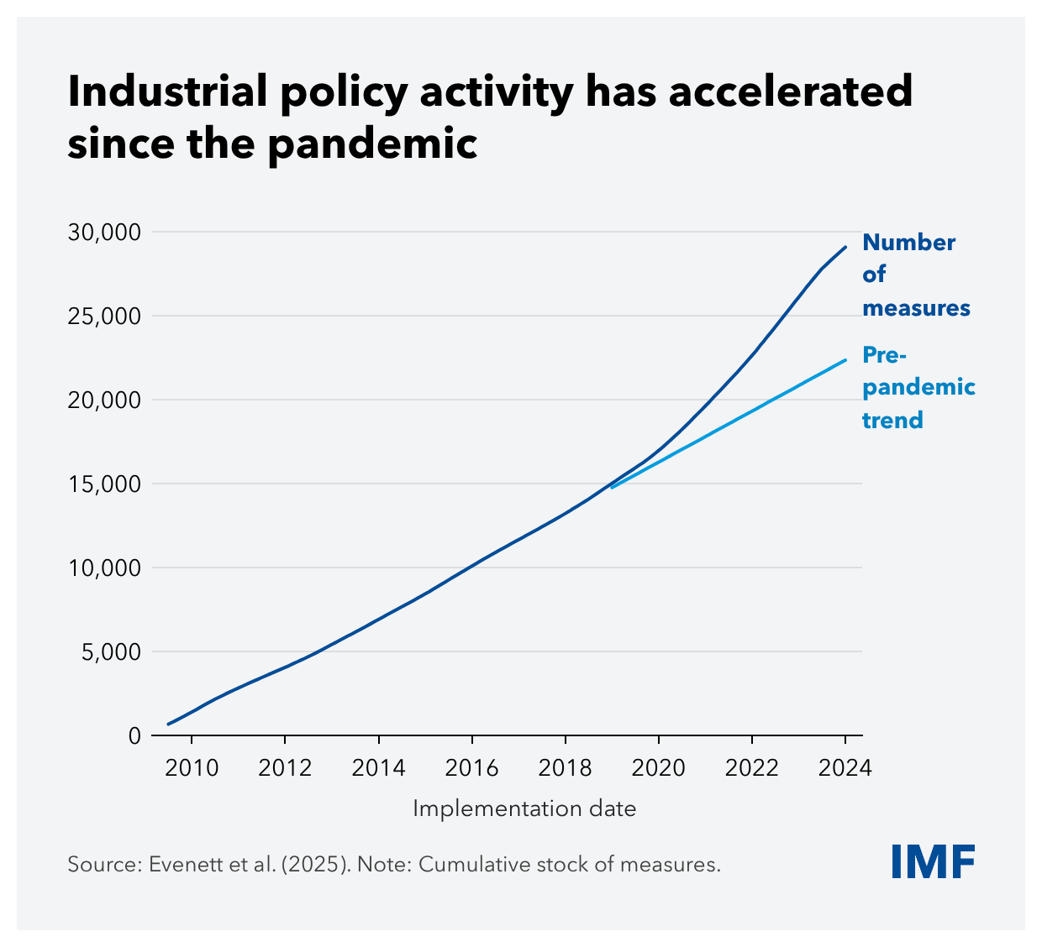
Industrial policy is back
The pandemic
accelerated an
existing rise
Cumulative stock of measures,
not annual new spending
Notes:
Supplied IMF chart 1. Source within image: Evenett et al. (2025). The series is the cumulative stock of measures, plotted through 2024, versus a pre-pandemic trend. The chart records policy activity, not fiscal cost or effectiveness. Related IMF discussion: https://www.imf.org/en/blogs/articles/2025/11/25/industrial-policy-can-lift-productivity-but-comes-with-risks-and-trade-offs .

Slide 11
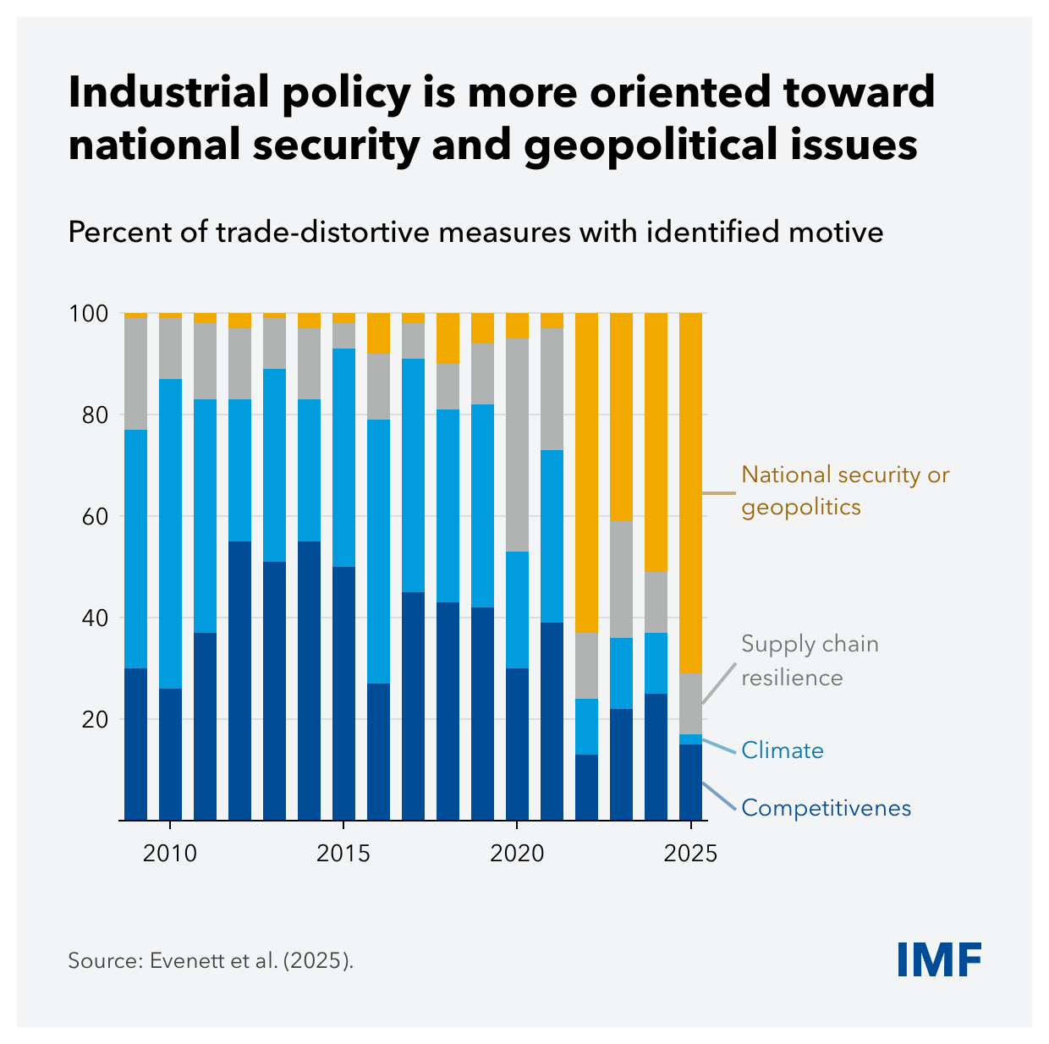
The purpose has changed
National security
and geopolitics
move to the fore
Stated motives among
trade-distortive measures
with an identified motive
Notes:
Supplied IMF chart 2, source Evenett et al. (2025). This is the distribution of stated motives among trade-distortive measures with identified motives, not all industrial policy and not shares of government spending. Motivation categories do not establish actual effectiveness or sincerity. Source context: IMF October 2025 WEO Chapter 3, https://www.elibrary.imf.org/display/book/9798229023948/CH003.xml .

Slide 12
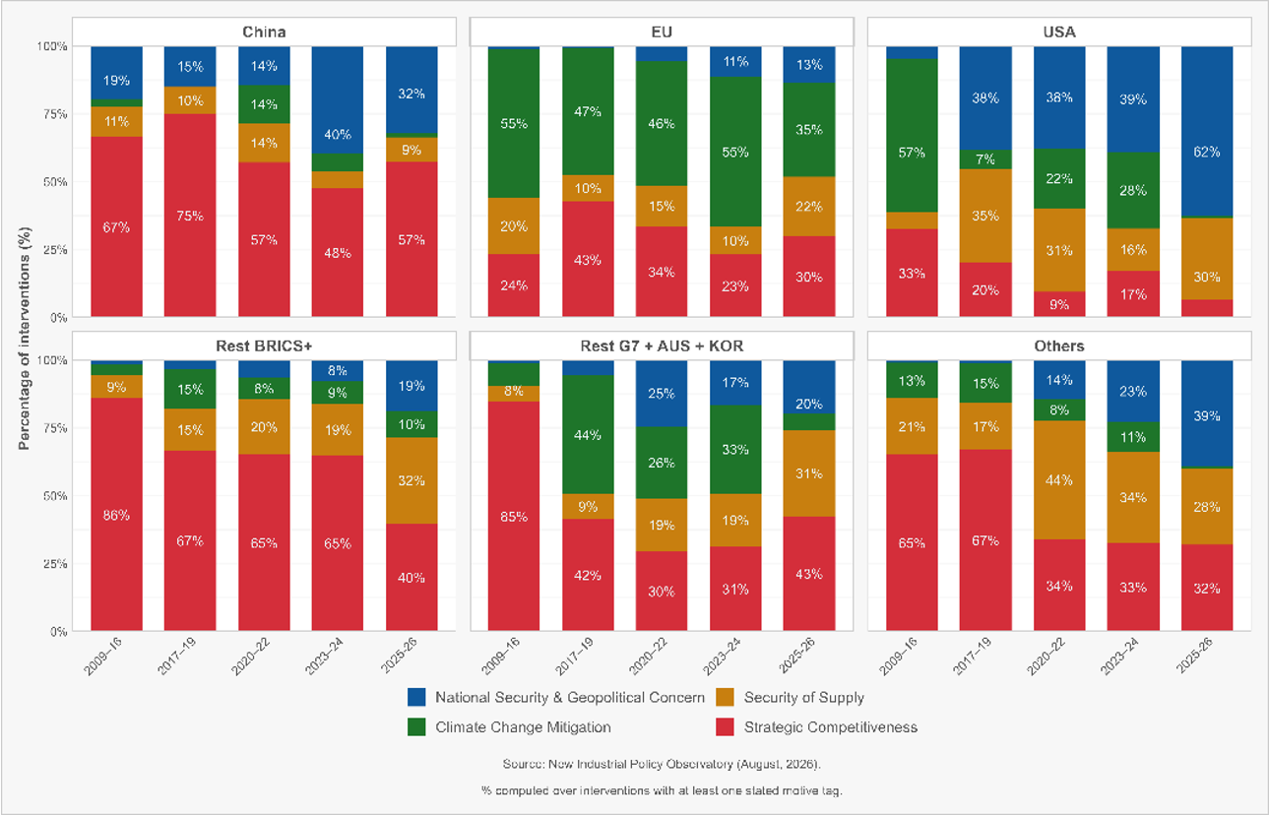
Different powers, different motives
Notes:
Supplied New Industrial Policy Observatory chart, August 2026, attributed by the user to Simon Evenett. Preserve the complete six-panel image and legend. Percentages concern interventions with at least one stated motive tag, not expenditure or policy success. In the chart’s 2025–26 period, China’s strategic-competitiveness share is 57%, the EU climate share is 35%, and the US national-security/geopolitical share is 62%. Different objective mixes complicate the idea of a single global industrial-policy model. The 2025–26 grouping includes the period covered by this August 2026 snapshot.

Slide 13
CHIPS: SEMATECH writ large
CHIPS and Science Act, 2022 • original programme design
$39 BILLION
Manufacturing incentives for facilities and equipment
in the United States
$11 BILLION
A domestic R&D ecosystem, including shared
research and advanced packaging capabilities
A WIDER AIM
Manufacturing scale and supply resilience, alongside
the collective-capability logic of SEMATECH
Notes:
Original 2022 design, not a report on current disbursement or individual company awards. NIST describes $50 billion for Commerce CHIPS programmes, of which $39 billion is for manufacturing incentives and $11 billion for R&D. The broader CHIPS appropriation includes other programmes. Source: https://www.nist.gov/chips and https://www.nist.gov/chips/implementation-strategy . Comparison with SEMATECH is an analogy: the new programme supports fabrication capacity directly and has a wider supply-chain and strategic remit. CHIPS guardrails and separate export controls link support to security policy, but export controls are not the same instrument as the grants.

Slide 14
IRA: climate, industry and geopolitics
Inflation Reduction Act, 2022 • original policy architecture
CLIMATE
Tax incentives lower the cost of clean-energy
deployment and production.
INDUSTRY
Manufacturing credits and domestic-content bonuses
pull investment toward US supply chains.
GEOPOLITICS
Sourcing conditions favour domestic and eligible
partner capacity, creating tensions with other suppliers.
Notes:
Historical case study of the 2022 architecture, not guidance on tax-credit eligibility in September 2026. Climate support and domestic industrial promotion can reinforce one another, but local sourcing can also raise costs and divert trade. Sources: US DOE, Inflation Reduction Act of 2022, https://www.energy.gov/edf/inflation-reduction-act-2022 ; DOE explanation of domestic content bonus and 45X production credit, https://www.energy.gov/policy/articles/president-bidens-investing-america-agenda-boosting-american-manufacturing-and-clean . The original clean-vehicle architecture included North American final assembly and critical-mineral/battery sourcing conditions. Subsequent legislation and guidance change programme availability; do not present the original package as unchanged current law.

Slide 15
Old and new industrial policy
A shift in emphasis, with substantial overlap
DEVELOPMENT STRATEGY
ECONOMIC SECURITY
Catch up with the productivity frontier
Protect critical capacities and supply
Build new export capabilities
Reduce strategic vulnerabilities
Use foreign markets as a performance test
Accept some efficiency cost for resilience
Risk: protected firms never graduate
Risk: security rationales become unlimited
Notes:
Stylised comparison, not mutually exclusive periods or regions. East Asian developmental states had security motives. Western states practised industrial policy long before the current revival, as SEMATECH demonstrates. Emerging economies still pursue competitiveness, while advanced economies still pursue productivity and climate goals. The shift is in prominence, scale and political justification.

Slide 16
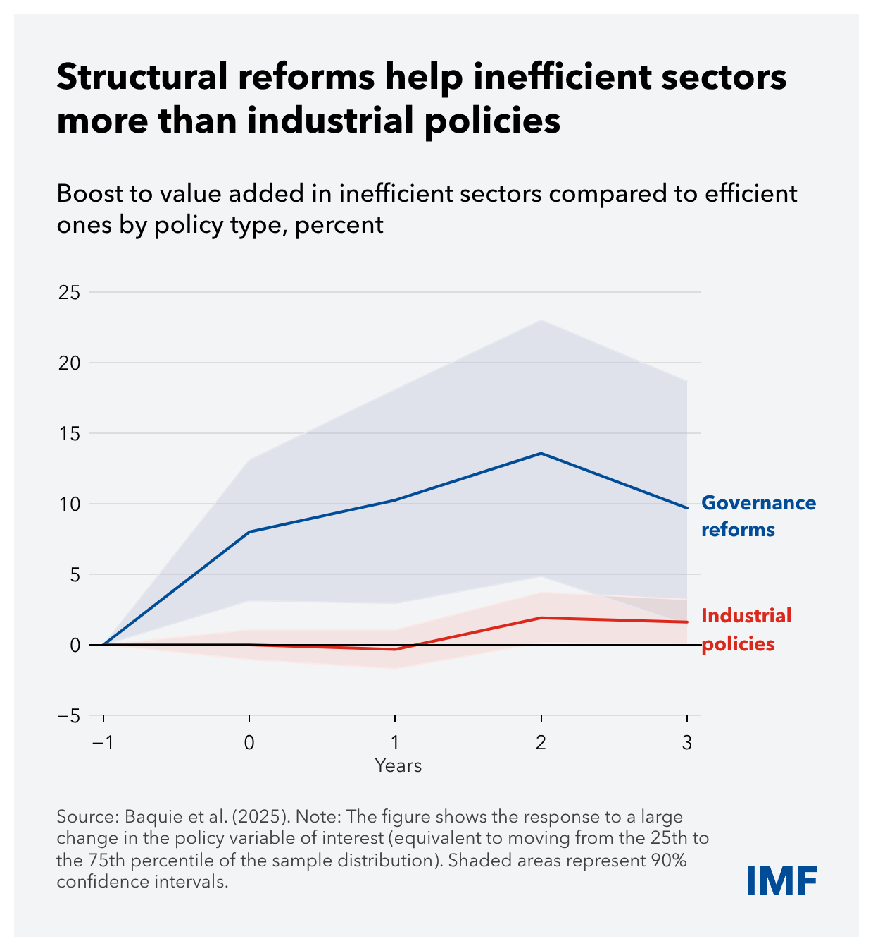
The structural-reform counterpunch
Could better
governance do more
than sector support?
This evidence favours reform
for inefficient sectors.
It does not settle every
technology or security case.
Notes:
Supplied IMF chart 3: Baquie et al. (2025). Outcome is the boost to value added in inefficient sectors relative to efficient ones, not an unconditional GDP multiplier. A large policy change means a move from the 25th to the 75th percentile. Shaded areas are 90% confidence intervals. Governance reform has larger estimated effects here. Use it to discipline the choice of instrument, not to infer that all targeted innovation or resilience policies fail. Source context: IMF October 2025 WEO Chapter 3, https://www.elibrary.imf.org/display/book/9798229023948/CH003.xml .

Slide 17
Build yourself up • Hold others down
Industrial policy occupies a spectrum of cross-border effects
BUILD CAPABILITY
Open research, skills and infrastructure
can increase productive capacity at home and abroad.
FAVOUR HOME
Subsidies and local-content rules build capacity
while potentially diverting trade and investment.
CONSTRAIN RIVALS
Technology denial and exclusion may deliberately
limit another economy’s options.
Notes:
Conceptual spectrum adapted from the supplied lecture notes. The same instrument can have multiple effects, so classification depends on design and context. Export controls are broader economic statecraft and overlap with industrial policy. Positive domestic effects alone do not establish global welfare gains. Consider retaliation, fiscal competition, downstream users and access for smaller states. Security restrictions can serve legitimate risk reduction; the relevant test is necessity, proportionality and available alternatives.

Slide 18
A five-question decision rule
A credible proposal needs an answer to every question
1 WHAT FAILURE?
Which market failure or security vulnerability is specific and material?
2 WHY THIS TOOL?
Why does targeted support beat reform or a less restrictive alternative?
3 WHAT NET GAIN?
Do benefits exceed fiscal costs, distortions and distributional losses?
4 WHO DISCIPLINES IT?
Who measures performance, prevents capture and ends failing support?
5 WHAT SPILLOVERS?
Can cooperation limit harm abroad, retaliation and subsidy escalation?
Notes:
Five-question decision rule synthesising the lecture. 1: require a mechanism and evidence, not a fashionable sector label. 2: compare against economy-wide reform and direct correction of the externality. 3: include opportunity cost, consumer and downstream costs, uncertainty and a measurable security benefit where relevant. 4: publish criteria, use independent evaluation, performance conditions, sunset dates and credible withdrawal. 5: consider cross-border benefits as well as harm and identify feasible coordination. Basri reminder: “Governments are bad at picking winners, but losers are good at picking governments.” An unanswered question calls for redesign or better evidence, not automatic approval.

Slide 19
Industrial policy has migrated
From a catching-up strategy to an instrument of strategic competition
THE CONTINUITY
Governments try to change productive capabilities
when private incentives appear insufficient.
THE CHANGE
Economic security expands the objectives
and the willingness to bear economic costs.
THE TEST
Can policy build capabilities, survive scrutiny
and limit harm beyond its borders?
“Losers are good at picking governments.” — Chatib Basri
Notes:
Closing synthesis. Return to the opening puzzle: industrial policy’s migration reflects changed objectives and anxieties as well as learning from East Asia. The case remains conditional. Security does not remove the need to compare instruments or govern political capture. Shortened Basri quotation repeats the line supplied in the lecture notes. For smaller economies, fiscal constraints and dependence on open external markets make instrument selection and cooperation especially consequential.

