Slide 1
PP5182 Multilateralism Future
Can pragmatic cooperation
rebuild international order?
The old rules are weakening. The alternatives may solve today’s problems—or deepen tomorrow’s fragmentation.
Danny Quah
Lee Kuan Yew School of Public Policy, NUS • 14 September 2026

Slide 2
More cooperation can mean less multilateralism
Opening puzzle • discuss before revealing the distinction
MULTILATERAL
finance • aid • debt relief • military exercises • sanctions • diplomacy
trade negotiations • security alliances • peacekeeping
Does “more of these” necessarily mean more multilateralism?
PAUSE • What would you require before calling a system multilateral?
Notes:
Give students 2–3 minutes. Collect criteria before revealing the three substantive principles.

Slide 3
What is multilateralism for?
Three substantive properties—not merely three or more states acting together
LEVEL PLAYING FIELD
Treat everyone by general rules; economise on costly displays of power and aggression.
PEACEFUL DISPUTE RESOLUTION
Elevate substantive disagreements over wasteful zero-sum contests.
SHARED CHALLENGES
Cooperate where joint provision avoids duplication and exploits complementary capabilities.
These are not only protections for weaker states. They can make the system more efficient.
Notes:
Fairness and correction of historical inequities matter, but keep the lecture’s operational definition on these three properties.

Slide 4
Traditional multilateralism: institutions and principles
Institutions matter insofar as they sustain general rules and collective provision
WORLD BANK IMF WTO UN
The institutional architecture is not the definition.
The question is what happens when states route around its principles.
That takes us to trade—and Bhagwati.

Slide 5
Bhagwati: liberalisation can undermine liberal order
Preferential trade can be individually attractive and systemically destructive
SPAGHETTI BOWL
Overlapping preferences, rules of origin and exceptions create complexity and discrimination.
TRADE DIVERSION
Preferences can redirect purchases from a lower-cost outsider to a higher-cost insider.
TERMITES
Beneficiaries of special access acquire an interest in preserving discrimination against outsiders.
Notes:
Introduce Bhagwati’s critique of departures from MFN. Stress that the target is preferentialism, not trade opening per se.

Slide 6
Singapore and India: the same FTA is not the same bargain
Initial MFN tariffs determine how much discrimination an FTA creates
LOW-TARIFF SINGAPORE
HIGH-TARIFF INDIA
Little home-market trade diversion
Can gain preferential access abroad
Gives away relatively little tariff protection
Large preference margin at home
Greater scope for trade diversion
Tariff revenue can be lost as imports switch
The tension for a small, already-open state: a preferential deal may be rational precisely while preferentialism is bad for the system.
Notes:
Discuss the fallacy-of-composition intuition. Avoid implying that every FTA necessarily causes diversion.

Slide 7
Bhagwati Beyond Trade
Three mechanisms travel remarkably well beyond commercial policy
1 LOCAL ≠ SYSTEMIC
An individually intelligent strategy need not aggregate into a successful international order.
2 EXCEPTIONS ACCUMULATE
Proliferating special arrangements create complexity, discrimination and incompatible obligations.
3 EXCEPTIONS CREATE ALLIES
Beneficiaries of special treatment can become constituencies against restoration of the general rule.
Keep these three tests. We will apply them to every alternative that follows.

Slide 8
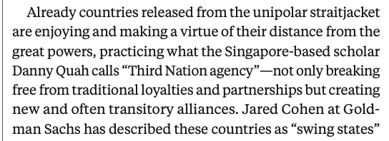
Gordon Brown generalises the pathology
The international-relations version of the spaghetti bowl
“ragged, overlapping,
and competing arrangements”
Brown’s worry is substitution:
bilateral, regional and transient arrangements cease to supplement global architecture and begin to replace it.
Third Nation agency expands—but what order does its exercise produce?
Notes:
Use the excerpt even while condensing Brown. It also provides the transition from Brown’s concern to middle-power agency.
[Sources]
Gordon Brown, “A New Multilateralism,” Foreign Policy, Fall 2023. User-supplied excerpt image.

Slide 9
The reversal
What Bhagwati and Brown fear, Carney and Stubb prescribe
BHAGWATI / BROWN
CARNEY / STUBB
Overlapping special arrangements
are the pathology.
A “dense web of connections”
is the practical response.
LET THE NOODLES WORK
The issue is whether the web is a bridge back to multilateralism—or its replacement.
Notes:
This is the dramatic centre of section THREE. Pause briefly on the reversal.
[Sources]
Mark Carney and Alexander Stubb, The Economist, 11 July 2026.

Slide 10
Values-based realism
Neither wishful multilateralism nor crude realpolitik
PRINCIPLED
Freedom, human rights, sustainability and solidarity remain commitments.
PRAGMATIC
Not every useful partner shares every value; interests diverge and progress is incremental.
PLURILATERAL
Build “ad hoc coalitions that work, issue by issue” while still seeking multilateral reform.
“Taking the world as it is, not passively waiting for a world we wish to be.”
Notes:
Variable geometry: purpose-built coalitions around shared interests, including with states that disagree on other issues.
[Sources]
Carney and Stubb, The Economist, 11 July 2026.

Slide 11
The Middle Power Bet
Coalition builders—or Great Power wannabes?
THE BET
Connected states can convene, broker and combine capabilities without demanding hierarchy.
Remove constraints and Middle Powers may simply “scrap for advantage”: multialign, arbitrage patrons, and practise power politics with smaller endowments.
THE DOUBT
Middle Power-ness itself supplies no guarantee of cooperative purpose.
Notes:
Russell supplies the sceptical side; do not prejudge it as a fallacy.
[Sources]
Alec Russell, Financial Times, 23 Dec. 2025.

Slide 12
Can we constrain variable geometry?
Herz and Ho: use geography to turn flexible cooperation into durable regionalism
FIXED MEMBERSHIP
You cannot choose your neighbours. Regional cooperation must survive disagreement.
REPEATED GAME
Institutional memory, reputation, and reciprocity discipline opportunism.
PATHFINDER
Regional experiments can converge, interoperate, and eventually feed rules back into global institutions.
Knit the noodles back together again.
Notes:
Present Herz–Ho explicitly as an attempted solution to the Carney–Stubb risk.
[Sources]
Monica Herz and Selina Ho, “How Multilateralism Can Survive,” Foreign Affairs, 2 Jan. 2026.

Slide 13
Herz–Ho’s Achilles heel
Student discussion • what hidden assumption makes geography a solution?
GEOGRAPHY
→
COMMON INTERESTS
→
COOPERATION
PAUSE • Where does this chain fail?
Think of security, trade, rivers, migration, technology—or any region you know well.
Notes:
Give 3–4 minutes. Ask students for counterexamples before showing the next slide.

Slide 14
Proximity concentrates interdependence—not agreement
The same geography can magnify potential gains and potential losses
SOUTH ASIA
India–Pakistan: shared exposure coexists with strategic rivalry; SAARC rarely meets.
SOUTHEAST ASIA
South China Sea: the same regional challenge generates sharply different interests and alignments.
THE GULF
Dense security and economic ties coexist with competing strategies; high stakes can reduce willingness to delegate.
Geography can sharpen rivalry just as readily as it encourages cooperation.
Notes:
Herz and Ho themselves acknowledge serious internal divisions in several regional organisations.
[Sources]
Herz and Ho, Foreign Affairs, 2 Jan. 2026.

Slide 15
Regionalism’s answer to Bhagwati
A building block only if the blocks are designed to fit together
EXPERIMENT
Develop workable rules regionally where universal agreement is too slow.
CONNECT
Coordinate across regions; reduce incompatibility and discriminatory lock-in.
MULTILATERALISE
Bring proven rules with broad buy-in back into WTO and other global institutions.
The unresolved question: why should regional rules converge rather than harden into rival standards?
Notes:
This is Herz–Ho’s theory of convergence—and the point at which Bhagwati’s warning returns.
[Sources]
Herz and Ho, Foreign Affairs, 2 Jan. 2026.

Slide 16
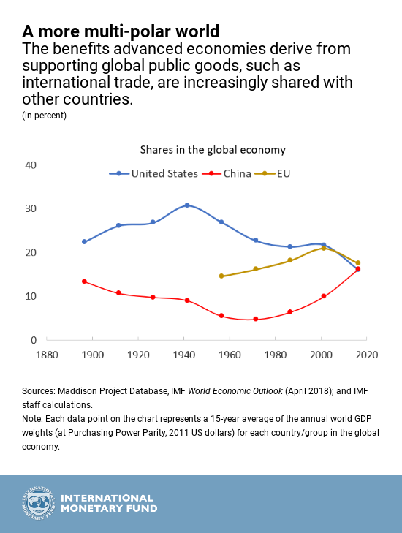
Who will pay for order?
The material basis of the old leadership model has diffused
Economic weight is more distributed.
But the need for global public goods has not become less global.
If no actor can—or wishes to—supply order on the old terms, waiting for a new hegemon may be the wrong question.
Notes:
Use the IMF figure as a visual claim about diffusion of global economic shares, not a complete measure of geopolitical power.
[Sources]
IMF, “A More Multi-polar World,” 2018; user-supplied IMF graphic.

Slide 17
The fallacy of composition returns
Individually intelligent strategies do not automatically aggregate into order
EACH STATE
seeks flexibility • special access • resilience • bargaining leverage
THE SYSTEM
gets discrimination • duplicated effort • rival standards • weaker general rules
The policy problem is not to suppress national interest.
It is to change what pursuing national interest produces.

Slide 18
Stop searching for benevolence
Can interests and incentives supply the behavioural guardrails?
“It is not from the benevolence of the butcher, the brewer, or the baker that we expect our dinner,
but from their regard to their own interest.”
ADAM SMITH
Must international order depend on states wanting to uphold international order?
Or can institutions make self-interested conduct inadvertently reproduce a level playing field, peaceful dispute resolution, and provision of shared goods?
Notes:
Foreground this as the lecture’s significant intellectual move, not a decorative closing quotation. The question shifts from benevolent leadership to incentive-compatible order.
[Sources]
Adam Smith, The Wealth of Nations, Book I, Ch. II.

Slide 19
Multilateralism future
Principles → pathology → pragmatic alternatives → behavioural foundations
THE PRINCIPLES
Level playing field • peaceful dispute resolution • cooperation on shared challenges.
THE PATHOLOGY
Bhagwati Beyond Trade: local rationality, accumulating exceptions, political constituencies.
THE PRAGMATIC TURN
Variable geometry and regional pathfinders can act—but must avoid becoming the new spaghetti bowl.
THE DEEPER TEST
Design interests and incentives so that pursuing advantage also reproduces international order.
Notes:
Return explicitly to the opening three principles. The final test is behavioural: what arrangements make those principles robust to ordinary self-interest?

