Slide 1
PP5182: Cooperation and Competition
Can cooperation help produce order?
Danny Quah
Lee Kuan Yew School of Public Policy, NUS
12 October 2026
Notes:
Opening: cooperation and leadership are not mutually exclusive. Ask which cooperation needs leadership to begin or persist.

Slide 2
The question
Cooperation is not the opposite of leadership
Which cooperation requires leadership to begin?
Which requires leadership to continue?
Which can sustain itself through incentives?
Notes:
Three questions frame the lecture; do not prejudge them.

Slide 3

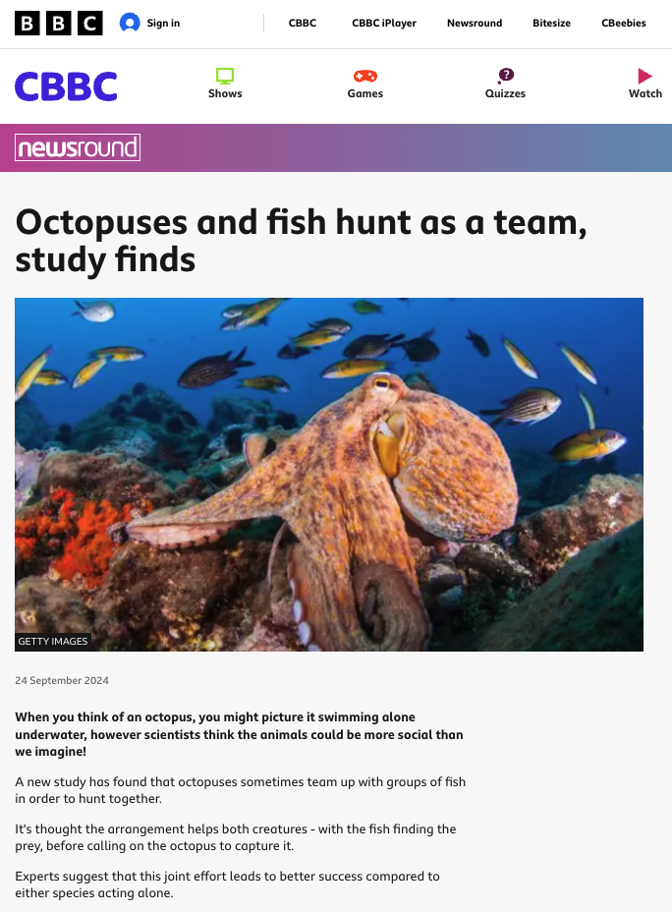
Cooperation without a common sovereign
Two mechanisms, two species
Starlings: long-term bonds
Octopus + fish: joint hunting
Repeated contact, reciprocal helping, and social relationships.
Complementary skills, immediate gains, and decentralised discipline.
Notes:
Ask students what the two animal examples establish. Starlings: long-term reciprocal helping. Octopus-fish: complementary hunting and policing; not identical to human political cooperation.
[Sources]
Columbia University, SciTechDaily, 25 May 2025; BBC Newsround, 24 Sep 2024.

Slide 4
Discussion break
What do the animal examples establish?
Both cooperate without a common sovereign.
• Starlings: repeated relationships and reciprocity.
• Octopus and fish: complementary interests in a task.
Same outcome; different mechanisms.
Notes:
Discussion: how do incentives and repeated contact differ? Is discipline necessarily sovereign enforcement?

Slide 5
Hobbes: why peace is precarious
Leviathan (1651), Chapter 13
Without a common power, each fears that others will defect.
• People recognise mutual advantage.
• But cannot be sure others will honour commitments.
• A sovereign supplies credible assurance.
Notes:
Hobbes: state of war is not perpetual fighting; it is absence of credible assurance. His position is more nuanced than asserting cooperation is logically impossible.
[Sources]
Hobbes, Leviathan (1651), ch. 13.

Slide 6
Locke: authority under constraints
Second Treatise of Government (1690), Chapter 2
Obligations precede government.
• Natural rights constrain legitimate authority.
• Government improves adjudication and enforcement.
• Consent and the right to resist limit political power.
Notes:
For Locke the law of nature binds before government; government remedies inconveniences in decentralized enforcement.
[Sources]
Locke, Second Treatise of Government (1690), ch. 2.

Slide 7
Ikenberry: power and rules together
The constitutional bargain of liberal international order
Other states accept American leadership partly because American power is embedded in institutions that restrain discretion.
• Restraint makes asymmetrical power more acceptable.
• Institutions deliver access, voice, and predictable returns.
• Power helps assure commitments—but is itself constrained.
Notes:
Do not conflate international order with a Lockean world government. The bargain constitutionalises an asymmetry, but does not abolish it.
[Sources]
Ikenberry, After Victory (2001); A World Safe for Democracy (2020).

Slide 8
The game-theoretic puzzle
Why rational choices can produce an epic fail
Two countries choose Cooperate (C) or Defect (D).
Column: C
Column: D
Row: C
(2, 2)
(0, 3)
Row: D
(3, 0)
(1, 1)
First payoff: Row. Second payoff: Column.
Notes:
Payoffs as requested: CC (2,2), CD (0,3), DC (3,0), DD (1,1). Ask students to find each best response.

Slide 9
Individually rational; collectively inferior
One-shot Prisoner’s Dilemma
Defect is strictly dominant for each country.
Mutual defection
Mutual cooperation
(1, 1) • Nash equilibrium
(2, 2) • Better for both
Notes:
In one shot, defect strictly dominates. Mutual defection is unique equilibrium, but Pareto inferior to mutual cooperation.

Slide 10
Repeated interaction changes the incentives
Not a new preference for benevolence
δ = value today of one unit received next period
• Future trade, reputation, and access now matter.
• Defection today can destroy tomorrow’s benefits.
What strategy makes this threat credible?
Notes:
Define discount factor 0 ≤ δ < 1. For finite known endpoint backward induction unravels this standard game.

Slide 11
Grim trigger: the strategy
A simple rule that can sustain cooperation
1 Start by cooperating
2 Continue if nobody defects
If either player defects even once:
Defect forever thereafter
Notes:
Explicit grim-trigger strategy: cooperate initially; after any observed defection, defect forever. The punishment path DD gives each player 1 per period and is itself an equilibrium.

Slide 12


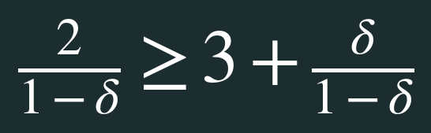
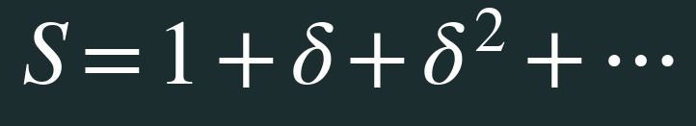

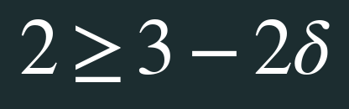
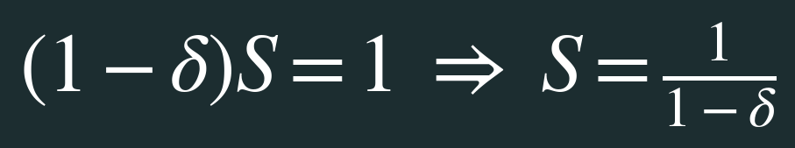
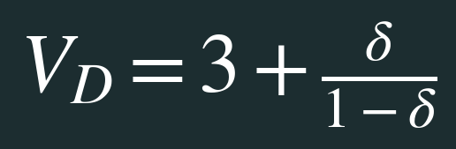
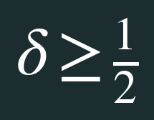
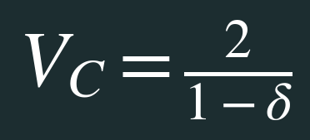
The repeated game: all the arithmetic on one slide
Grim trigger • geometric series • incentive constraint
Cooperate forever
Defect once
Compare payoffs
3 today; then 1 each period
At equality: indifferent. Above: cooperate.
Notes:
Walk left-to-right. Grim trigger already defined: cooperation gives 2 every period; defection gives 3 immediately then 1 forever. Geometric series S=1+δ+δ²+... and δS=δ+δ²+..., hence (1−δ)S=1. Cooperation if 2/(1−δ) ≥ 3+δ/(1−δ), i.e. δ≥1/2. The condition assumes 0≤δ<1 and infinite or uncertain horizon.

Slide 13
Discussion break
What have we proved—and what have we not?
• Cooperation can be an equilibrium without a sovereign.
• It is not the only equilibrium: always defect also works.
• Finite, known end dates unravel the usual one-shot dilemma.
Possible ≠ inevitable.
Who or what selects the cooperative equilibrium?
Notes:
Discuss equilibrium selection and assurance. This is where institutions, expectations, and leadership can matter even though leadership is not logically required for cooperative equilibrium.

Slide 14
Trade can help produce order
Reverse the familiar direction of causality
Leadership → rules → predictable trade
Trade → repeated gains → incentives for rules
Trade need not eliminate distrust; it can make cooperation ordinary despite distrust.
Notes:
The proposed reverse causal direction complements rather than refutes Ikenberry. Trade can build order but interdependence may be weaponised.
[Sources]
Danny Quah, Trade Builds Order, 2026.

Slide 15
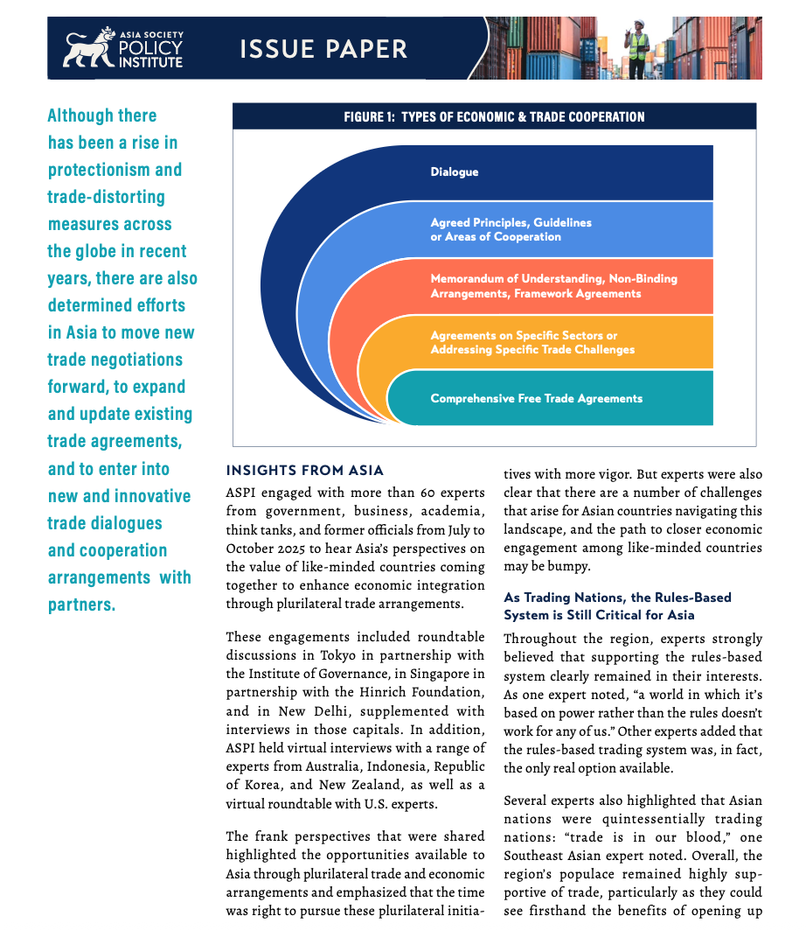
Regional cooperation after hegemonic withdrawal
Asia continues to build and update rules
CPTPP after US withdrawal
RCEP and regional supply chains
Digital trade and sectoral initiatives
But Mellsop still calls for plural regional leadership.
Notes:
Mellsop surveys over 60 experts. CPTPP proceeded after US withdrew from original TPP; nevertheless new initiatives may require plural regional leadership. The layered illustration shows different cooperation instruments, not a necessary hierarchy.
[Sources]
Jane Mellsop, Asia Society Policy Institute, Jan 2026.

Slide 16
Multilateral enough
Preserve the functions, not necessarily the hierarchy
• A level playing field
• Peaceful dispute resolution
• Cooperation on shared challenges
Example: MPIA offers an appeal-arbitration route for participating WTO members.
Notes:
Multilateral enough is a functional definition, not merely membership count. MPIA preserves a WTO appeal function for participating members.
[Sources]
Danny Quah, A Cooperative Advantage, IMF Finance & Development, 2026.

Slide 17
Three different cooperation problems
A compact diagnostic, not another full theory
Coordination
Assurance
Collective provision
Standards
Interoperability
Repetition
Reciprocity
Clubs
Cost-sharing
Different problems need different mechanisms—not always a Leviathan.
Notes:
Keep this as a brief diagnostic rather than a new theory. Different games pose different challenges.

Slide 18
Cooperation and leadership: what survives?
The final distinction
Leadership to initiate cooperation
Leadership to sustain cooperation
Cooperation that becomes self-sustaining
G-minus asks which functions of order can survive without hegemonic leadership.
Notes:
Return to opening. Cooperation and leadership are not exclusive. The question is which ordering functions can survive withdrawal or obstruction by hegemonic leadership.

