Slide 1
PP5182: The Basic 3A Toolkit
Acquiesce. Adapt. Aggregate.
Danny Quah
Lee Kuan Yew School of Public Policy, NUS
5 Oct 2026
Notes:
[Sources]
PP5182-2026.10.05.Mon-Basic-Toolkit-3A-lecture-notes.md
Presentation-norms-2026.09.md
[/Sources]

Slide 2
Four ways to navigate Great-Power pressure
The 3As sit alongside familiar strategic approaches; they do not deny that states can align, hedge, or fight back.
ALIGN
HEDGE
RESIST
3A
Choose a side. Accept the benefits and constraints of locating close to one Great Power.
Locate somewhere in the space spanned by Great Powers. Preserve flexibility by balancing relationships.
Retaliate, litigate, refuse, or protest. Contest the Great Power directly on the axis of contention.
Acquiesce on the immediate axis; adapt at home; aggregate abroad. Construct a portfolio rather than choose one posture.
Notes:
[Sources]
Lecture outline lines 22-30.
[/Sources]

Slide 3
Alignment is one answer - but Southeast Asia is heterogeneous
Khong and Liow score 0 = full alignment with China; 100 = full alignment with the United States; 45-55 = hedging band.
HEDGING BAND
Myanmar 24
Laos 29
Cambodia 38
Vietnam 43
Brunei 44
Thailand 45
Malaysia 47
Singapore 48
Indonesia 49
Philippines 60
US
CHINA
0
25
50
75
100
Notes:
[Sources]
Yuen Foong Khong and Joseph Chinyong Liow, "Southeast Asia Is Starting to Choose," Foreign Affairs, July/August 2025. Library file: 2025.07-Yuen-Foong.Khong-Joseph.Liow-SEA-Starting-to-Choose-FA.md.
[/Sources]

Slide 4
The 3A toolkit
Three constructive modalities for Third Nations seeking to preserve policy space under asymmetric pressure.
ACQUIESCENCE
ADAPTATION
AGGREGATION
Symbolic yielding on the axis of contention.
Reduce the immediate cost of asymmetric confrontation; buy policy space.
Domestic restructuring for increased resilience.
Reduce vulnerability to the next shock by changing oneself.
Coalition-building when Great Powers are aggressive, obstructionist, distracted, or absent.
Change outside options.
A state normally constructs a portfolio across the three - differing by issue, counterparty, and time horizon.
Notes:
[Sources]
Intellectual-framework-2026.09.md, current 3As definitions.
Lecture outline lines 28-30.
[/Sources]

Slide 5
TWO
3As in actual national strategies

Slide 6
What exactly are we observing?
The current dataset is a response-side census. It is not yet a US-trigger census.
US-trigger
impulse
Third-Nation
response
Realized geoeconomic
interaction
Interim
result
Annual counts combine both sides of the interaction: more US impulses can raise observed activity even if the Third-Nation response function is unchanged.
So: describe realized geoeconomic interactions - do not infer Third-Nation responsiveness alone.
Notes:
[Sources]
Conceptual framing developed from the exploratory dataset and lecture outline.
[/Sources]

Slide 7
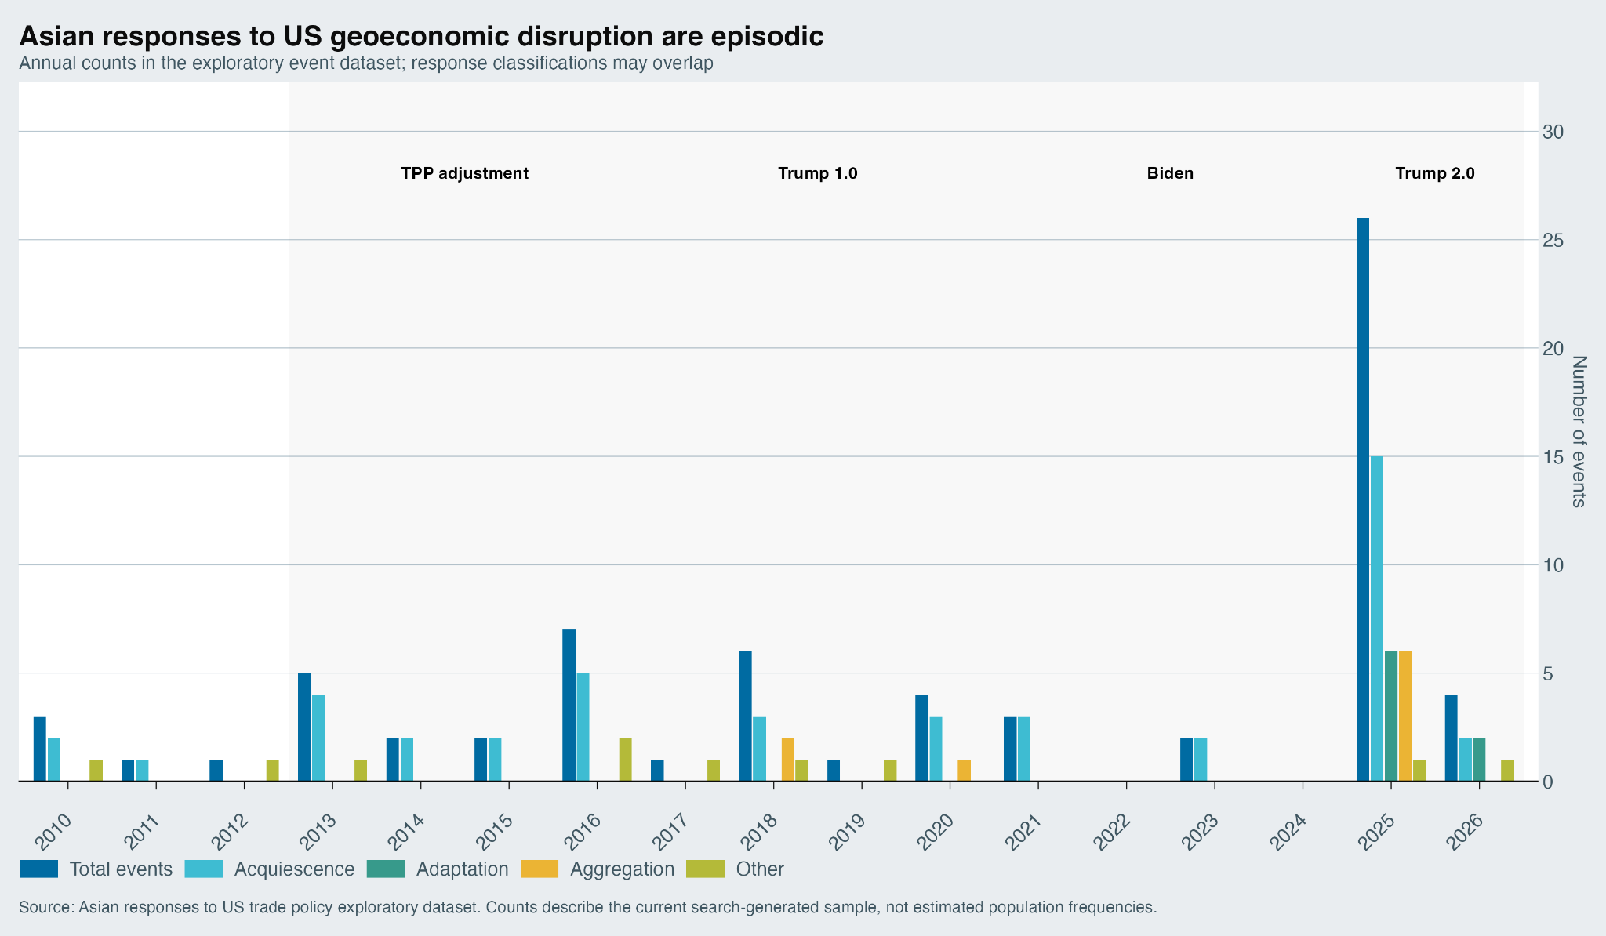
Asian responses to US geoeconomic disruption are episodic
Annual counts in the exploratory response-side census; classifications may overlap.
Notes:
[Sources]
Graphic asset supplied by user: annual_3A_responses_economist.png.
Underlying exploratory event dataset: 68 events, 2010-2026.
[/Sources]

Slide 8
The exploratory response-side census: 68 events
Acquiescence is the most visible category; Adaptation and Aggregation are rarer but conceptually distinct.
Total
68
Acquiescence
44
Adaptation
8
Aggregation
9
OTHER
10
Counts are not mutually exclusive: an event may carry multiple strategy codes.
Notes:
[Sources]
Lecture outline lines 39-45.
[/Sources]

Slide 9
It is not just Trump
Pre-2017 cases already show acquiescence, legal resistance, and movement between the two.
2013
Indonesia
US WTO challenge to import restrictions
Resistance / legal defence
2013
India
Private-sector electronics local-purchase mandate removed after US pressure
Acquiescence
2015
India
Poultry dispute: adverse WTO ruling -> implementation
Resistance -> Acquiescence
2016
India
Solar local-content challenge: India appeals
OTHER / resistance
Notes:
[Sources]
Lecture outline lines 48-50; underlying event dataset sources.
[/Sources]

Slide 10
Acquiescence is highly visible
Steel quotas, currency commitments, purchases, tariff cuts, regulatory concessions, and transshipment enforcement.
BARGAINING MARGIN
A visible concession is tied to a named US contention. The state avoids public retaliation on that axis.
Examples: Korea steel quota; Vietnam currency commitments; Trump-II tariff bargains.
Acquiescence changes the bargain.
It is Great-Power-facing. Its near-term result can therefore be observed in whether Washington relaxes, settles, or moves into implementation.
But visibility is endogenous: negotiated bargains are easier to find in news and official releases than quiet domestic restructuring.
Notes:
[Sources]
Lecture outline line 51 and interim-results discussion.
[/Sources]

Slide 11
Adaptation changes oneself
Domestic restructuring is not aimed at persuading Washington; it seeks to reduce vulnerability to the next shock.
Korea
Japan
Emergency automobile support; export-market diversification
Tariff emergency package
Singapore
Korea 2026
Economic resilience machinery
Public-private Section 301 task force
Relevant outcomes: resilience, substitution, diversification, fiscal cost - not necessarily US policy reversal.
Notes:
[Sources]
Lecture outline line 52.
[/Sources]

Slide 12
Aggregation changes outside options
Coalition-building can succeed even if Washington does not change its position.
CPTPP
Japan-EU EPA
After US withdrawal, 11 states proceed without Washington
Large non-US trade agreement amid protectionist pressure
RCEP
ASEAN-GCC-China
15 Asia-Pacific economies institutionalise regional trade
Broader coalition around resilience and supply chains
Success = a viable outside option, additional policy space, and institutions that remain useful when Great-Power participation is optional.
Notes:
[Sources]
Lecture outline lines 53-54.
[/Sources]

Slide 13
Resistance is not unknown
OTHER is substantive behaviour outside the 3As - not a coding failure.
WTO challenge
WTO litigation
WTO appeal
Legal defence
Retaliatory tariffs
Diplomatic protest
Refusal
Potentially high-risk under asymmetric power
The question is not whether resistance exists. It is when asymmetric confrontation creates enough leverage to justify its risk.
India, June 2019: retaliatory tariffs; US holds its position.
Australia, April 2025: criticises Trump tariffs but declines to retaliate - resistance plus restraint.
Notes:
[Sources]
Lecture outline lines 56-59.
[/Sources]

Slide 14
PAUSE
Discussion
When should a Third Nation fight back rather than acquiesce, adapt, or aggregate?
Notes:
[Sources]
Teaching discussion break per Presentation-norms-2026.09.md.
[/Sources]

Slide 15
Interim results differ sharply across strategies
Observed disposition within roughly 60 days; descriptive association, not causal effectiveness.
Interaction
N
US relaxes
Compromise
Implementation / monitoring
US holds
US escalates
No clear result
Acquiescence
44
19 (43%)
5 (11%)
13 (30%)
5 (11%)
0
2 (5%)
Adaptation
8
1 (13%)
0
2 (25%)
5 (63%)
0
0
Aggregation
9
0
0
4 (44%)
1 (11%)
0
4 (44%)
OTHER
10
0
0
1 (10%)
7 (70%)
1 (10%)
1 (10%)
Codes can overlap; rows are not mutually exclusive.
Notes:
[Sources]
Lecture outline lines 60-66; interim-results spreadsheet.
[/Sources]

Slide 16
Different strategies seek different outcomes
Do not turn the interim-results table into a single horse race over “what works”.
ACQUIESCENCE
ADAPTATION
AGGREGATION
OTHER
What changes?
The bargain.
Outcome to measure:
US relief, settlement, implementation.
Clock:
Often short.
What changes?
Oneself.
Outcome to measure:
Resilience, diversification, substitution, fiscal cost.
Clock:
Medium.
What changes?
Outside options.
Outcome to measure:
Viable institutions, policy space, coalition durability.
Clock:
Medium to long.
What changes?
The contest.
Outcome to measure:
Deterrence, delay, precedent, leverage.
Clock:
Often long.
A 60-day US-response variable is naturally best suited to Acquiescence.
Notes:
[Sources]
Interpretive synthesis from interim-results analysis; lecture outline lines 76-80.
[/Sources]

Slide 17
The 3As are a portfolio, not three mutually exclusive choices
A state can sequence the modalities across horizons and counterparties.
TODAY
AT HOME
ABROAD
Acquiesce
Adapt
Aggregate
Buy policy space on the immediate axis of contention.
Make the next shock hurt less.
Build better outside options.
Aggregation frequently follows rather than substitutes for Acquiescence: bargain bilaterally while building institutions elsewhere.
Notes:
[Sources]
Lecture outline line 54; current Intellectual-framework-2026.09.md portfolio formulation.
[/Sources]

Slide 18
Conclusion
The 3As describe constructive strategic modalities; the research programme asks when, why, and with what effects states use them.
Acquiescence changes the bargain. It is Great-Power-facing.
Adaptation changes oneself. It seeks greater Great-Power independence.
Aggregation changes outside options. It builds G-minus institutional capacity.
Resistance remains available - but in this exploratory sample the US usually persists and sometimes escalates.
Can Acquiescence today finance the Adaptation and Aggregation that make Acquiescence less necessary tomorrow?
Notes:
[Sources]
Lecture outline conclusions lines 68-80, revised to distinguish strategy-specific outcomes and portfolio dynamics.
[/Sources]

